Slide 1
Communications & Customer Service
COMMITTEE MEETING
October 15, 2024

Slide 2
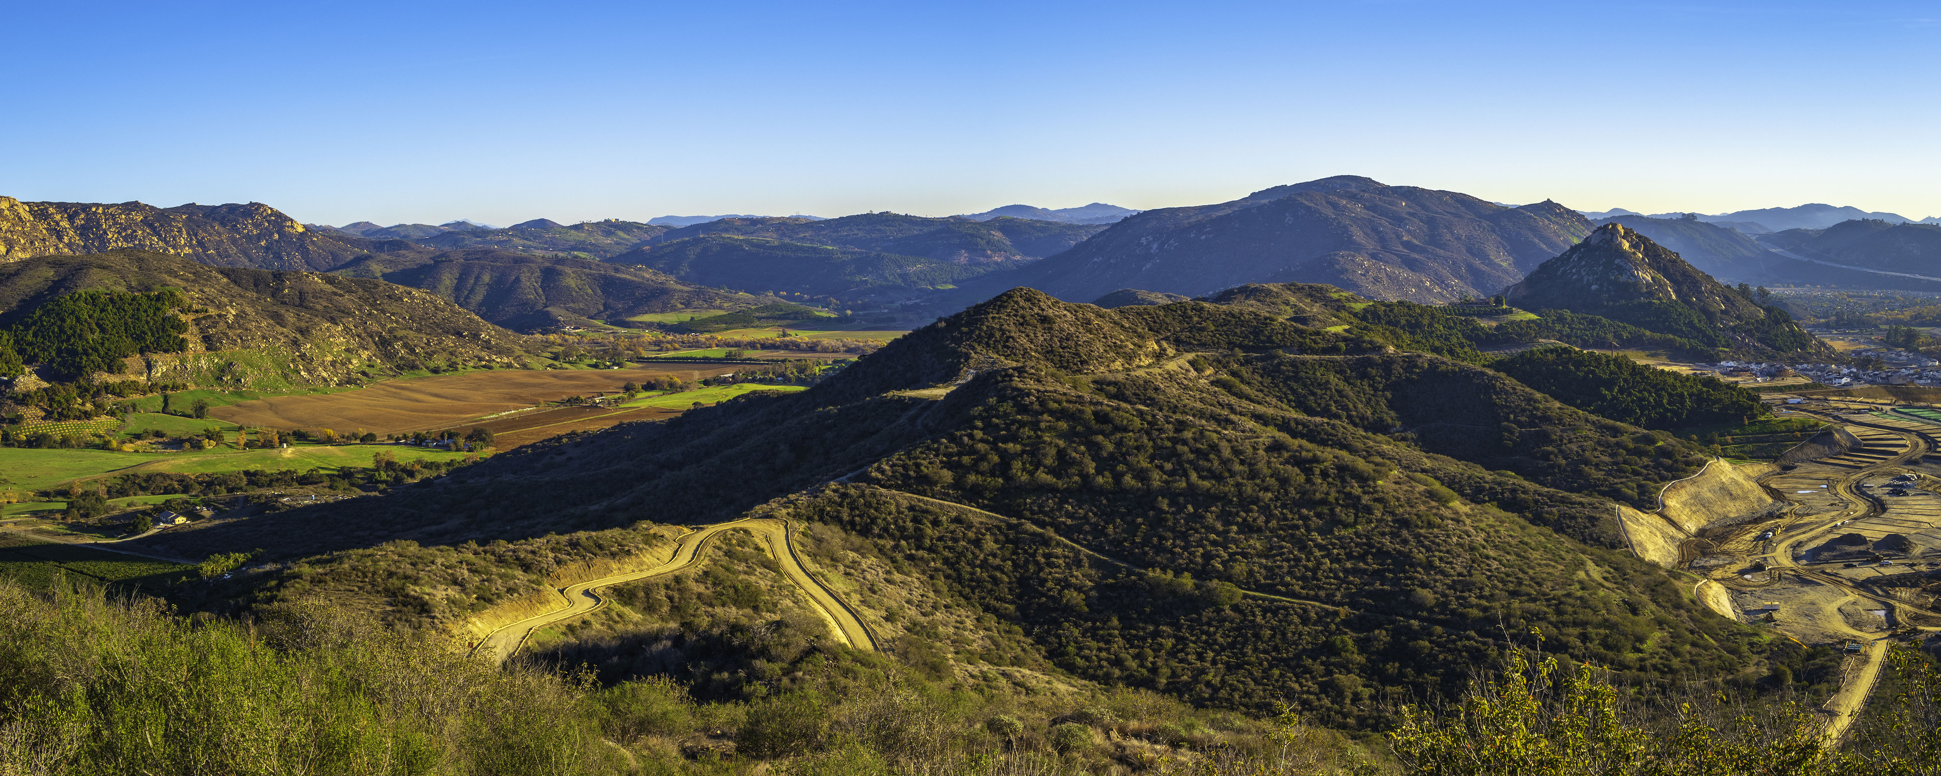
Agenda
Approval of Minutes
General Manager Comments
Committee Member Comments

Slide 3
CropSWAP Program
Regional Program Update

Slide 4
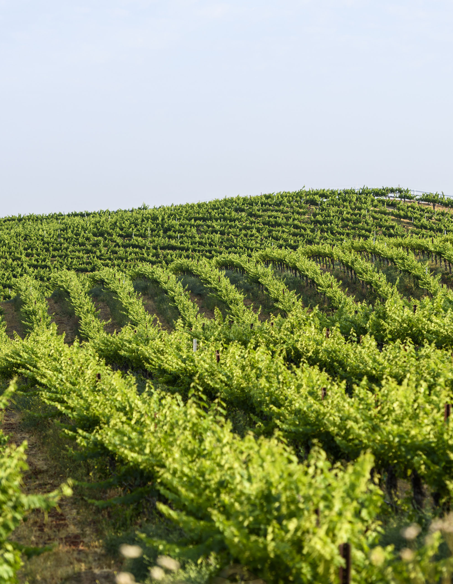

CropSWAP Program
Rainbow Water leads with participation in Regional CropSWAP program
Strong uptick in application approval for the month of September
Two projects rejected and resubmitted to meet requirements
_
6
Submissions Sept-Oct

Slide 5




Program Metrics
_
67
Submissions to Date
_
55
Projects Approved
$765,700
In Reserved Grant Funding for Approved Projects
_
4
Pre-Inspection

Slide 6
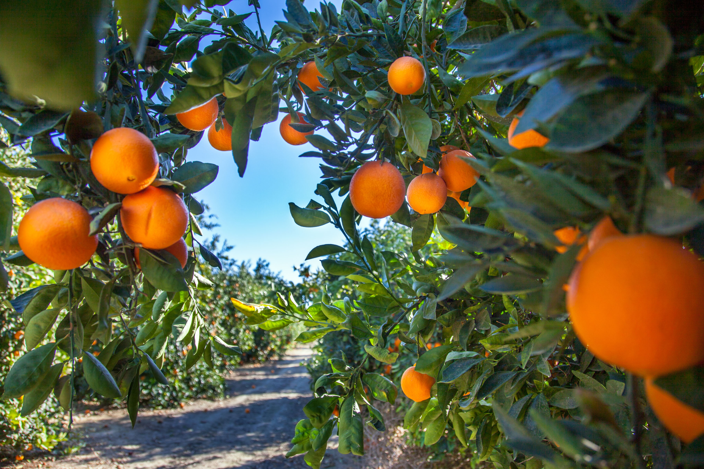

Total Applications by Project Type
13
Crop Conversion
8
Avocado Rejuvenation
6
Soil Moisture Sensors
5
Mulching
5
Scheduling Automation
3
Uniformity Improvements
2
Nutrient Management
1
Cover Crops
23
Avocado Rootstock

Slide 7
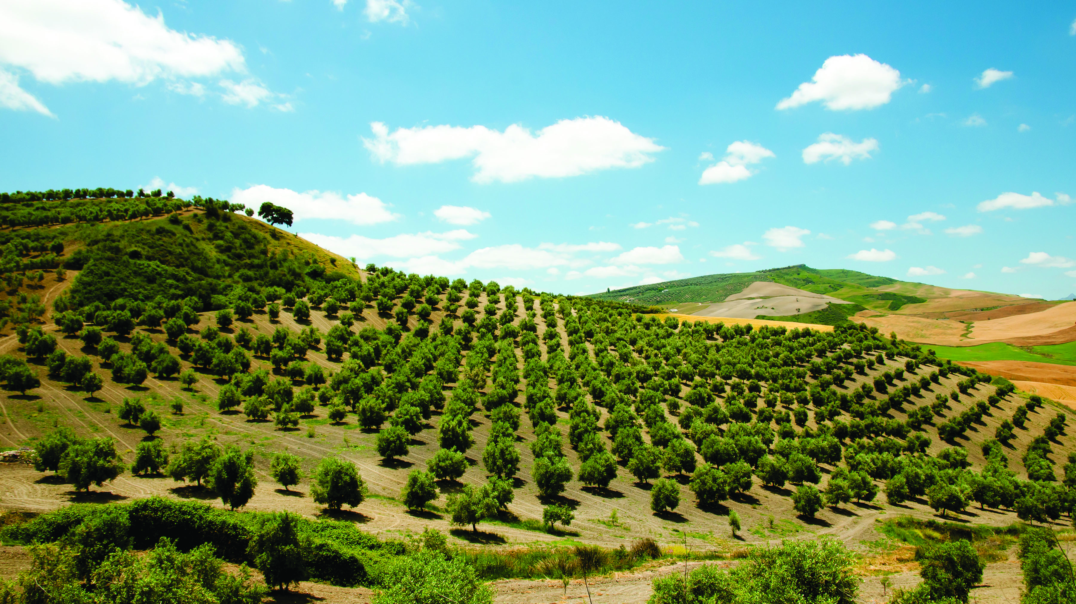

Average Project
Avocado Rootstock
Projects received the largest grant funds
Project Average 36-50K
Division 1
Area with largest amount of projects
Multiple Project Submissions
41% of Customers submitted more than two projects for review

Slide 8
Customer Calls
Contact Study

Slide 9
August Call Types

Slide 10
September Call Types

Slide 11
Monthly Calls vs Call Backs

Slide 12
Community Events Update

Slide 13
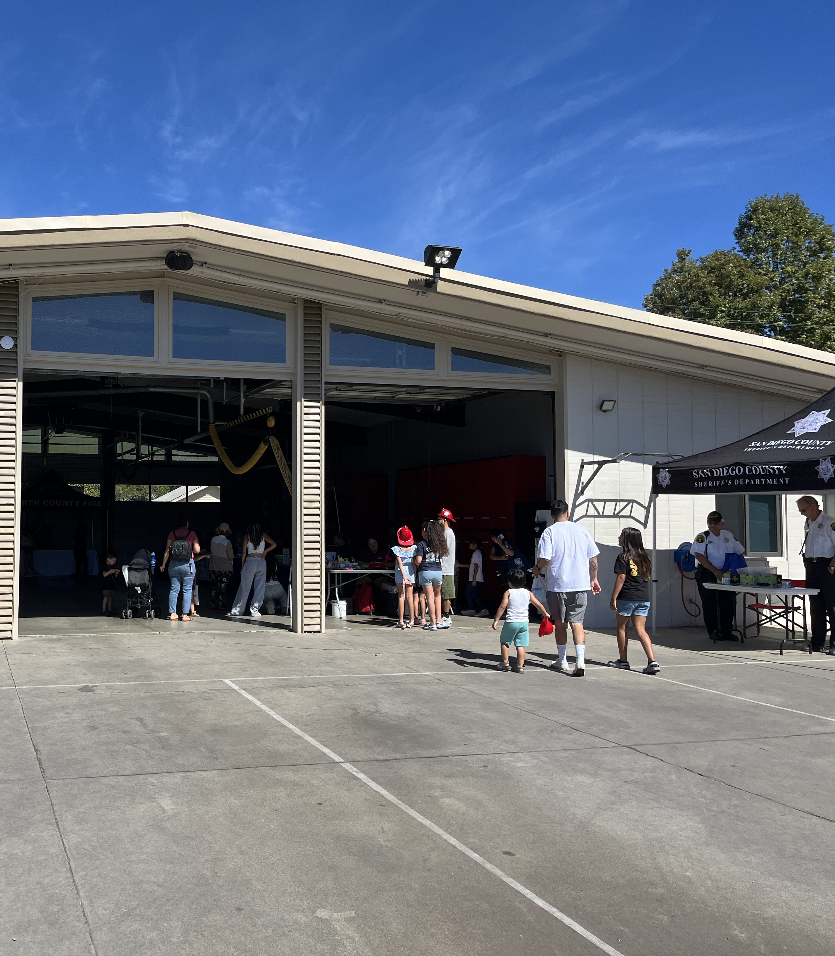

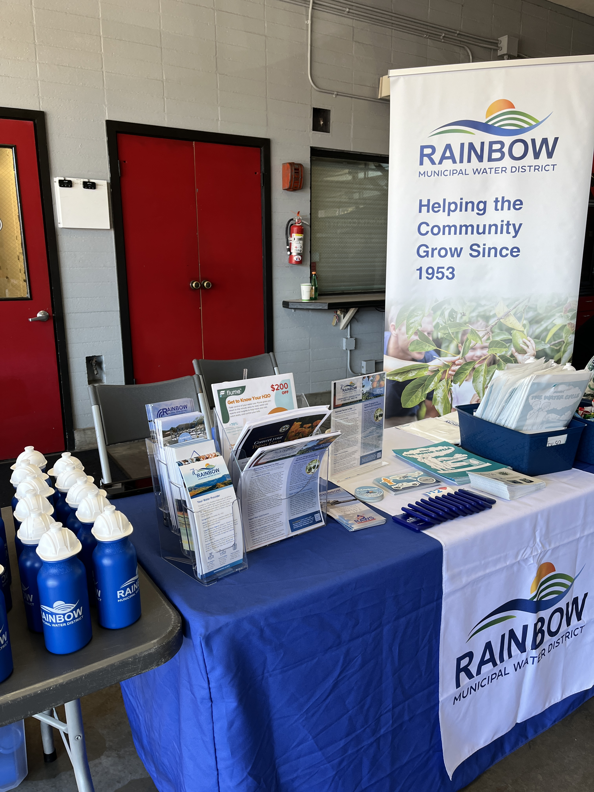
North County Fire Open House
Saturday, October 12
Free community event at Fire Station 1 in Fallbrook
Team members networked with agencies, handed out promotional items, and answered customer questions
Notes:
Most common questions were related to detachment and rates
Gave away 285 pieces of promotional gear, bags and candy. Hand sanitizers and gardening kits were a big hit as were stickers.
Many FPUD customers were not aware of detachment, RMWD customers asked about wells, detachment, how it will work, and lower rates

Slide 14
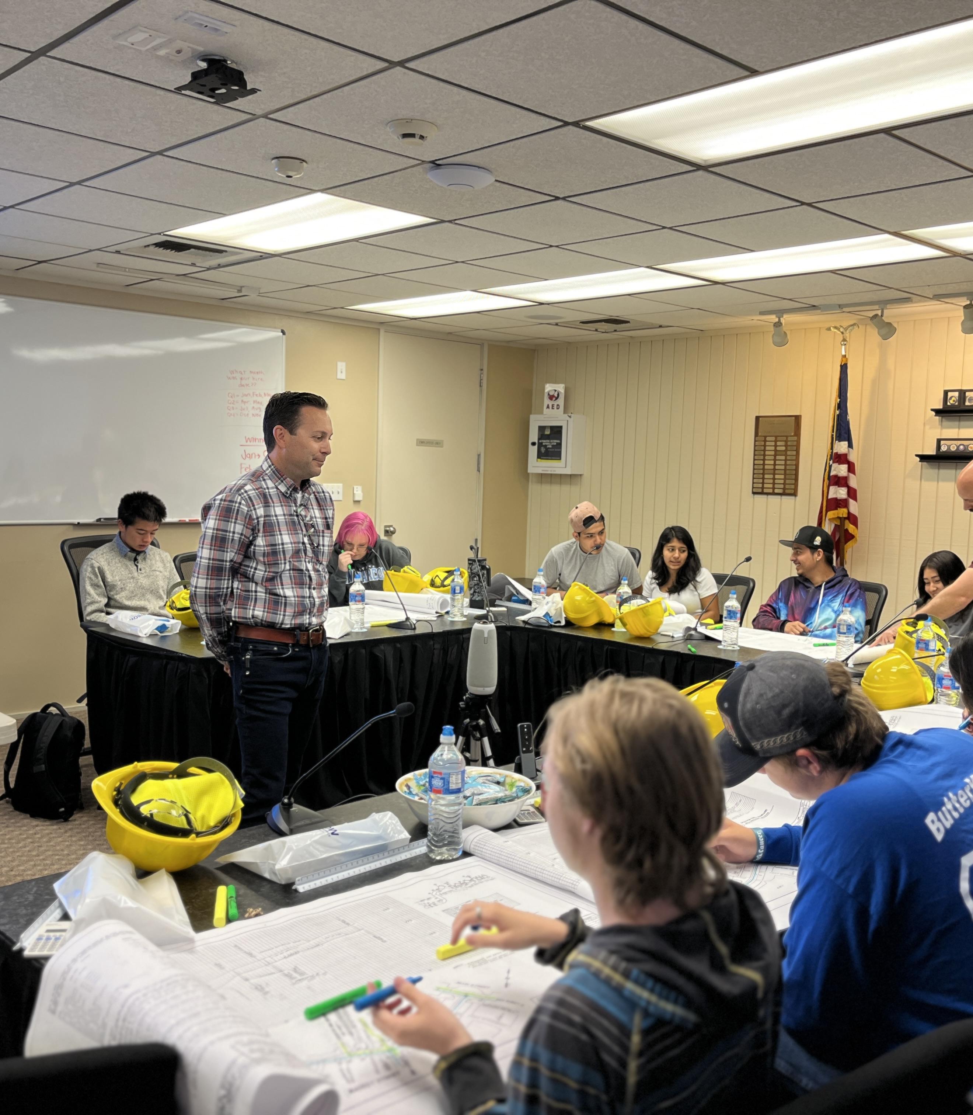
Speakers Bureau
Friday, October 25
Bonsall High School
Managers from IT and Engineering will give presentations to computer science and chemistry classes on careers in the water industry
Connect classroom curriculum to everyday use at Rainbow Water

Slide 15
Newsletter Content Planning

Slide 16
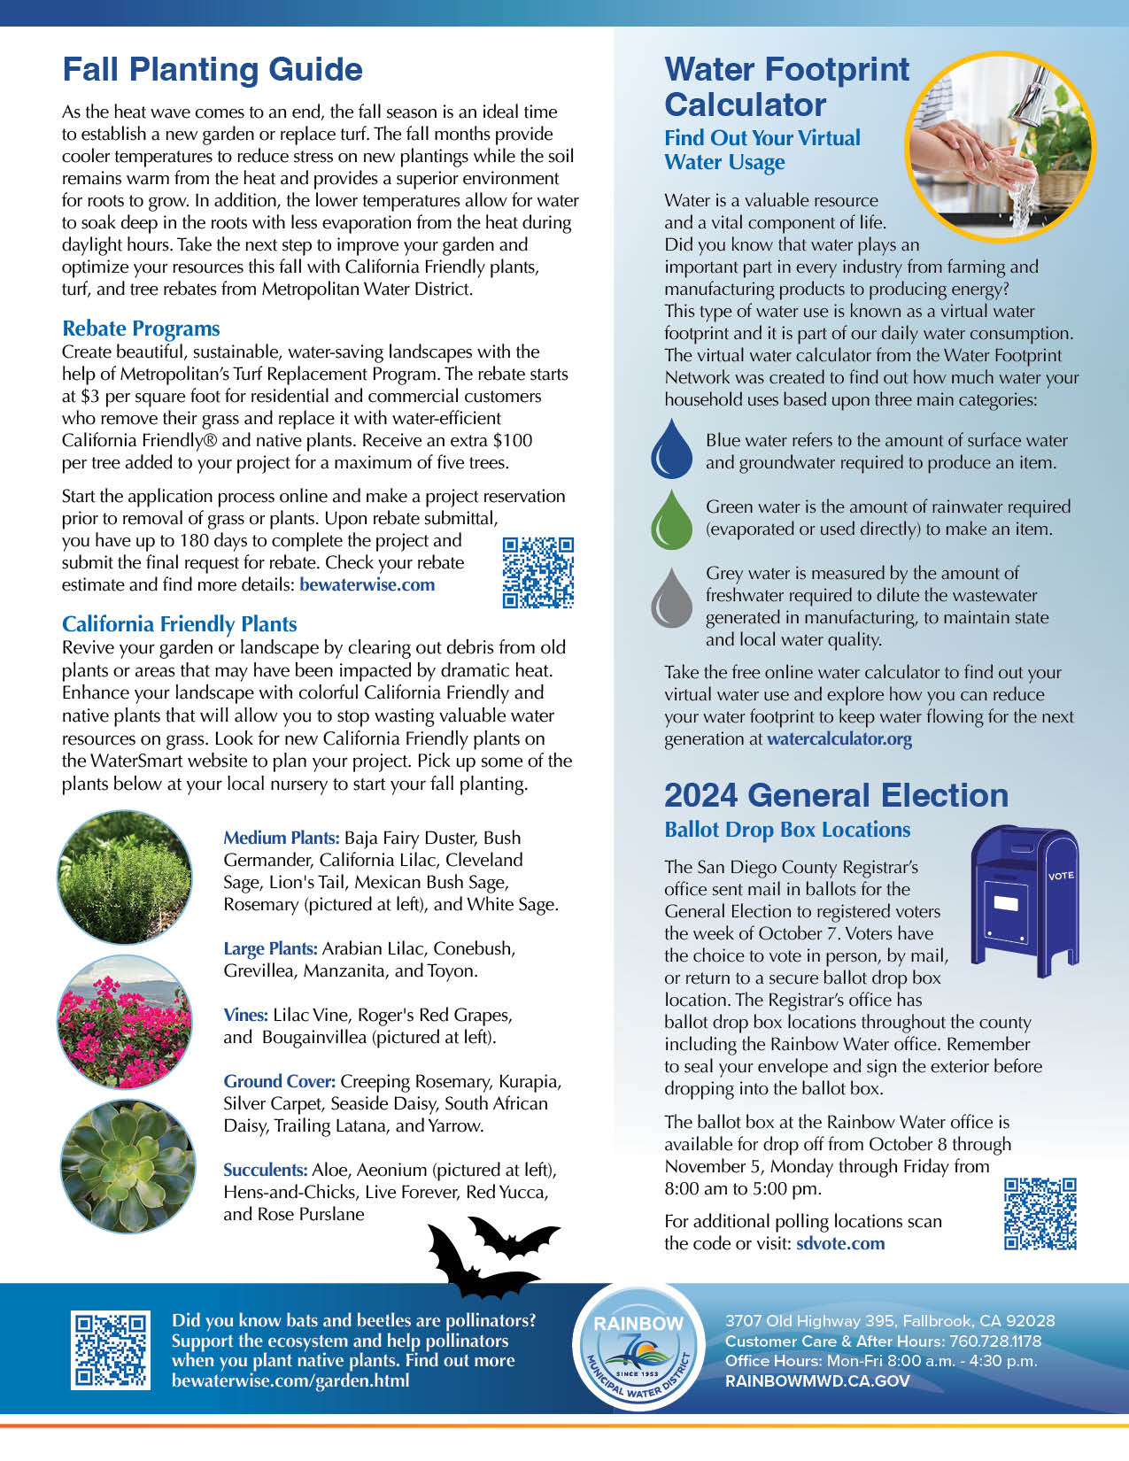

Newsletter Review
October
National Farmer’s Day
History of farming in the community
Tips to support local growers by buying local
Grant Programs for Ag Customer
CropSWAP stats and program info
Met’s WISP Program
Link to Rice Canyon video
Fall Planting Guide
Rebates for turf & tree replacement
California Friendly Plants list
Water Footprint Calculator
General Election: Ballot Drop Box at the office
Notes:
Free tool to assess virtual water usage

Slide 17
Newsletter Planning
November
Detachment Update
Construction progress for lift stations
The Value of Water
Importing Water from 500 miles away, cost savings with new rate increases from wholesaler
Infographic: Water compared to other essential expenses
Taste and hardness overview from imported water
Bonsall HS Classroom Visits
Photo recap of Engineering and IT
Share Your Experience
Take the 1-minute customer service survey online
December
Bill Overview
Graphic on new bill layout
Video on how to pay your bill online
Sign up to receive bill via email and auto pay
Water Update
Intro EMWD, look out for letter
Changing PSAWR to new class
Rebates from Met
High efficiency toilet install, clothes washer new requirements, and rain barrels
Holiday Reminders
Office hours, online bill pay

Slide 18
Public Communications
& Related Media Stories

Slide 19
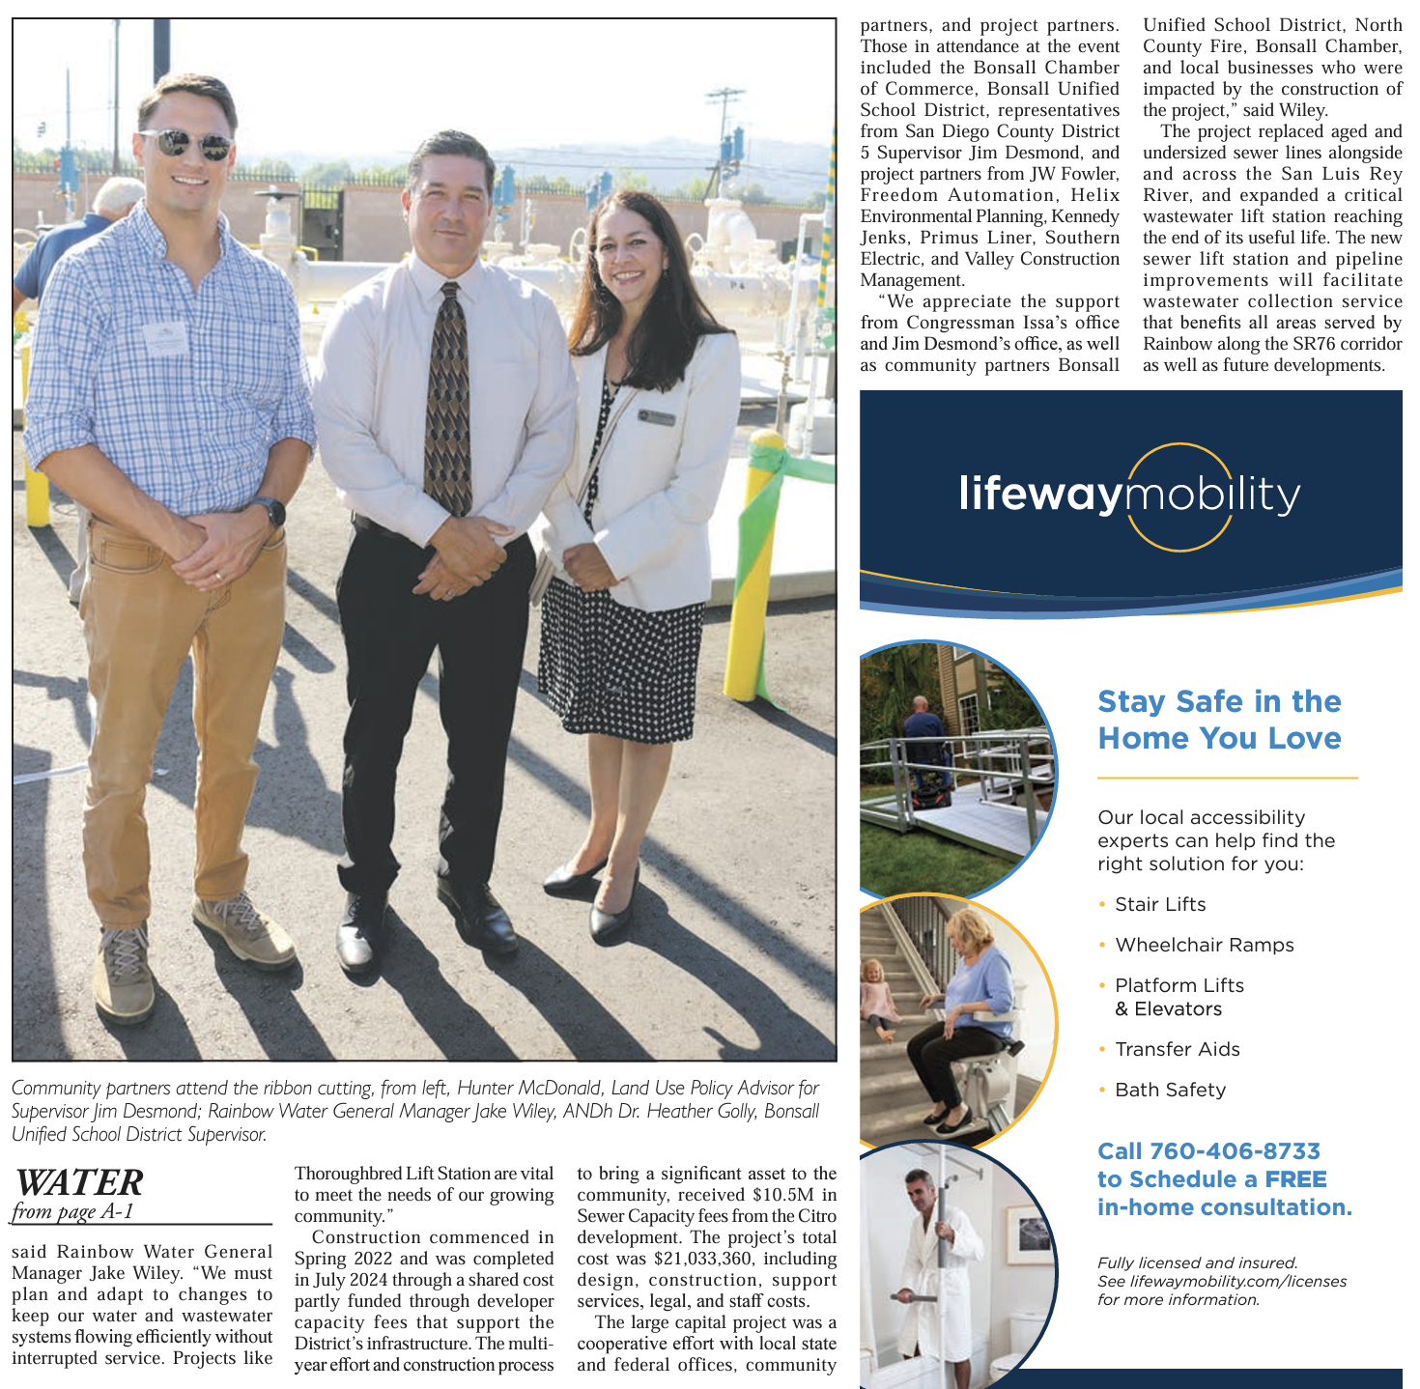
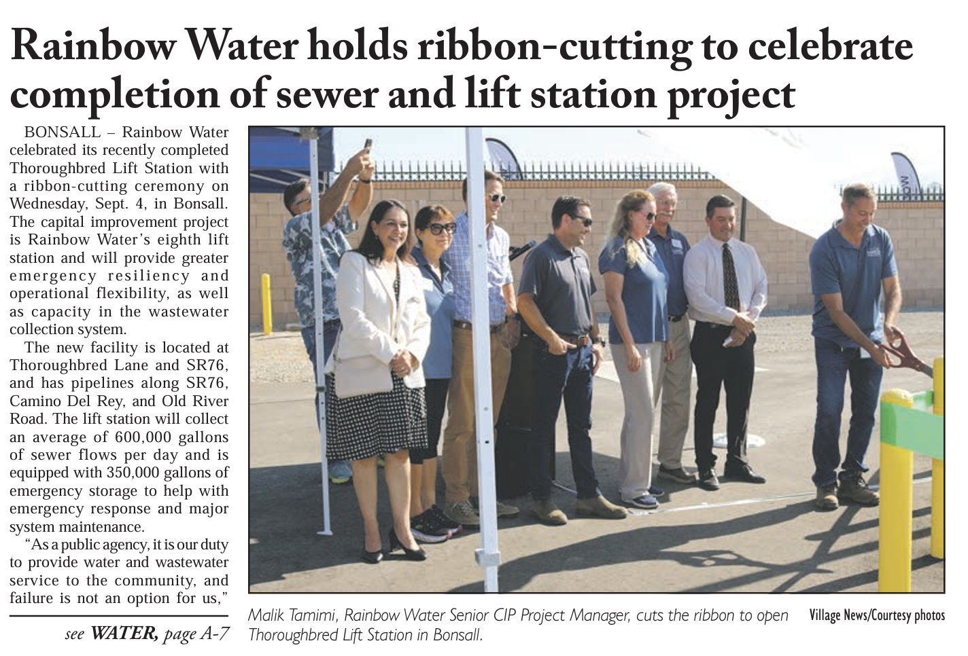
Village News
September 12
Rainbow Water holds ribbon-cutting to celebrate sewer and lift station project

Slide 20

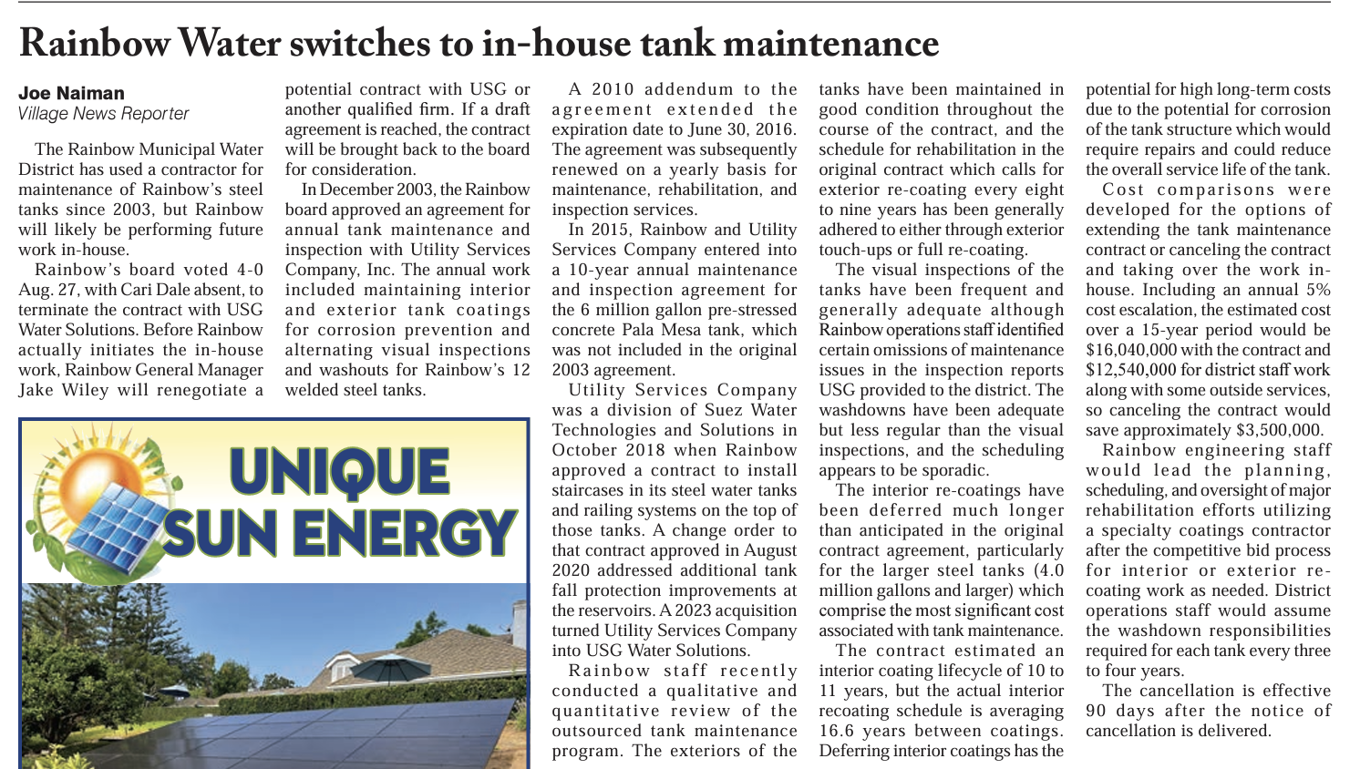
Village News
September 12
Rainbow Water to use peak month for meter reduction decisions
Rainbow Water switches to in-house maintenance

Slide 21
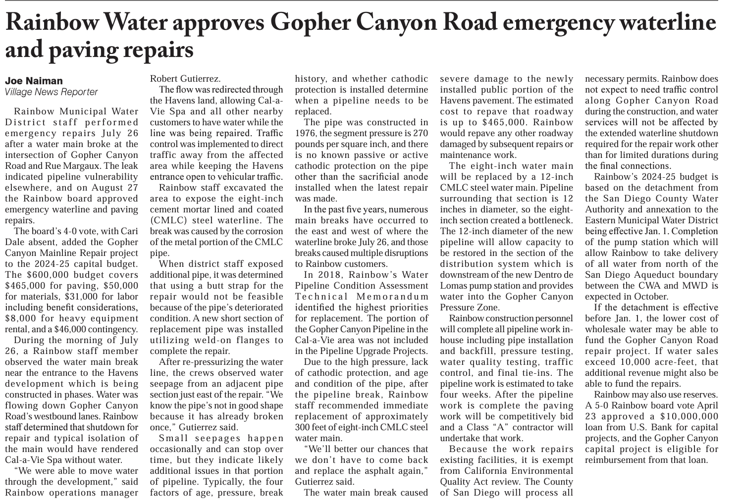
Village News
September 12
Rainbow Water approves Gopher Canyon Road emergency waterline paving repairs

Slide 22
Agenda Items for the Next Meeting

