Slide 1
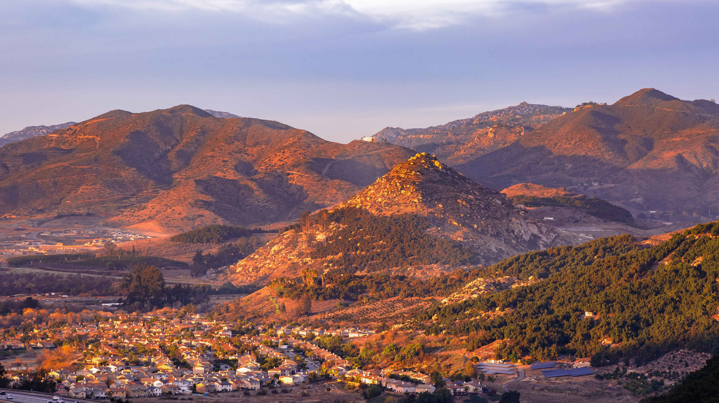
Communications & Customer Service
Committee Update
November 19, 2024

Slide 2

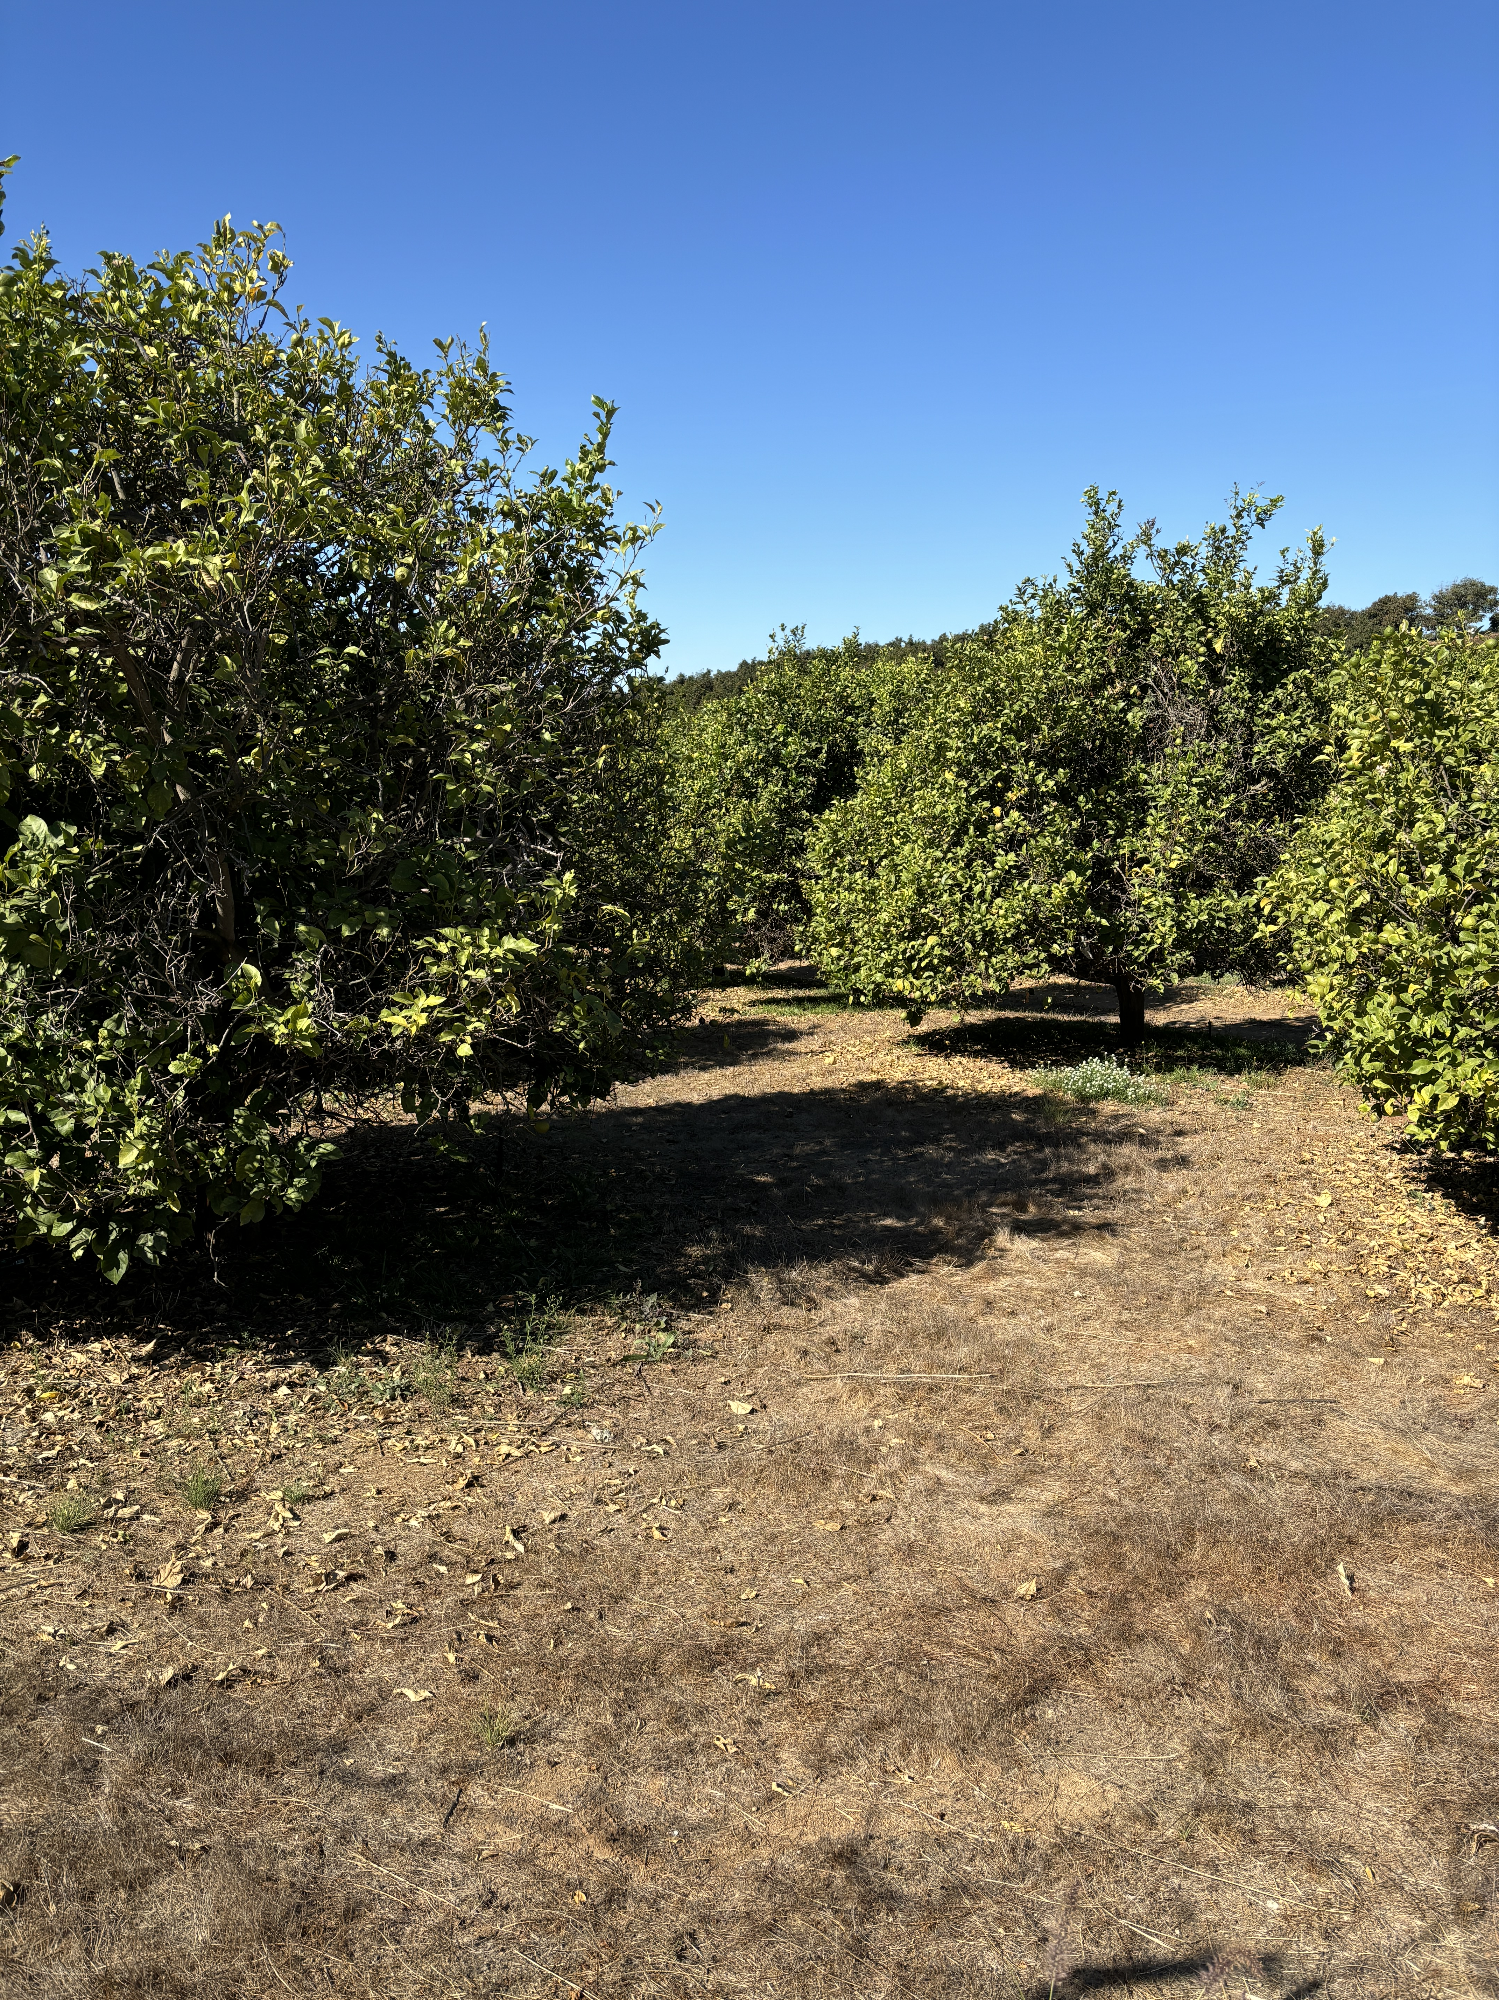



CropSWAP Program
_
76
Submissions to Date
_
$878,950
58
Projects Approved
In Reserved Grant Funding for Approved Projects
_
10
Pre-Inspection
Notes:
5 Submissions for month of October – Sept
Pre- inspection 2 are crop conversion, 1 avocado tree rejuvenation, 1 avocado rootstock
Used 565,700 in the communal fund
Rainbow Water leads with participation in Regional CropSWAP program
Current projects are pending review as the first come, first served period has ended

Slide 3
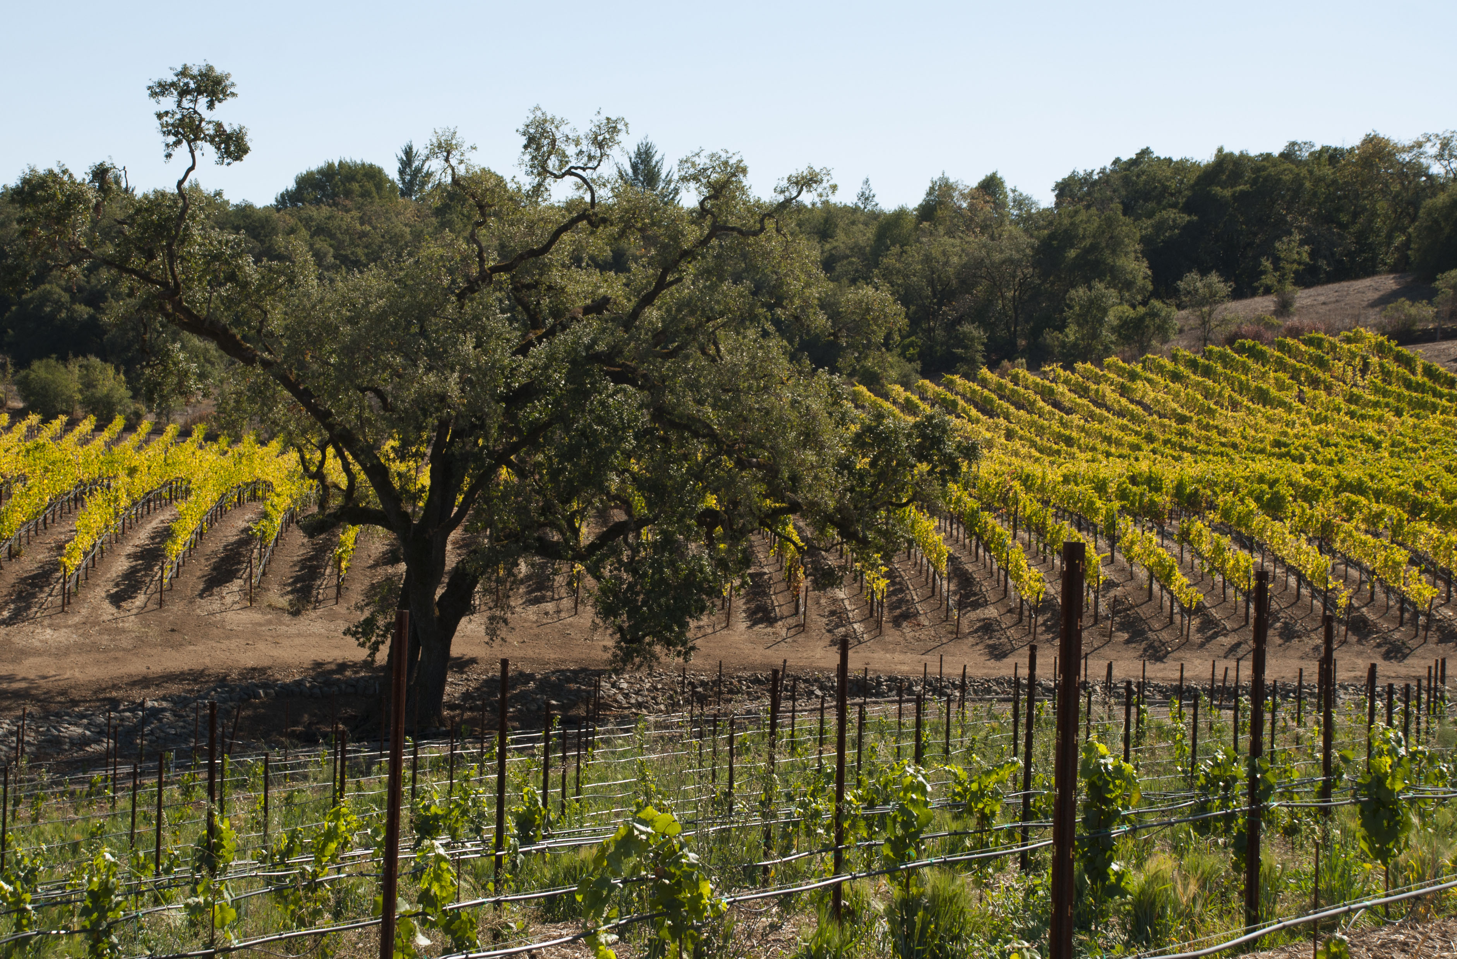
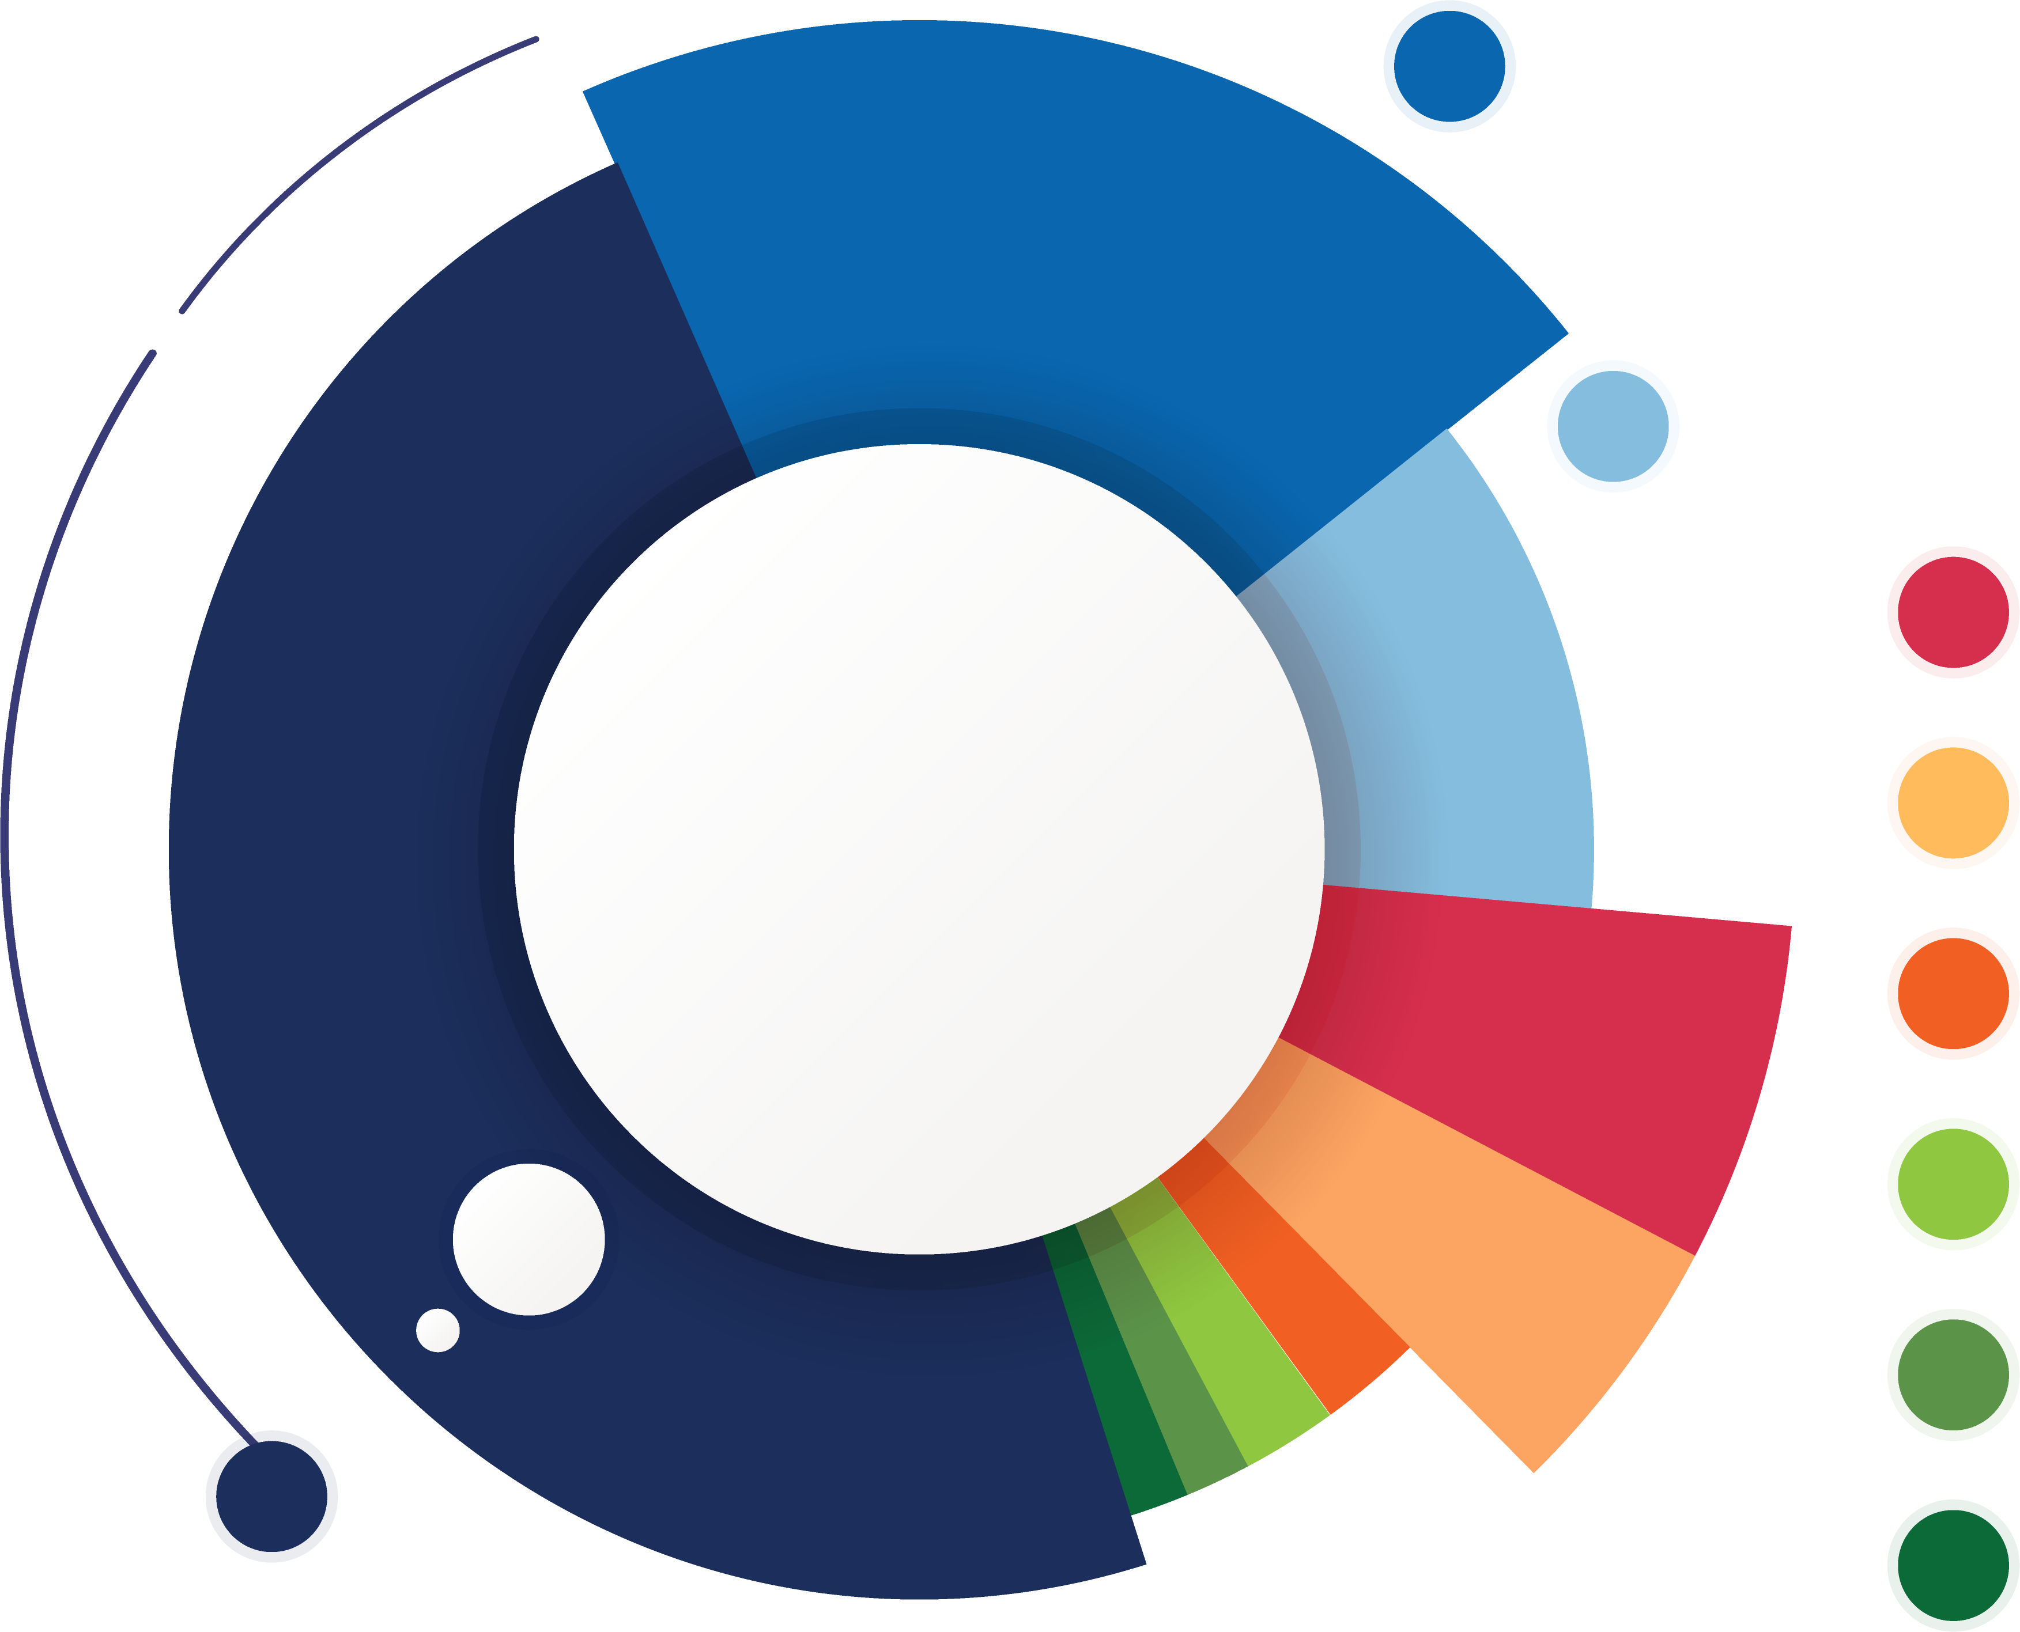
Total Applications by Project Type
17
Crop Conversion
9
Avocado Rejuvenation
6
Soil Moisture Sensors
6
Mulching
5
Scheduling Automation
3
Uniformity Improvements
2
Nutrient Management
1
Cover Crops
26
Avocado Rootstock
Notes:
Largest gains were increase of 4 crop conversion types, increase of 3 avocado rootstock, 1 avocado tree rejuvination and one soil moisture sensors

Slide 4
Discussion
Financial Options:
One Time Savings from Early Detachment from SDCWA

Slide 5
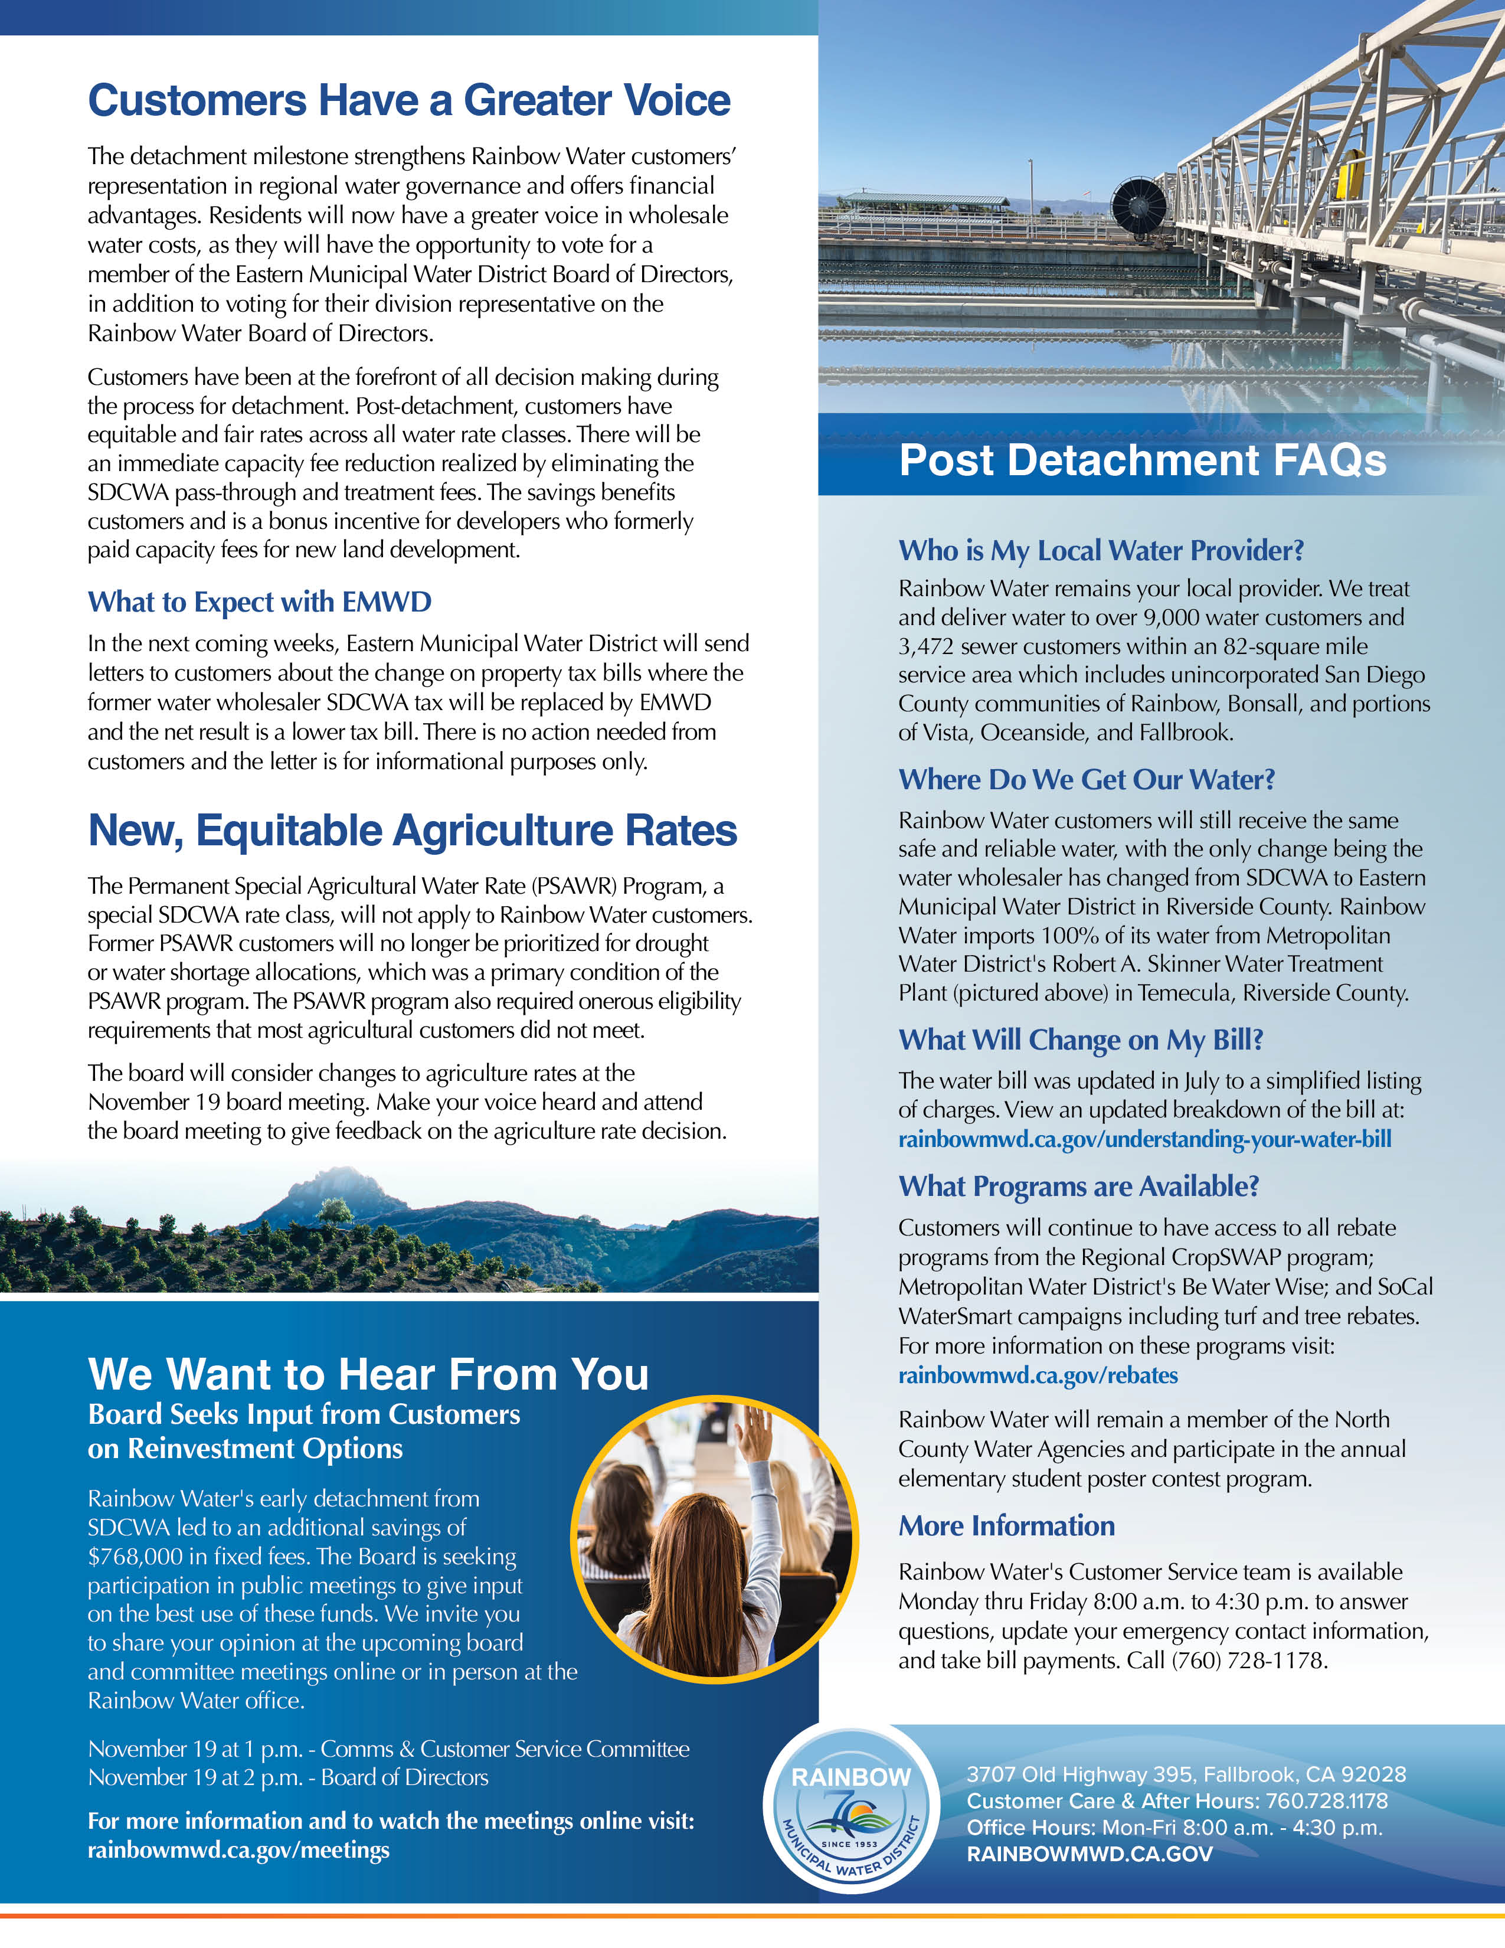
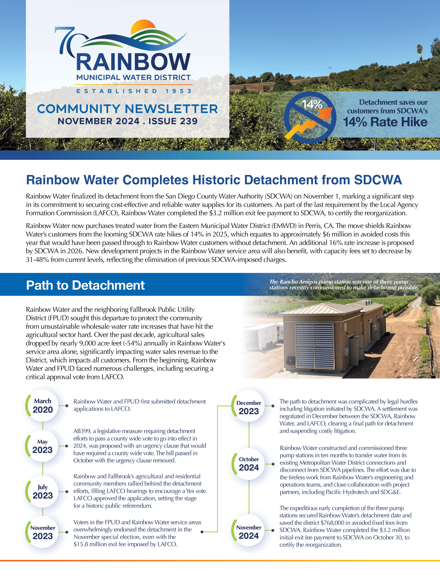
Newsletter Review
November
Historic Detachment from SDCWA
Completion and Path to Detachment
Customers Have a Greater Voice
Voting opportunities for EMWD Board
What to Expect with EMWD
Equitable Agriculture Rates
Attend Board & Committee Meetings
Post Detachment FAQs
Blood Drive at Rainbow Water
San Diego Blood Bank Mobile Unit visits Rainbow Water on Weds Dec 18

Slide 6

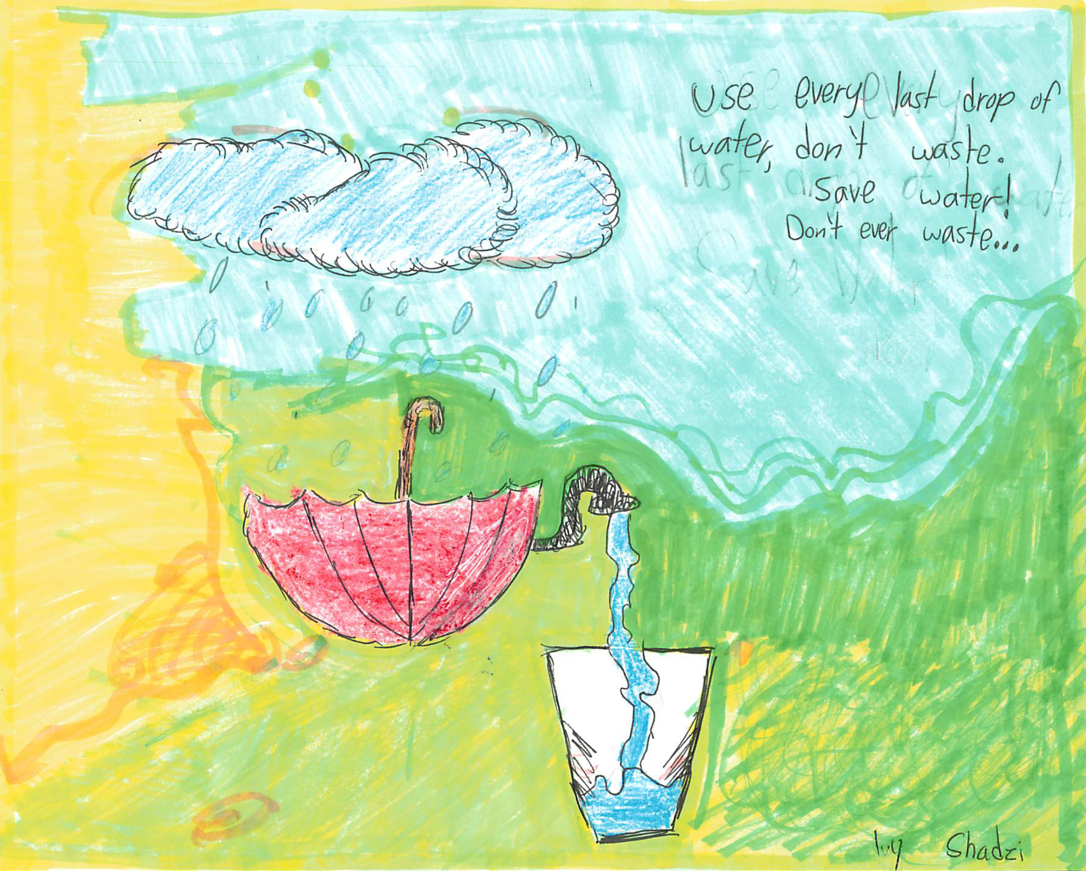
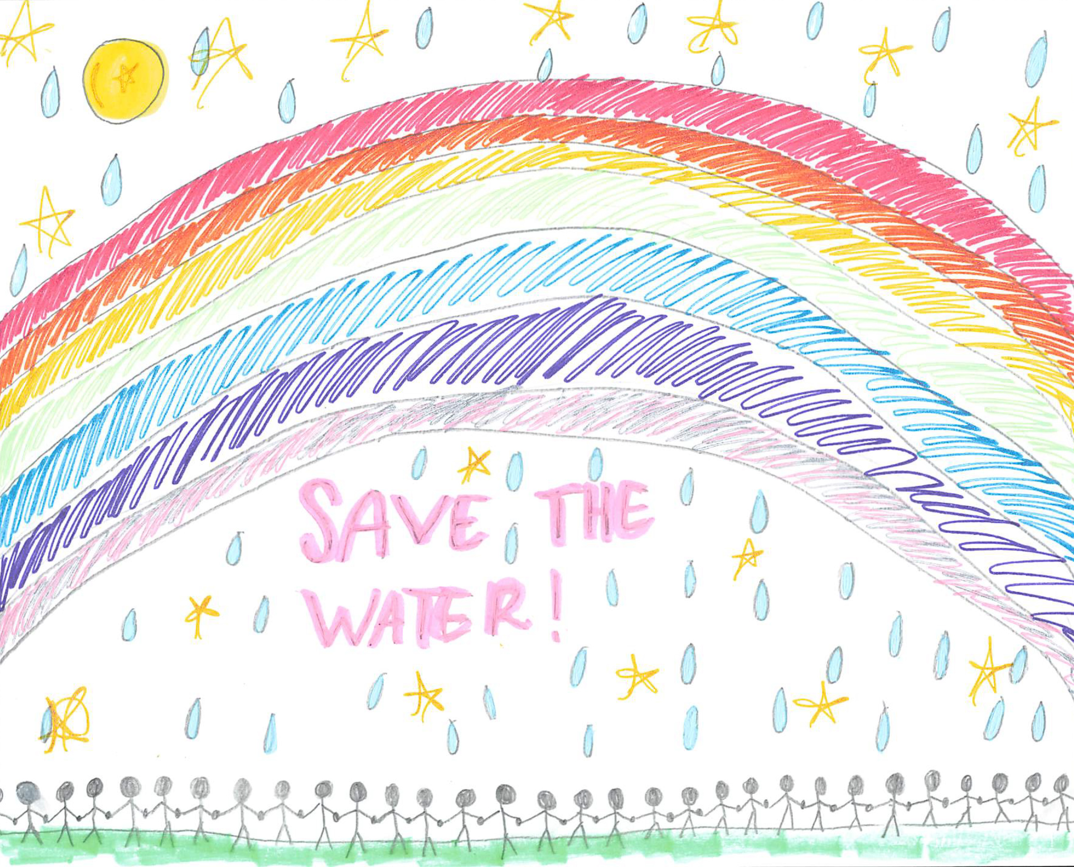

North County Water Agency Calendar
Calendar Contest Update
2025 Calendar will be available at the office in December
Copies distributed to student winners/BES 4th grade teachers, and BUSD Superintendent
2025 Contest scheduled for launch Jan 2025

Slide 7

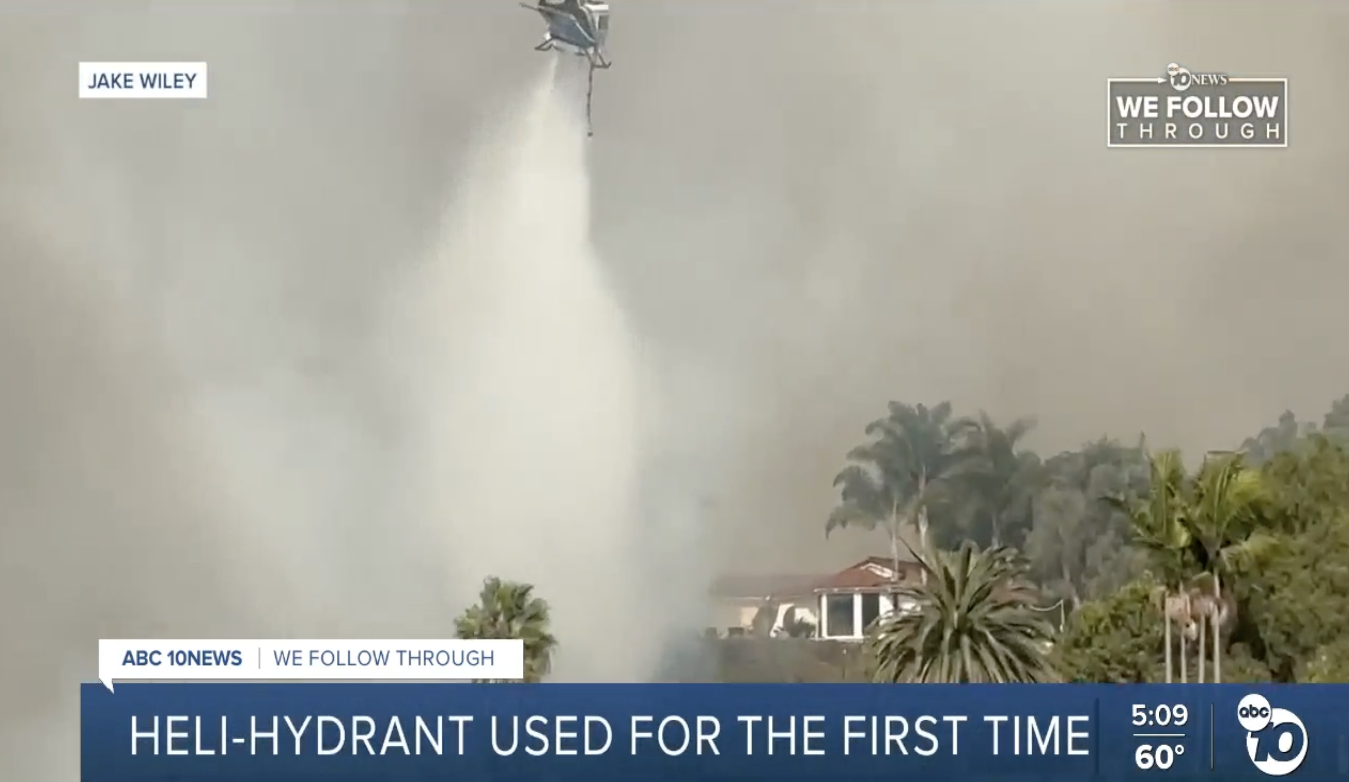
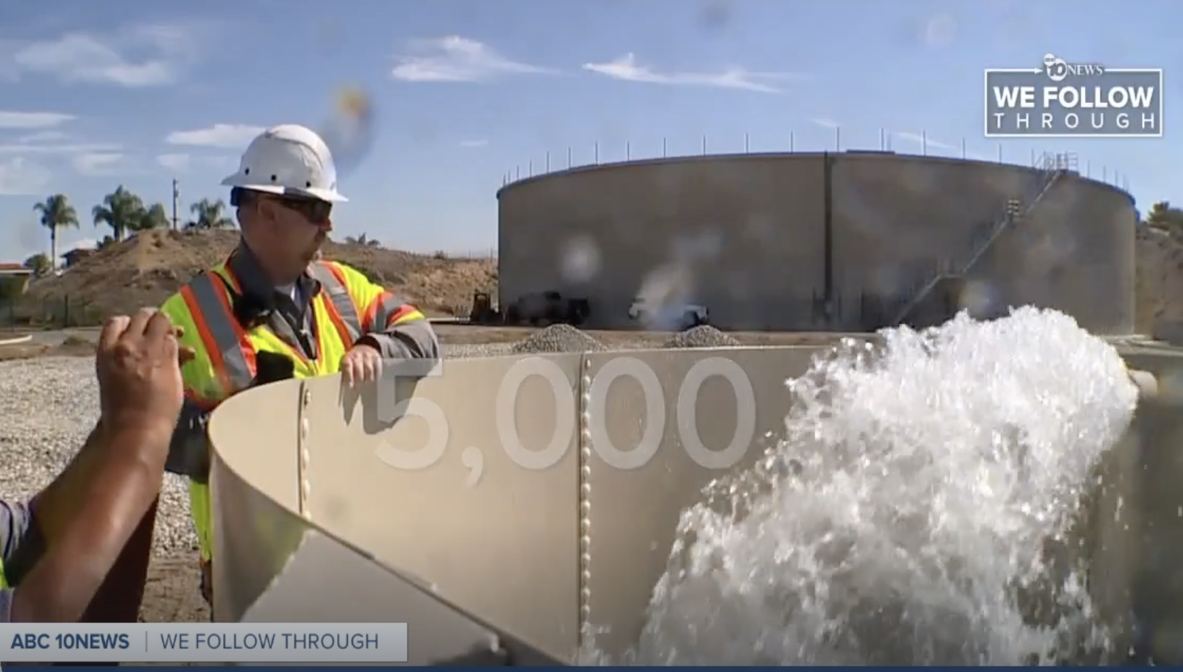
ABC 10
November 15
Fire Crews use Heli-Hydrant for its First Time to Flight Garden Fire
Notes:
35 drops were made possible from the heli-hydrant
The heli-hydrant is a reliable water source within close proximity of the fire that was key in providing swift response to the 48 acre firre.

Slide 8

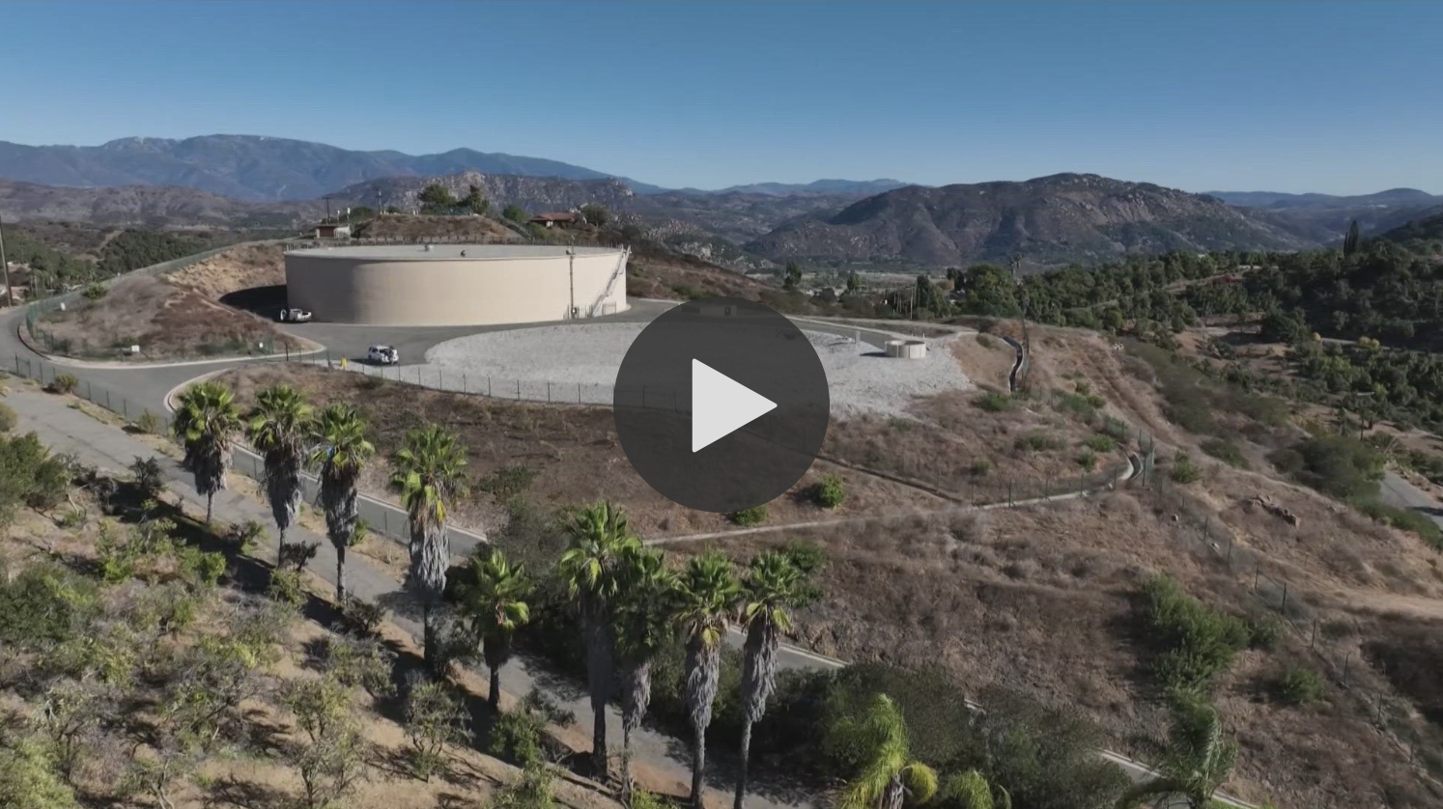
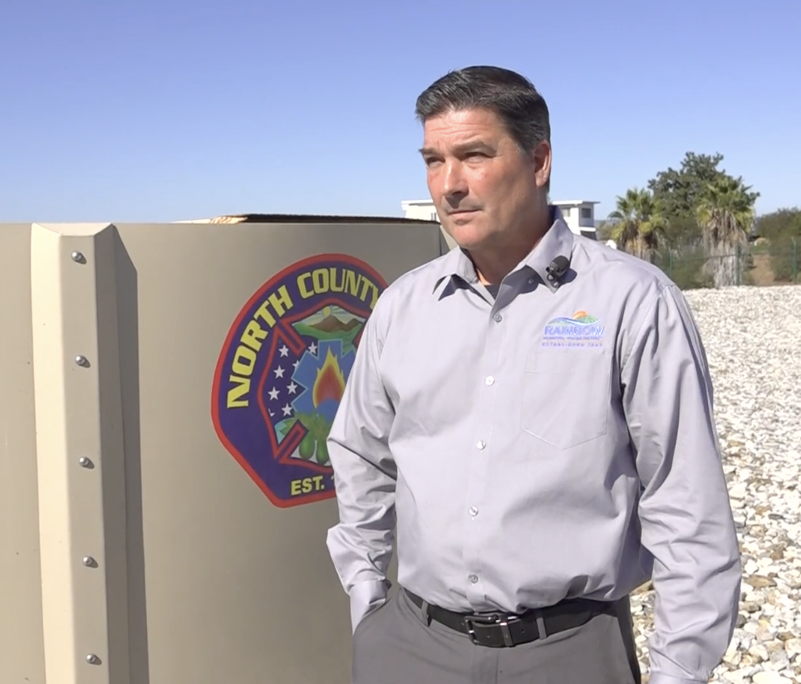
CBS 8
November 13
New Water Tank Helps Prevent Disaster in Fallbrook Wildfire
Interview with Fire Captains and General Manager
Notes:
A new Rapid Aerial Water Supply tank in San Diego County helped contain the Fallbrook wildfire, preventing major damage and speeding up helicopter response times.

Slide 9

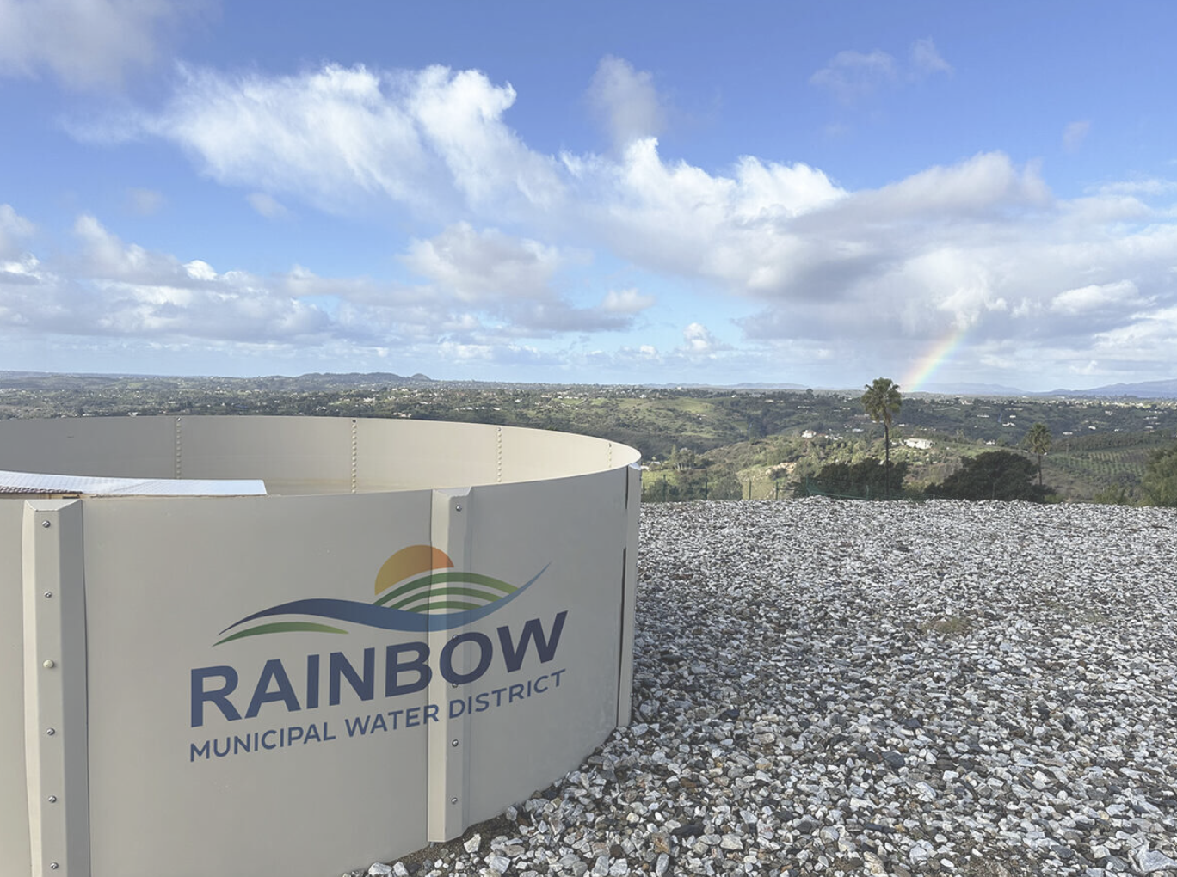
Village News
Rainbow Municipal Water District Completes Historic Detachment from San Diego County Water Authority
FALLBROOK, CA- Rainbow Municipal Water District (Rainbow Water) has finalized its detachment from the San Diego County Water Authority (SDCWA), marking a significant step in its commitment to securing cost-effective and reliable water supplies for its customers. On Wednesday, October 30, Rainbow Water made a $3.2 million exit fee payment to SDCWA, the last requirement by the Local Agency Formation Commission (LAFCO) to certify Rainbow Water's reorganization.
Effective November 1, Rainbow Water will purchase treated water from the Eastern Municipal Water District (EMWD), shielding Rainbow Water's customers from the looming SDCWA rate hikes of 14% in 2025 and an additional 16% proposed in 2026. New development projects in the Rainbow Water service area will also benefit, with capacity fees set to decrease by 31-48% from current levels, reflecting the elimination of previous SDCWA-imposed charges.
Rainbow Water and the neighboring.
November 7
Rainbow Municipal Water District Completes Historic Detachment from San Diego County Water Authority
Fallbrook Public Utility District (FPUD) sought this departure to protect the community from unsustainable wholesale water rate increases that have hit the agricultural sector hard. Over the past decade, agricultural sales dropped by nearly 9,000 acre-feet annually in Rainbow Water's service area alone, significantly impacting water sales revenue to the District, which impacts all customers.

