Slide 1
Detachment Finalization & Results
Board of Directors
January 28, 2025

Slide 2
Detachment Requirements & Results
Agenda
System & Operations Modifications
Startup and Commissioning of Facilities
Exit Fee Payment Status/Schedule
Reserves Position & Savings

Slide 3
System & Operations Modifications
Elimination of Use of Southern SDCWA Turnouts (RB-3, -6, -11)
Morro Reservoir Chloramination
Acquisition and O&M for Four Turnouts
  RB-1, RB-8, RB-9, & RB-10

Slide 4
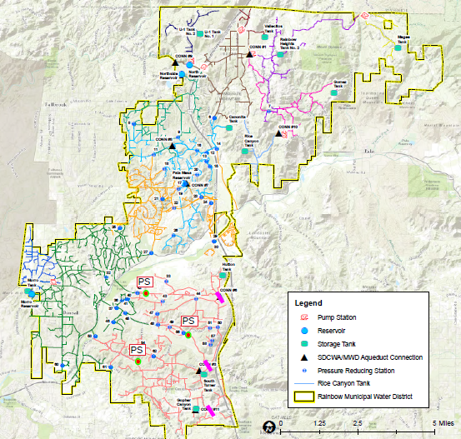
Southern Connections
Eliminate the use of SDCWA turnouts serving the South Zone
Construction & Commissioning of Three (3) New Pump Stations
  Lilac PS
  Dentro de Lomas PS
  Rancho Amigos PS

Slide 5
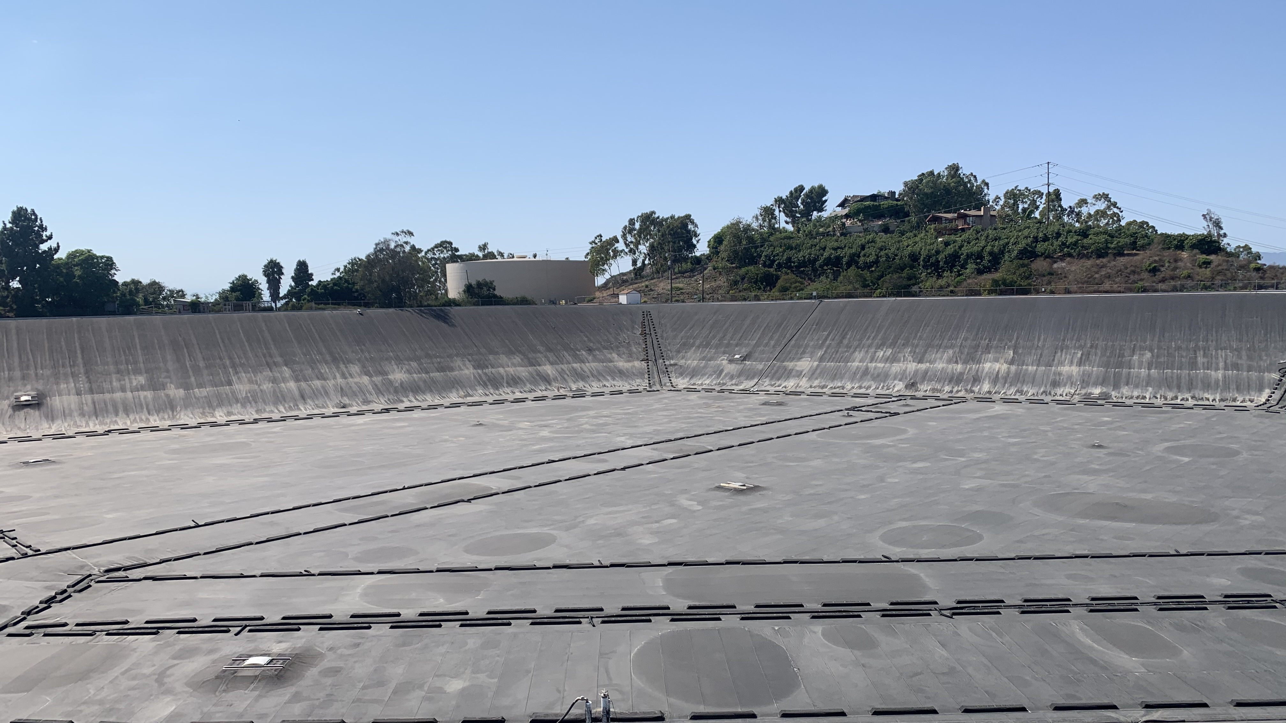
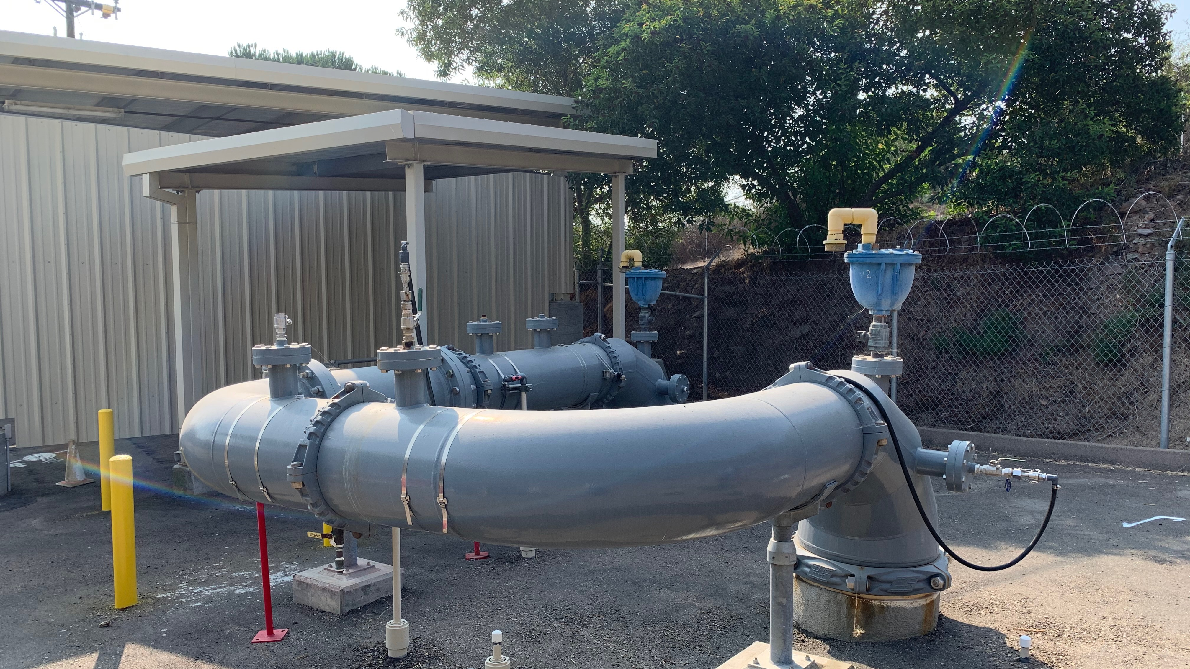
Morro Reservoir Chloramination
Dates back to 2012 when Reservoir was covered.
Difficult in-reservoir disinfection
Addition of in-reservoir mixers with co-located NaOCl & NH4 injection has produced stellar results!

Slide 6
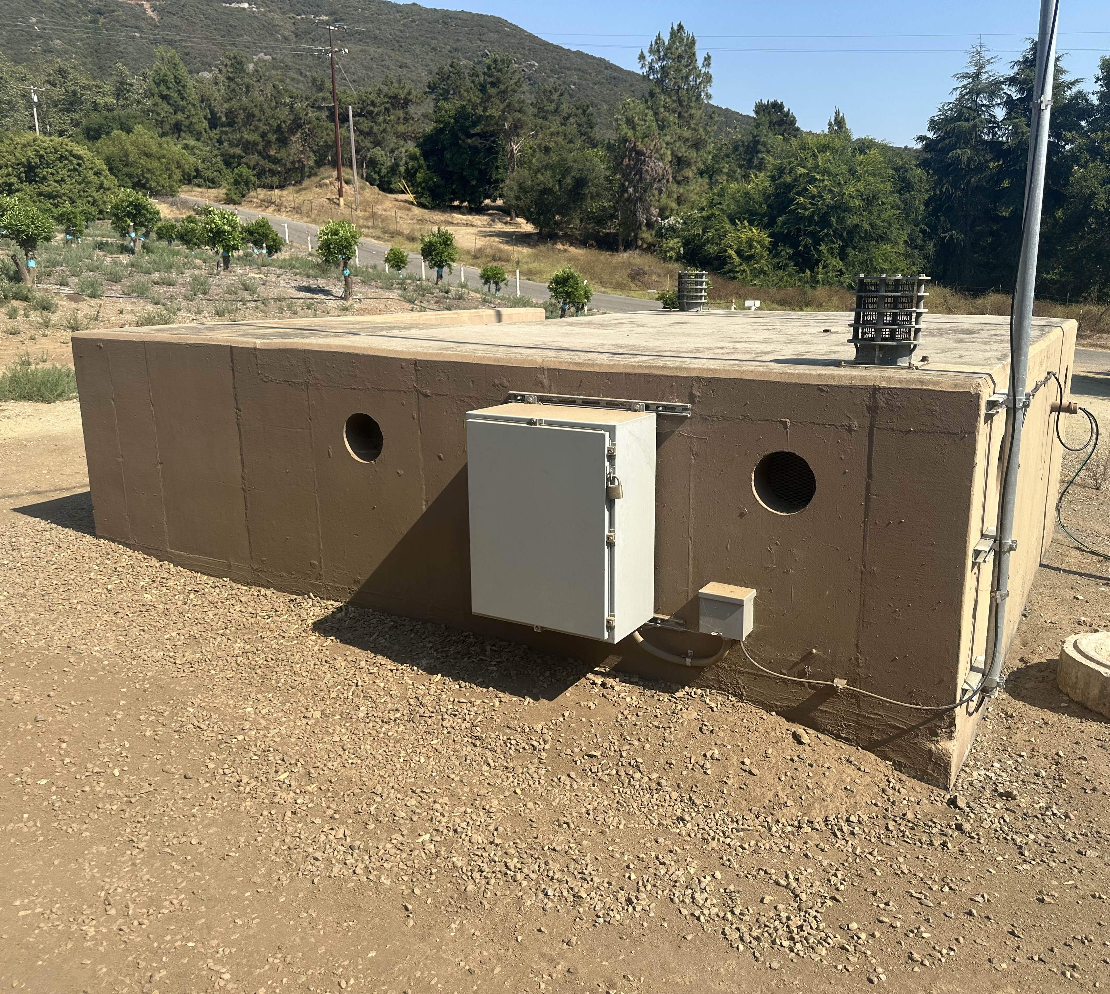
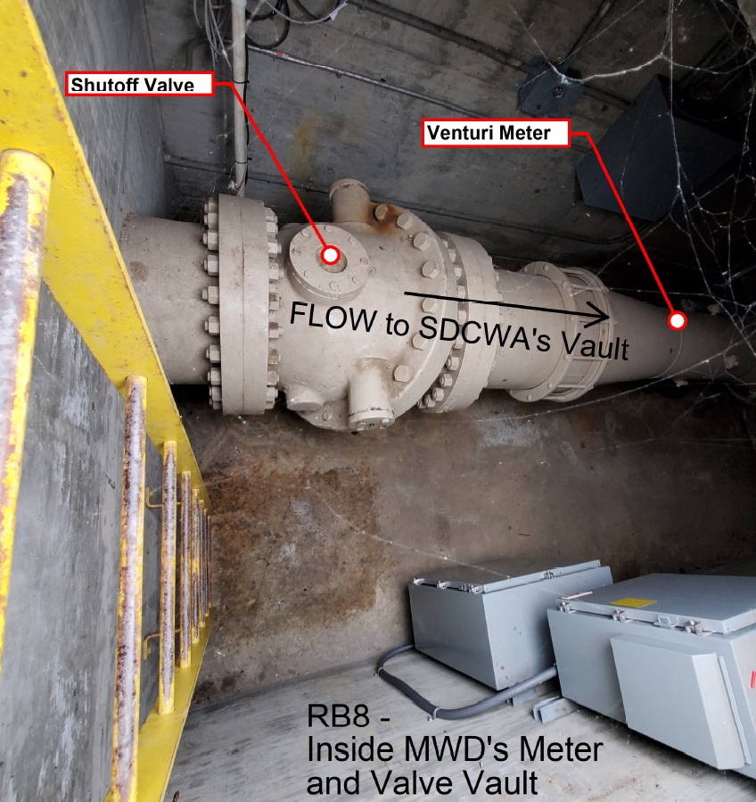
System & Operations Modifications
Turnout Acquisition
Purchased four connection
(RB-1, RB-8, RB-9, &
RB-10) for $607k
Post-detachment secured the sites and assumed control
  IT/Electrical Services led Project in coordination w/SDCWA operations staff
Rainbow operates RB-8, RB-9 exclusively. SDCWA operates RB-1, RB-10 control valve due to the sensitive operations downstream of the 1st Aqueduct.

Slide 7
Pump Station Commissioning

Slide 8
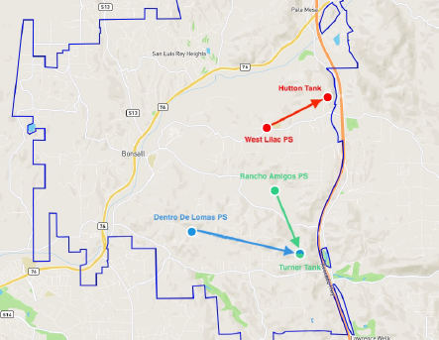
Pump Stations Commissioning
Pump Station to Tank Flow
Power Startup
Station Testing:
  Valves
  Pumps
  Electrical
  SCADA
  Communications
  Generator testing

Slide 9
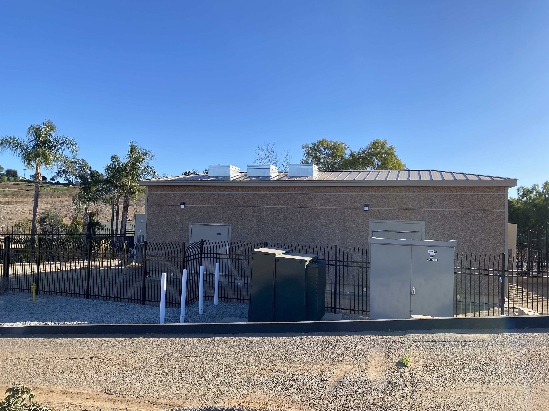
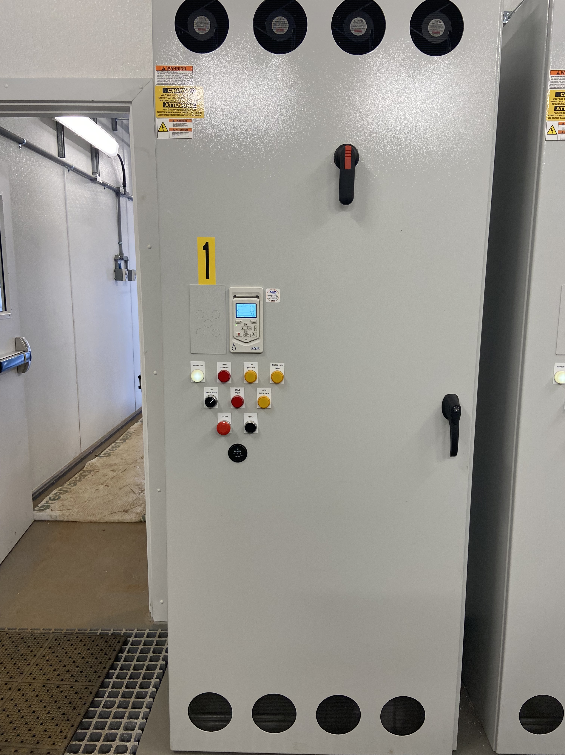
Pump Stations Commissioning (West Lilac)

Slide 10
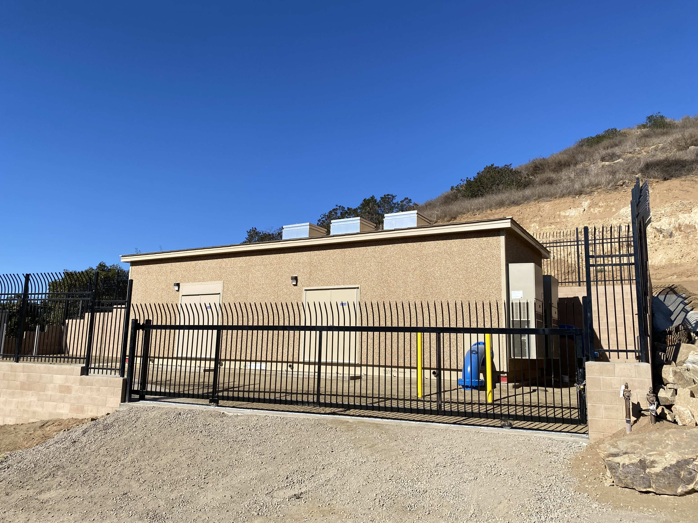
Pump Stations Commissioning (Dentro De Lomas)

Slide 11
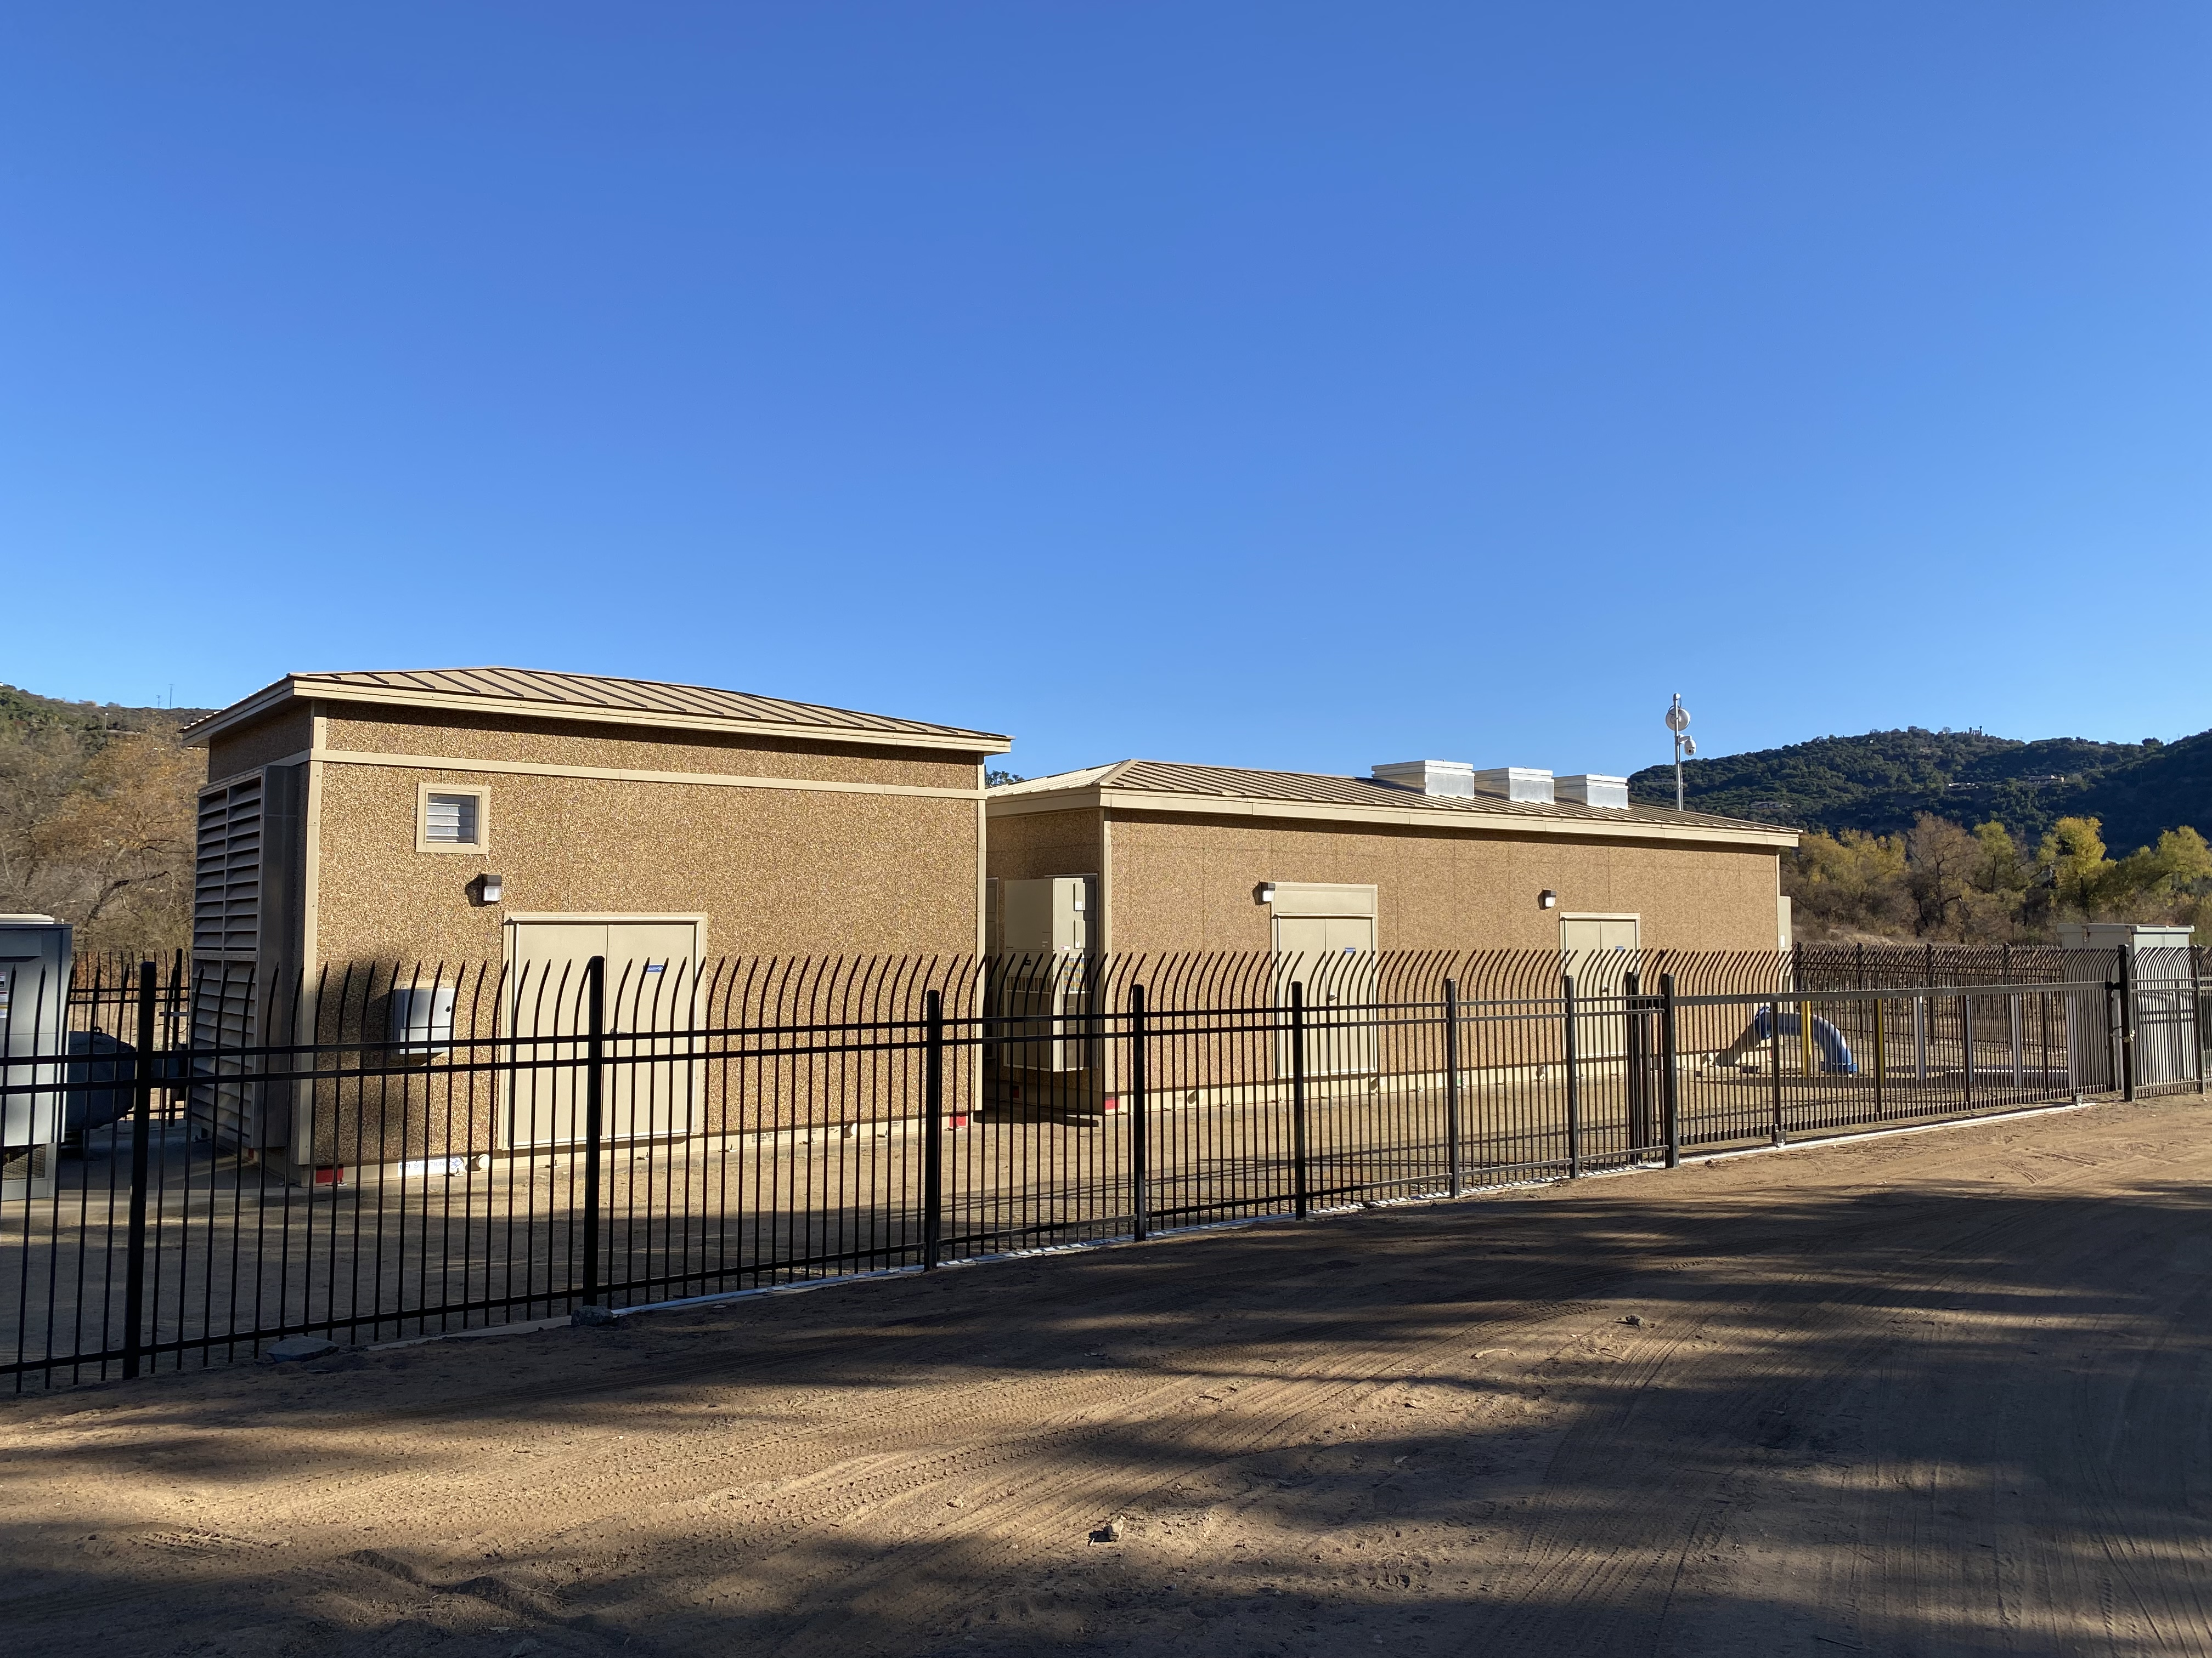
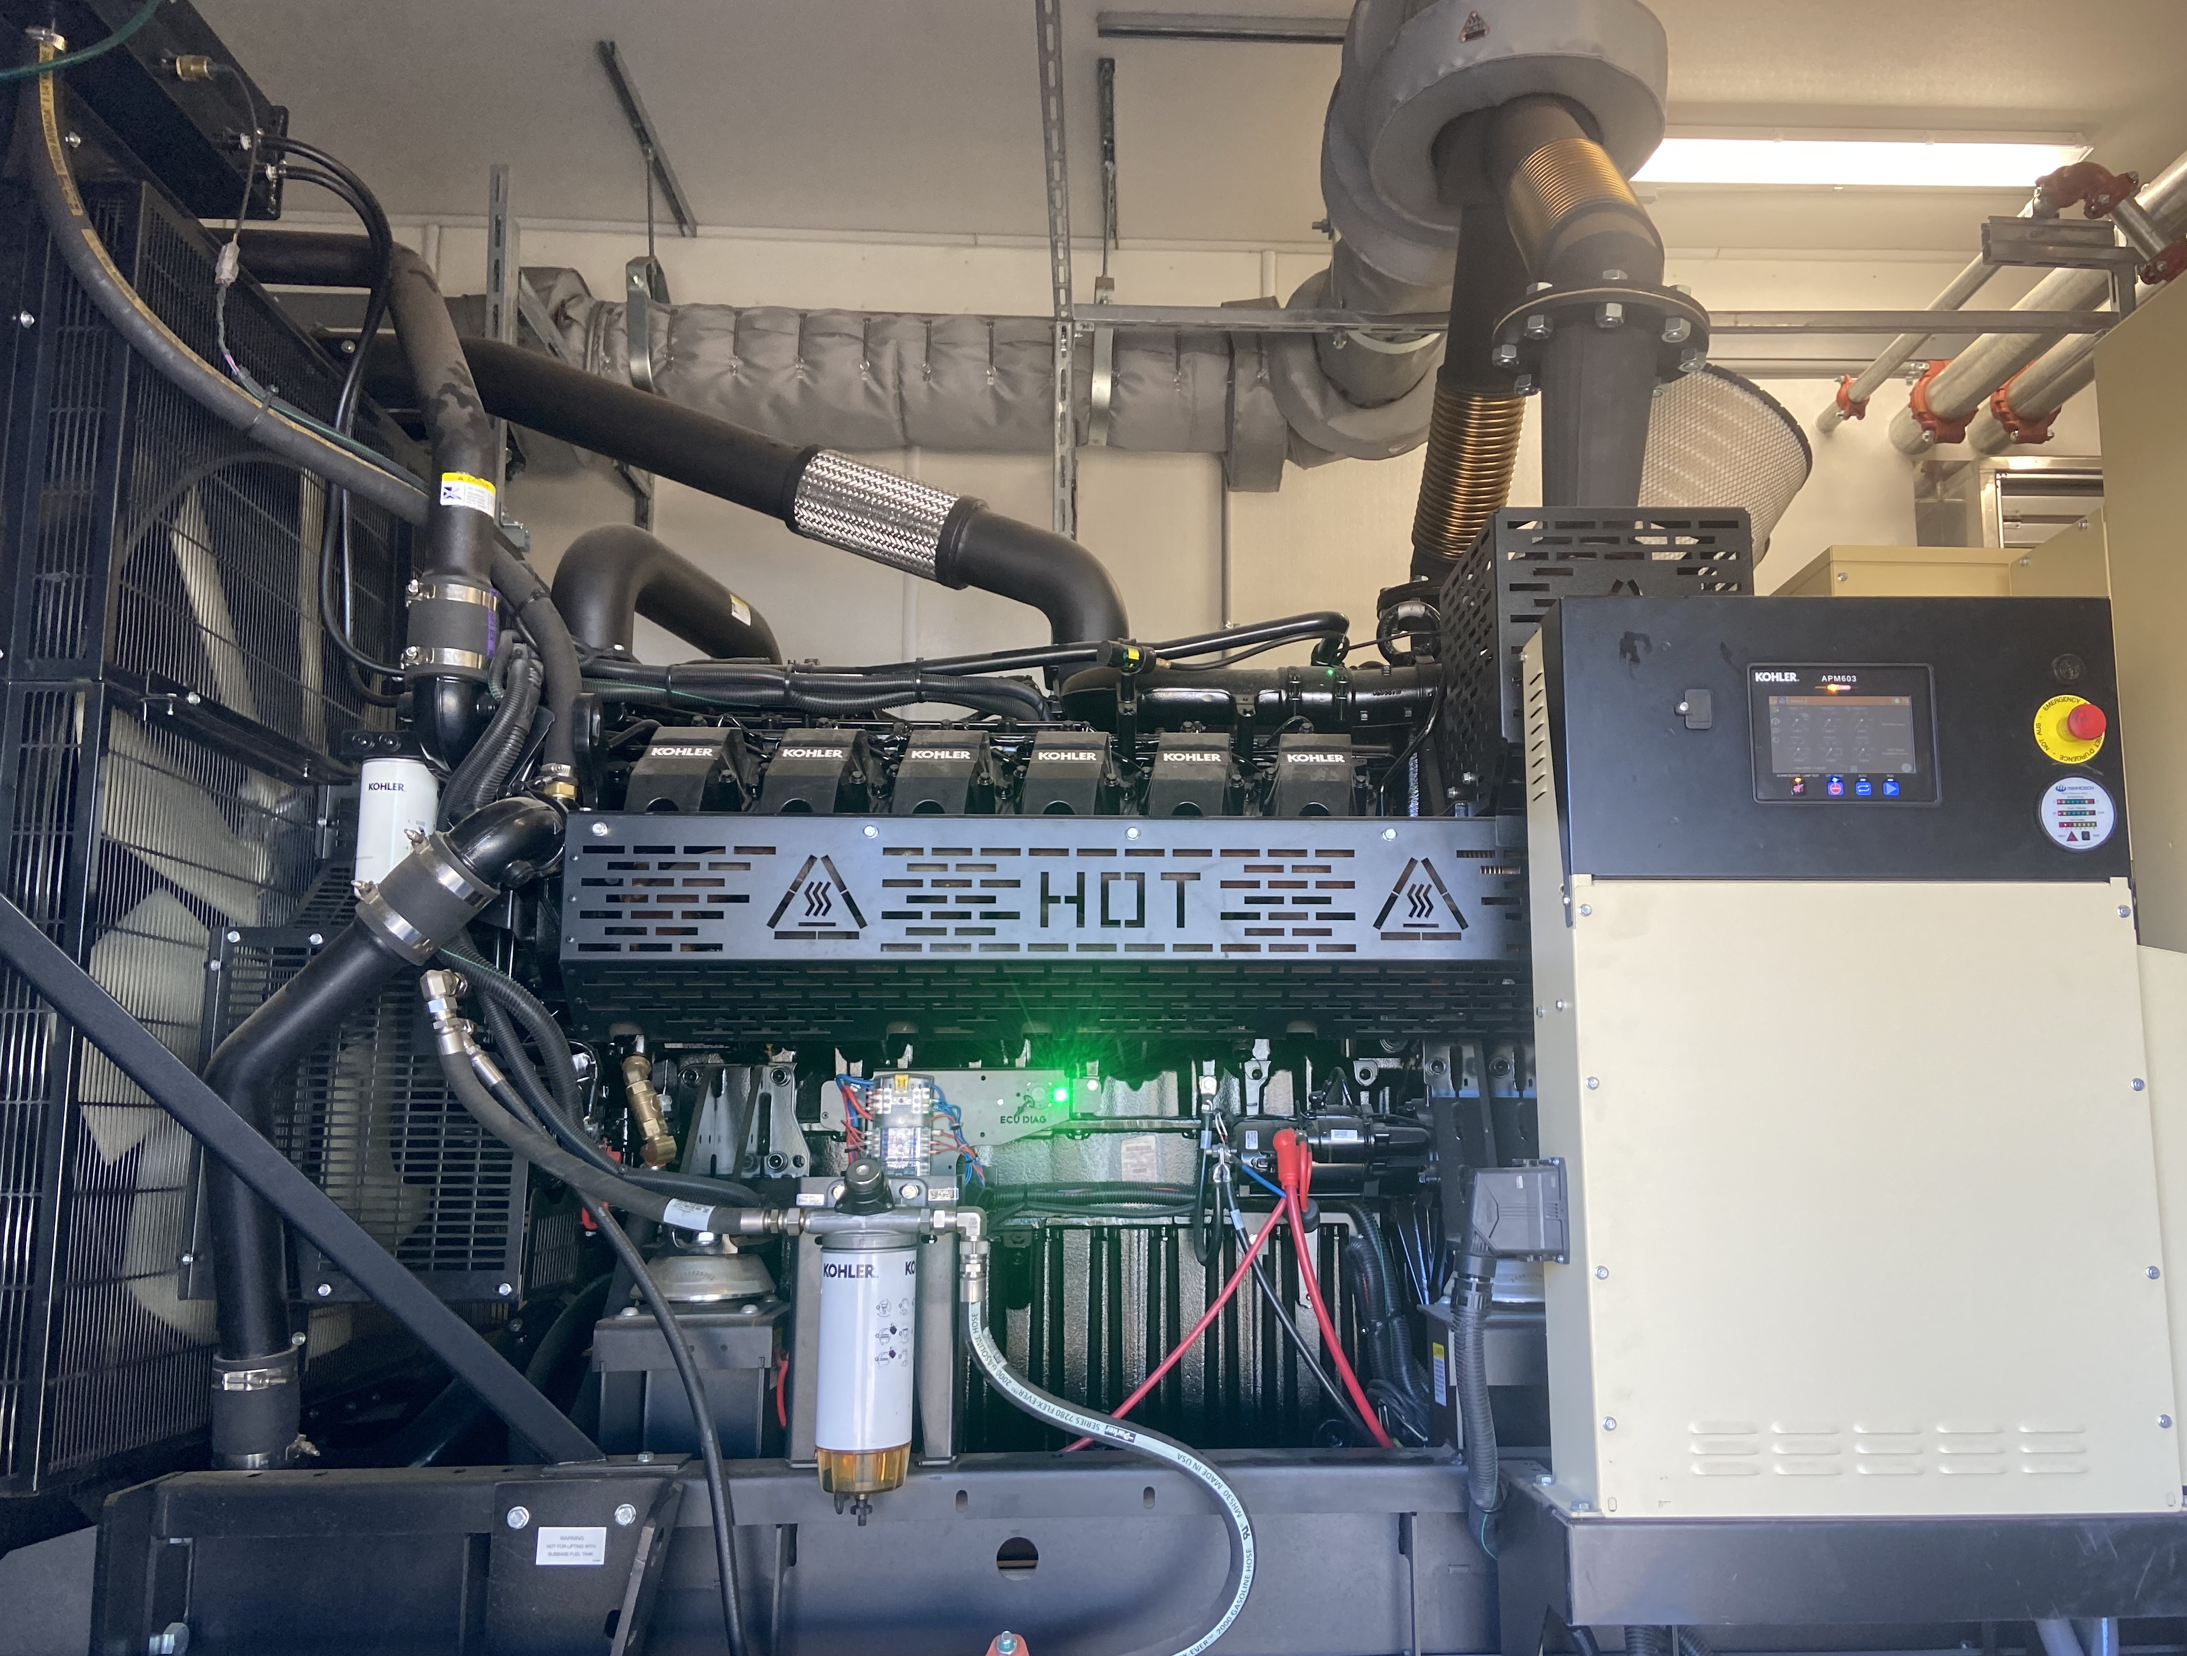
Pump Stations Commissioning (Rancho Amigos)

Slide 12
Pump Stations Capacity Testing
Pump Station Designed flow Specifications were met at each station with only 2 out of 3 Pumps.
Suction/Discharge Pressure.
No main breaks due to station operation testing.

Slide 13
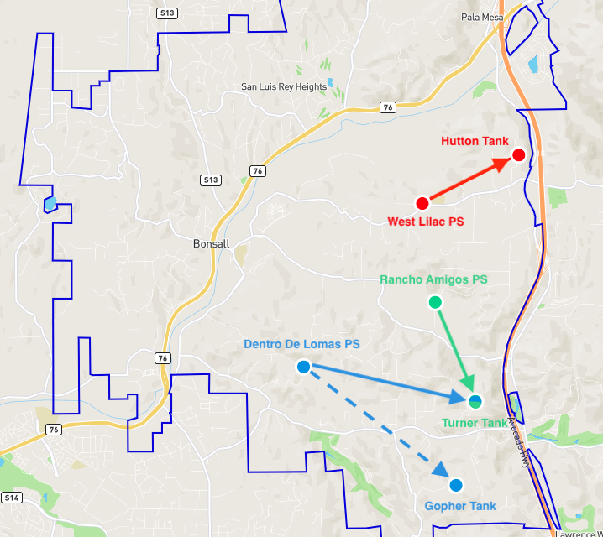
Operational Flexibility
By manipulating the system valving, we were able to pump to the Gopher Tank via Dentro De Lomas PS.
Ability to move water into either of our most southern tanks based on need.

Slide 14
System Online & Operational
The system was online one week before the deadline.
The implementation of the new pump stations introduced unique challenges, each of which we successfully resolved.
System operators are currently running the stations learning and developing ideal pumping strategies.

Slide 15
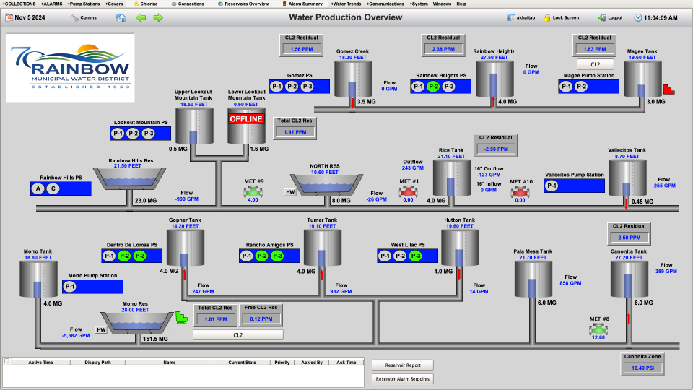

Slide 16
Exit Fee Status
Initial Payment made on October 30, 2024
Funding for the full exit fee received on January 7, 2025
  $3.1M initial exit fee payment returned to reserves
Wire Transfer for $12.6M remaining exit fee balance scheduled for Thursday, January 30, 2025.
  Within 90 days of Filing of the Certificate of Completion by LAFCO per the terms of the settlement agreement

Slide 17
2024
Financial Results
November 1, 2024 detachment date occurred two months earlier than budgeted for in FY24/25.
Actual fixed cost savings from early detachment = $803,730
Staff is currently compiling budget review to assess impacts to CIP, operating budgets, and projected reserve levels through mid-year.
Recommendation is to assess results of FY24/25 during FY25/26 budget process to take a more holistic look of financial picture with added savings.

Slide 18
Questions?

