Slide 1
Gopher Canyon Emergency Pipe Project Update
Board of Directors Meeting
January 28, 2025

Slide 2
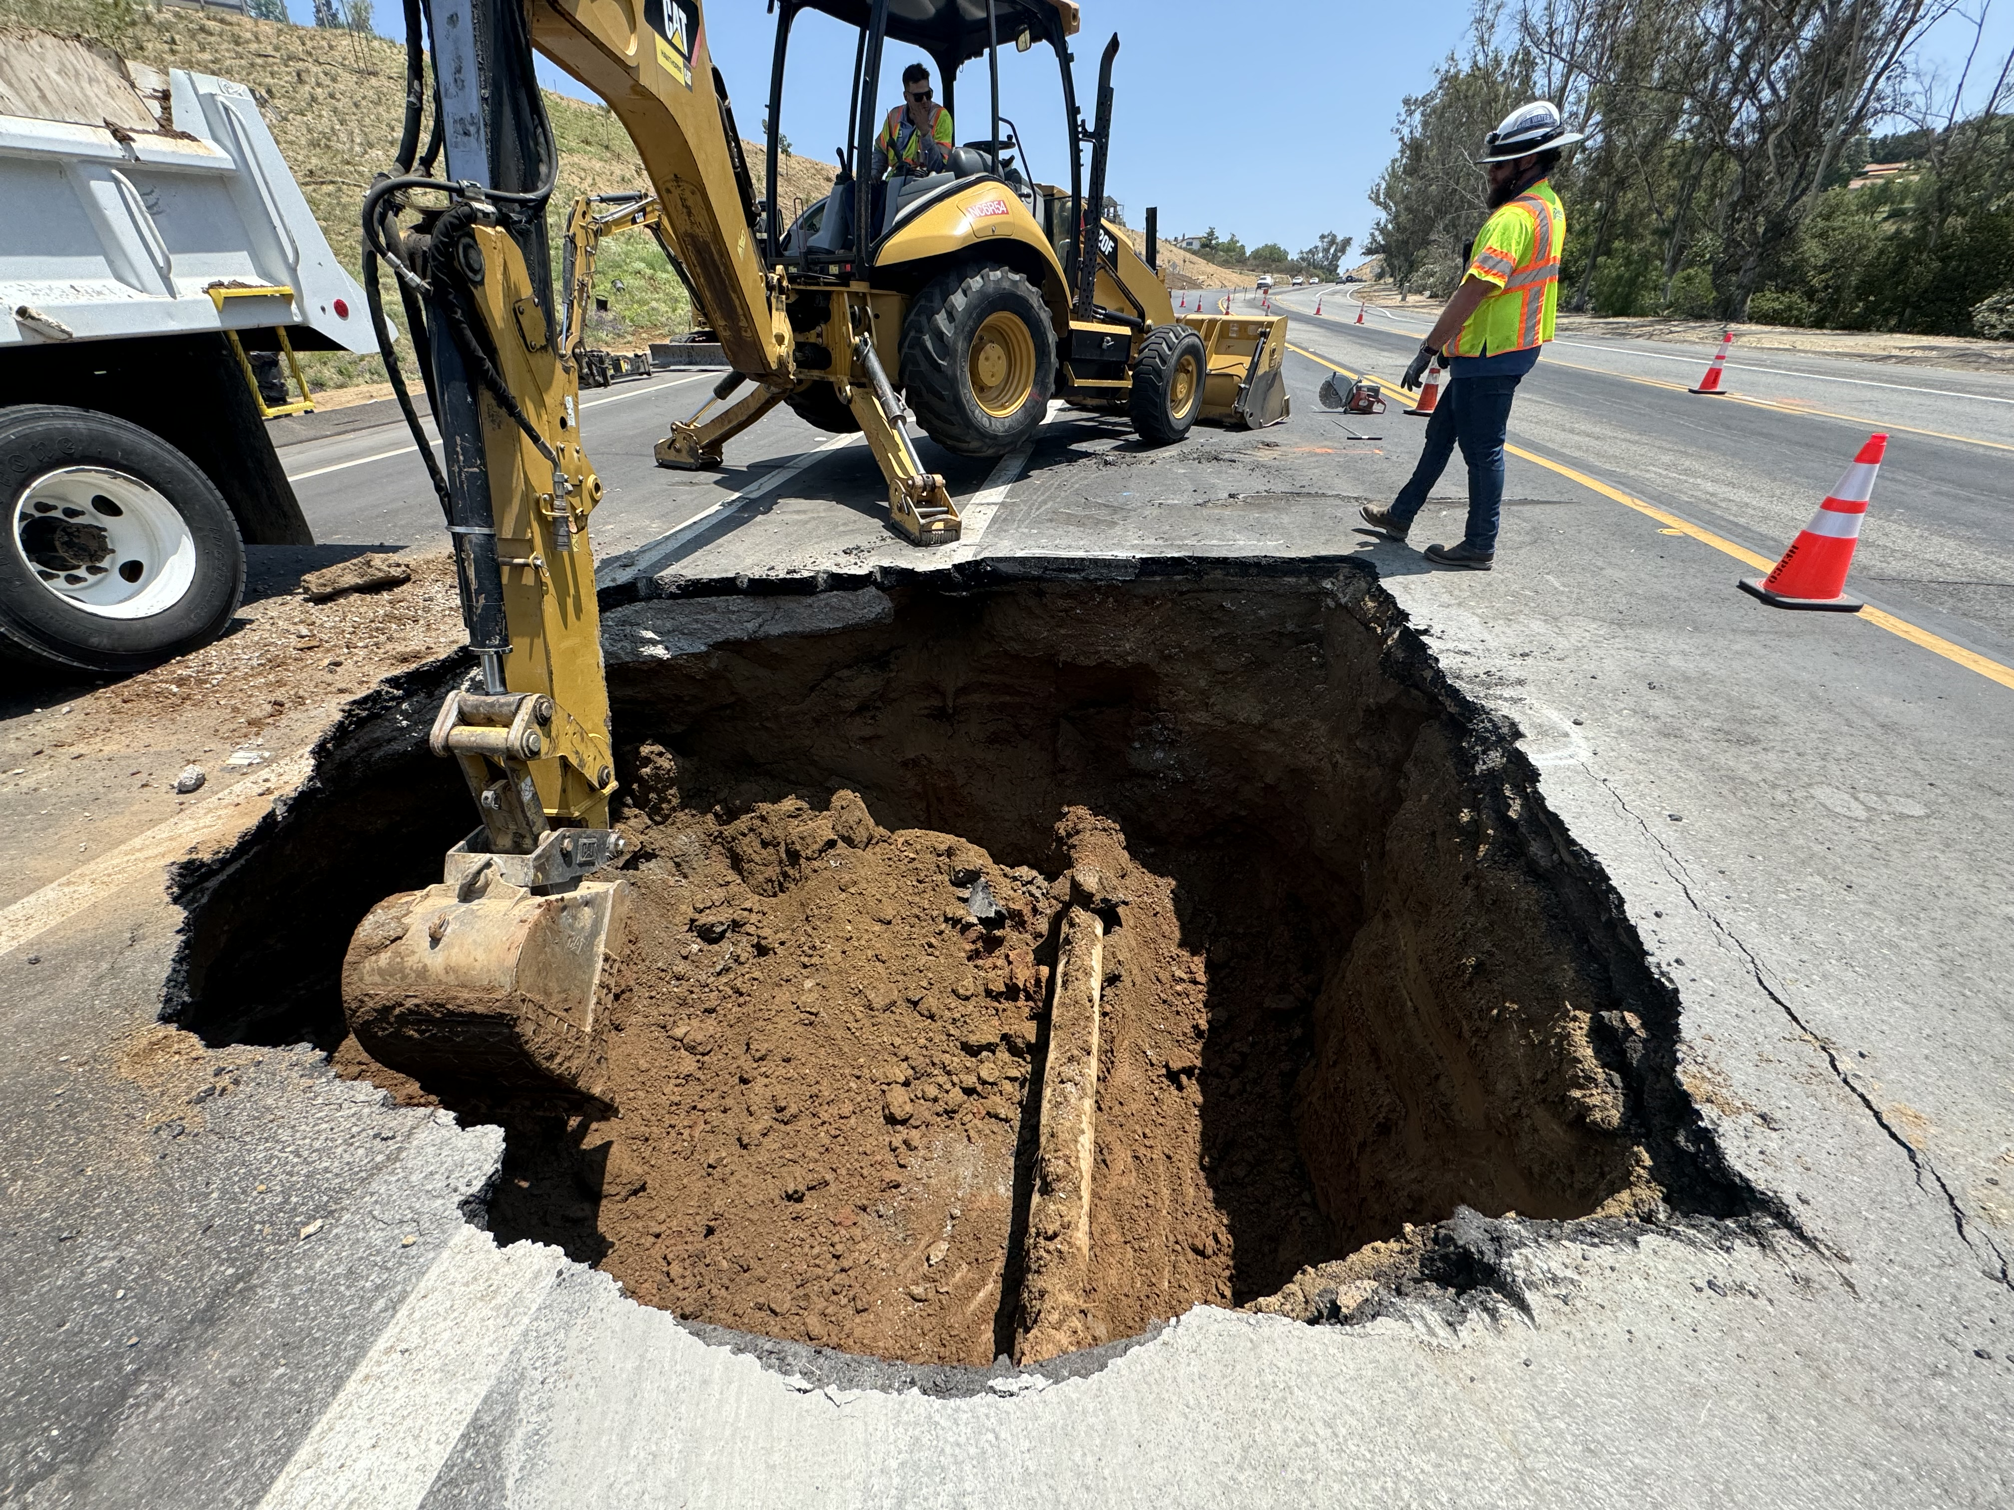
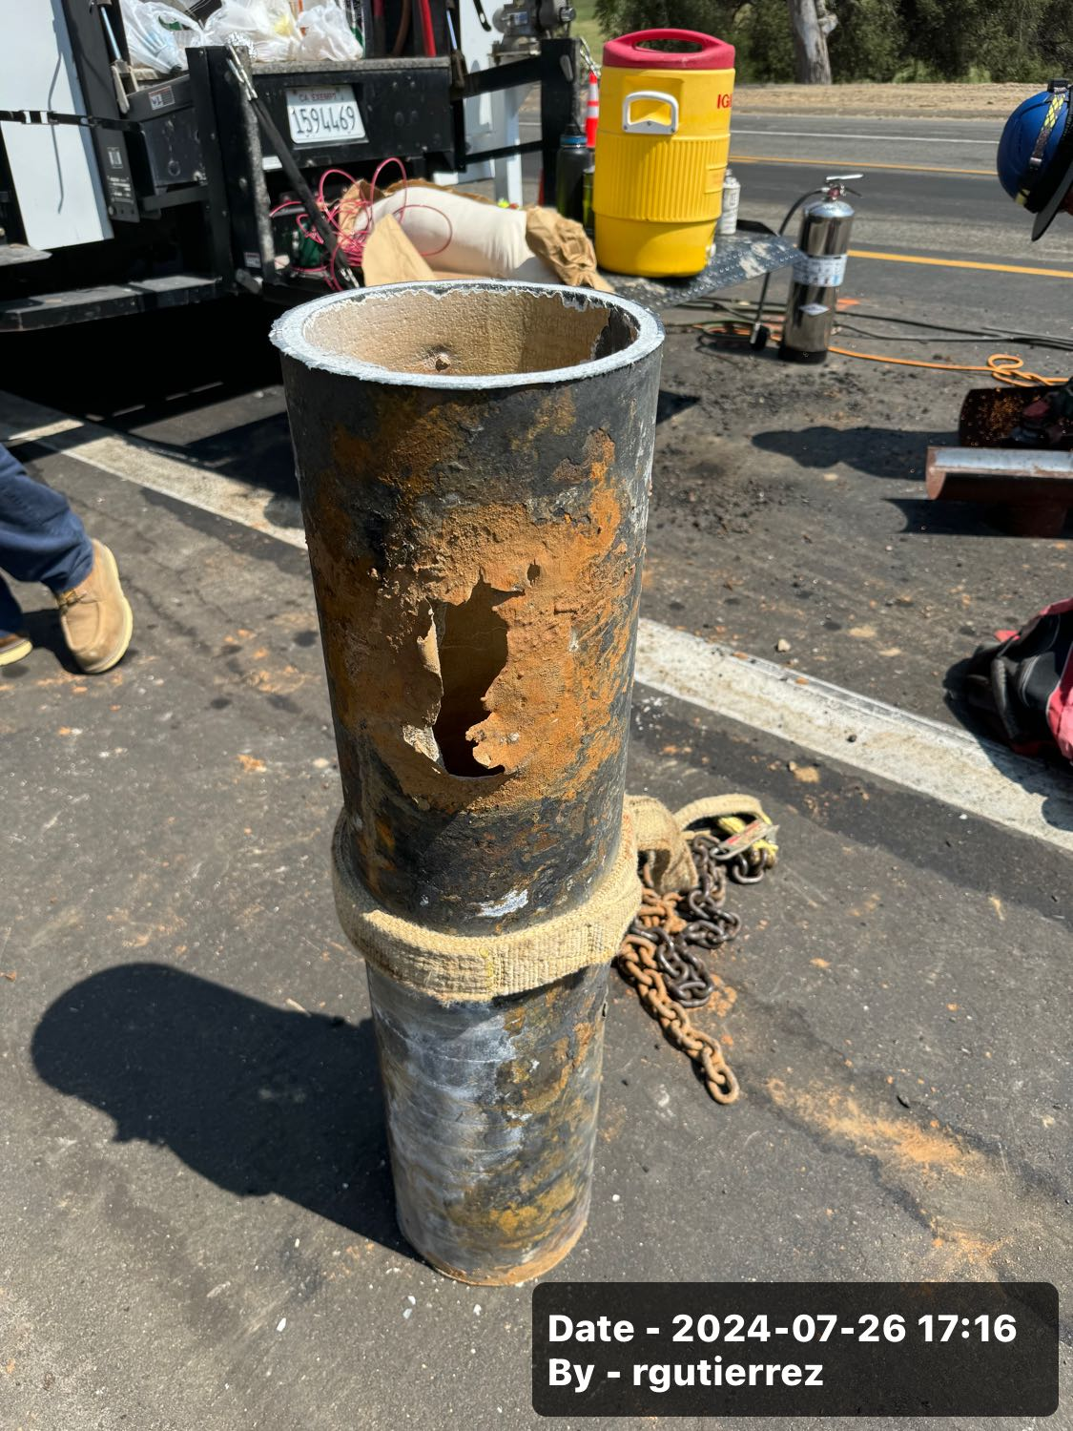
Background
7/26 Main break
8/6 Presented to E&O

Slide 3
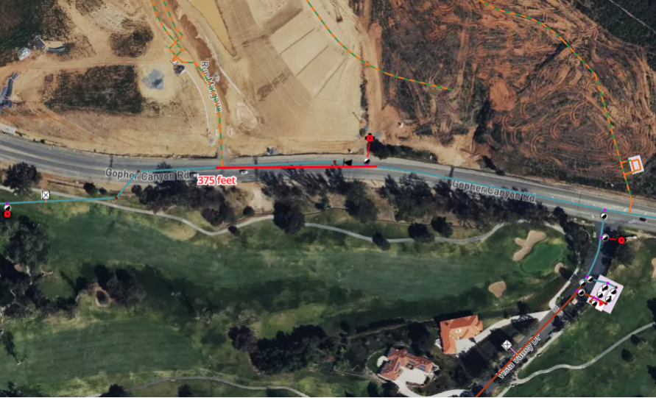

Slide 4
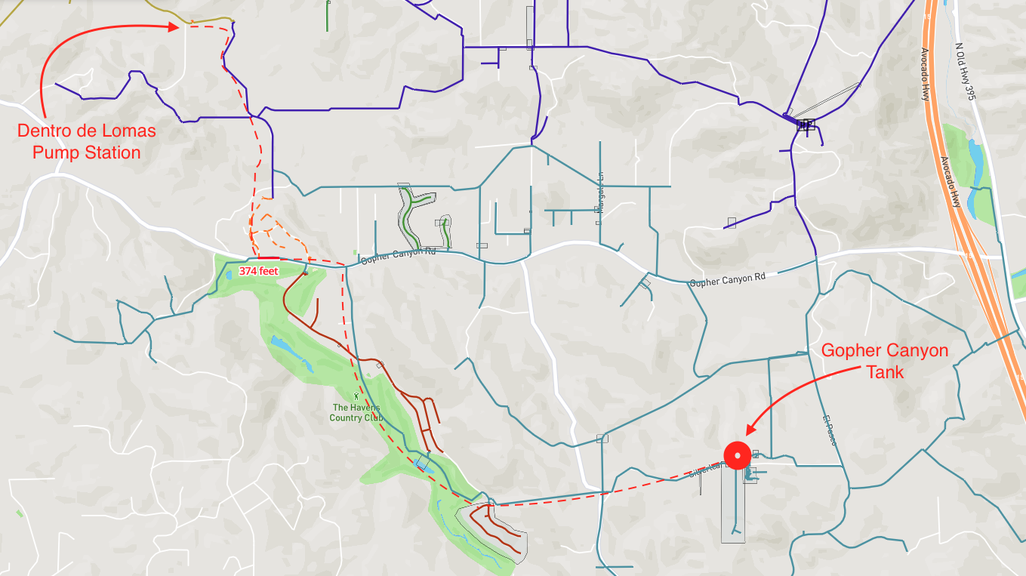

Slide 5
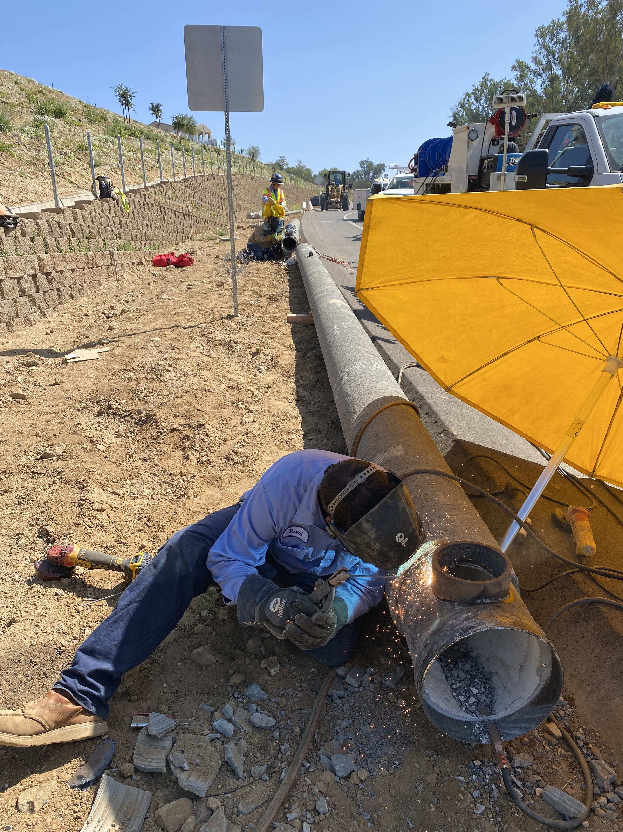
Background
8/27 Board approved $600K
  Emergency Paving
  Emergency Pipe Project
  Ordered pipe and fittings
9/26 Pipe Arrived

Slide 6
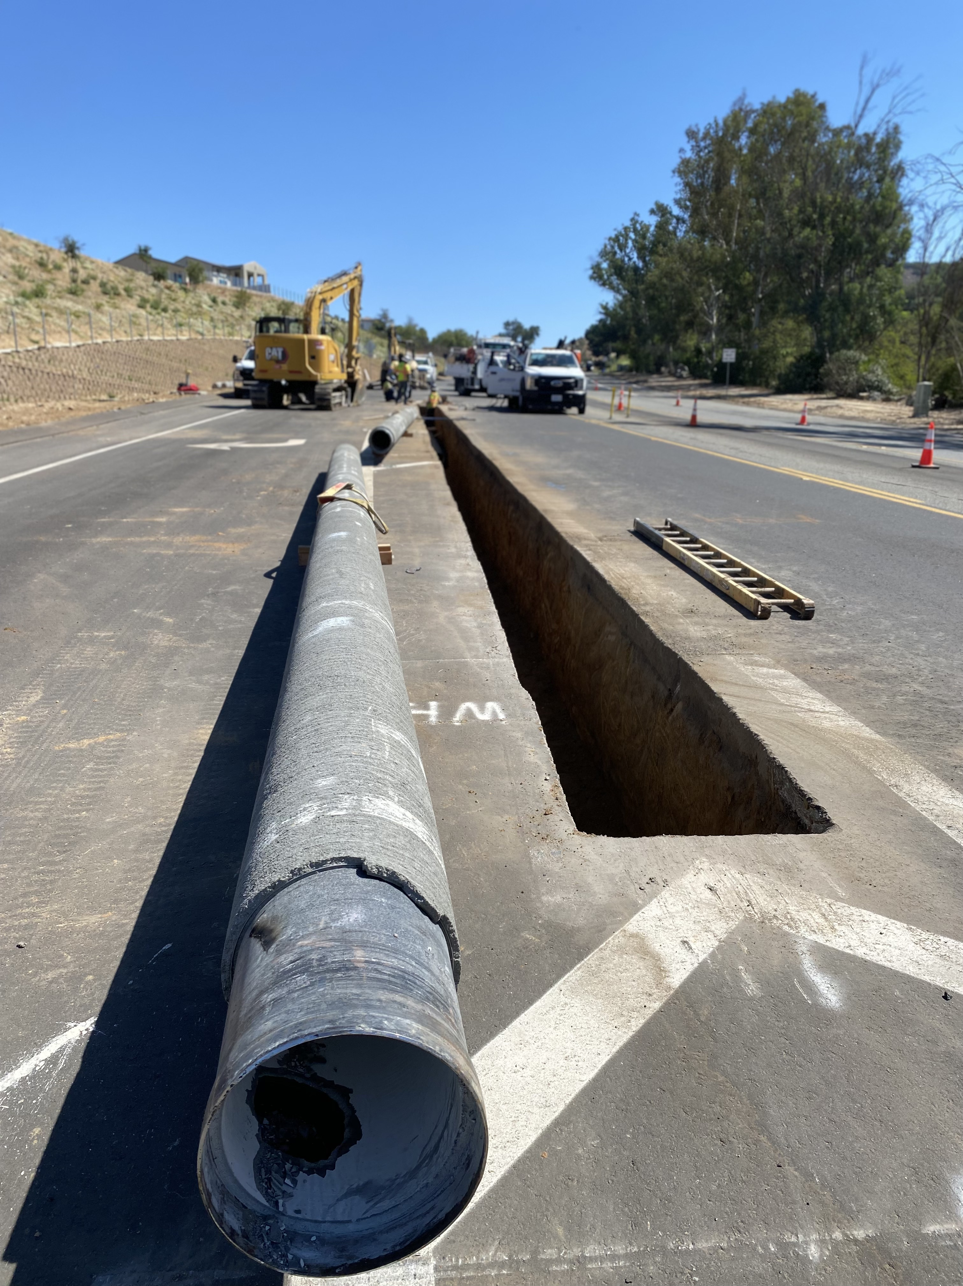
Pipeline Installation
9/30 Started
  12-inch CML&C pipe
  Upsizing from 8-inch
  4 days to install 350-feet

Slide 7
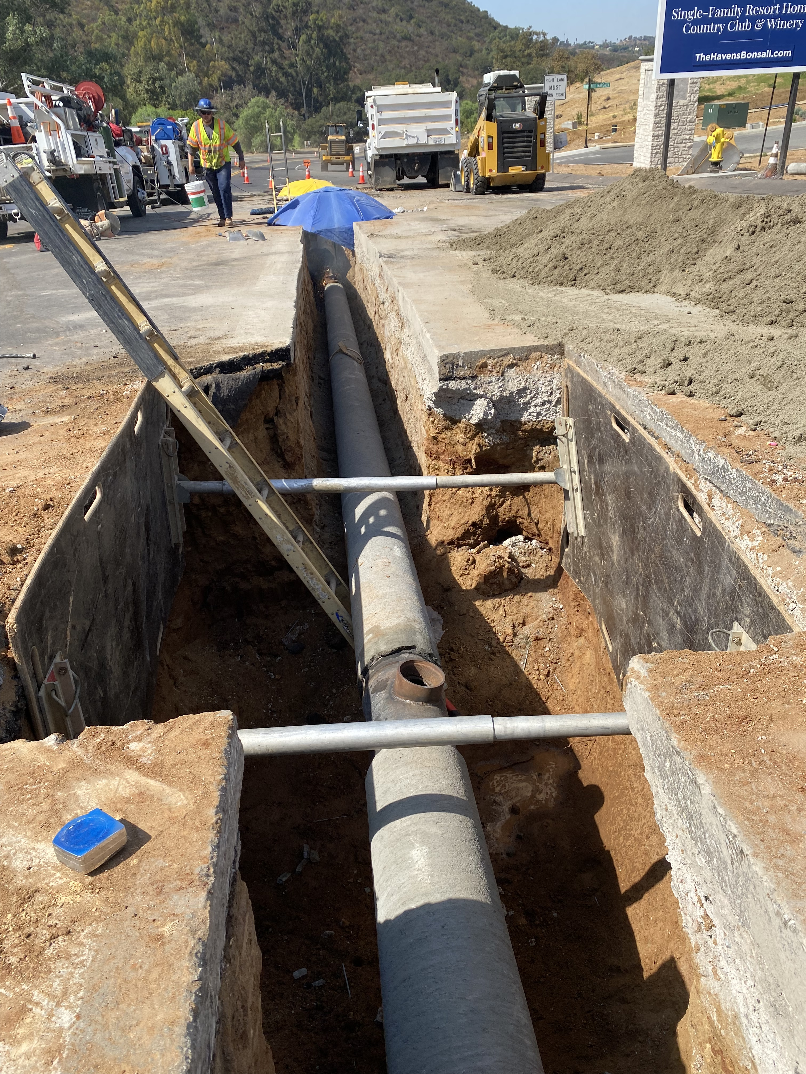
Project Update
10/3 Finished Installing Pipe
10/7 Pipe Testing (3 Days)
  Pressure testing
  High-Chlorine
  Flushing
  Bac-T samples

Slide 8
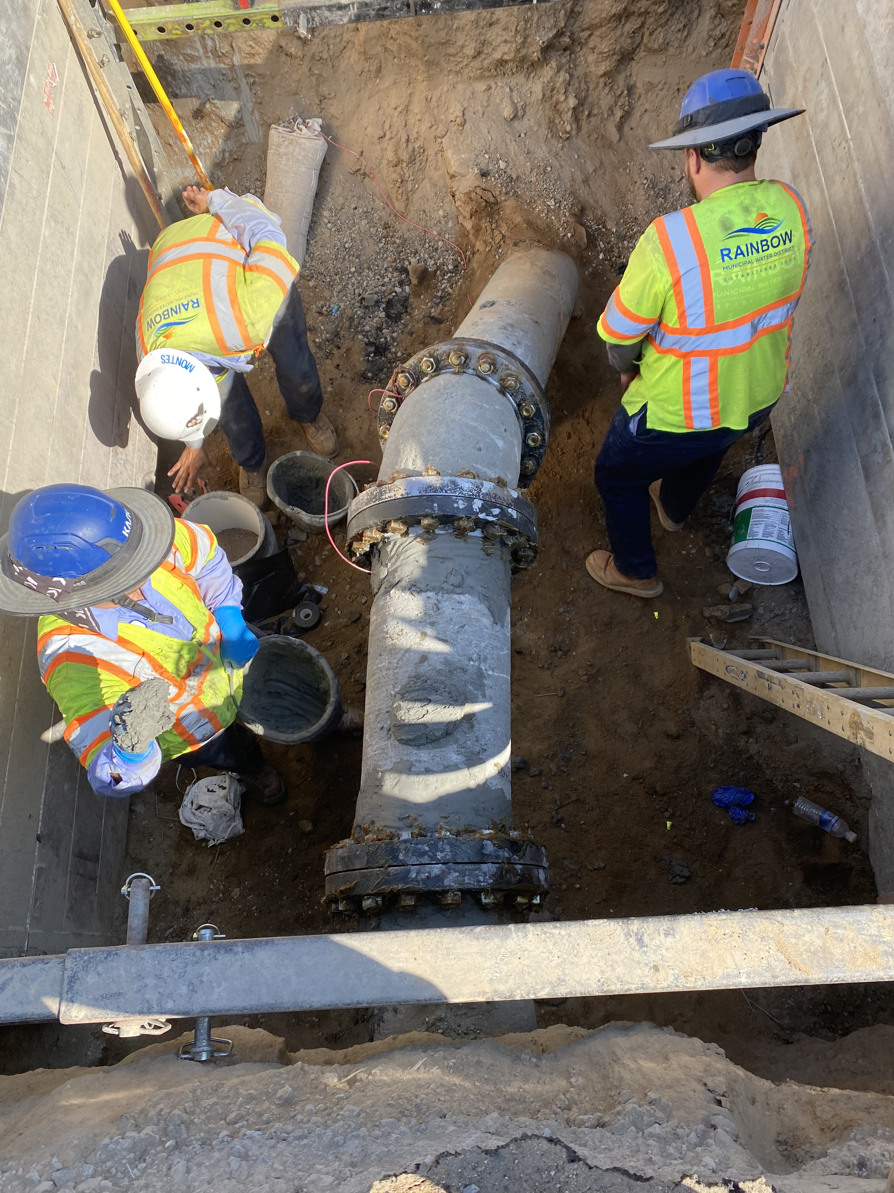
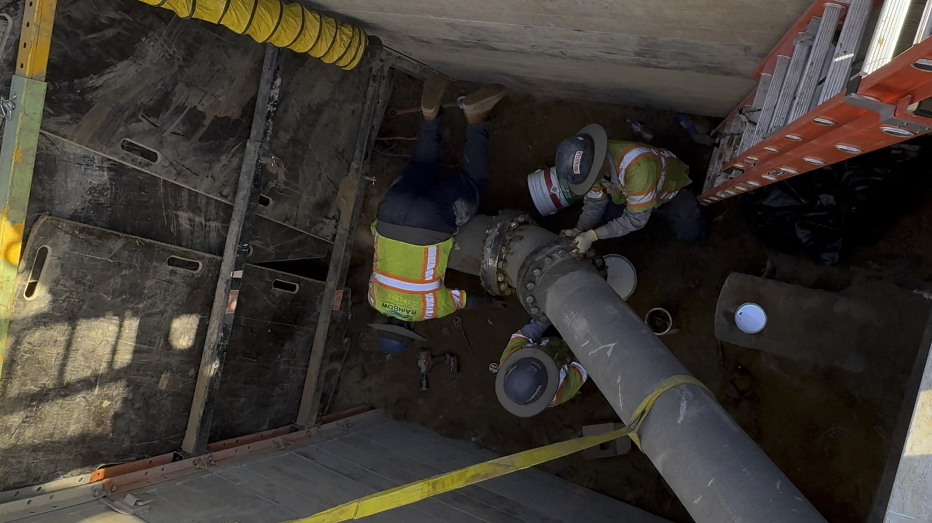
10/14 Tie-in Eastside (2 working days)

Slide 9
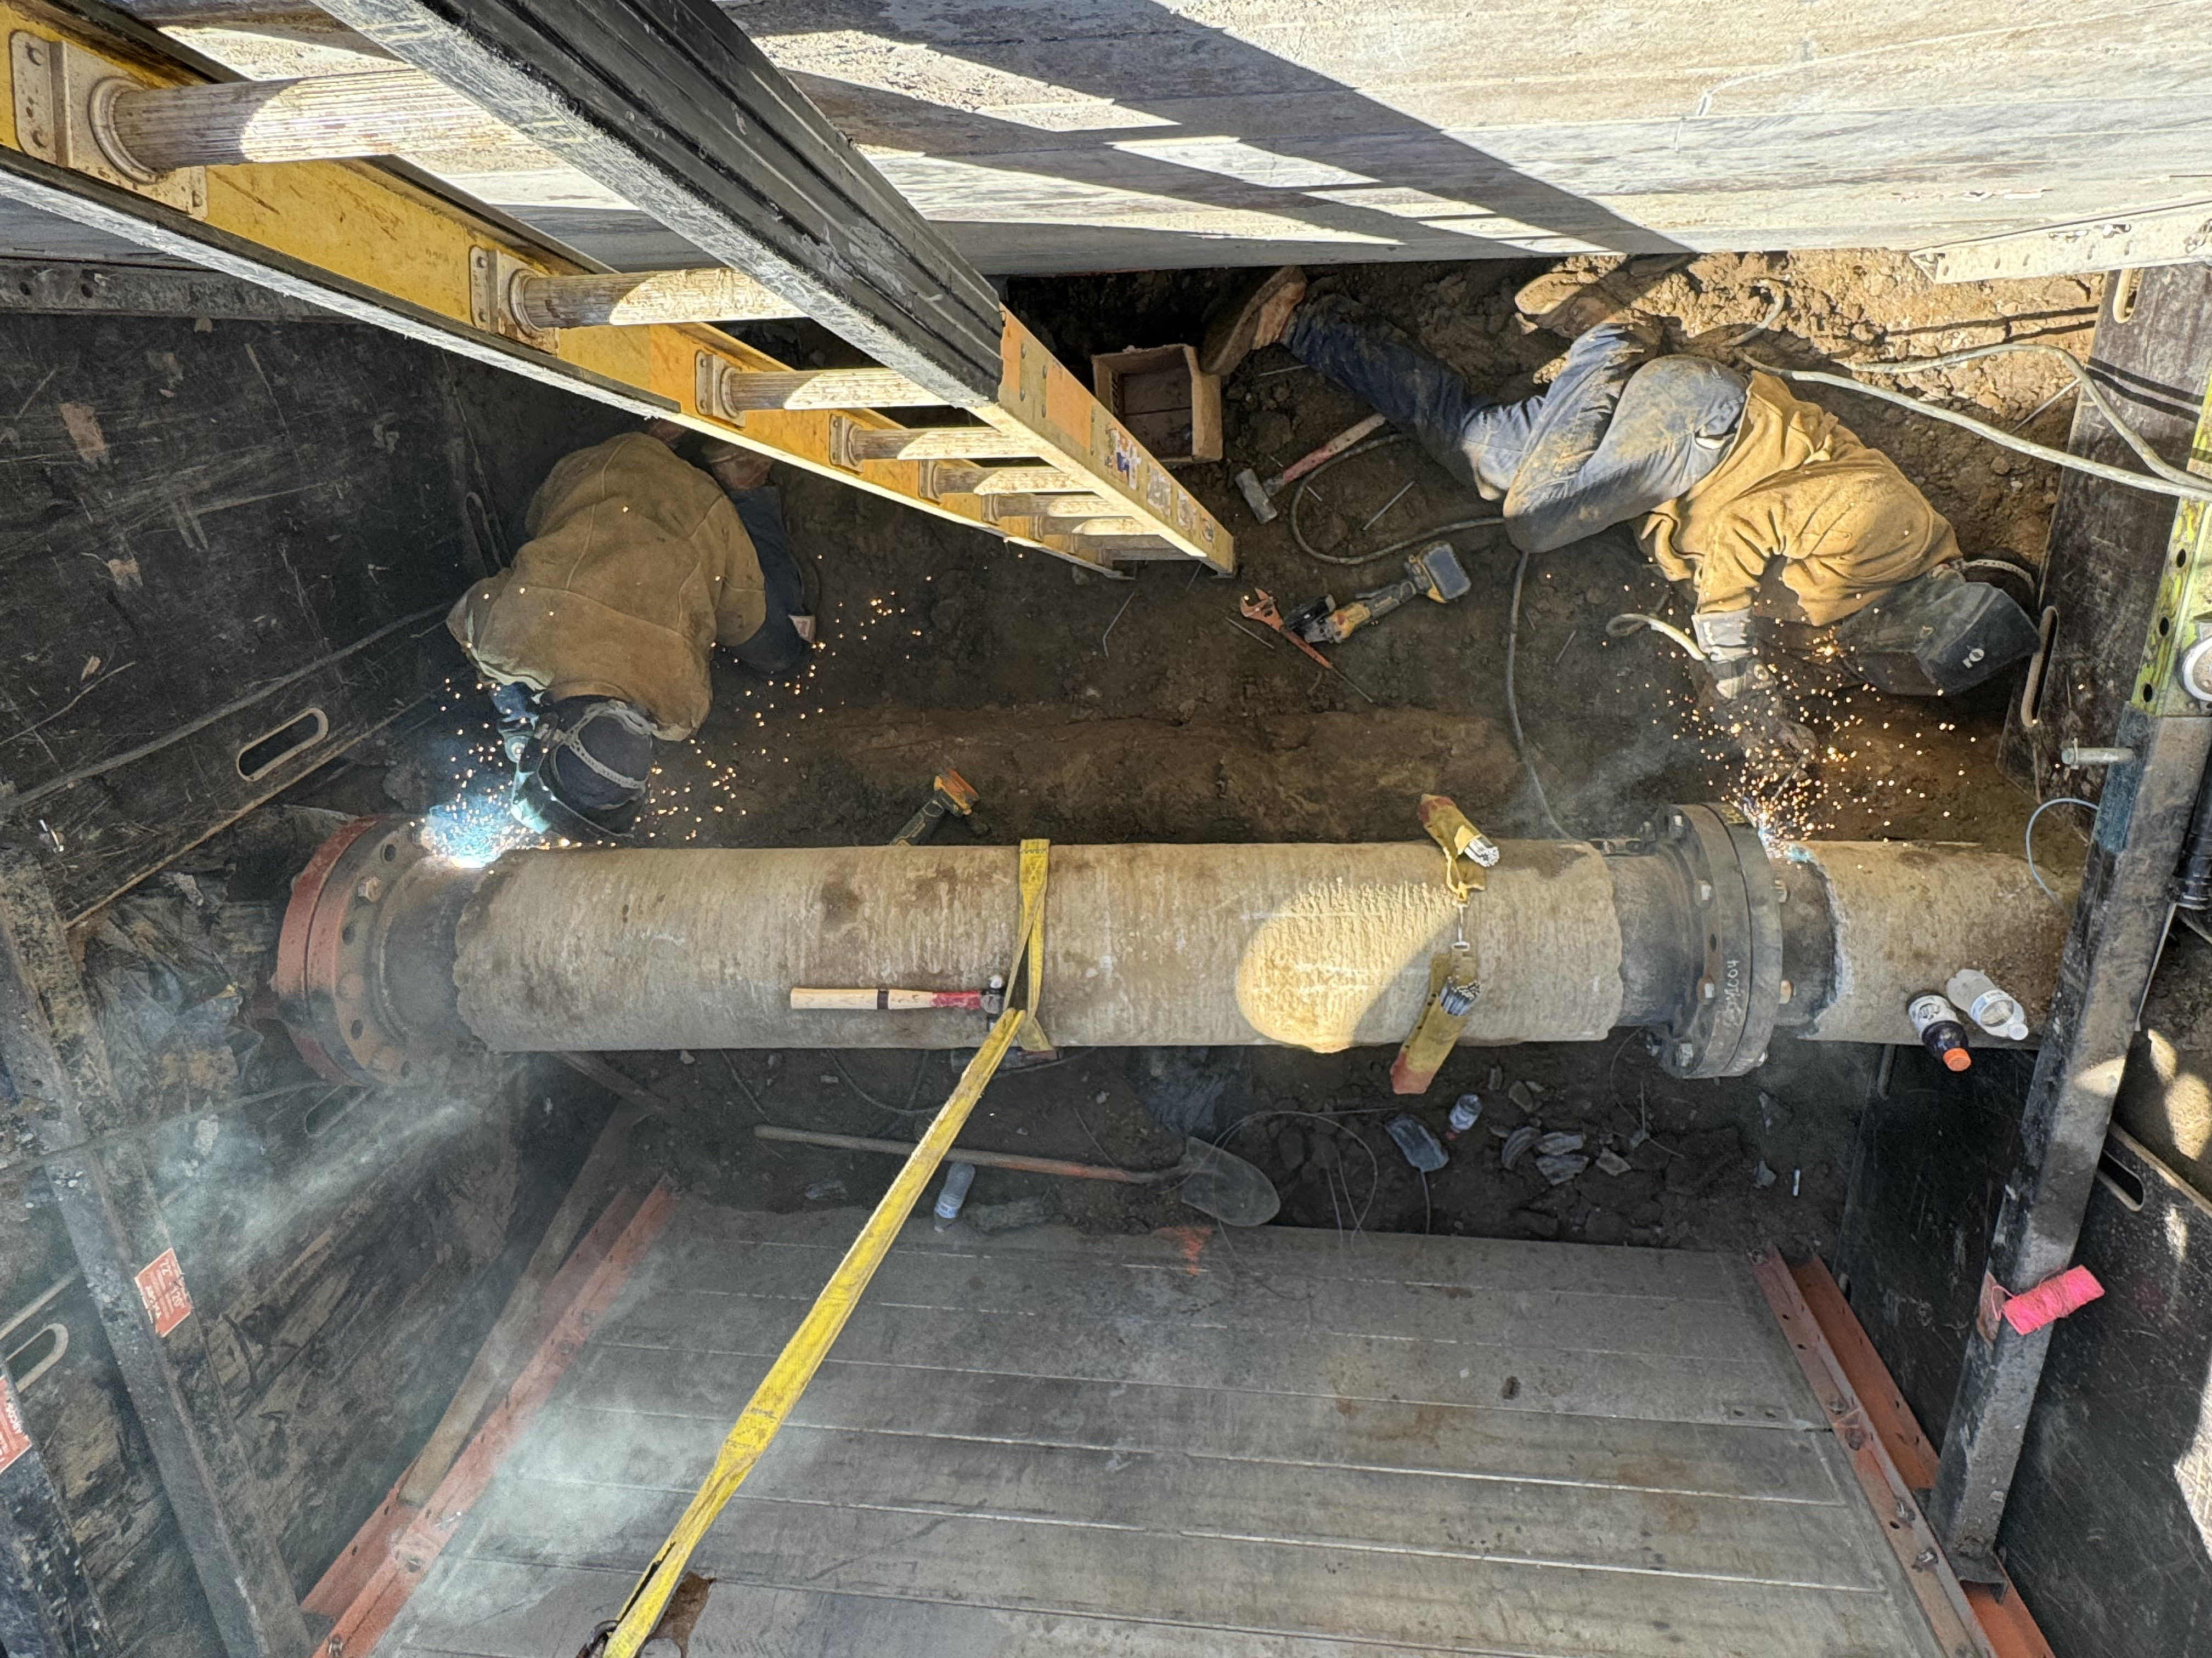
10/21 Tie-in Westside (2 working days)

Slide 10
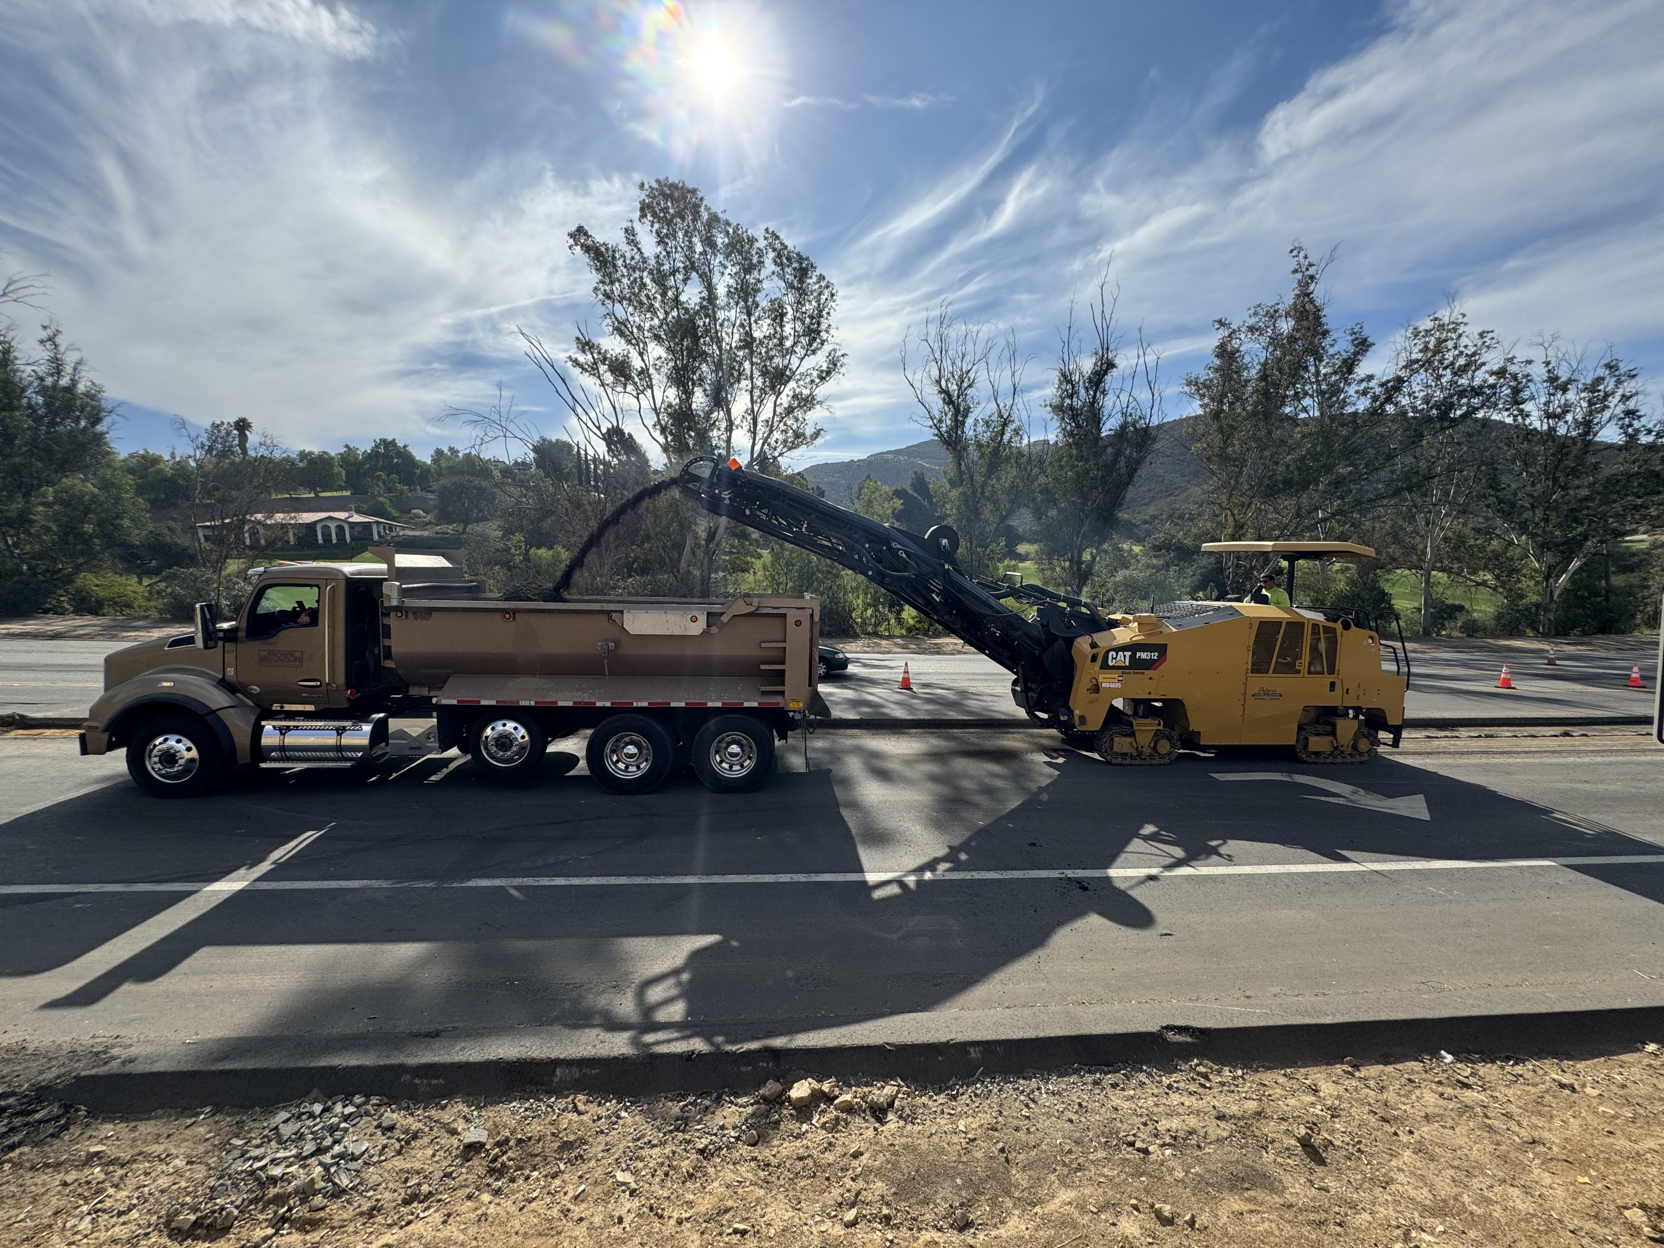
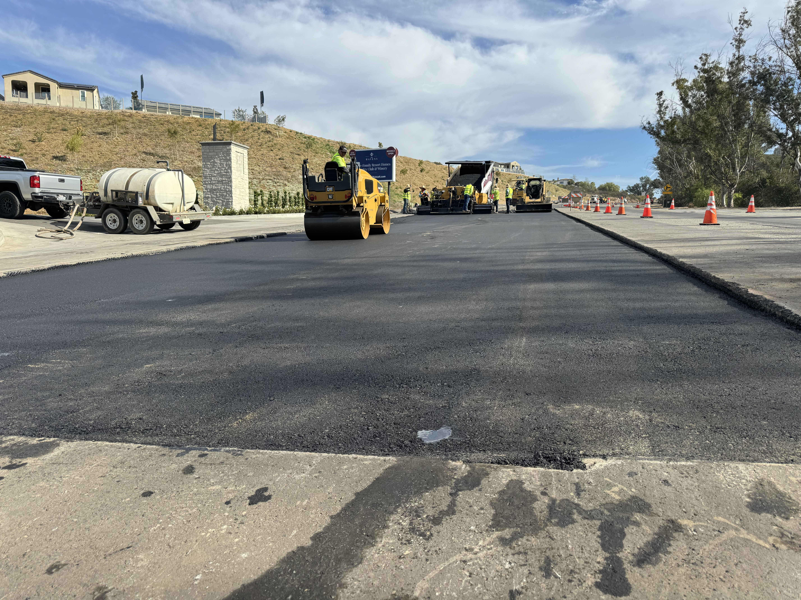
Paving Completed 12/3

Slide 11
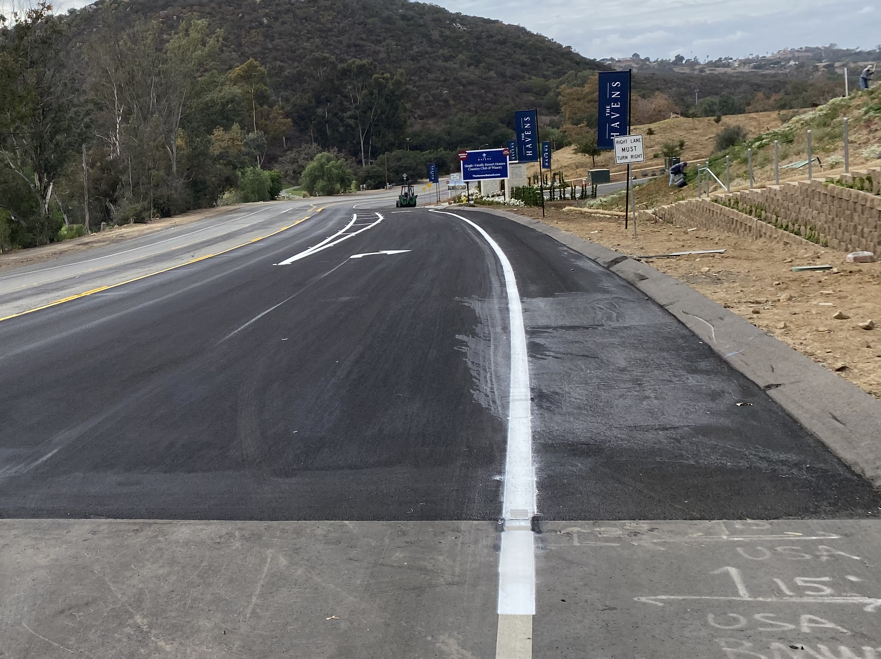
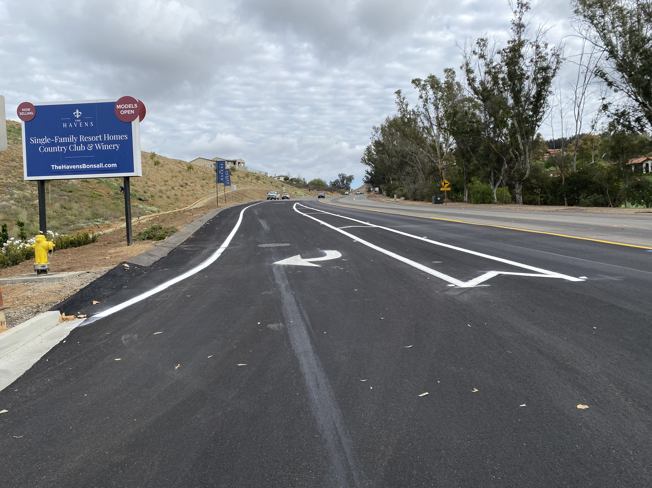
Slurry and Striping 12/10 – 12/12

Slide 12
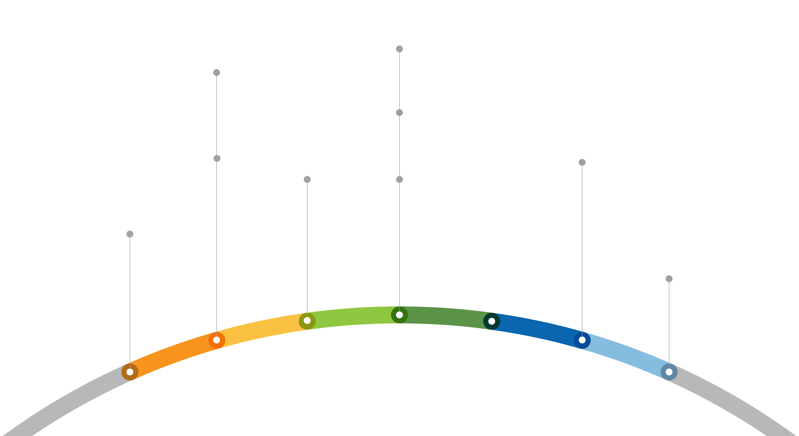

Project Timeline
Oct 3
Finished Pipe Installation
August 6
Presented to E&O Committee
October 14
Tie in East
August 27
Board Approved
December 2024
Paving
Sept 30
Started Pipe Installation
October 21
Tie in West
July 26
Main Break
2025

Slide 13
Cost Summary
$97,500 Paving
$74,565 RMWD Labor
$63,738 Pipe & Parts
$19,207 Equip. Rental
$10,301 Traffic Control
$9,276 Backfill Material
$274,587 Total Project Cost

Slide 14
Questions?

