Slide 1

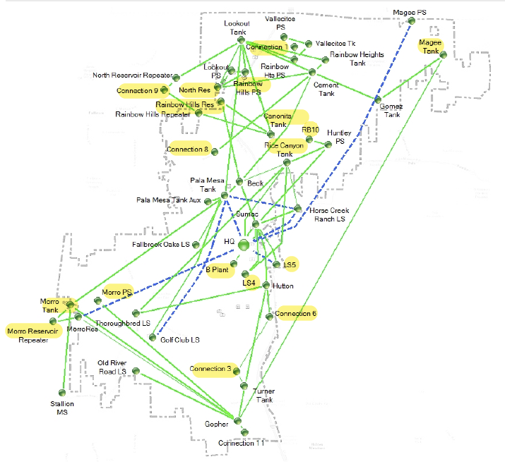
DISTRICTWIDE SCADA UPGRADES
DISTRICT PROJECT NO. 600019

