Slide 1
Pump Station Commissioning Progress Update
E&O Committee - November 5, 2024

Slide 2
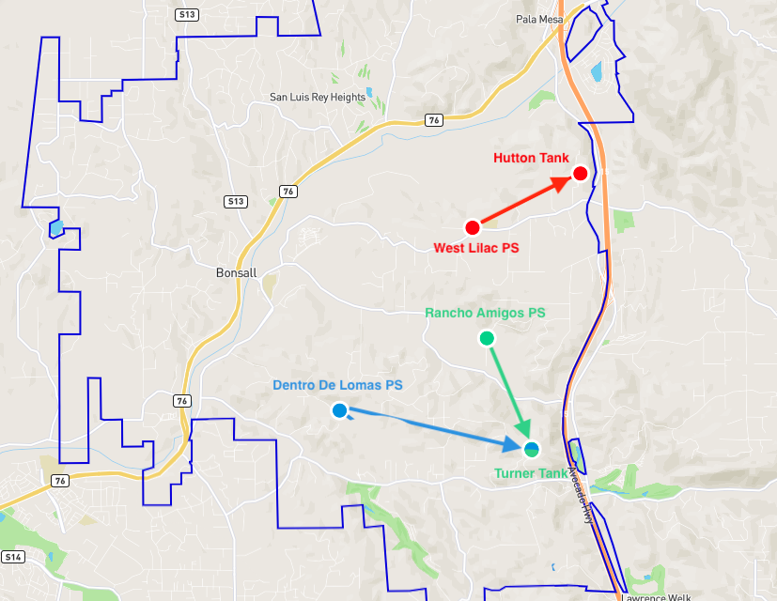
Pump Stations Commissioning
Pump Station to Tank Flow
Power Startup
Station Testing:
  Valves
  Pumps
  Electrical
  SCADA
  Communications
  Generator testing

Slide 3
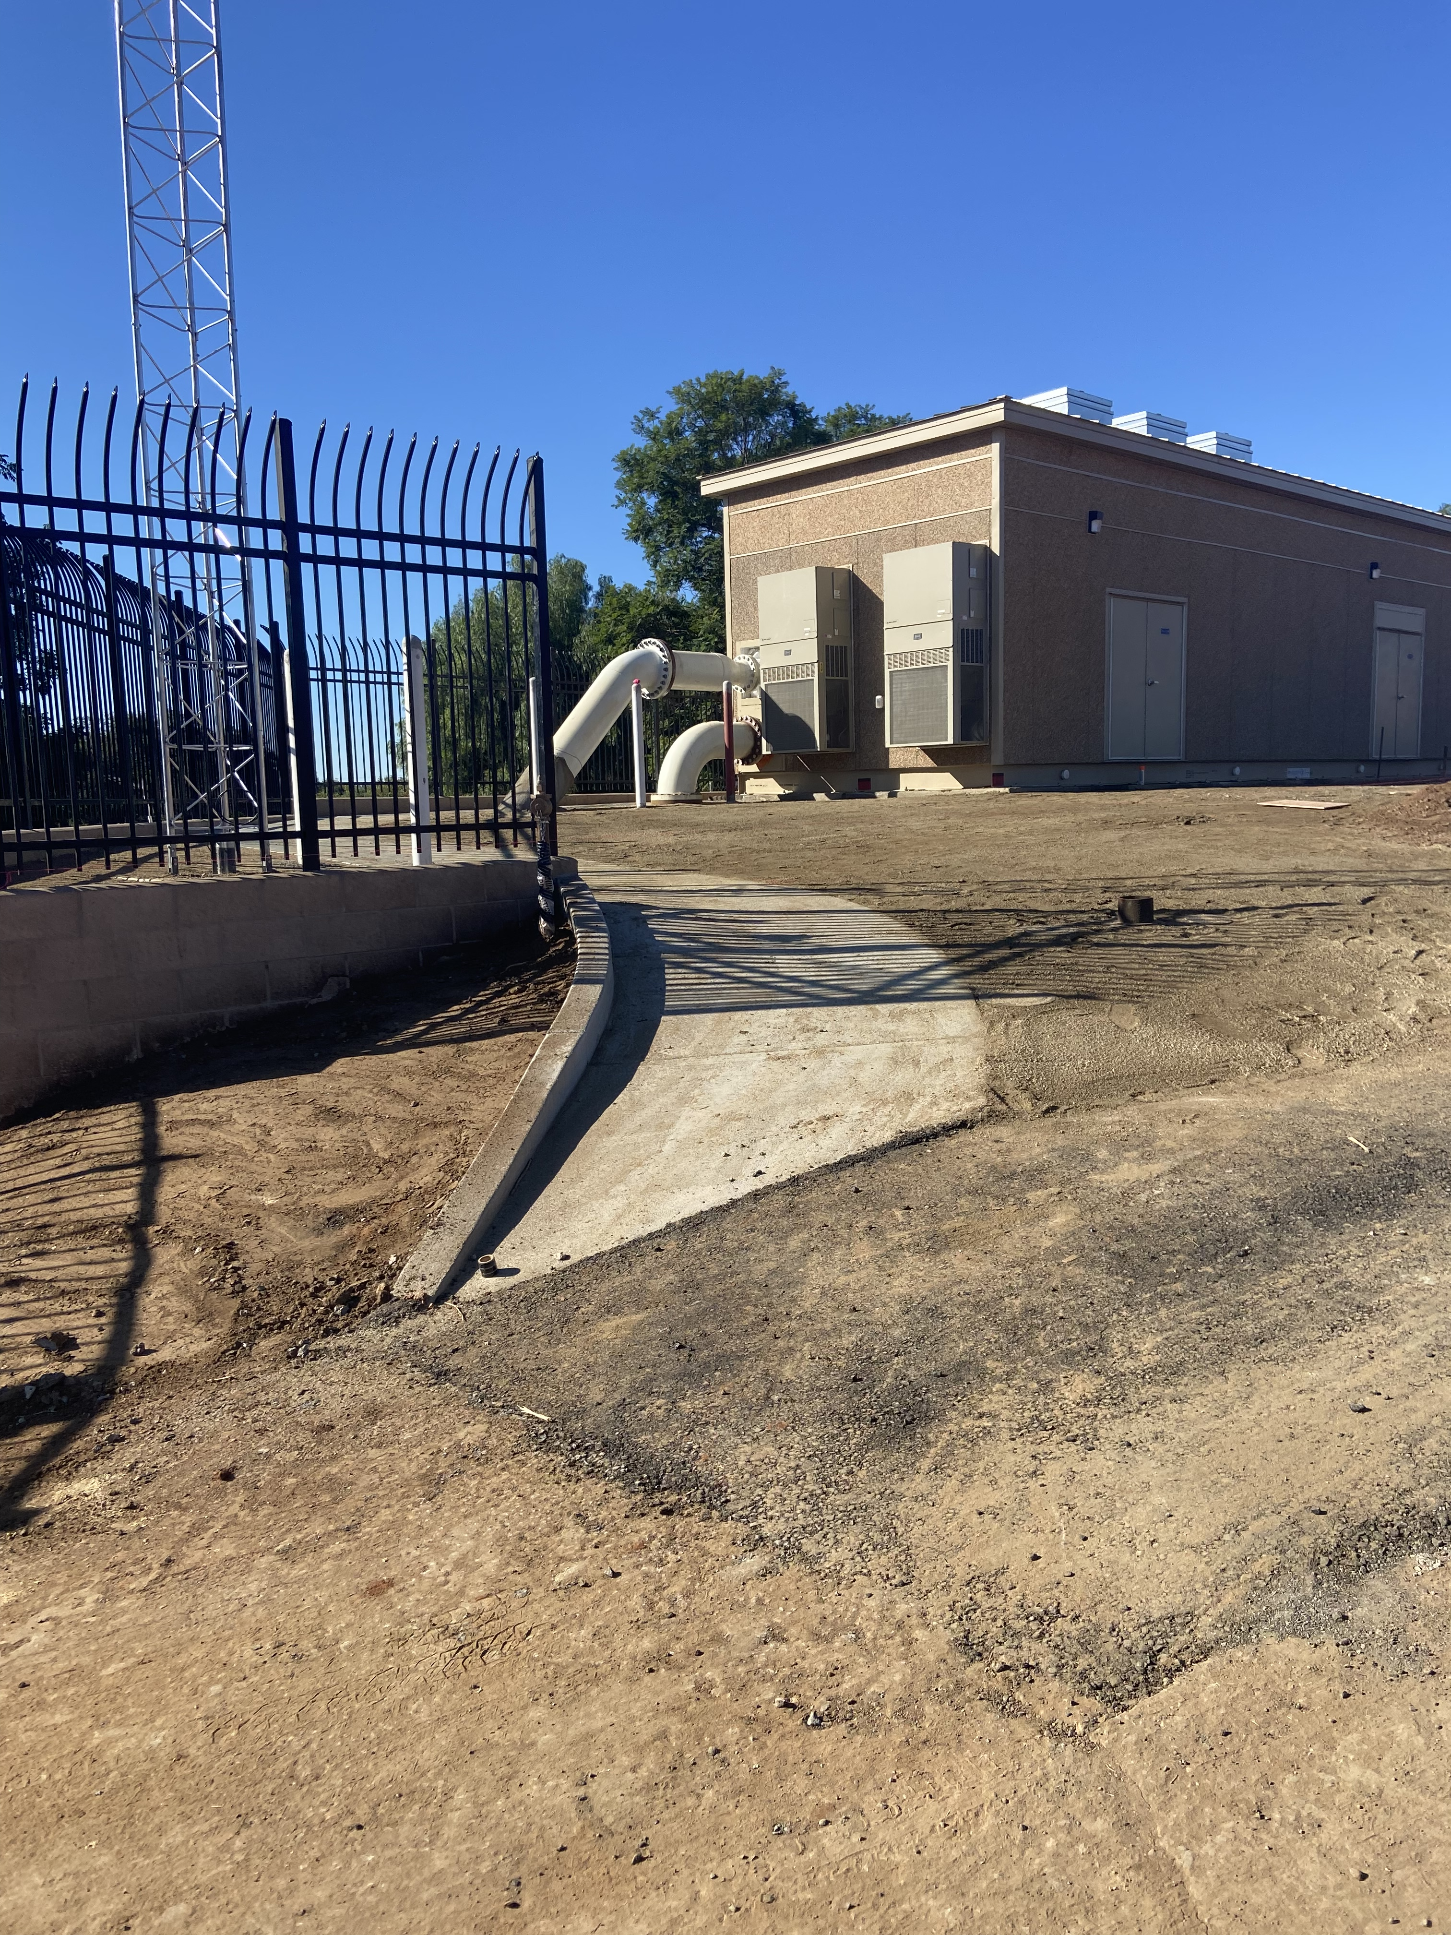
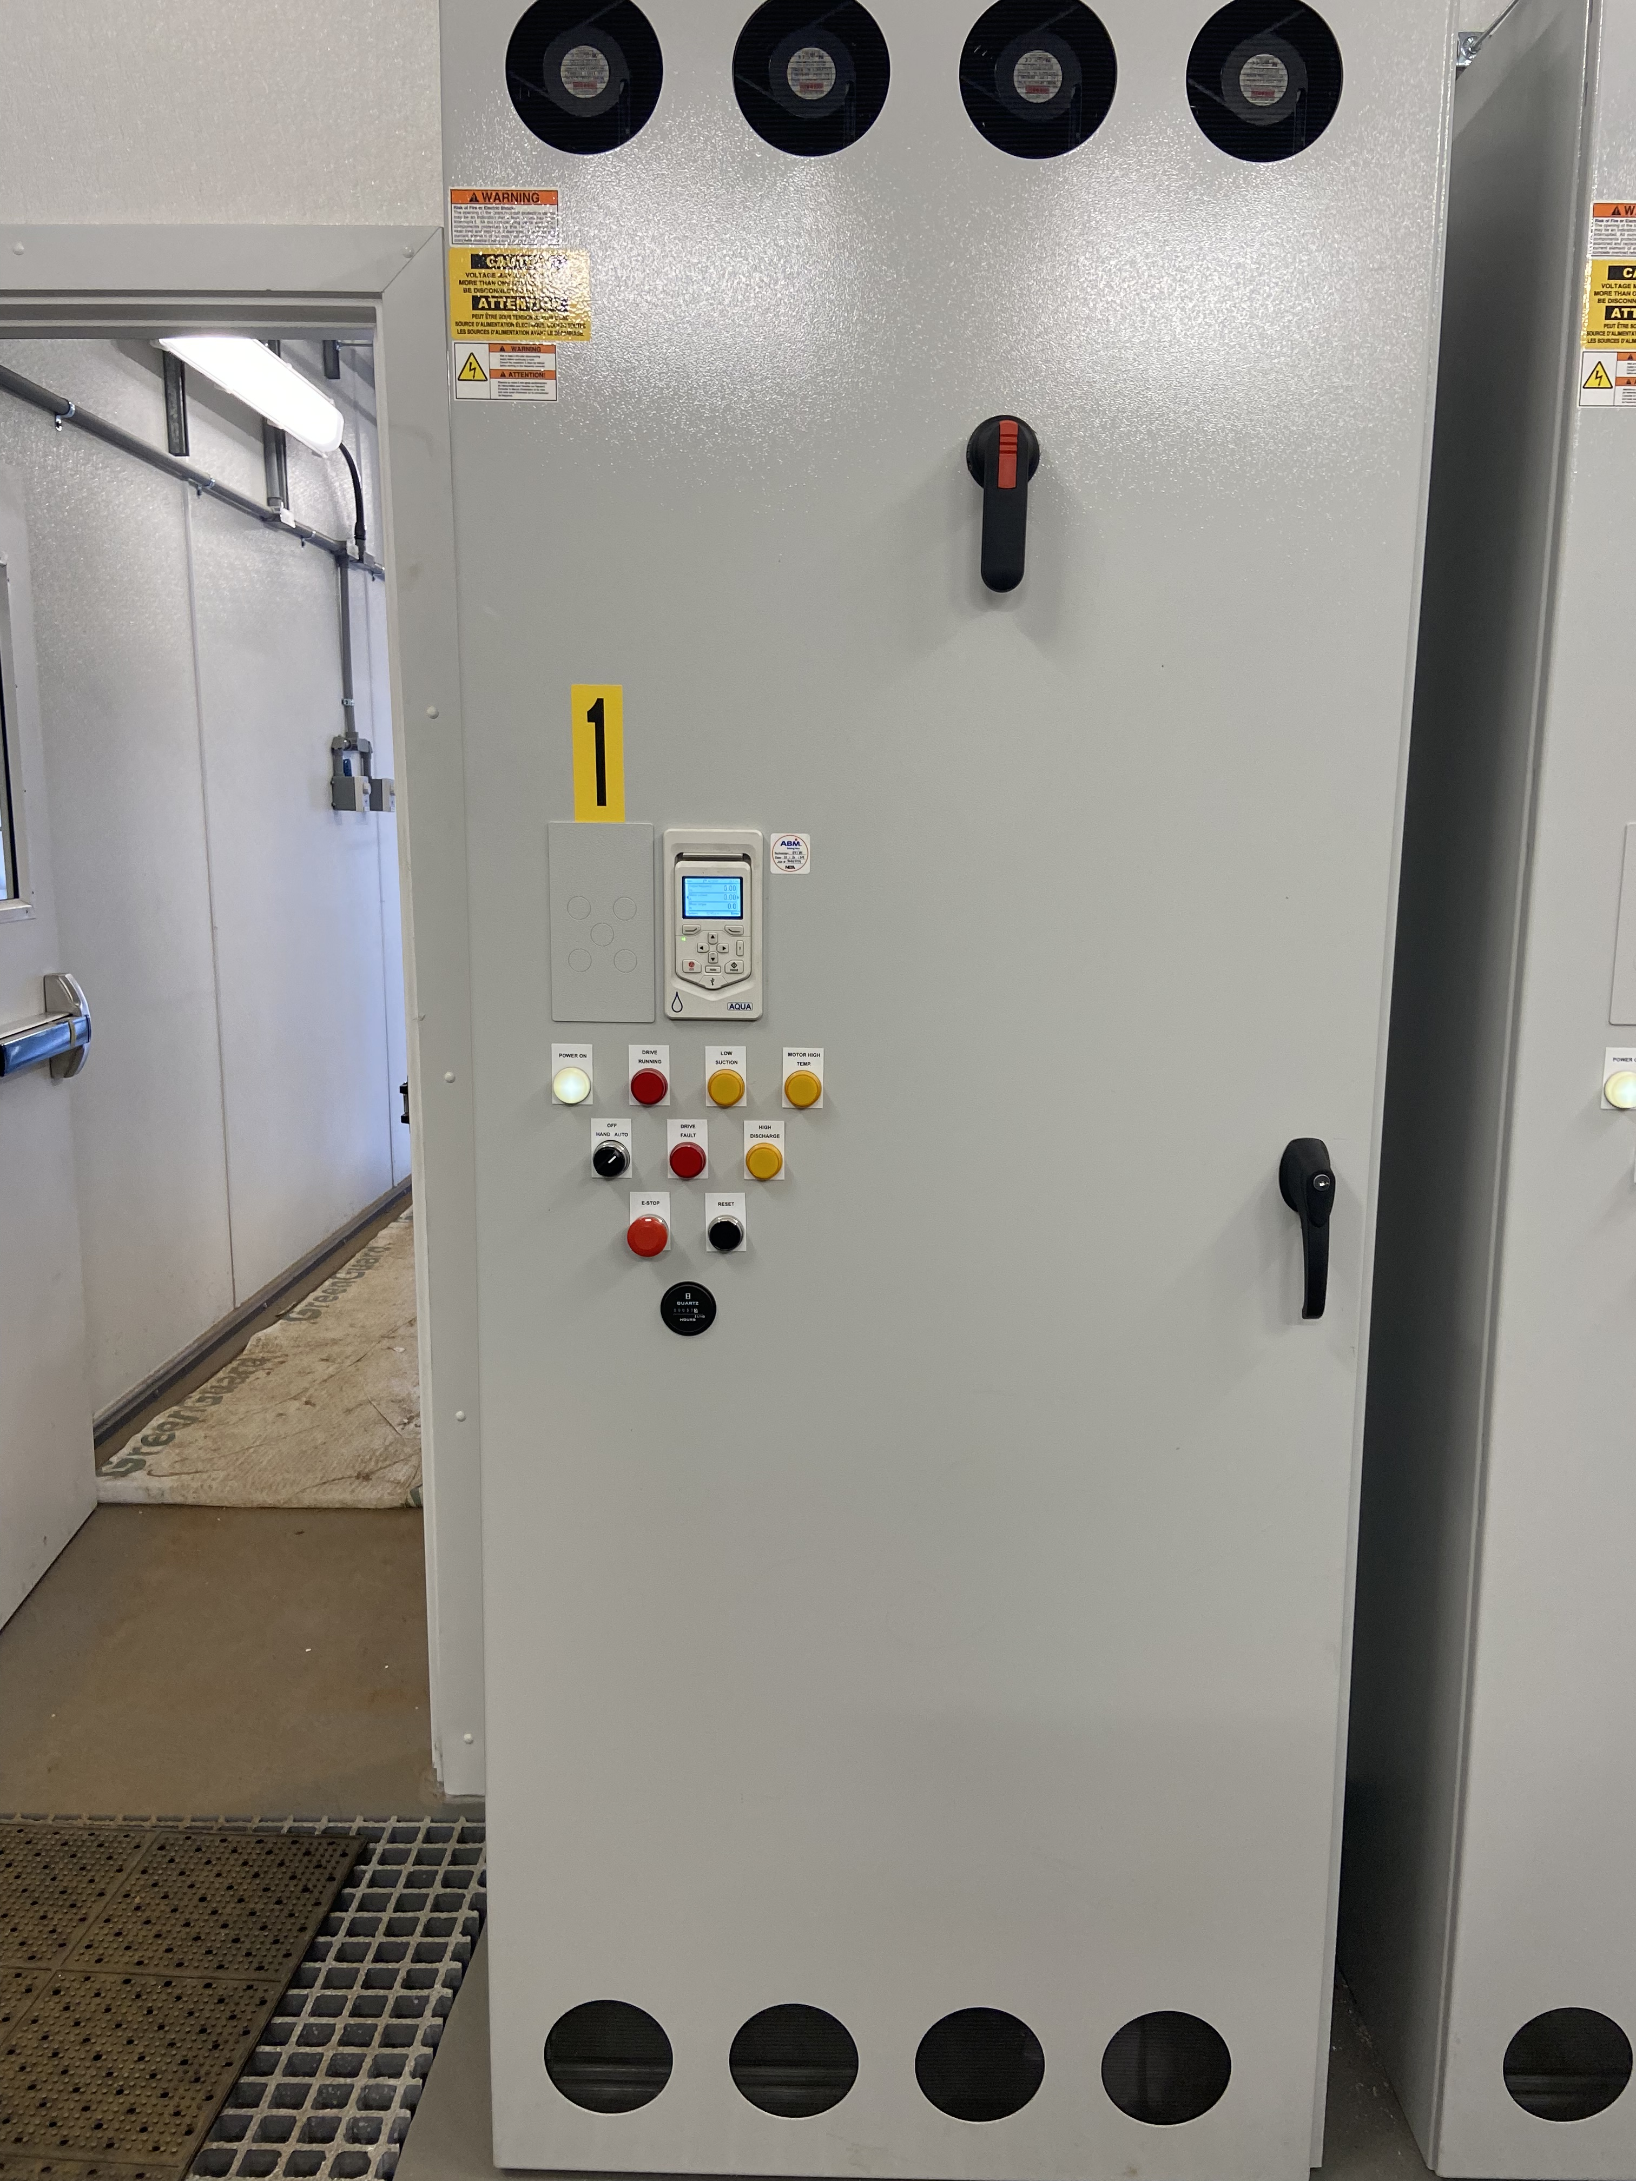
Pump Stations Commissioning (West Lilac)

Slide 4
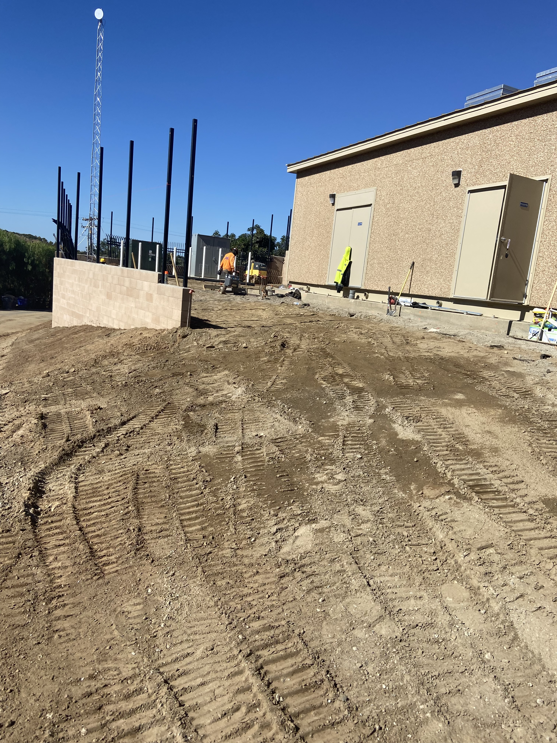
Pump Stations Commissioning (Dentro De Lomas)

Slide 5
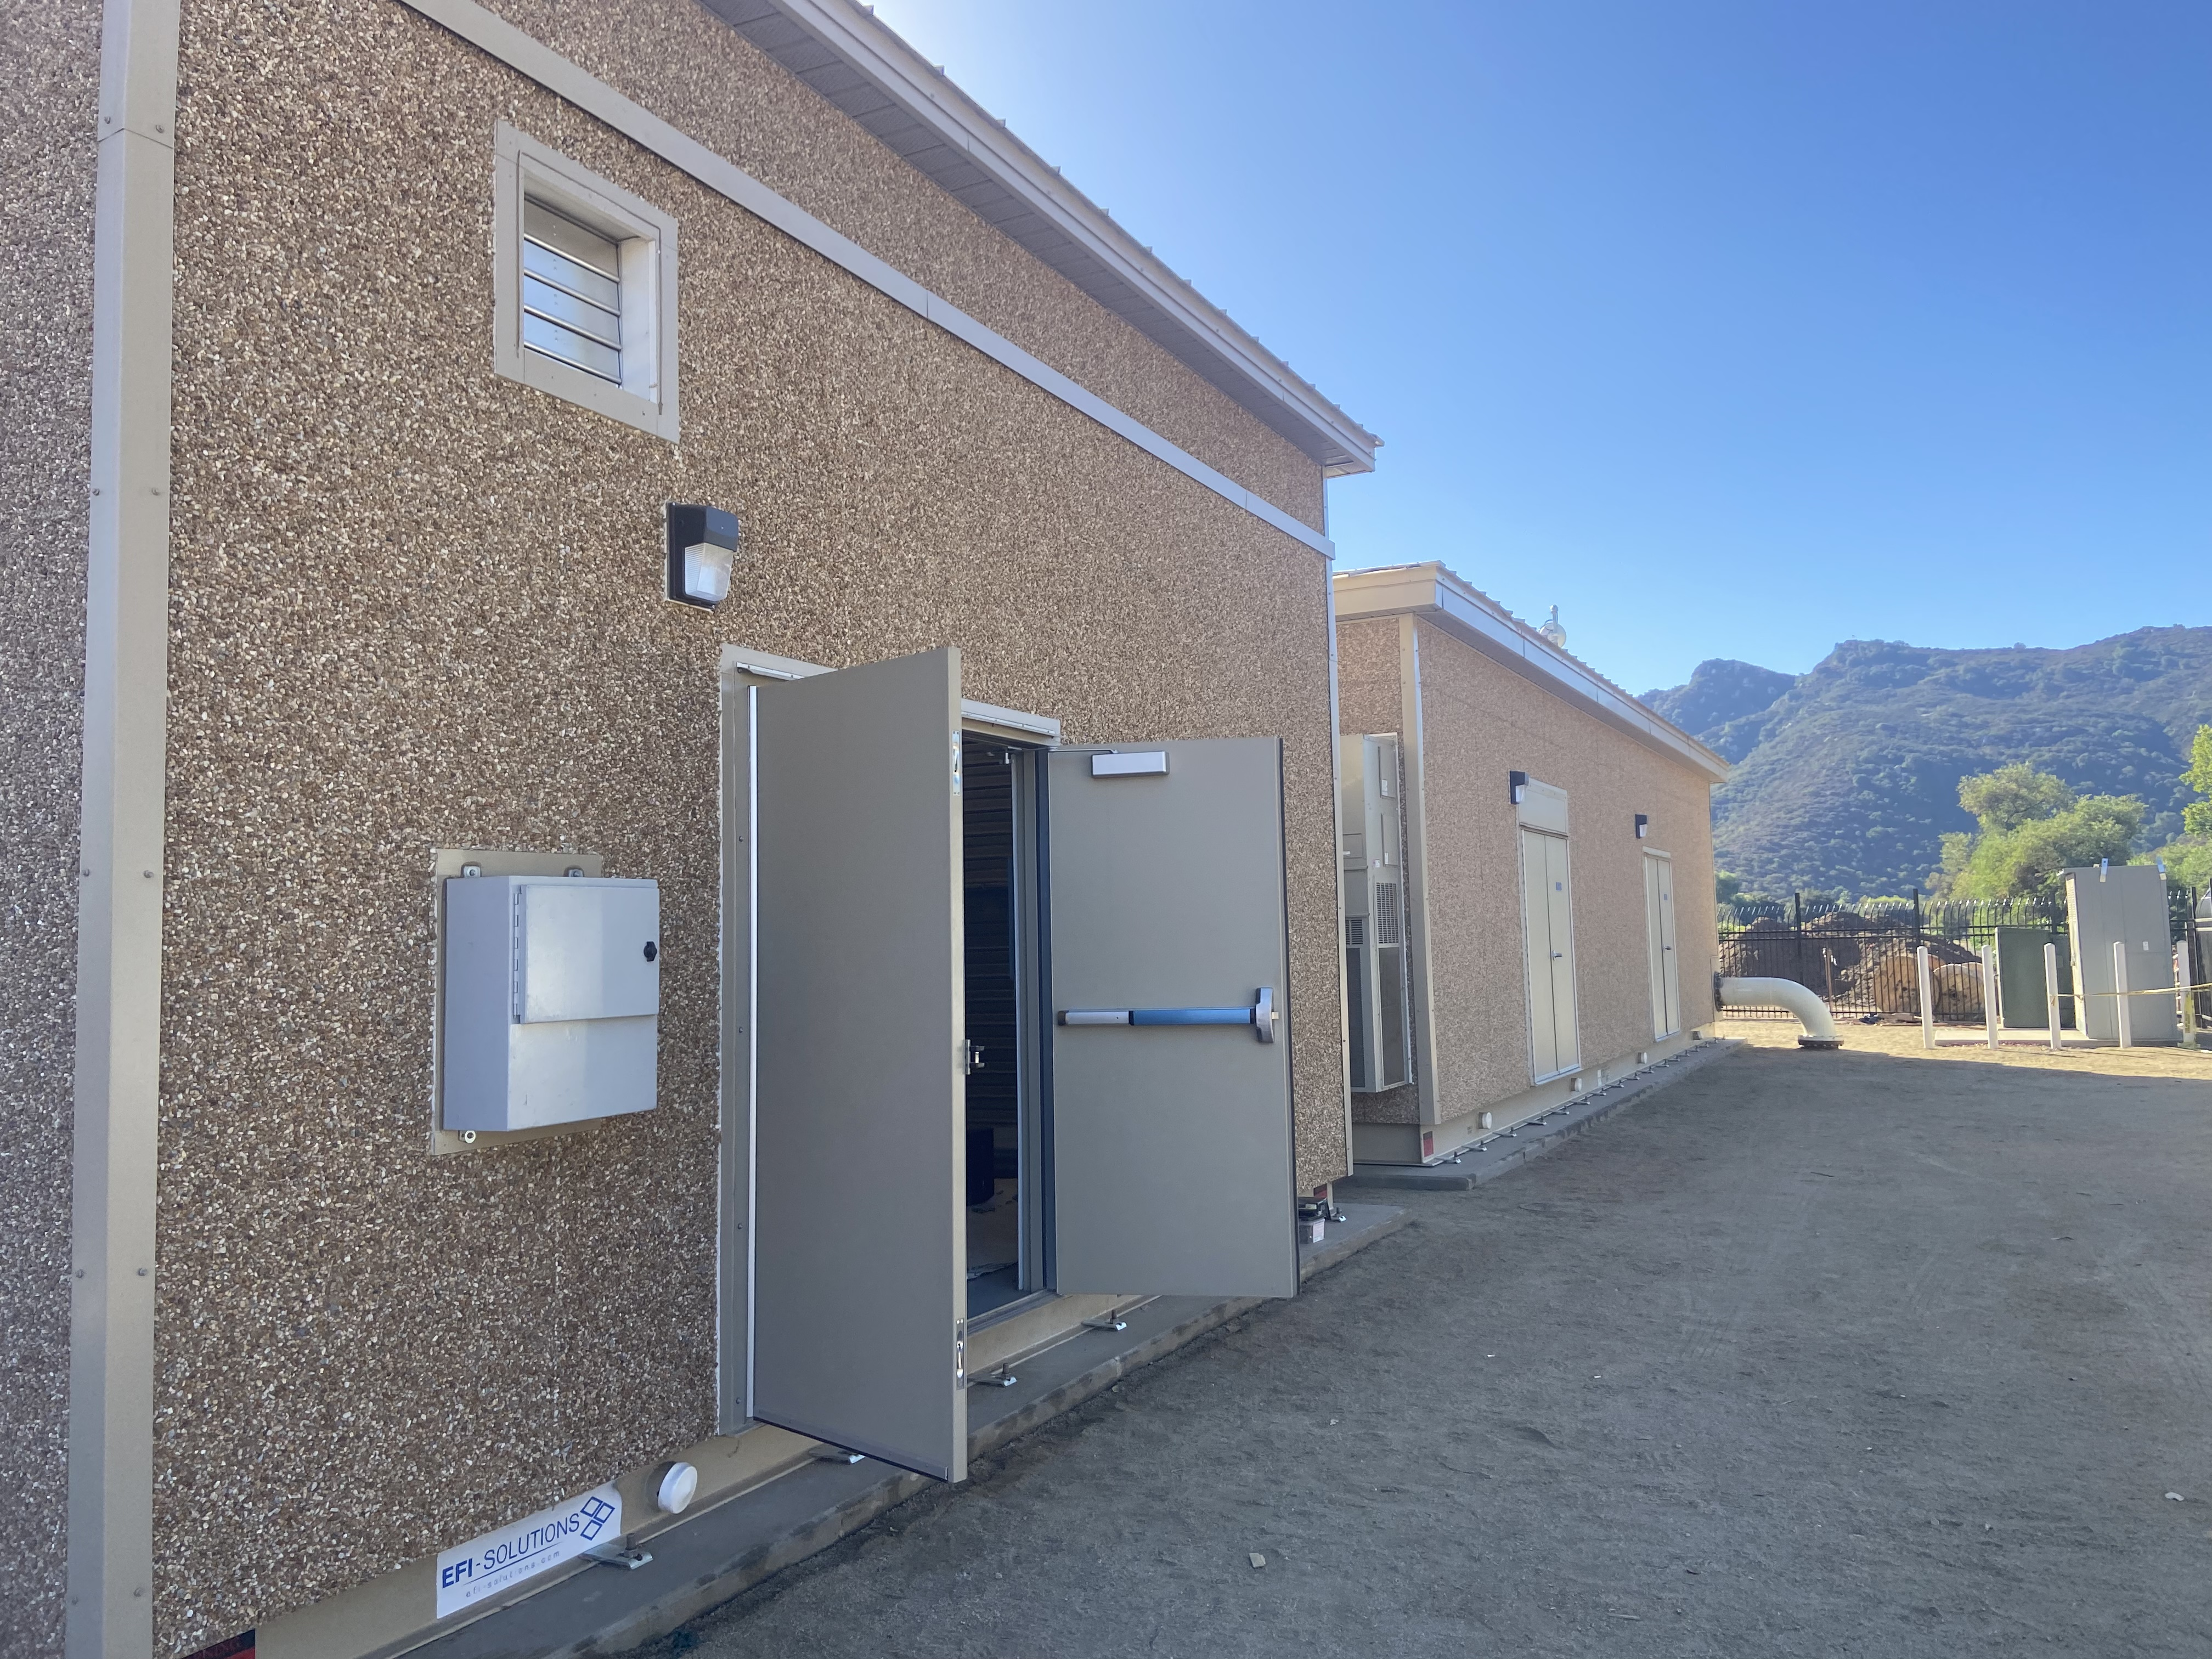
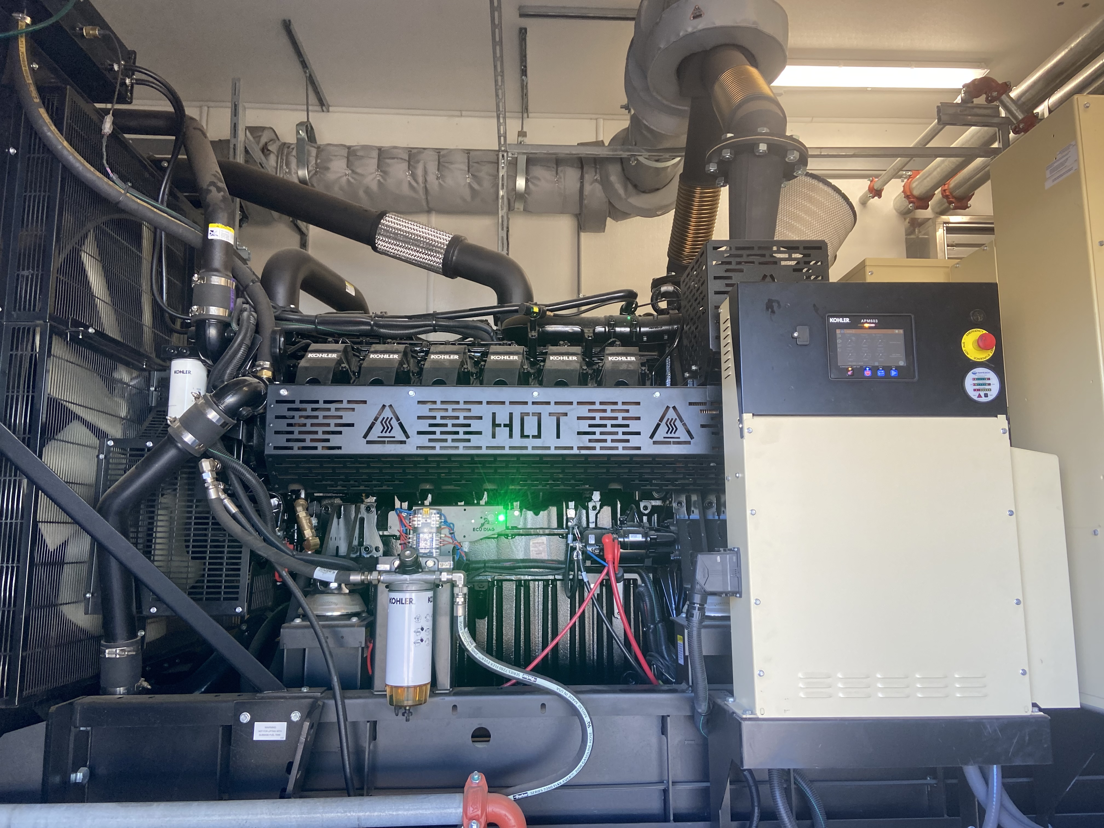
Pump Stations Commissioning (Rancho Amigos)

Slide 6
Pump Stations Capacity Testing
Pump Station Designed flow Specifications were met at each station with only 2 out of 3 Pumps.
Suction/Discharge Pressure.
No main breaks due to station operation testing.

Slide 7
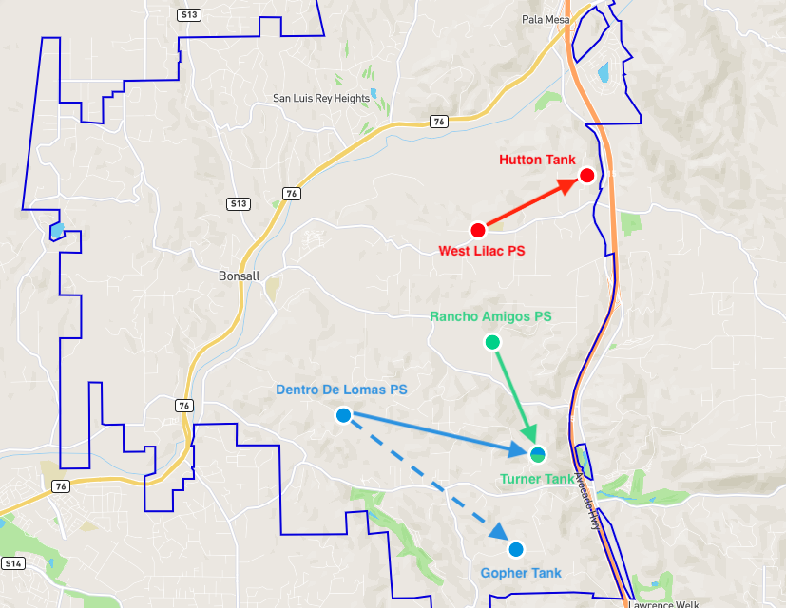
Operational Bonus
By manipulating the system valving, we were able to pump to the Gopher Tank via Dentro De Lomas PS.
The benefit of this is we can move water into our most southern tank.

Slide 8
System Online & Operational
The system was online one week before the deadline.
The implementation of the new pump stations introduced unique challenges, each of which we successfully resolved.
System operators are currently running the stations learning and developing ideal pumping strategies.

Slide 9
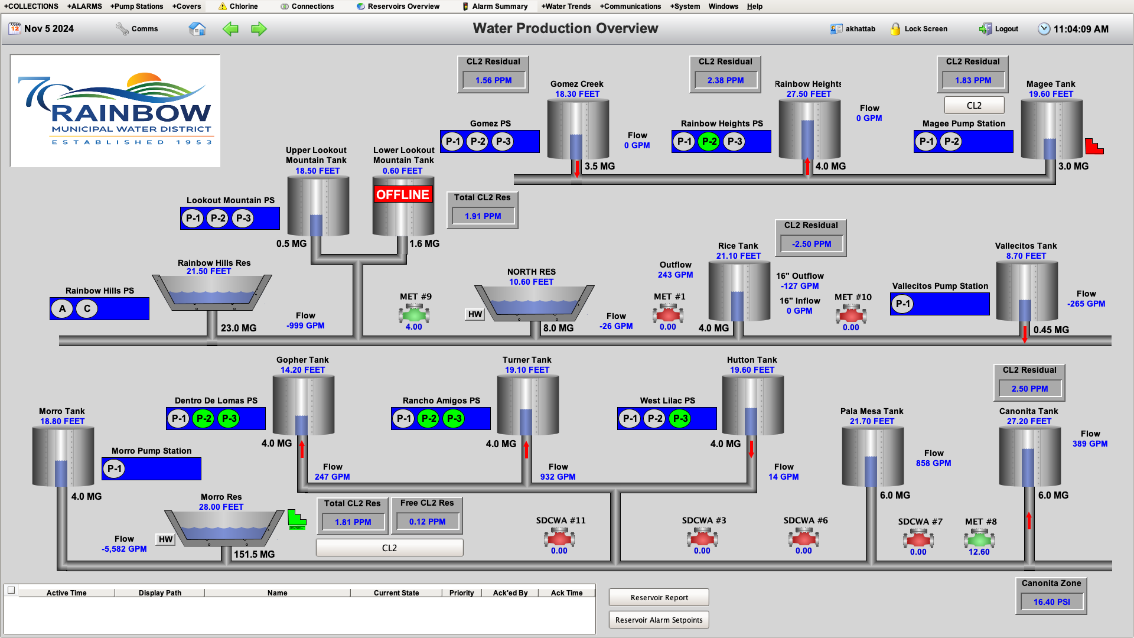

Slide 10
Questions?

