Slide 1
Gopher Canyon Emergency Pipe Project Update
Esa Lagunas: 11/5/2024

Slide 2
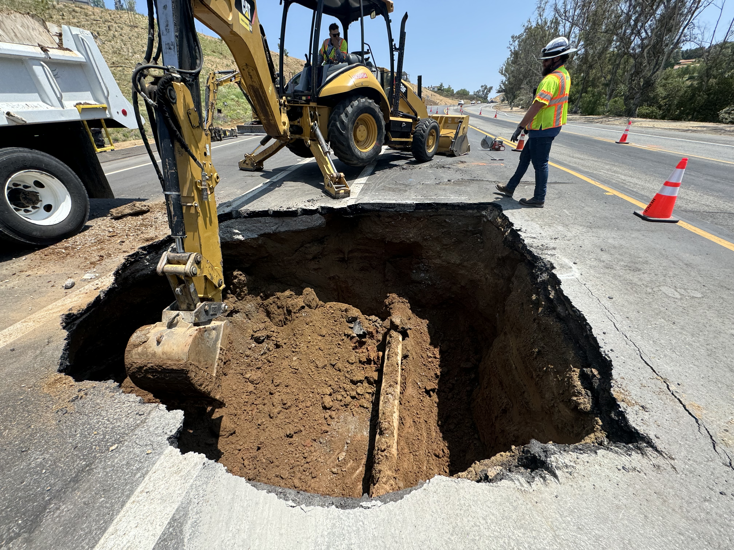
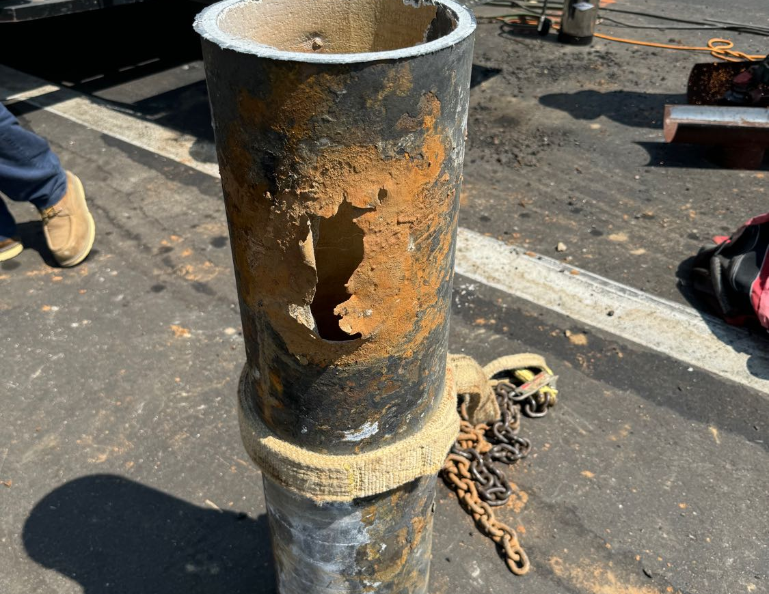
Background
7/26 Main break
8/6 Presented to E&O

Slide 3
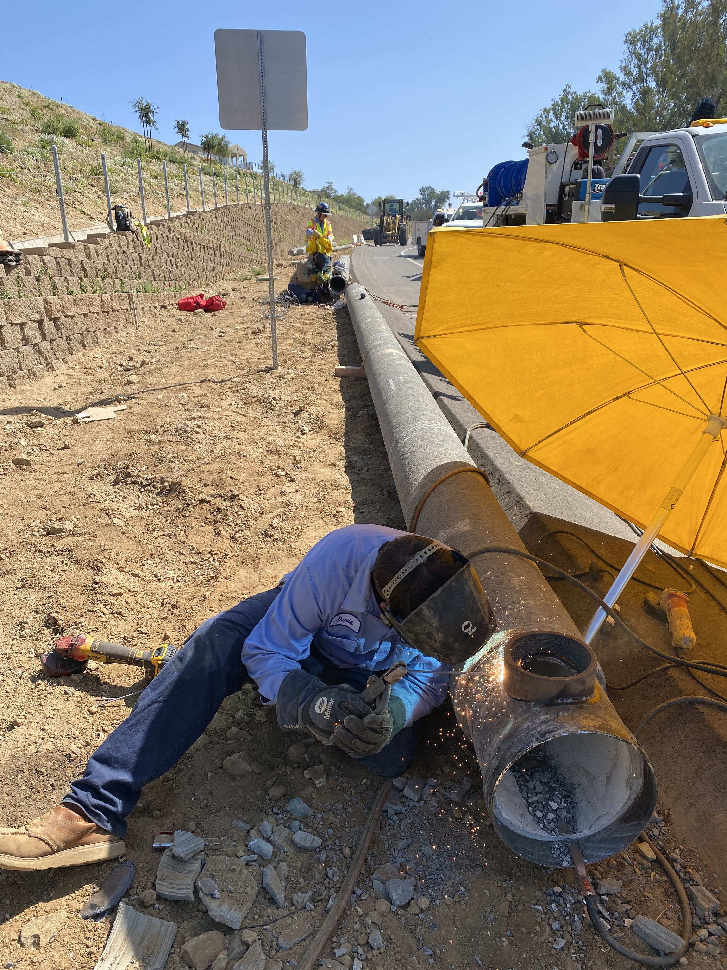
Background
8/27 Board approved $400K
  Emergency Paving
  Emergency Pipe Project
  Ordered pipe and fittings
9/26 Pipe Arrived

Slide 4
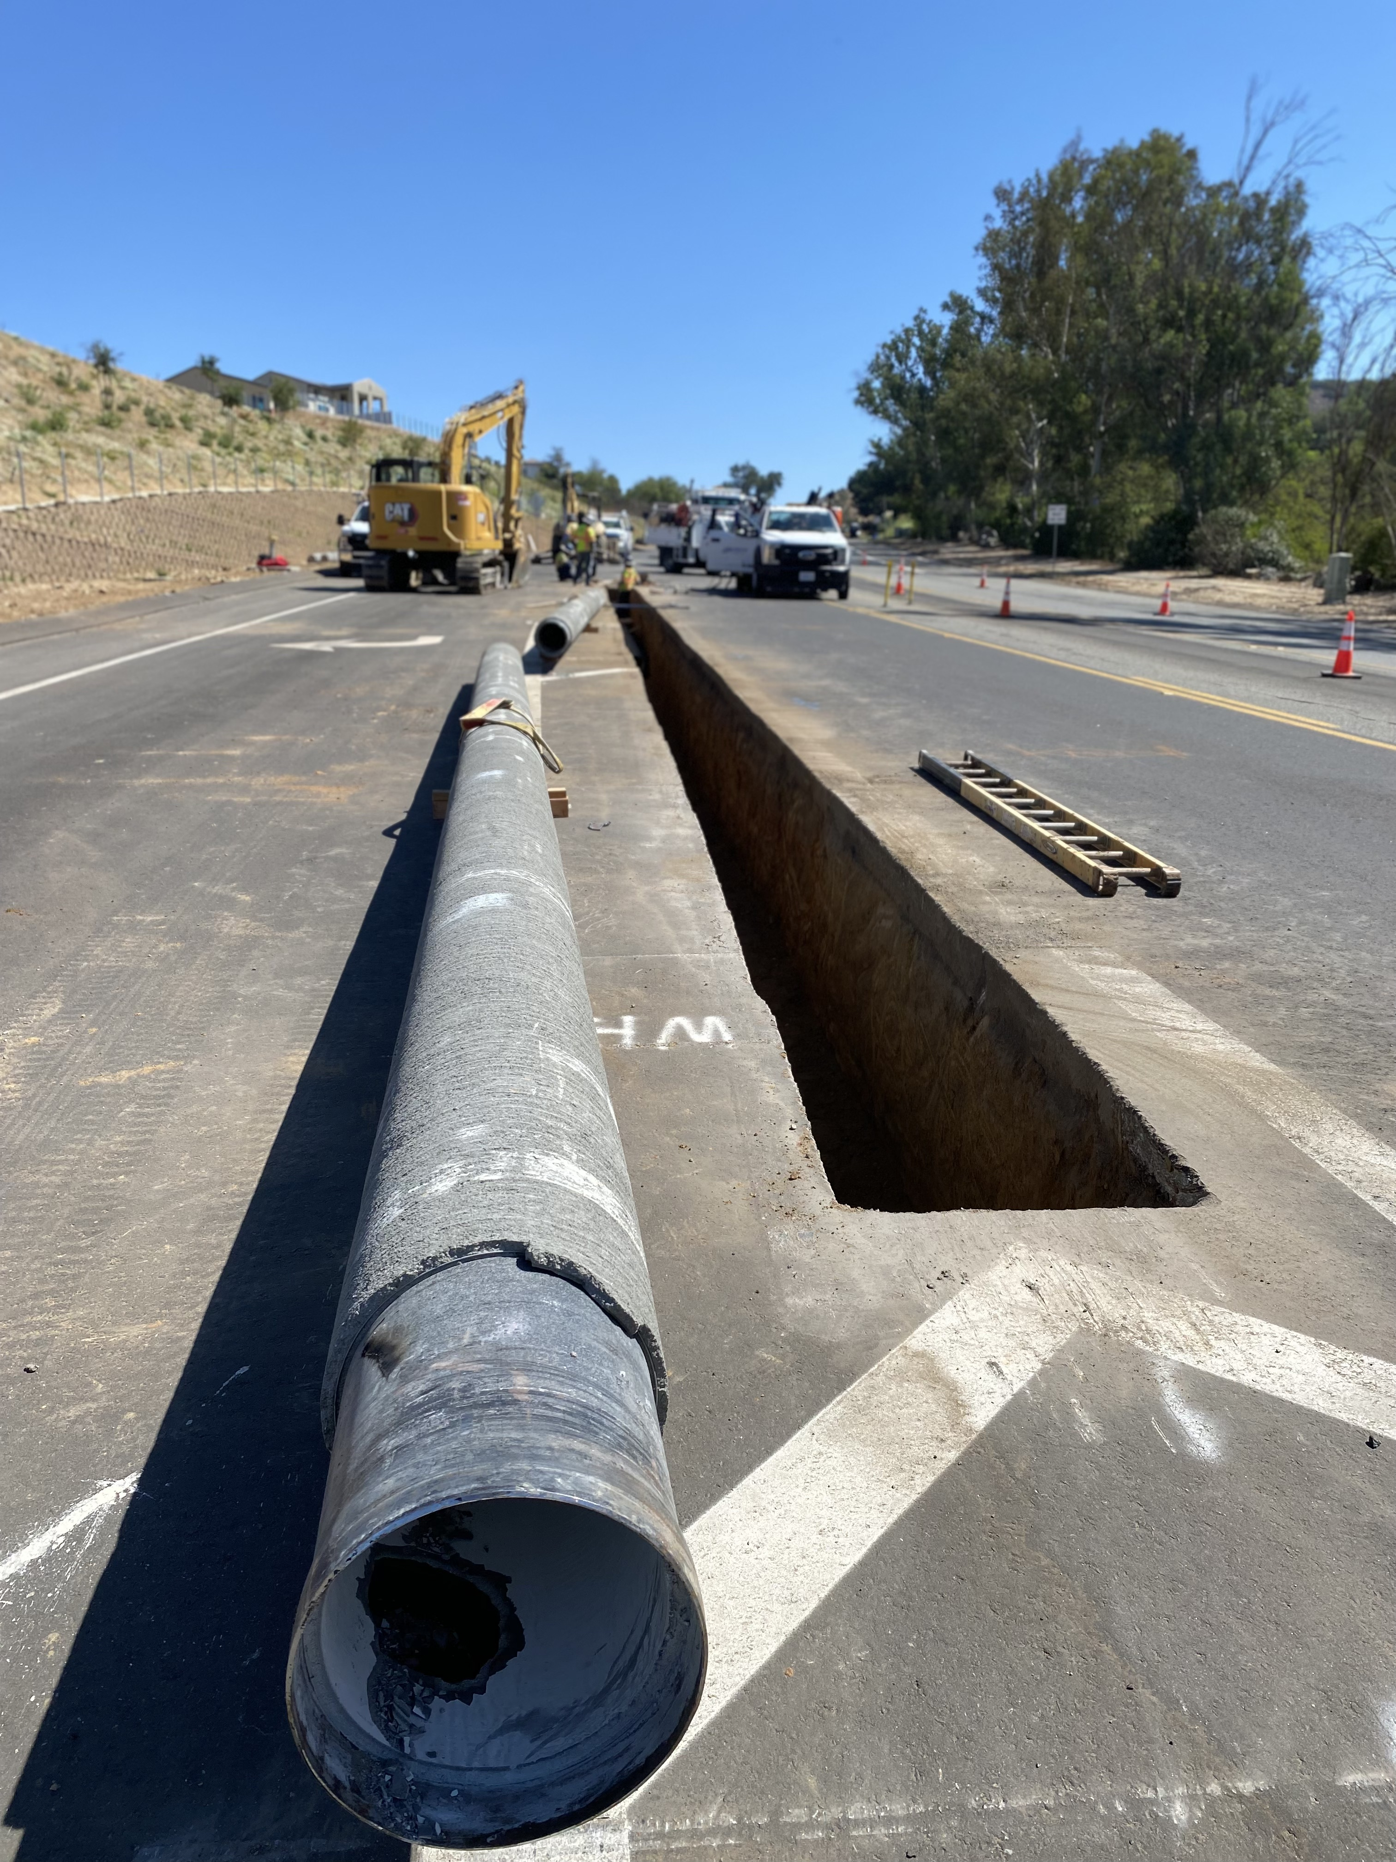
9/30 Started Installing Pipe
12-inch CML&C pipe
Upsizing from 8-inch
4 days to install 350-feet

Slide 5
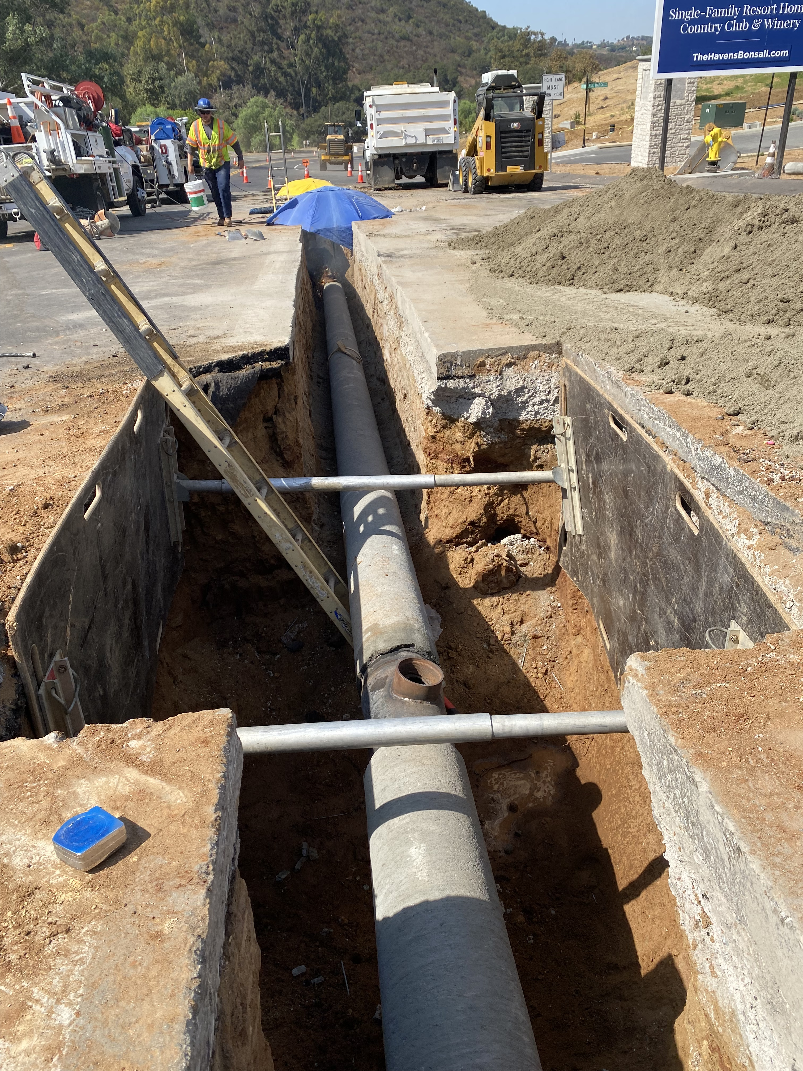
Update
10/3 Finished installing pipe
10/7 Pipe Testing (3 Days)
  Pressure testing
  High-Chlorine
  Flushing
  Bac-T samples

Slide 6
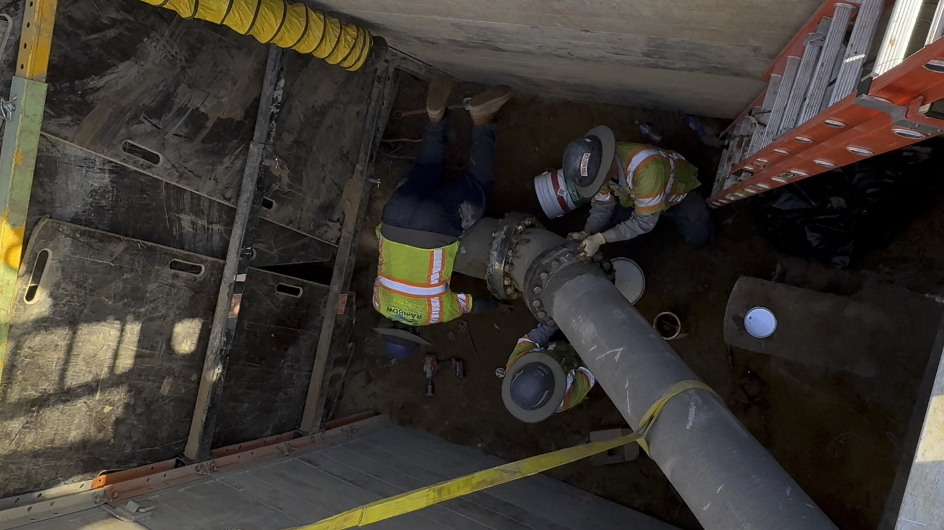
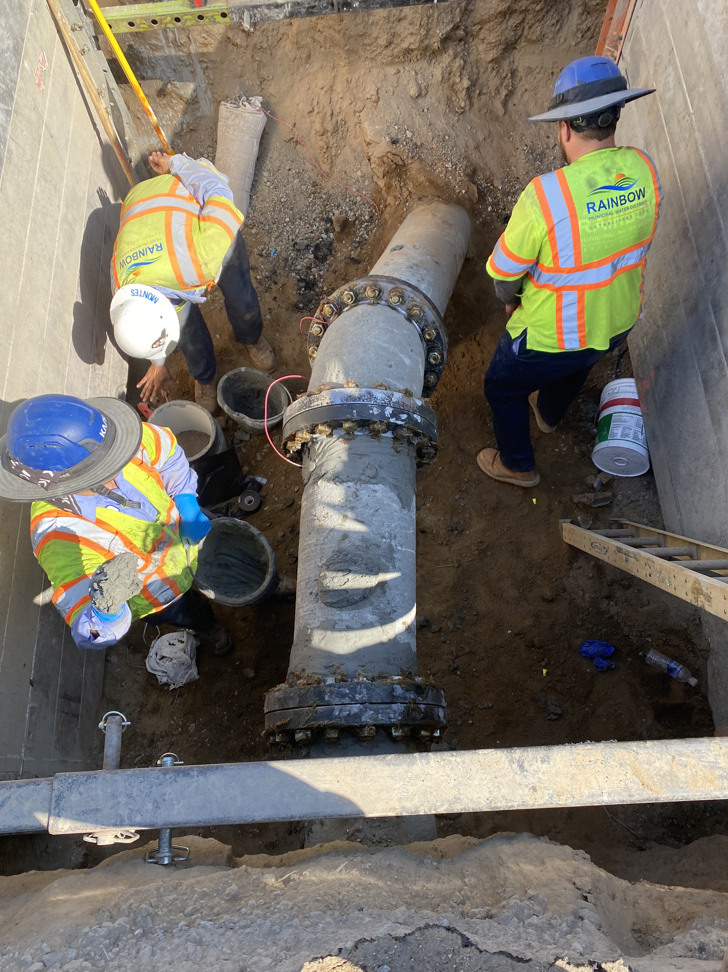
10/14 Tie-in Eastside (2 working days)

Slide 7
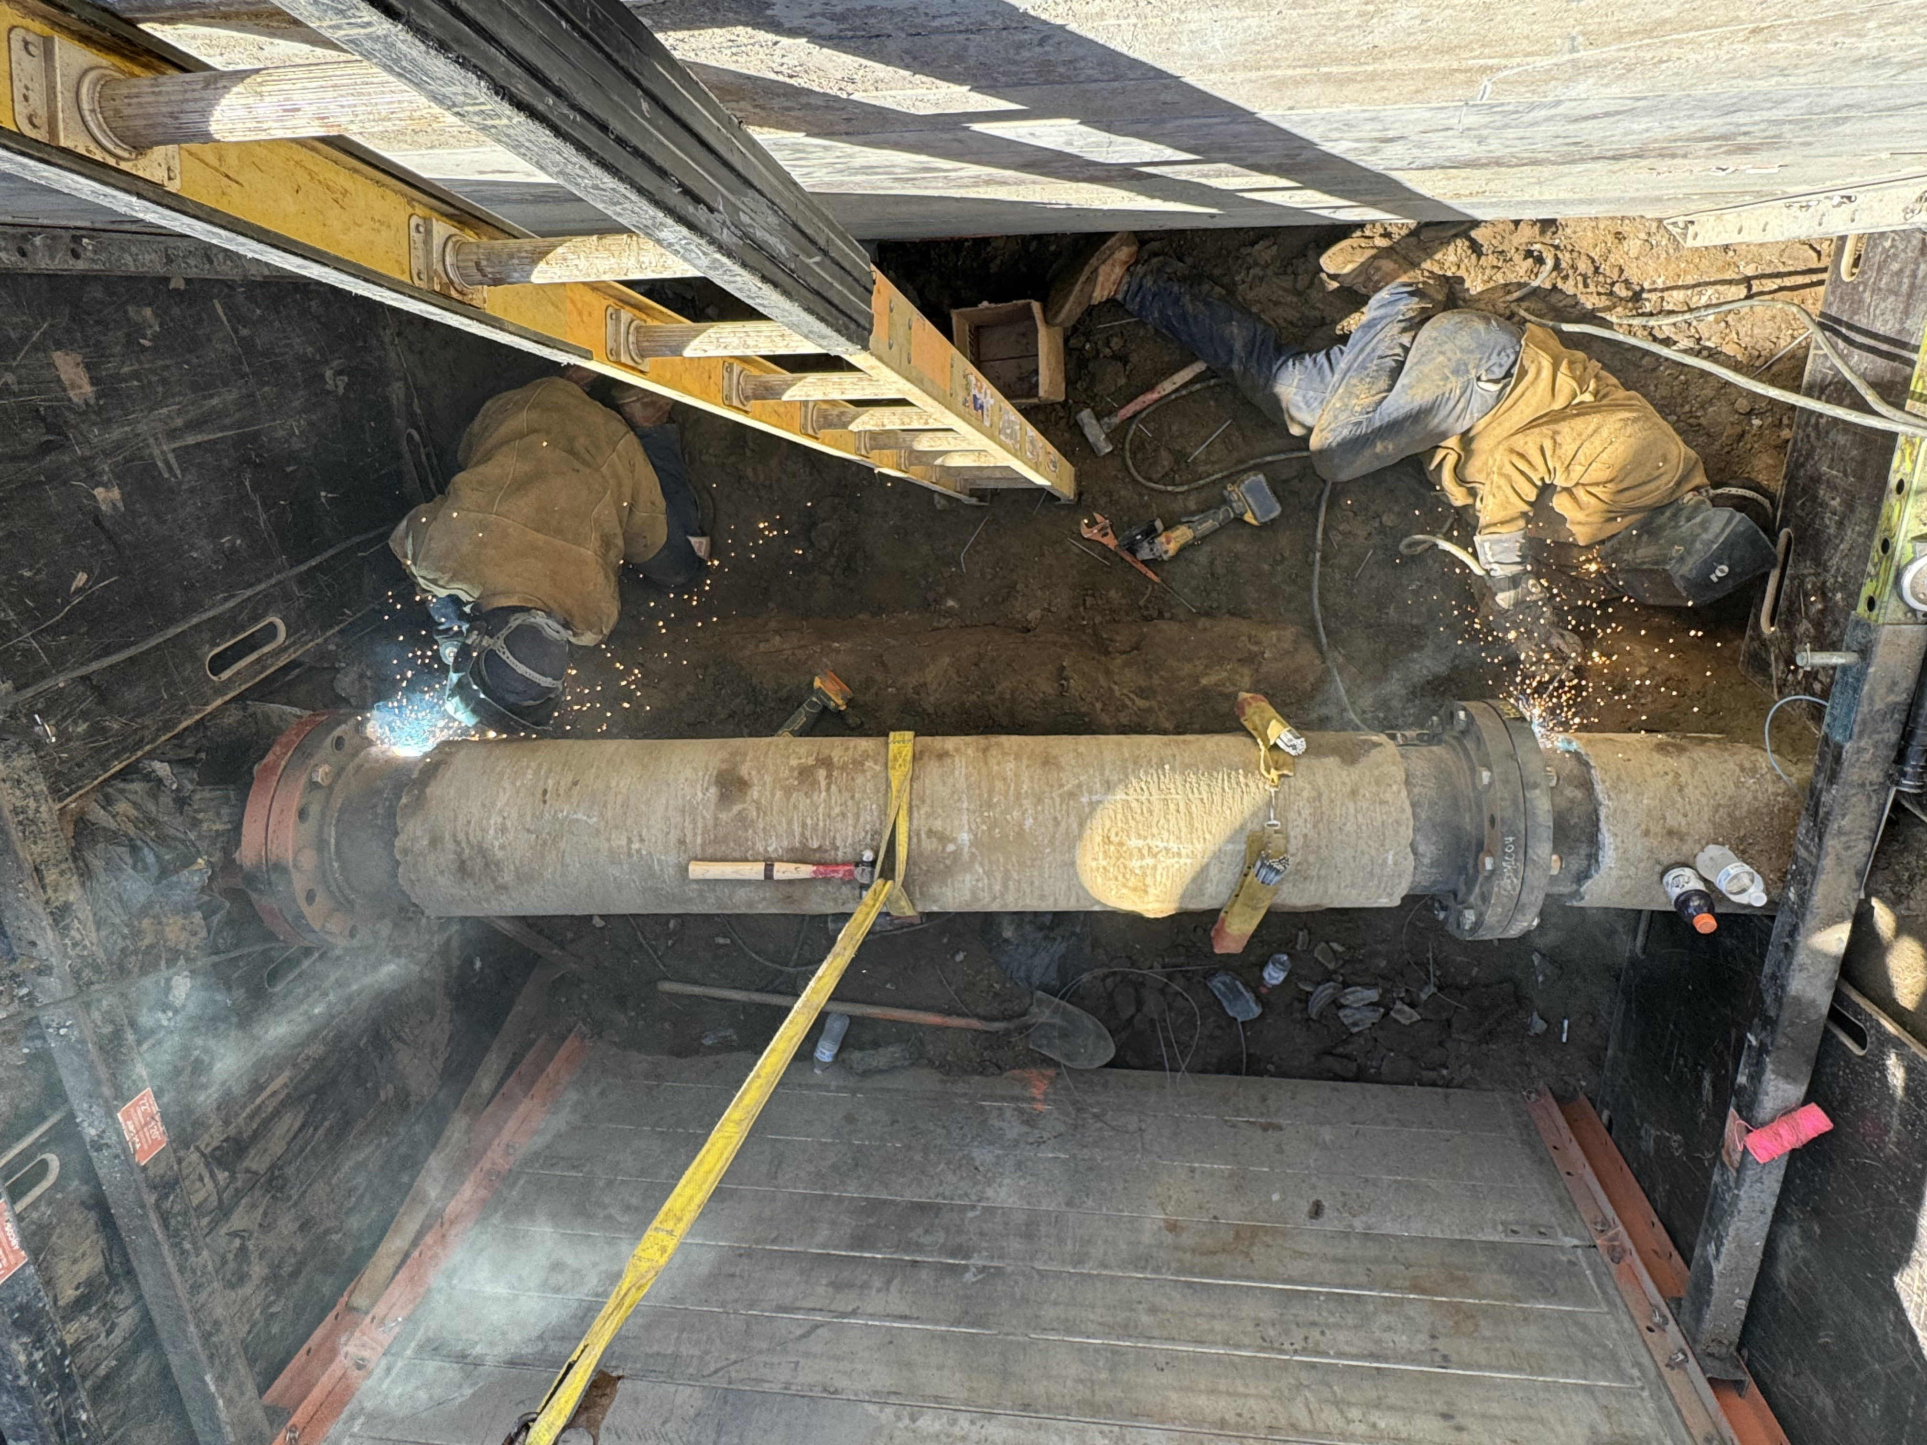
10/21 Tie-in Westside (2 working days)

Slide 8
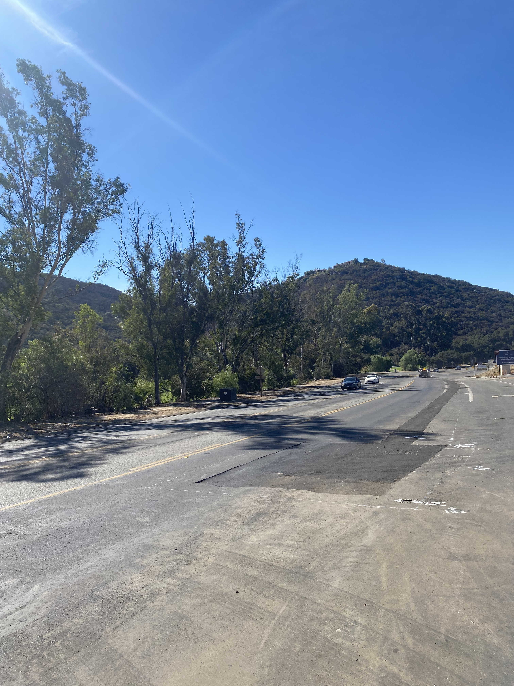
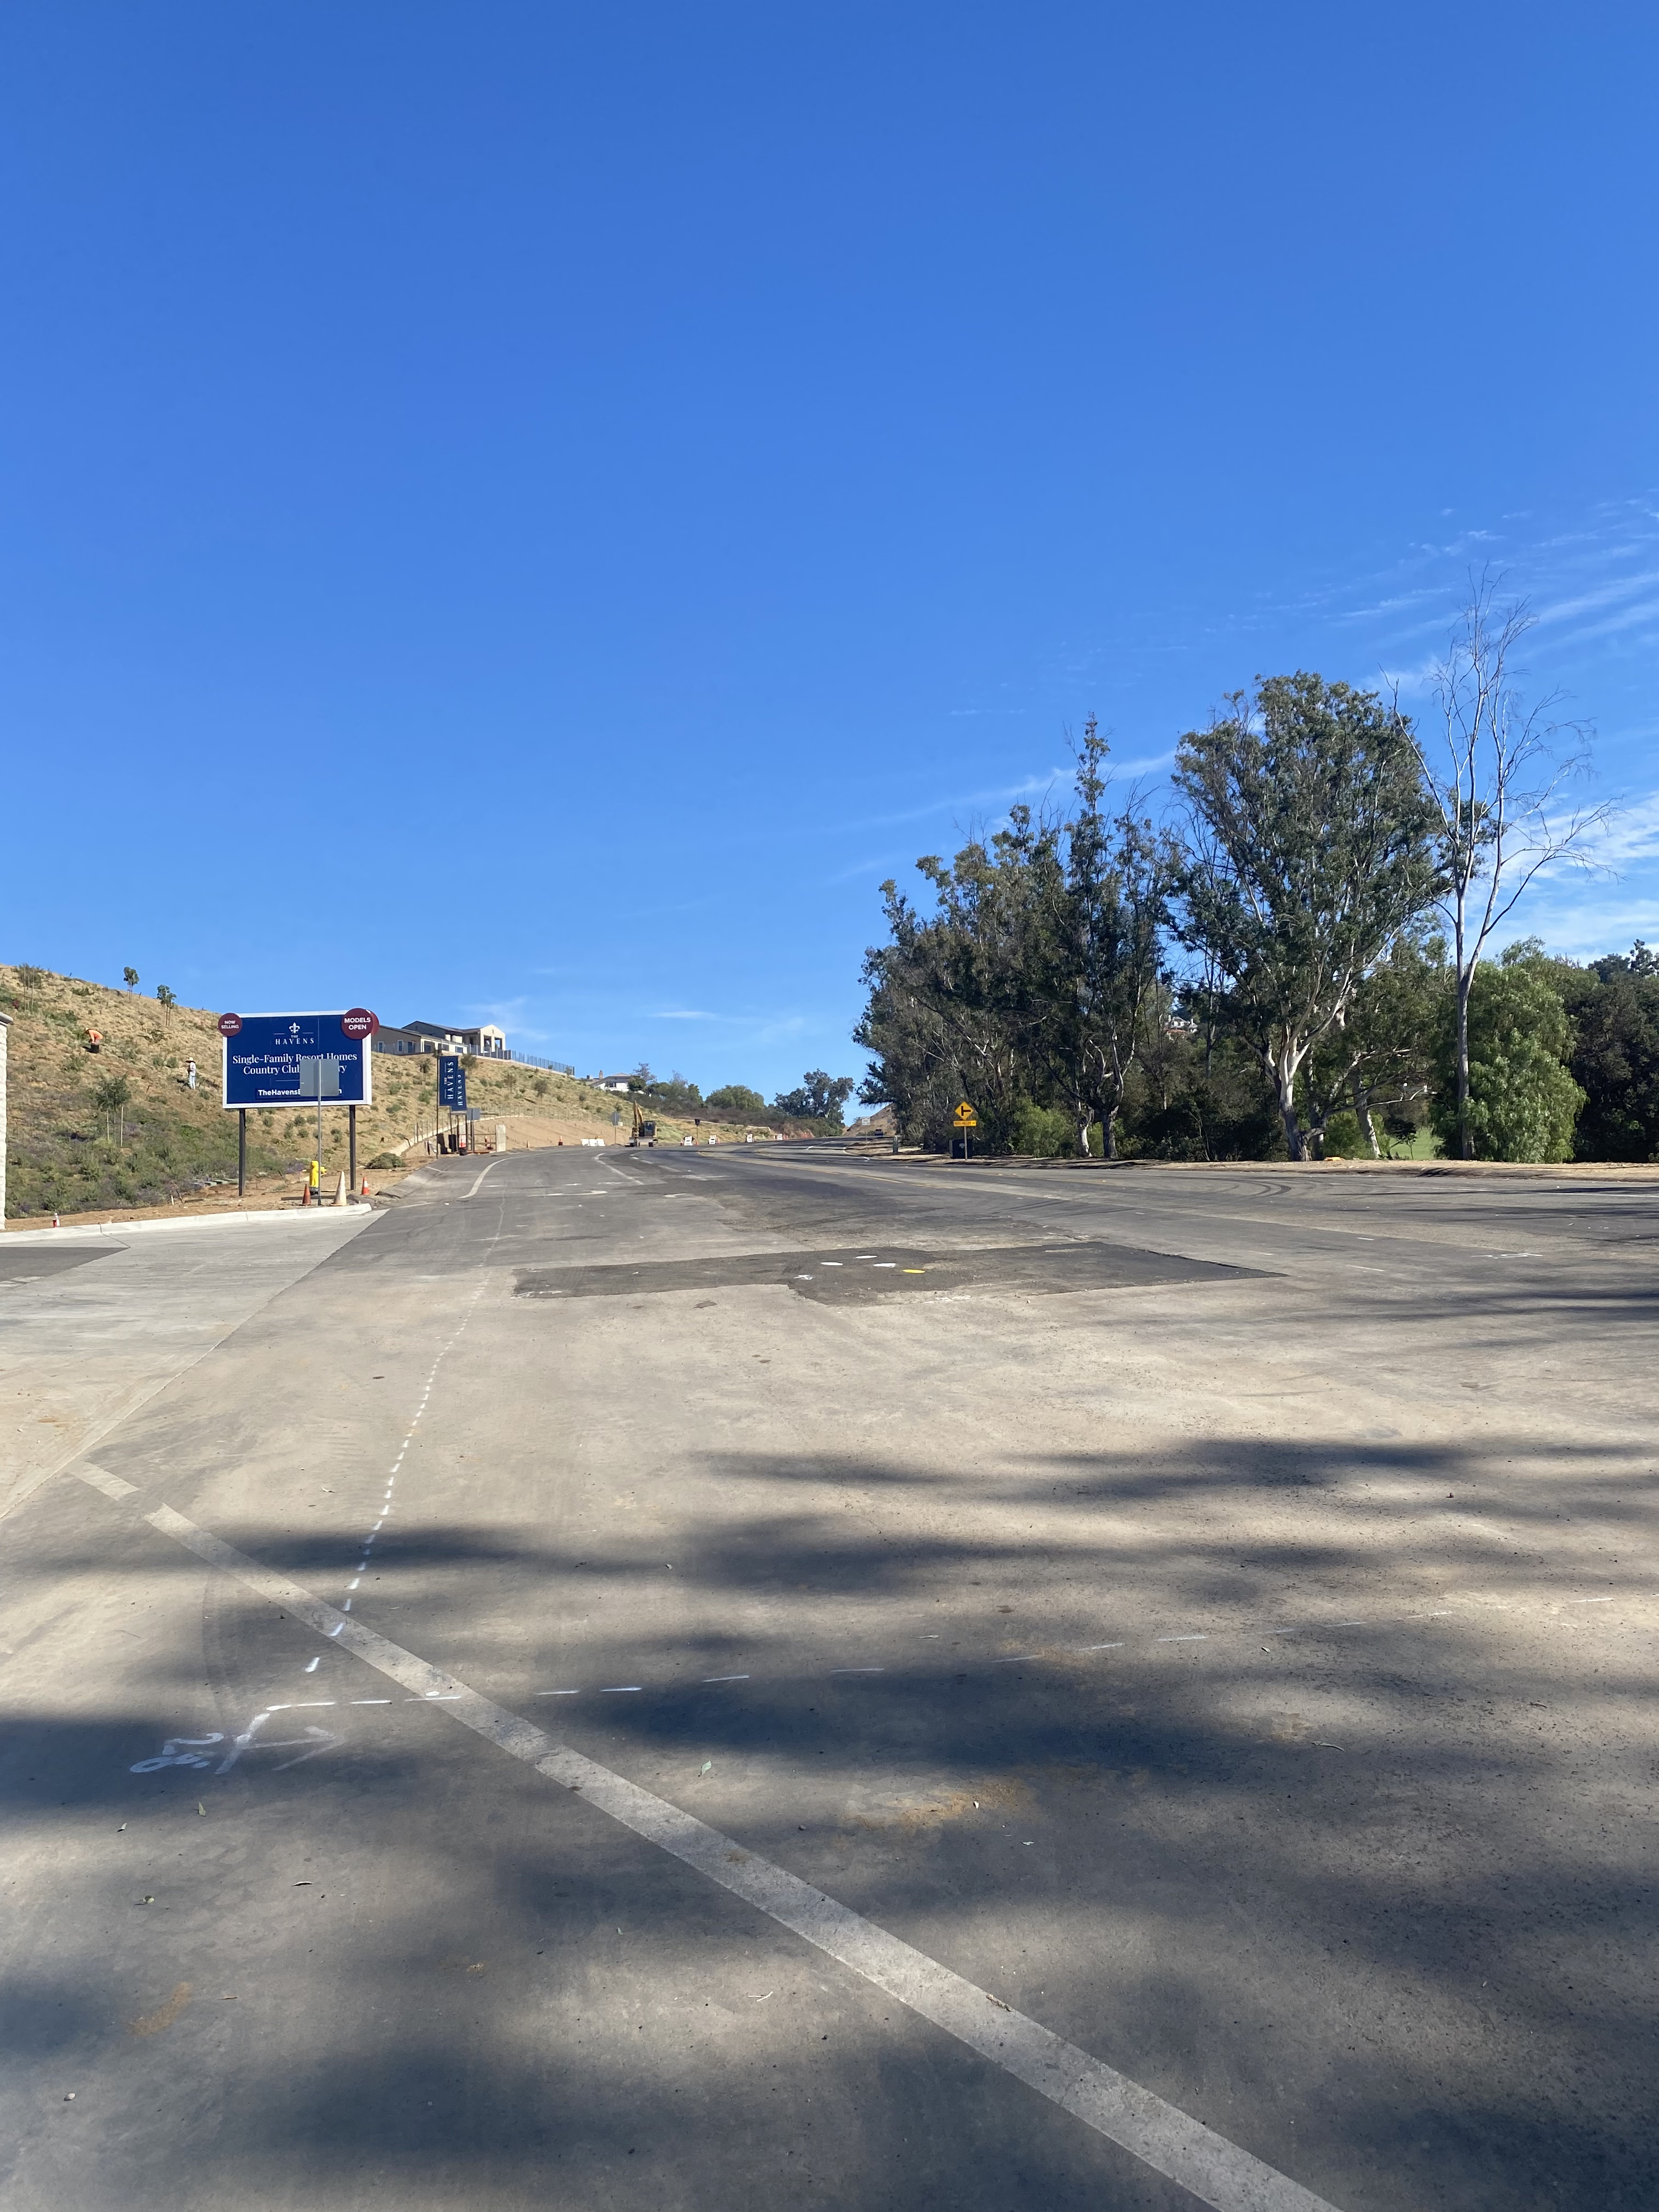
Paving Coming Soon

Slide 9
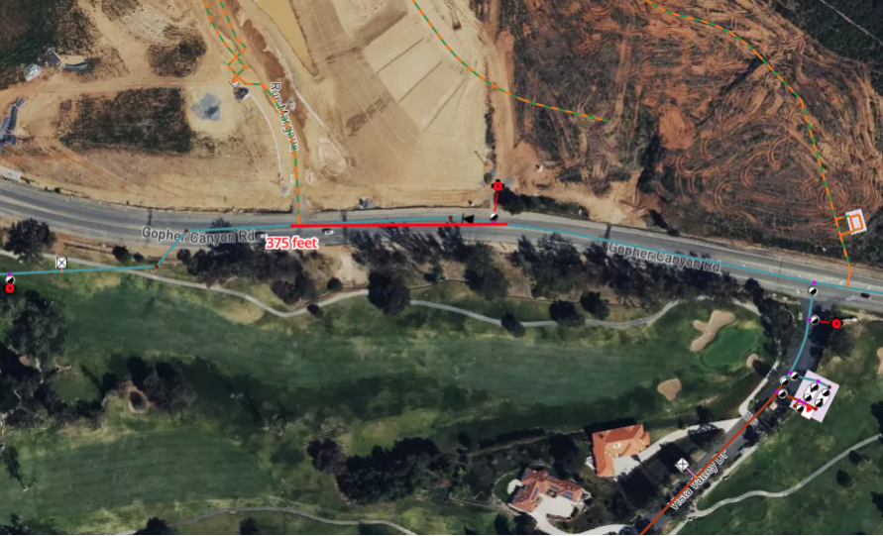

Slide 10
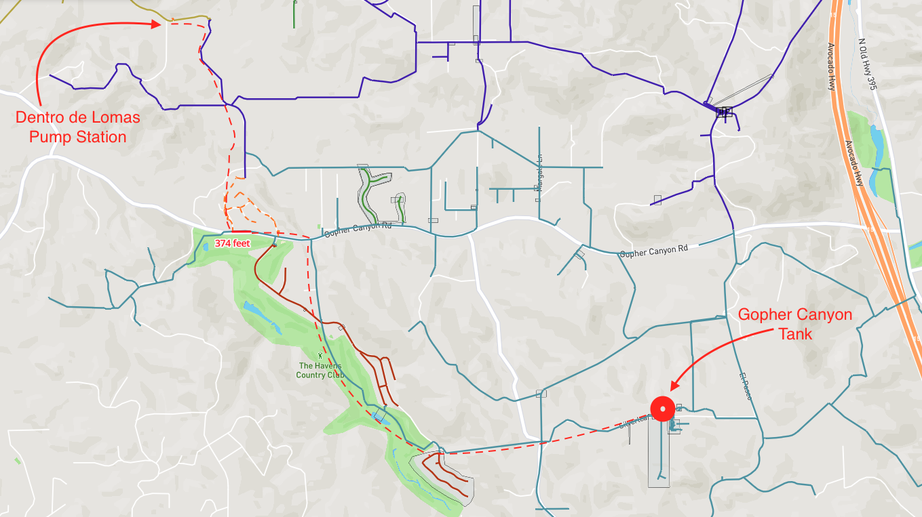

Slide 11
Questions?

