Slide 1
Urban Water Institute
Connecting Water Leaders to Secure Our Water Future

Slide 2
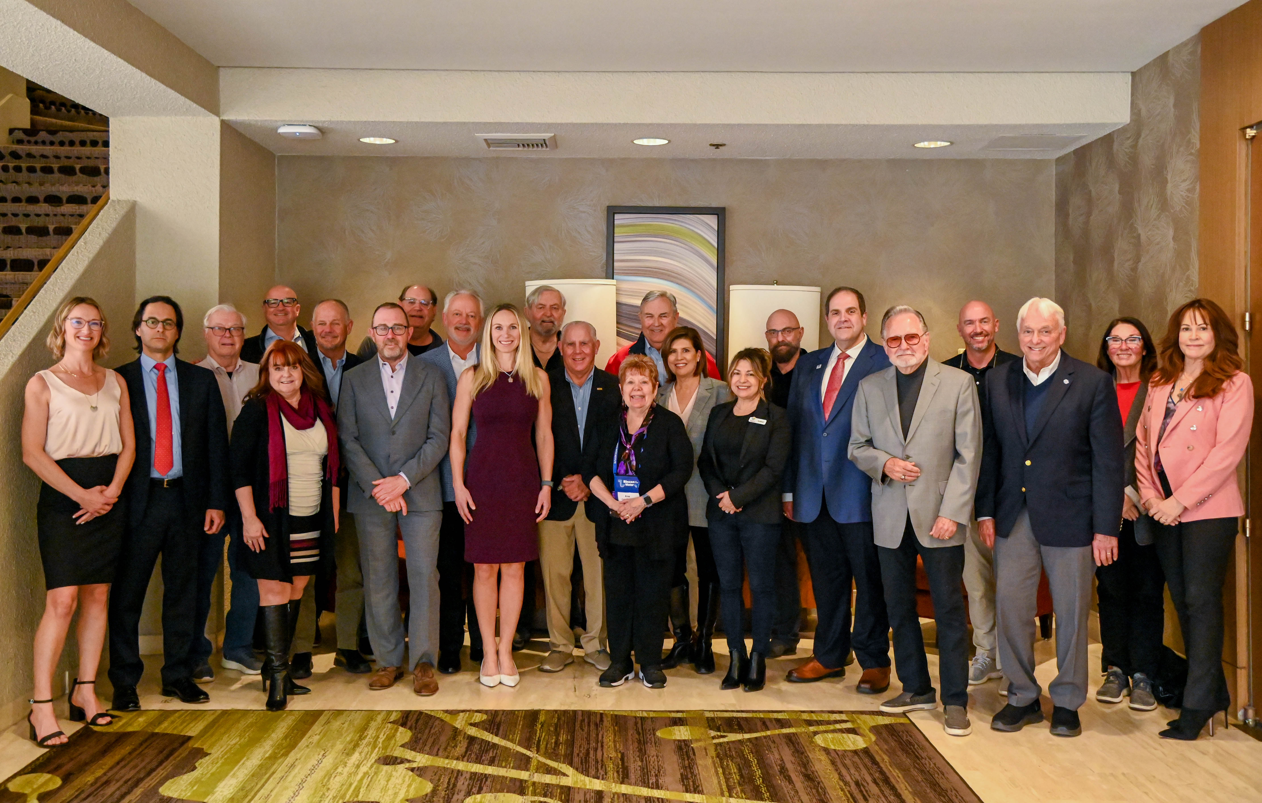
Founding Vision & Evolution
Founding year: 1993
Founders: Wayne Clark, Kevin Hunt & John Thornton
Founding vision: to provide a forum for discussion focused on urban water management issues in Orange County/Southern California.
While other existing organizations focused on agricultural water management, no such organization existed with an urban focus.
Evolution of UWI:
UWI’s mission has evolved to focus on developing collaborative solutions to water management issues facing all types of water-related organizations throughout California and the western US.

Slide 3
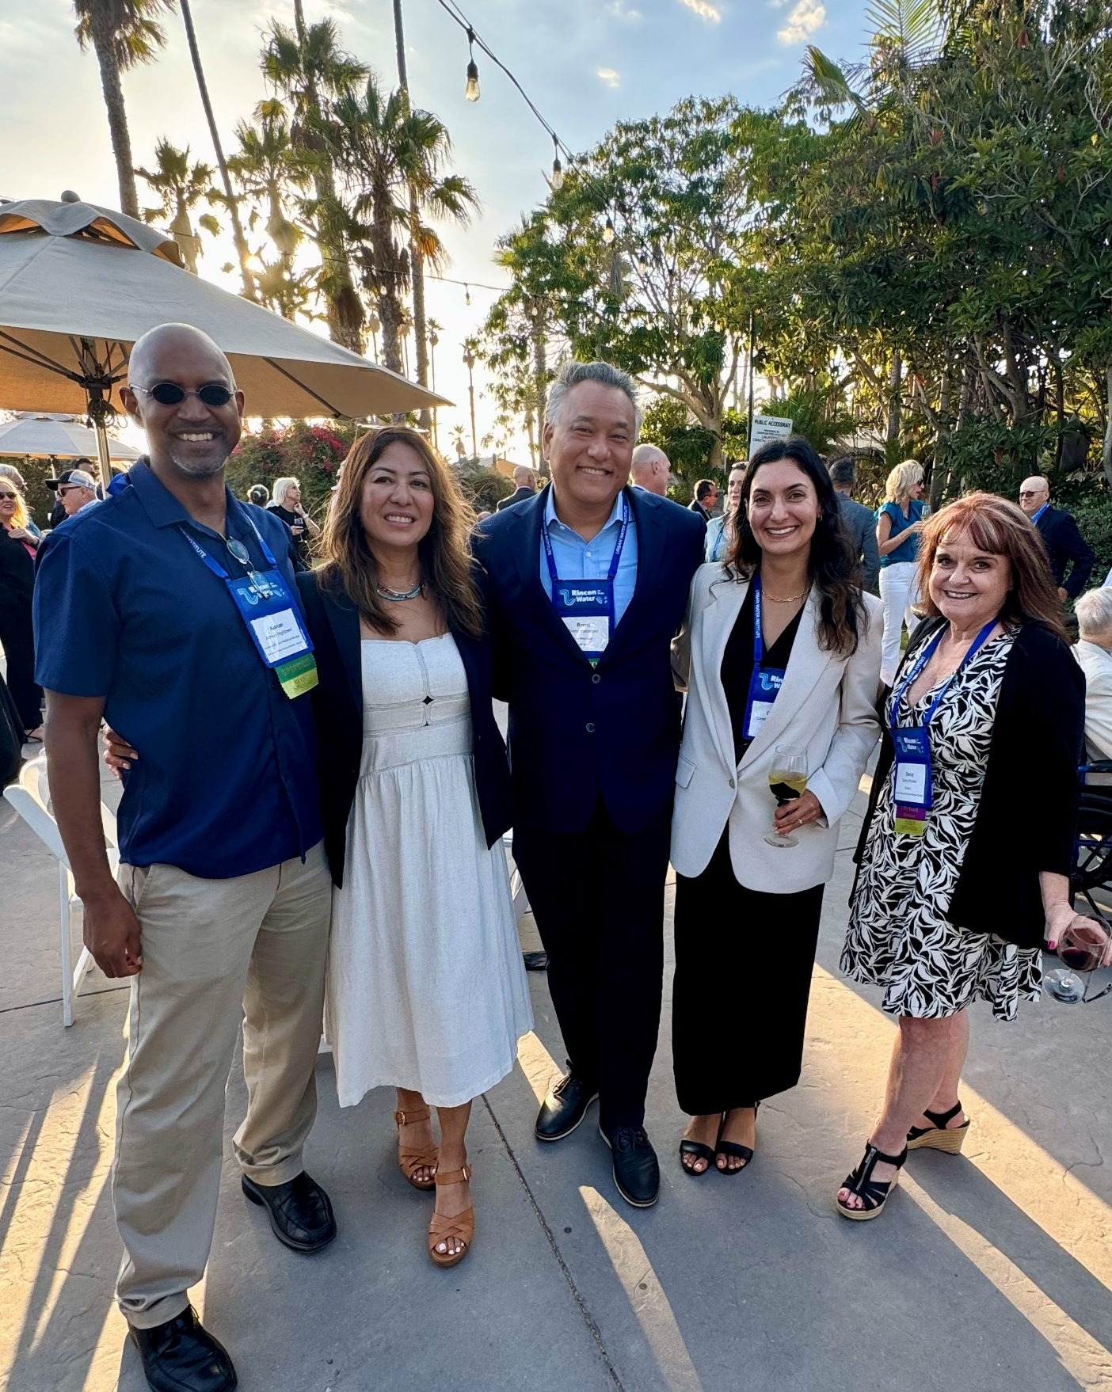
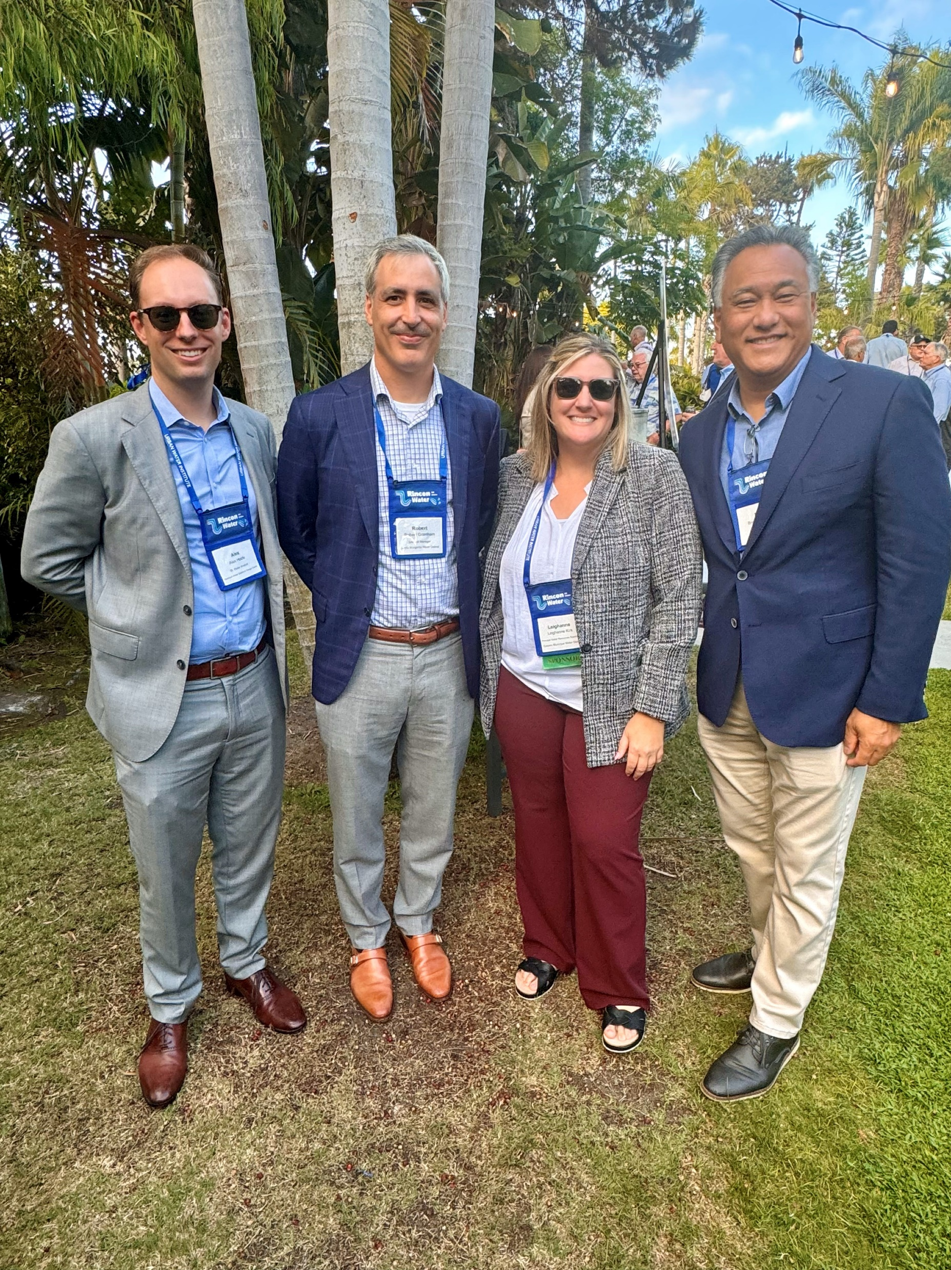
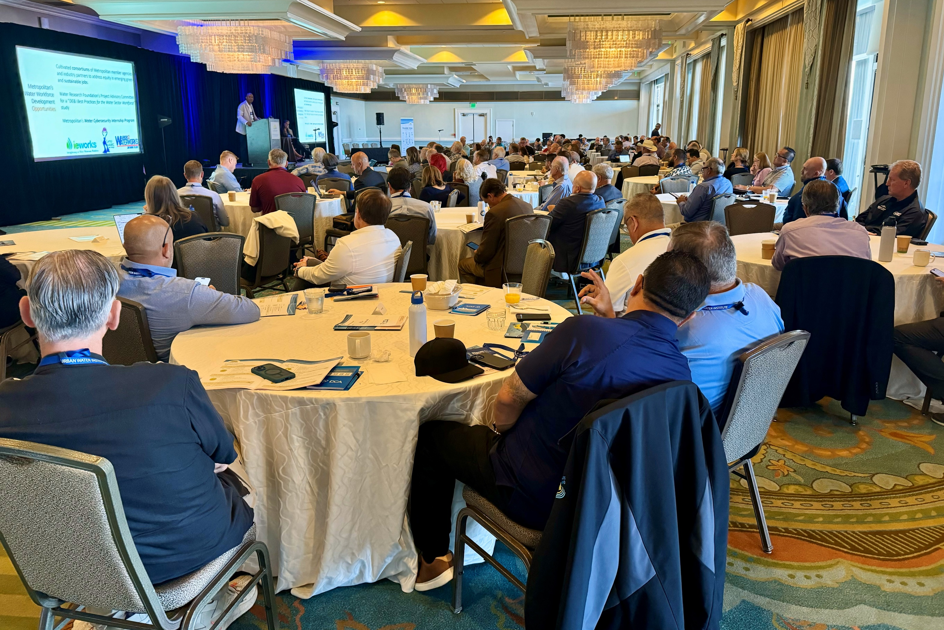
Our Pivotal Role
The Preeminent Venue for Water Knowledge & Collaboration…
UWI is a relationship-based organization where water leaders at the highest levels forge new partnerships that yield collaborative solutions among diverse water users.
Participants at our two annual conferences gain pioneering insight on critical water management topics, enabling their organizations to face difficult challenges.

Slide 4

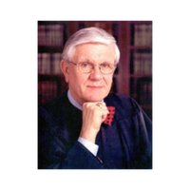
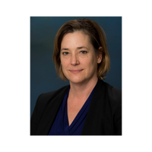
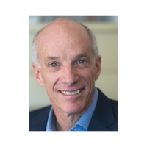
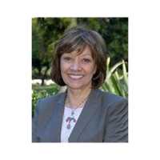
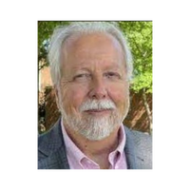
Conference Speaker Highlights
Peter McBride Award-winning
National Geographic
Photographer,
Videographer & Author
Justice Ronald Robie
United States
Supreme Court Justice
Karla Nemeth
Director of the
California Department
of Water Resources
Dr. David Sedlak
Vice Chair of Graduate Studies at the University of
California, Berkeley
Karen Ross
Secretary of the California Department
of Food and
Agriculture
Dr. Marty Ralph
Director of the
Center for Western Water & Weather
Extremes at
Scripps Institute

Slide 5

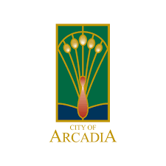























Public Sector Members

Slide 6

























Public Sector Members

Slide 7


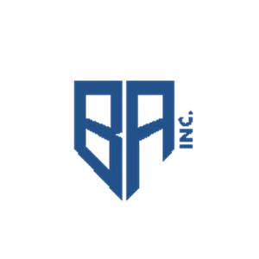








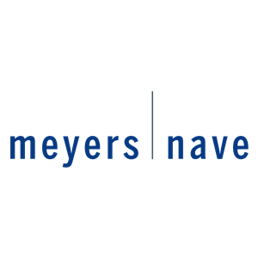




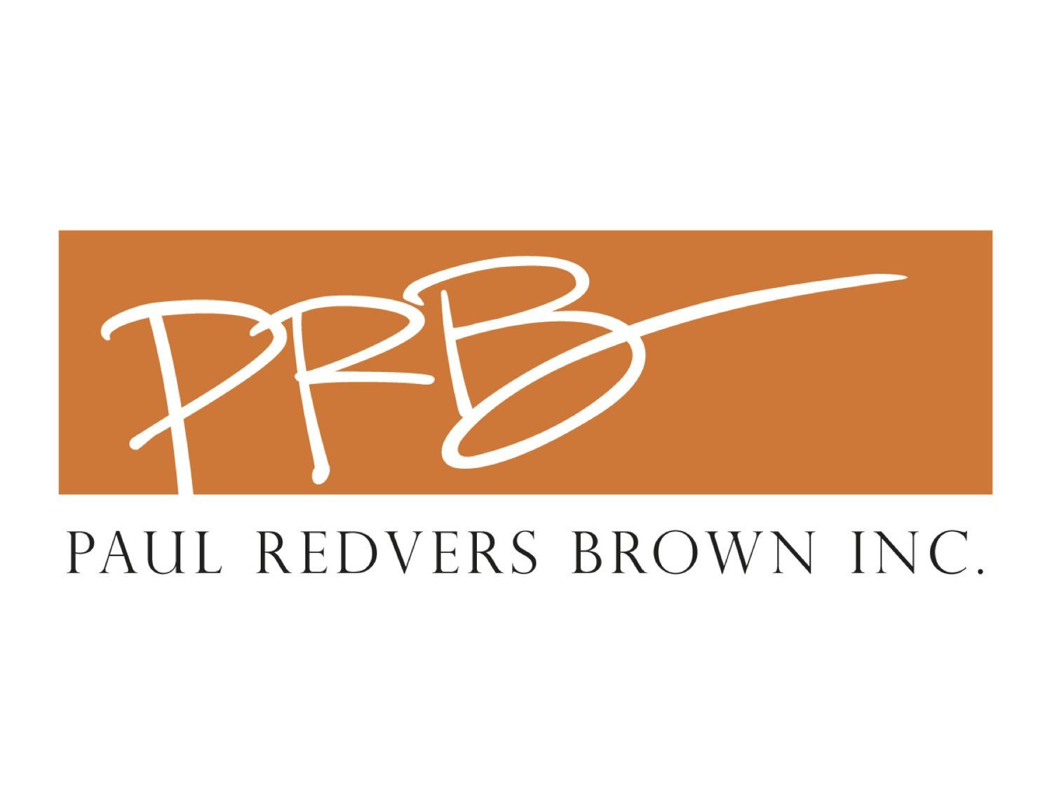



Private Sector Members

Slide 8
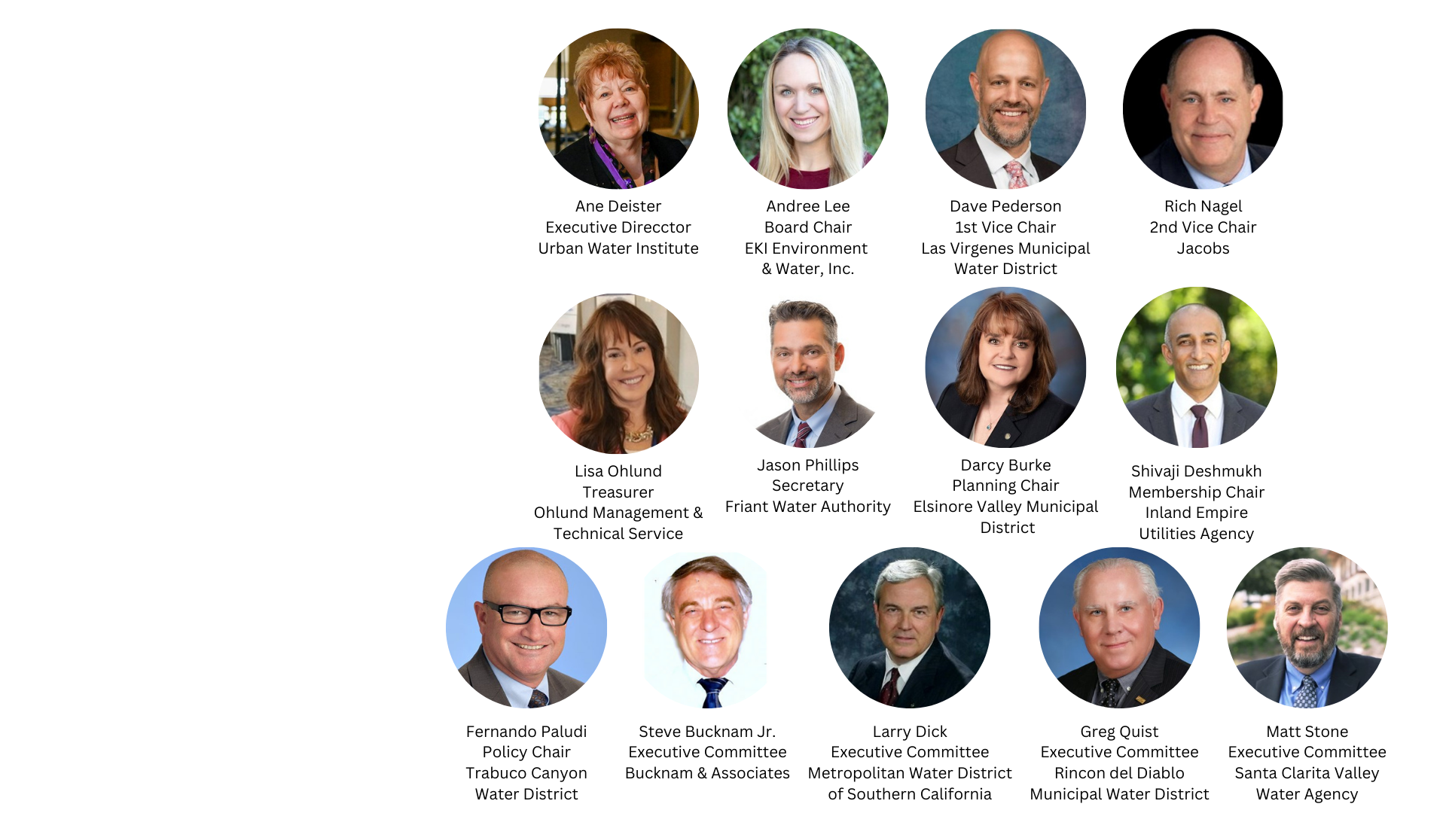
Board of Directors
Our Board of Directors is comprised of water industry leaders who represent a cross-section of:
Water districts and city/county water departments
Engineering and consulting firms, law firms
Water-related nonprofits
Leading water academics
The Executive Committee is involved in the hands-on operations of the organization:
Conferences planning, special events
Strategic planning
Membership/sponsorship outreach
Meet Our Executive Committee

Slide 9
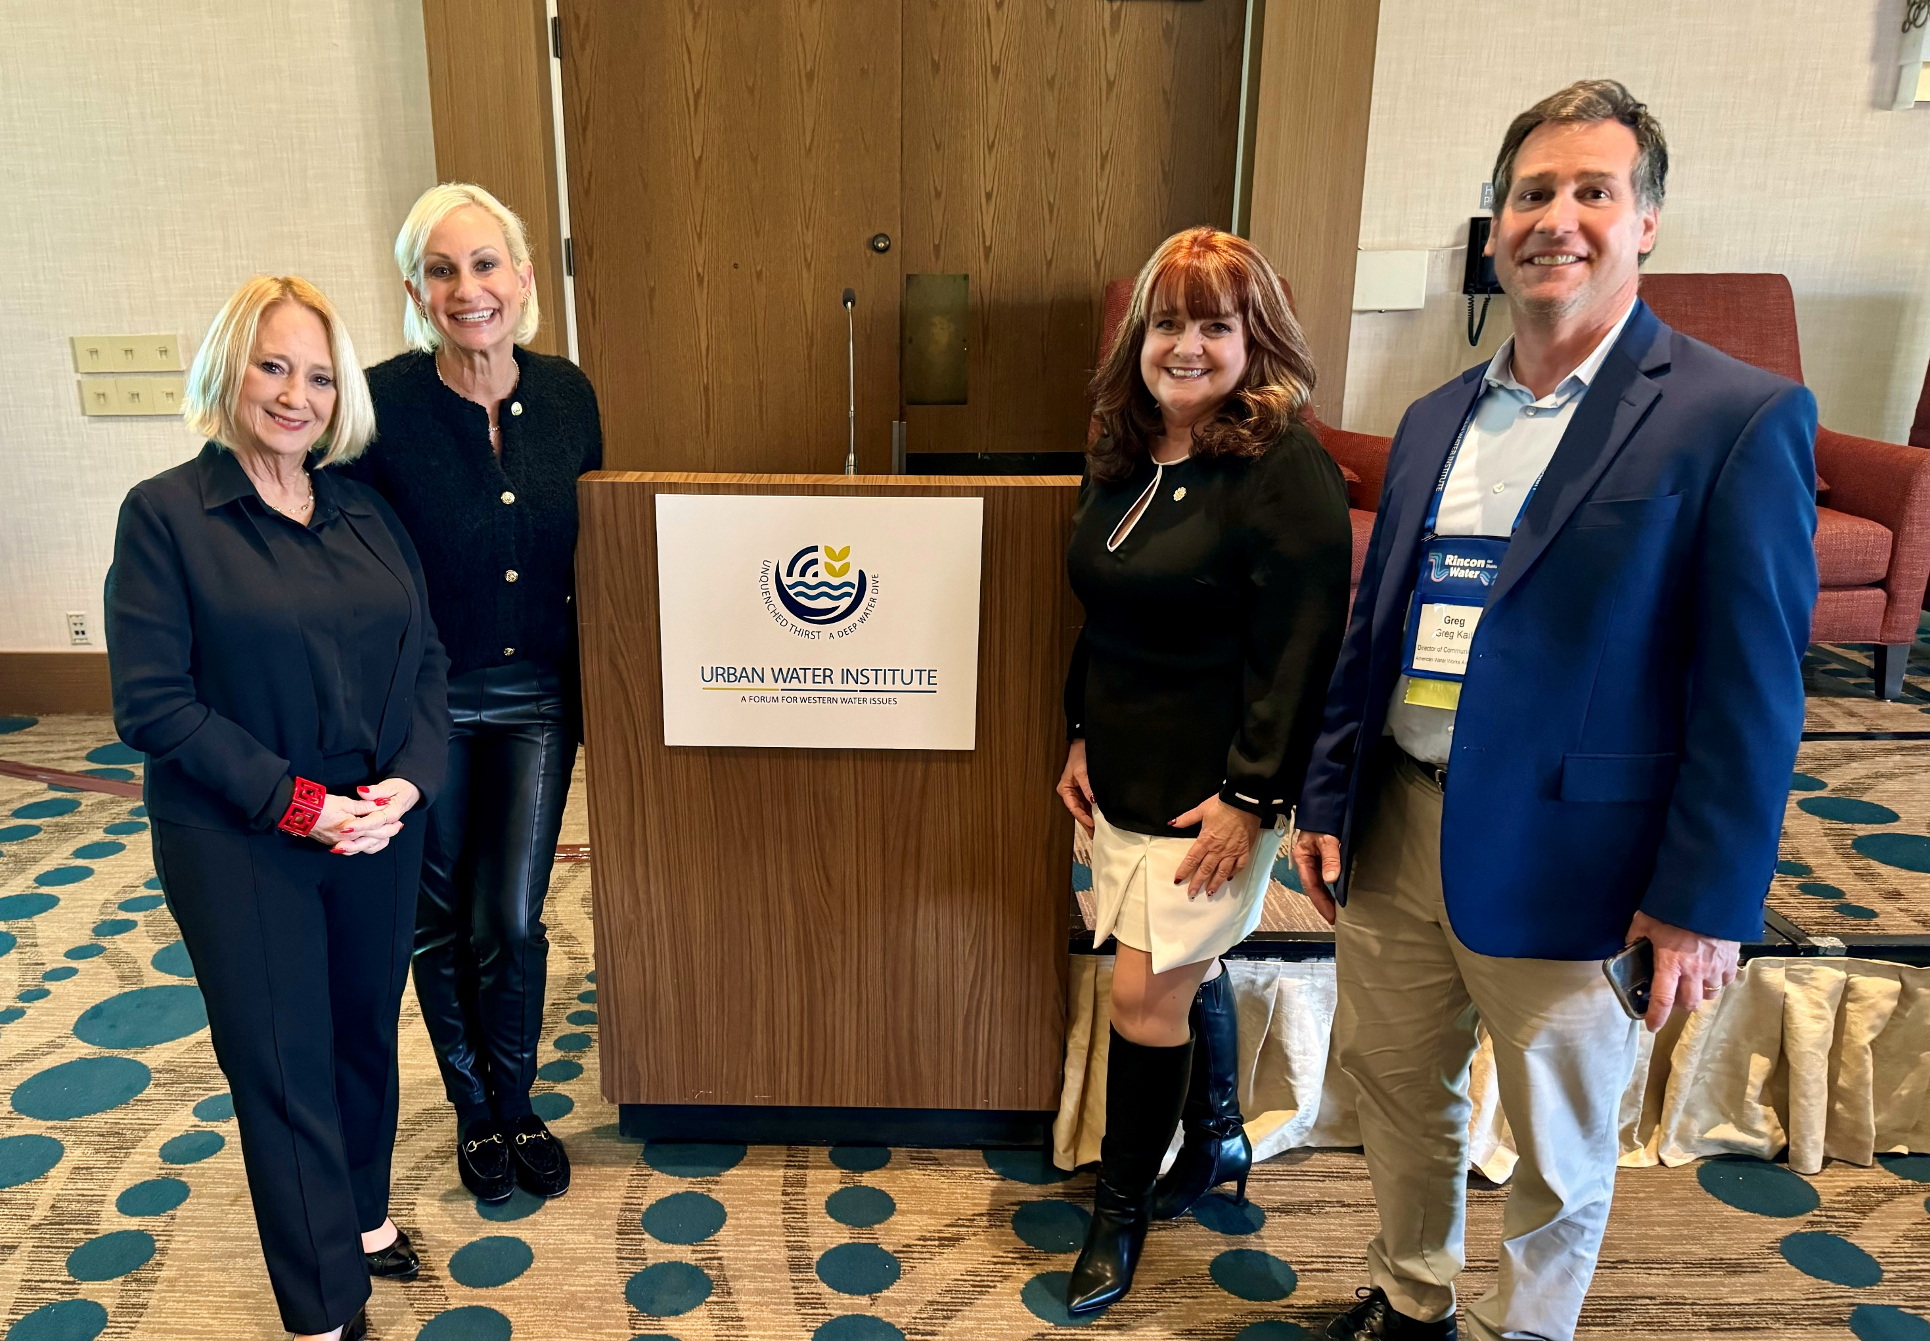
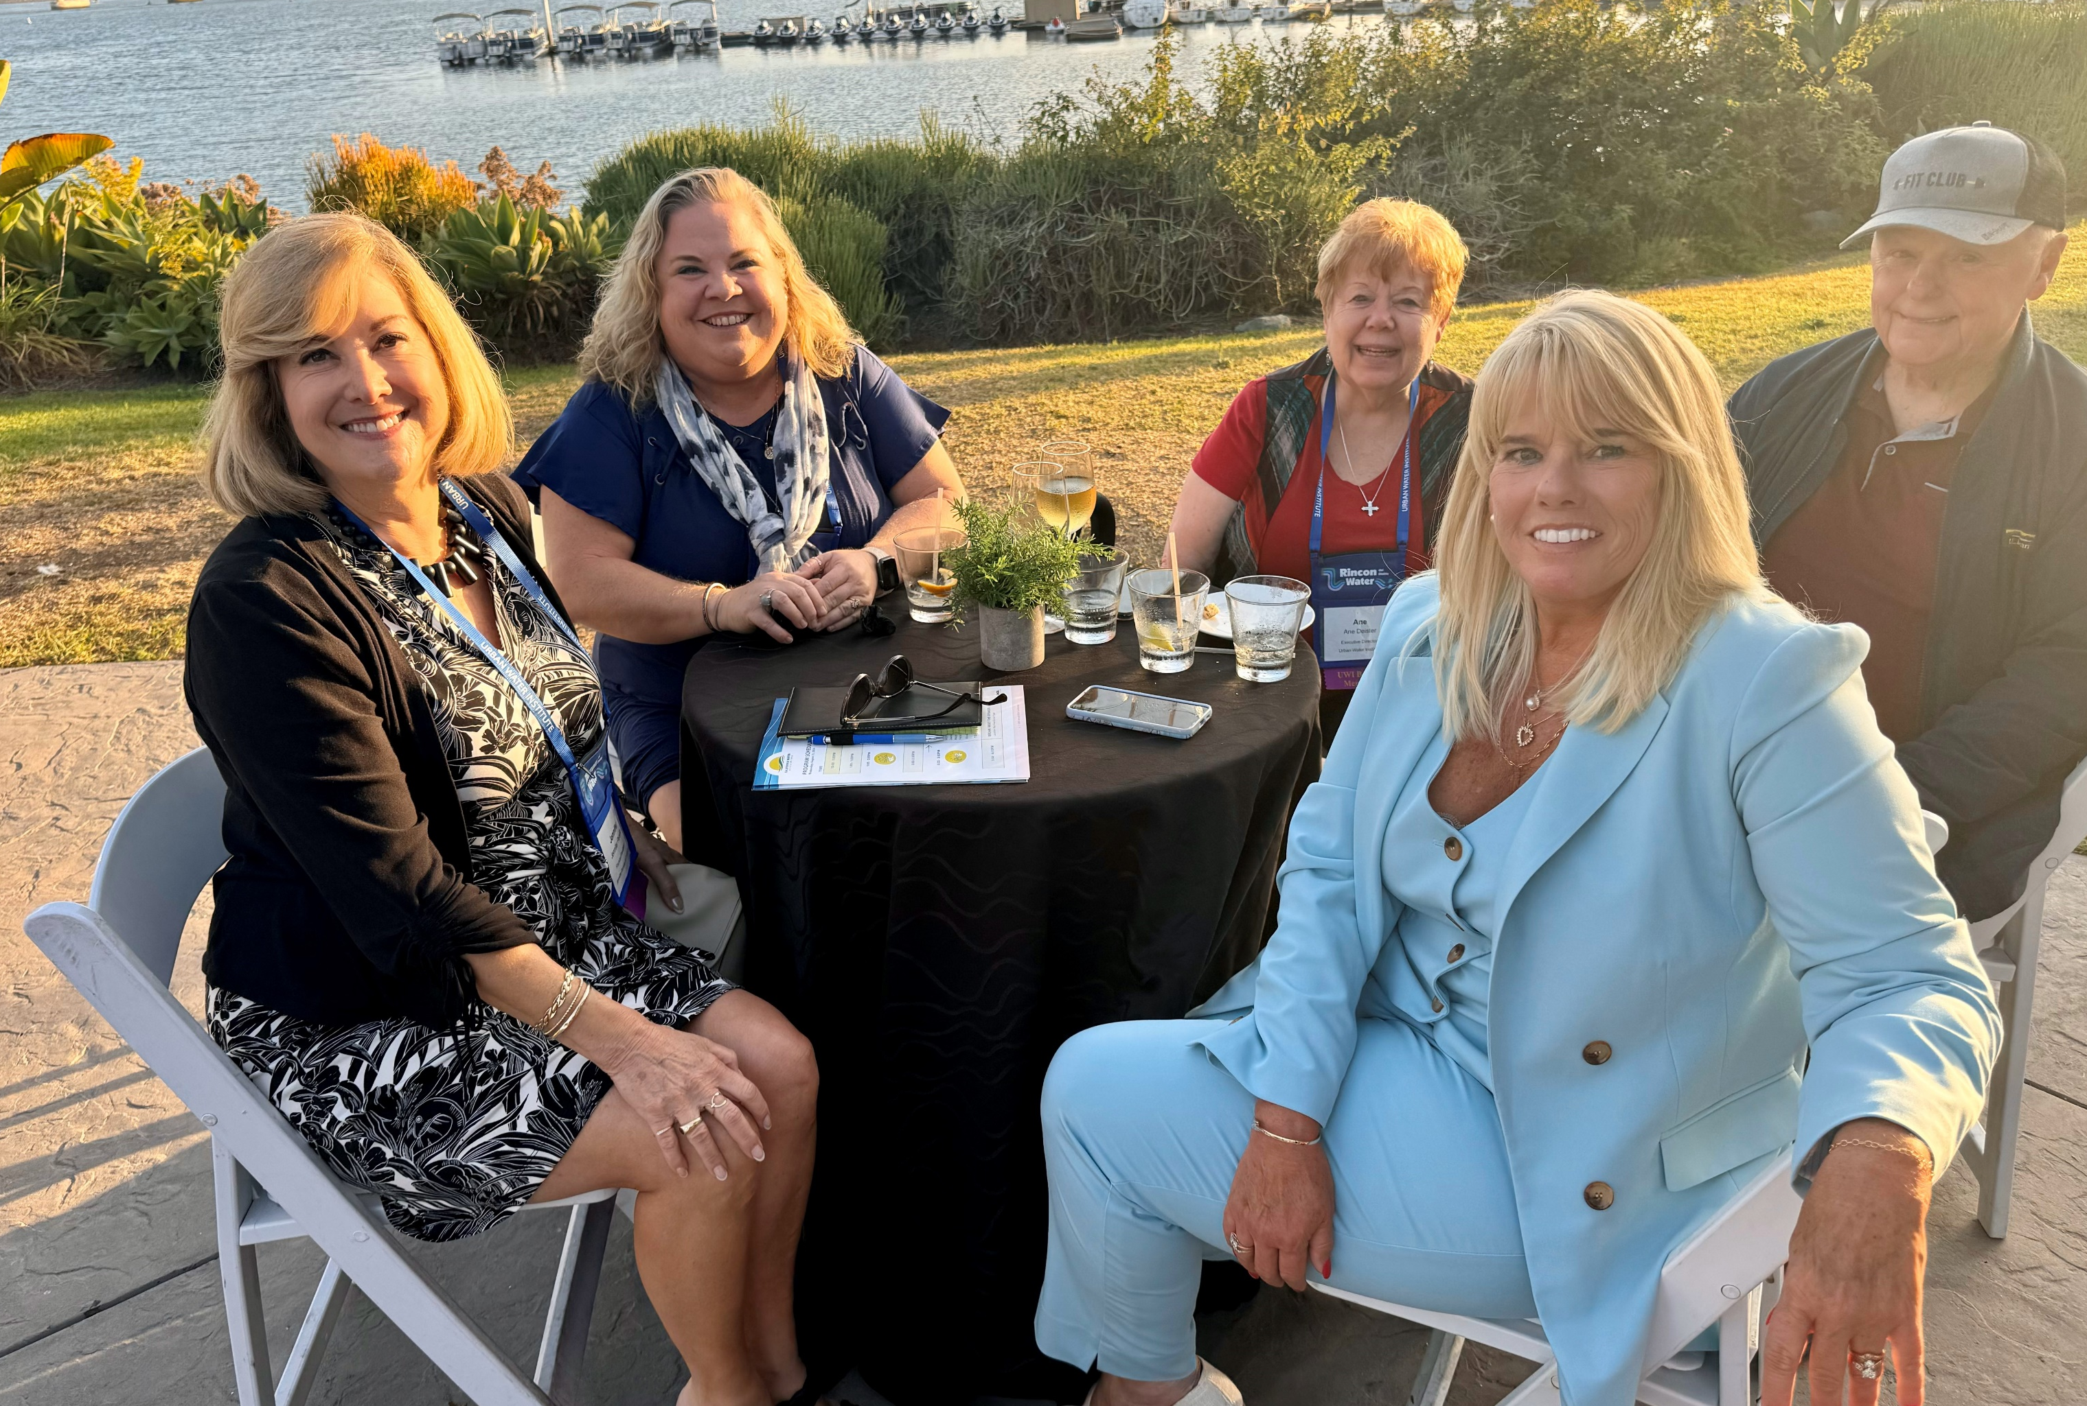
Member Testimonials
“The importance of being a member of the Urban Water Institute cannot be overstated. We all have different backgrounds, experiences, and a desire to learn the best way to serve our community. By sharing these experiences with one another and learning the latest water strategies, we develop the professional skills necessary to effectively preserve, protect and manage our most valuable resource…water.”
– Russ Martin, Director, Mission Springs Water District
“As the CEO of the Friant water authority, representing over 1,000,000 acres of productive farmland in the San Joaquin valley, I get the opportunity to work with organizations up and down the state, sometimes with similar interests, sometimes not. Working with UWI, the preeminent organization that recognizes the nexus between municipal and ag water reliability, has been crucial to ensure that all of California’s water users, irrespective of their geographic location or purpose, have a common goal. And that is to strive for sensible water policy that aims to protect consumers and producers alike. We have much work to do, but we’re on our way.”
– Jason Phillips, CEO, Friant Water Authority
“During my nearly 30 years of involvement, I have seen Urban Water Institute continue to evolve and adapt to our changing water industry. As the challenges and decisions we must make get more complex, Urban Water Institute has delivered timely, insightful and diverse programs to inform and engage water managers and decision makers alike.”
– Matt Stone, Santa Clarita Valley Water Agency

Slide 10
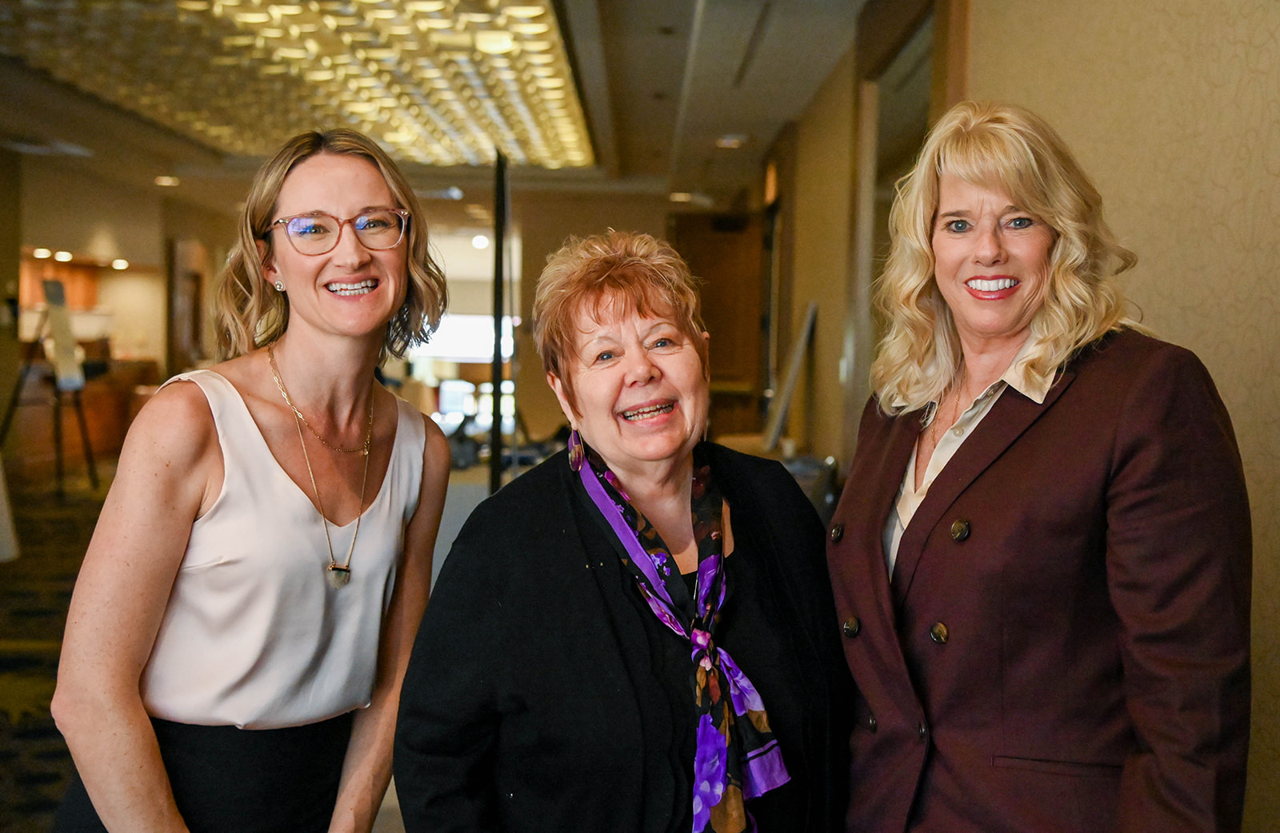
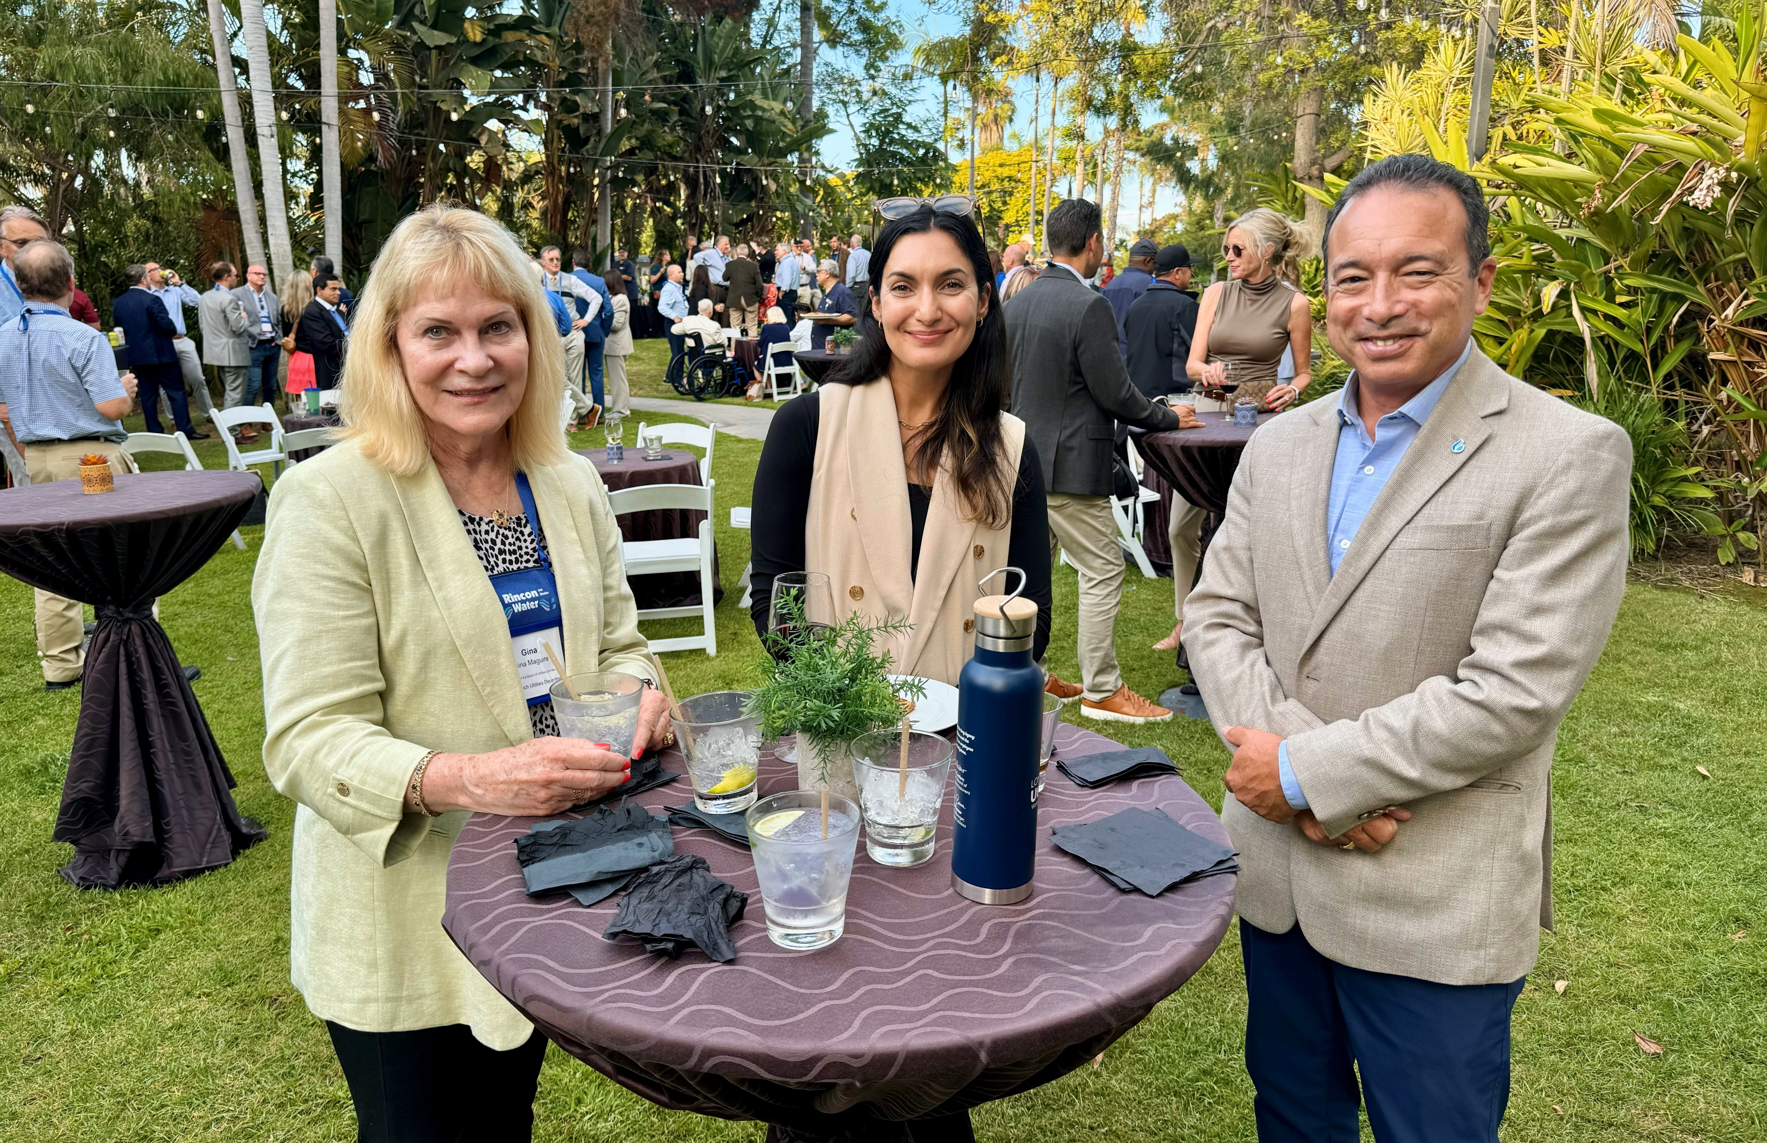
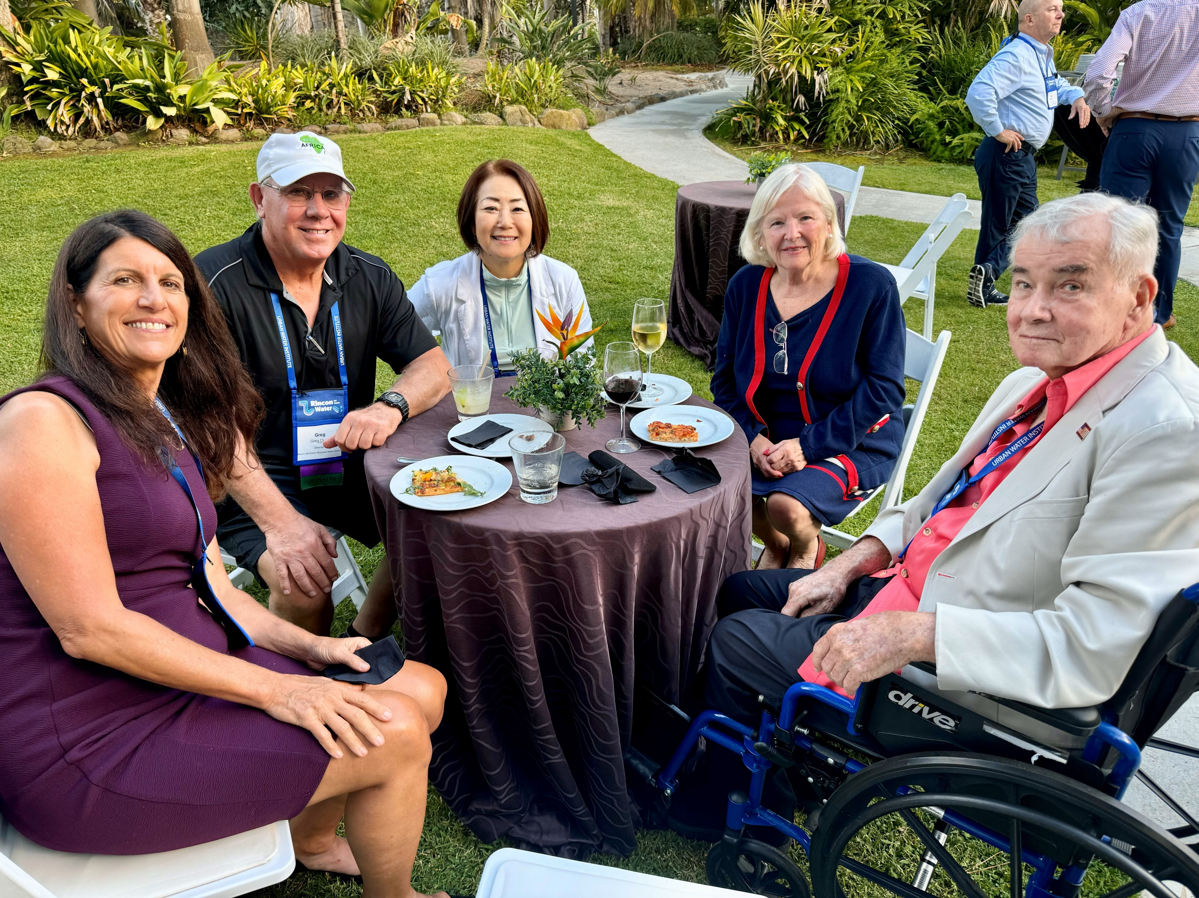
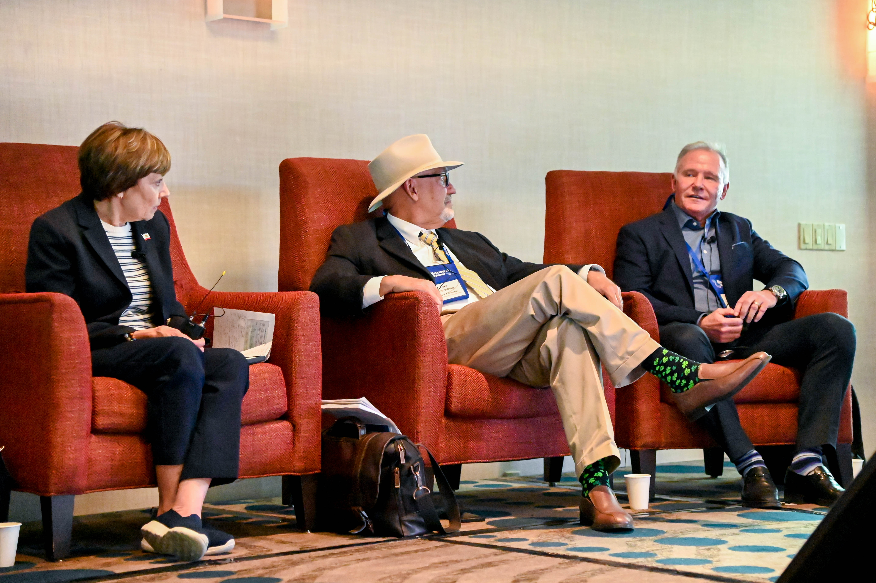
Member Testimonials
"No other water organization fosters relationships and open and frank dialogue that build trust like the Urban Water Institute. Unafraid to lift the covers and dive deep into sometimes uncomfortable topics, and explore all angles of a water issue, the UWI provides a unique and refreshing platform for education, illumination, and connection.“
– Greg Quist, Director, Rincon del Diablo Municipal Water District
“As both a board member and water manager, my involvement with the Urban Water Institute has fostered collaboration among industry leaders, offering a platform to exchange innovative ideas and tackle the pressing water challenges we face. The association is a critical resource for staying ahead of emerging issues and ensuring sustainable water solutions for our communities.”
– Craig Miller, General Manager, Western Municipal Water District
"Many organizations feel like echo chambers — like-minded professionals talking to themselves. UWI expands the boundaries, inviting points of view that stretch conventional wisdom and open up new opportunities and possibilities."
– Paul Brown, President, Paul Redvers Brown Inc.
“The Urban Water Institute provides a forum for frank discussions around the most pressing issues affecting the water sector. We don’t shy away from controversial topics – rather we take them head on and look for solutions. The membership is diverse with everyone bringing their unique expertise to the table for the benefit of the group.”
– Dave Pedersen, General Manager, Las Virgenes Municipal Water District

Slide 11
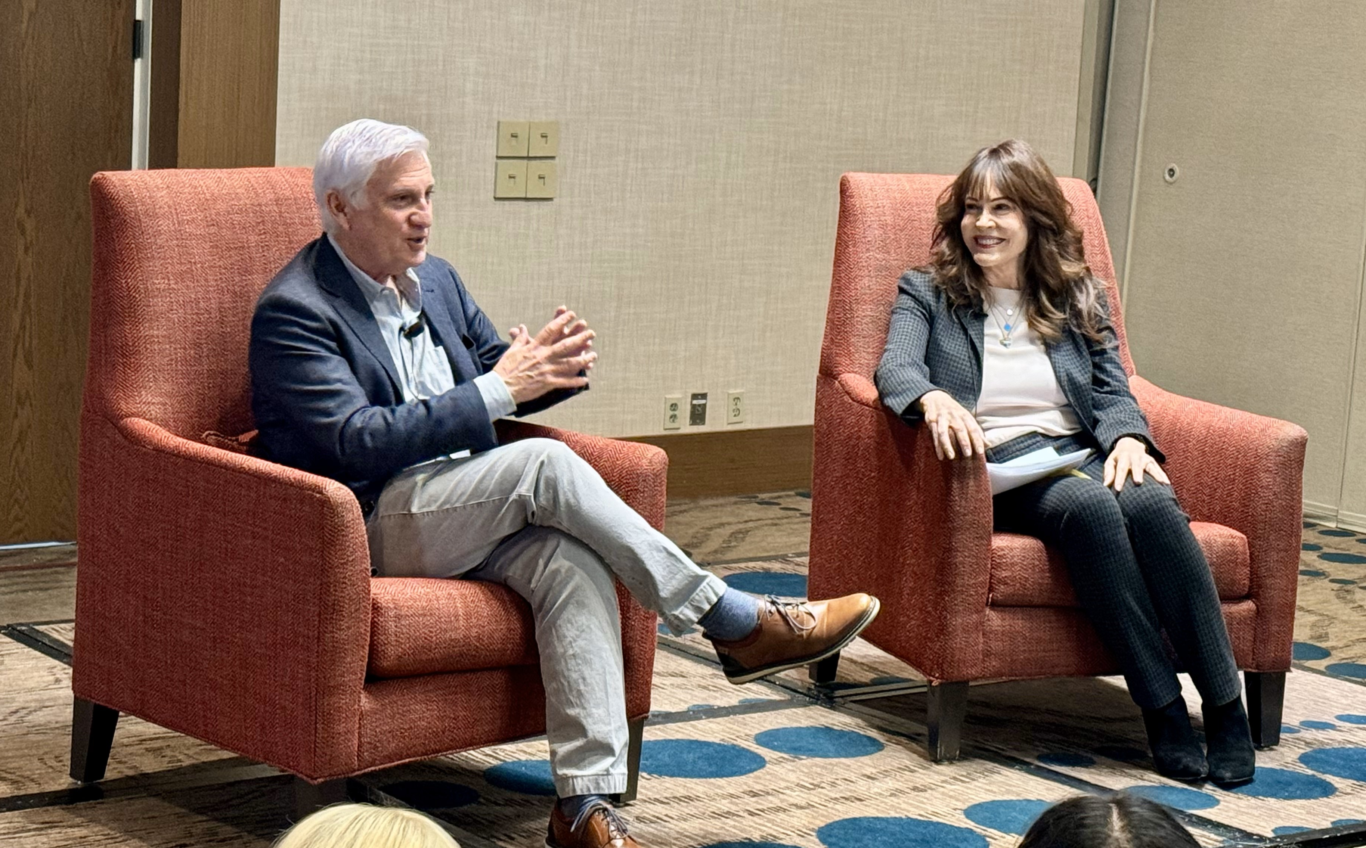
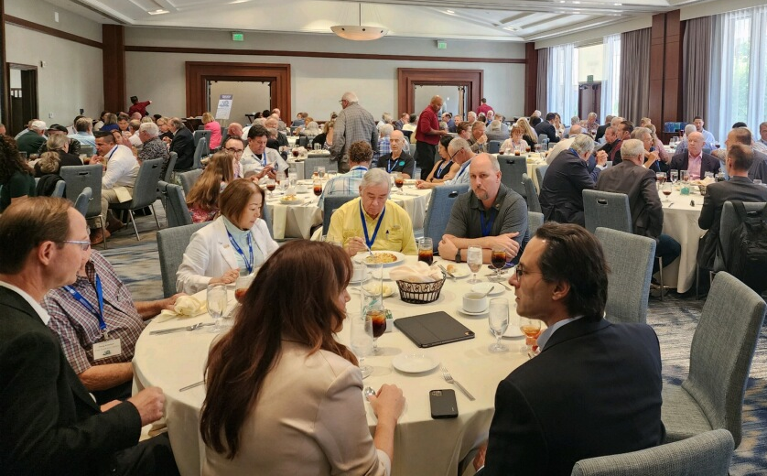
Membership Levels
Public Sector (cities, water districts and other government organizations): Dues range from $550 to $3,000 depending on the size of the population served by your organization.
Private Sector (businesses, consulting firms and private water utilities): Dues range from $550 to $3,000 depending on the number of employees in your organization.
Nonprofit Organization: $500
Academia: Institutions/Centers: $500
Academia: Professors/Researchers: $250
Member Emeritus/Retired: $110

Slide 12
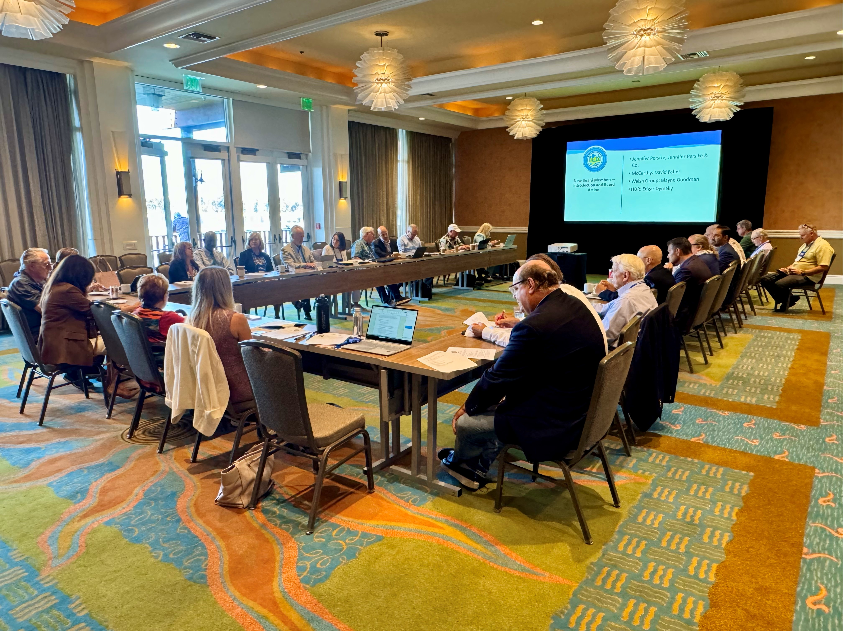
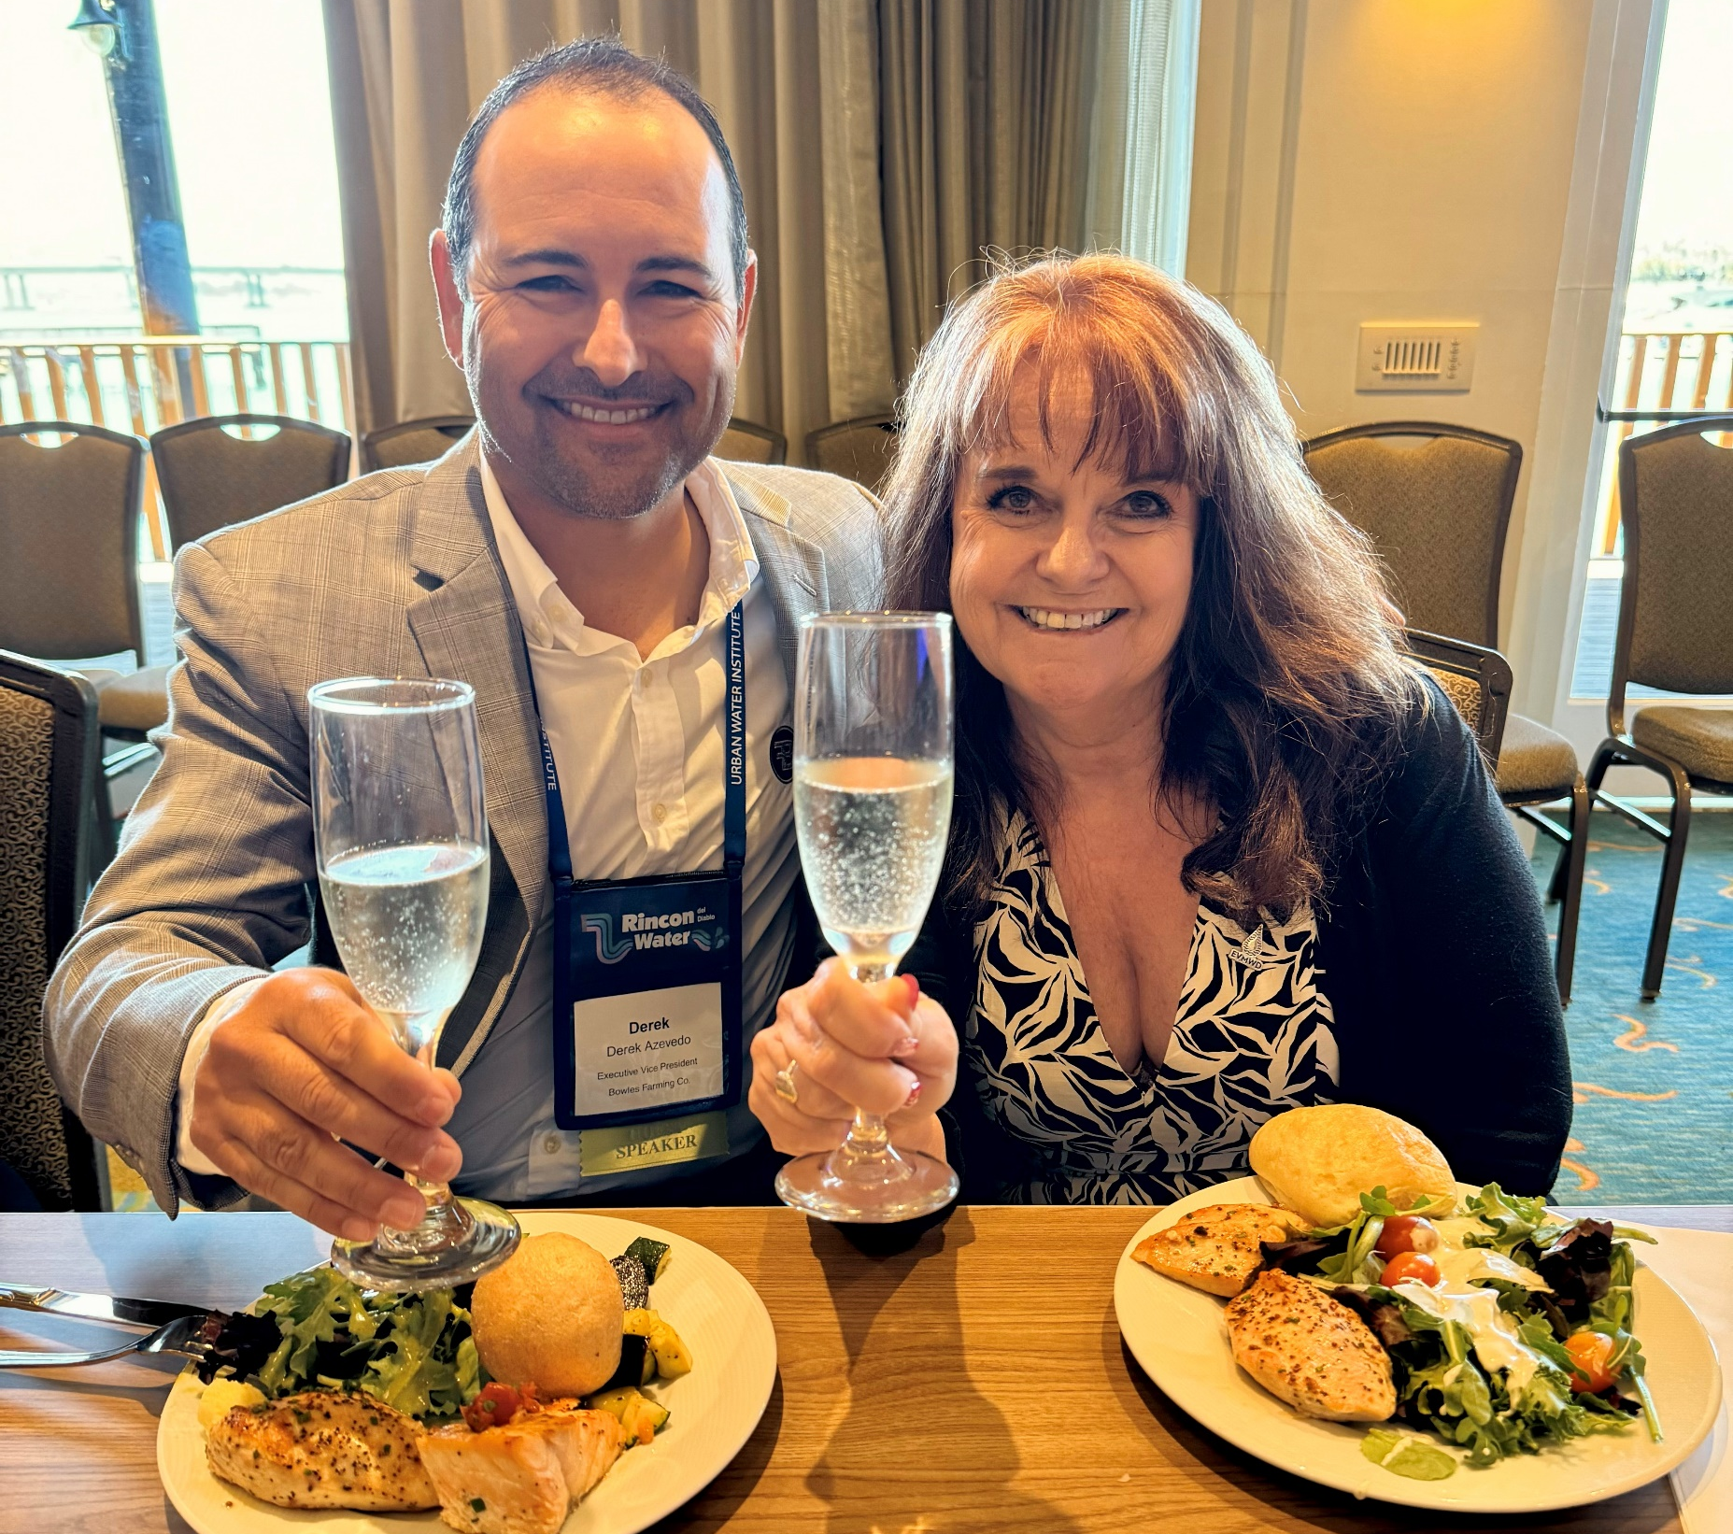
Membership Benefits
Your membership includes:
Seat on the UWI Board (shapes the organization’s priorities and activities, including conference programs)
Discounted conference registrations for everyone at your organization
Access to all conference presentations
Exclusive networking opportunities
Access to the full UWI membership directory (with contact information for each member)
Quarterly newsletter
A voice in the water community

Slide 13
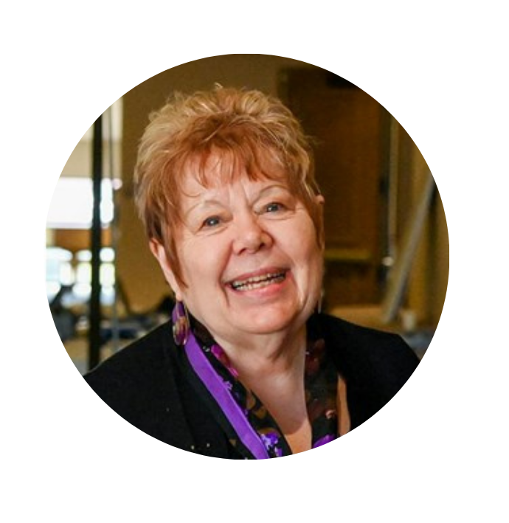
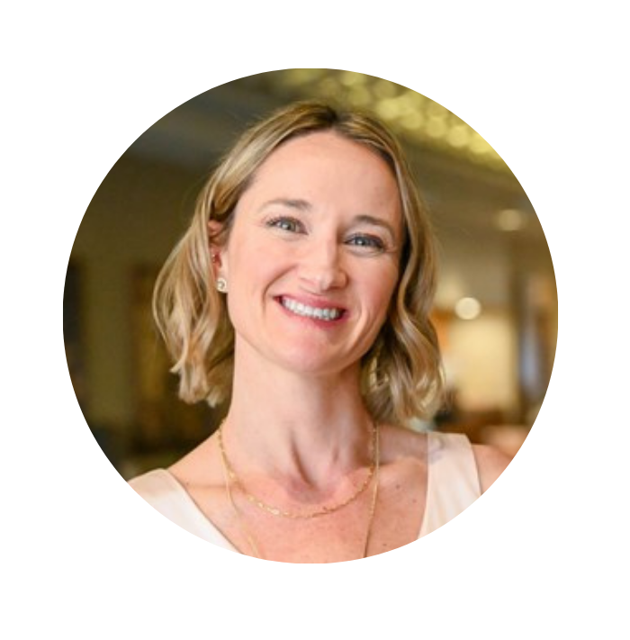
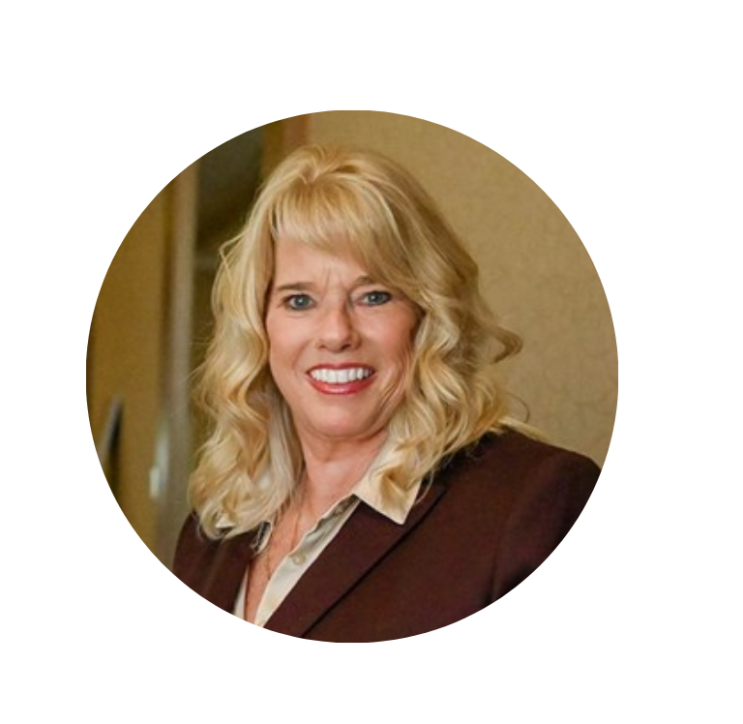
Contact Our Team:
Ane Deister
Executive Director
ane.deister@yahoo.com
Ready to join the most dynamic and impactful organization in water?
Urban Water Institute 14271 Jeffrey Road, #509 Irvine, CA 92620
949.679.9676
admin@urbanwater.com
Jessica Ouwerkerk
Marketing & Admin Director
marketing@urbanwater.com
Paula Currie
Events & Sponsorships Director
events@urbanwater.com

