Slide 1
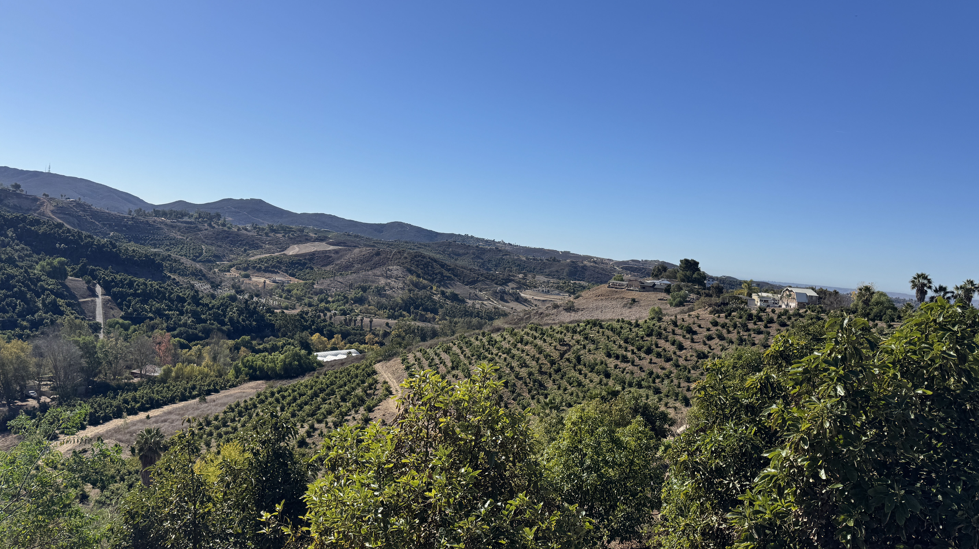
Communications & Customer Service
COMMITTEE MEETING
April 22, 2025

Slide 2
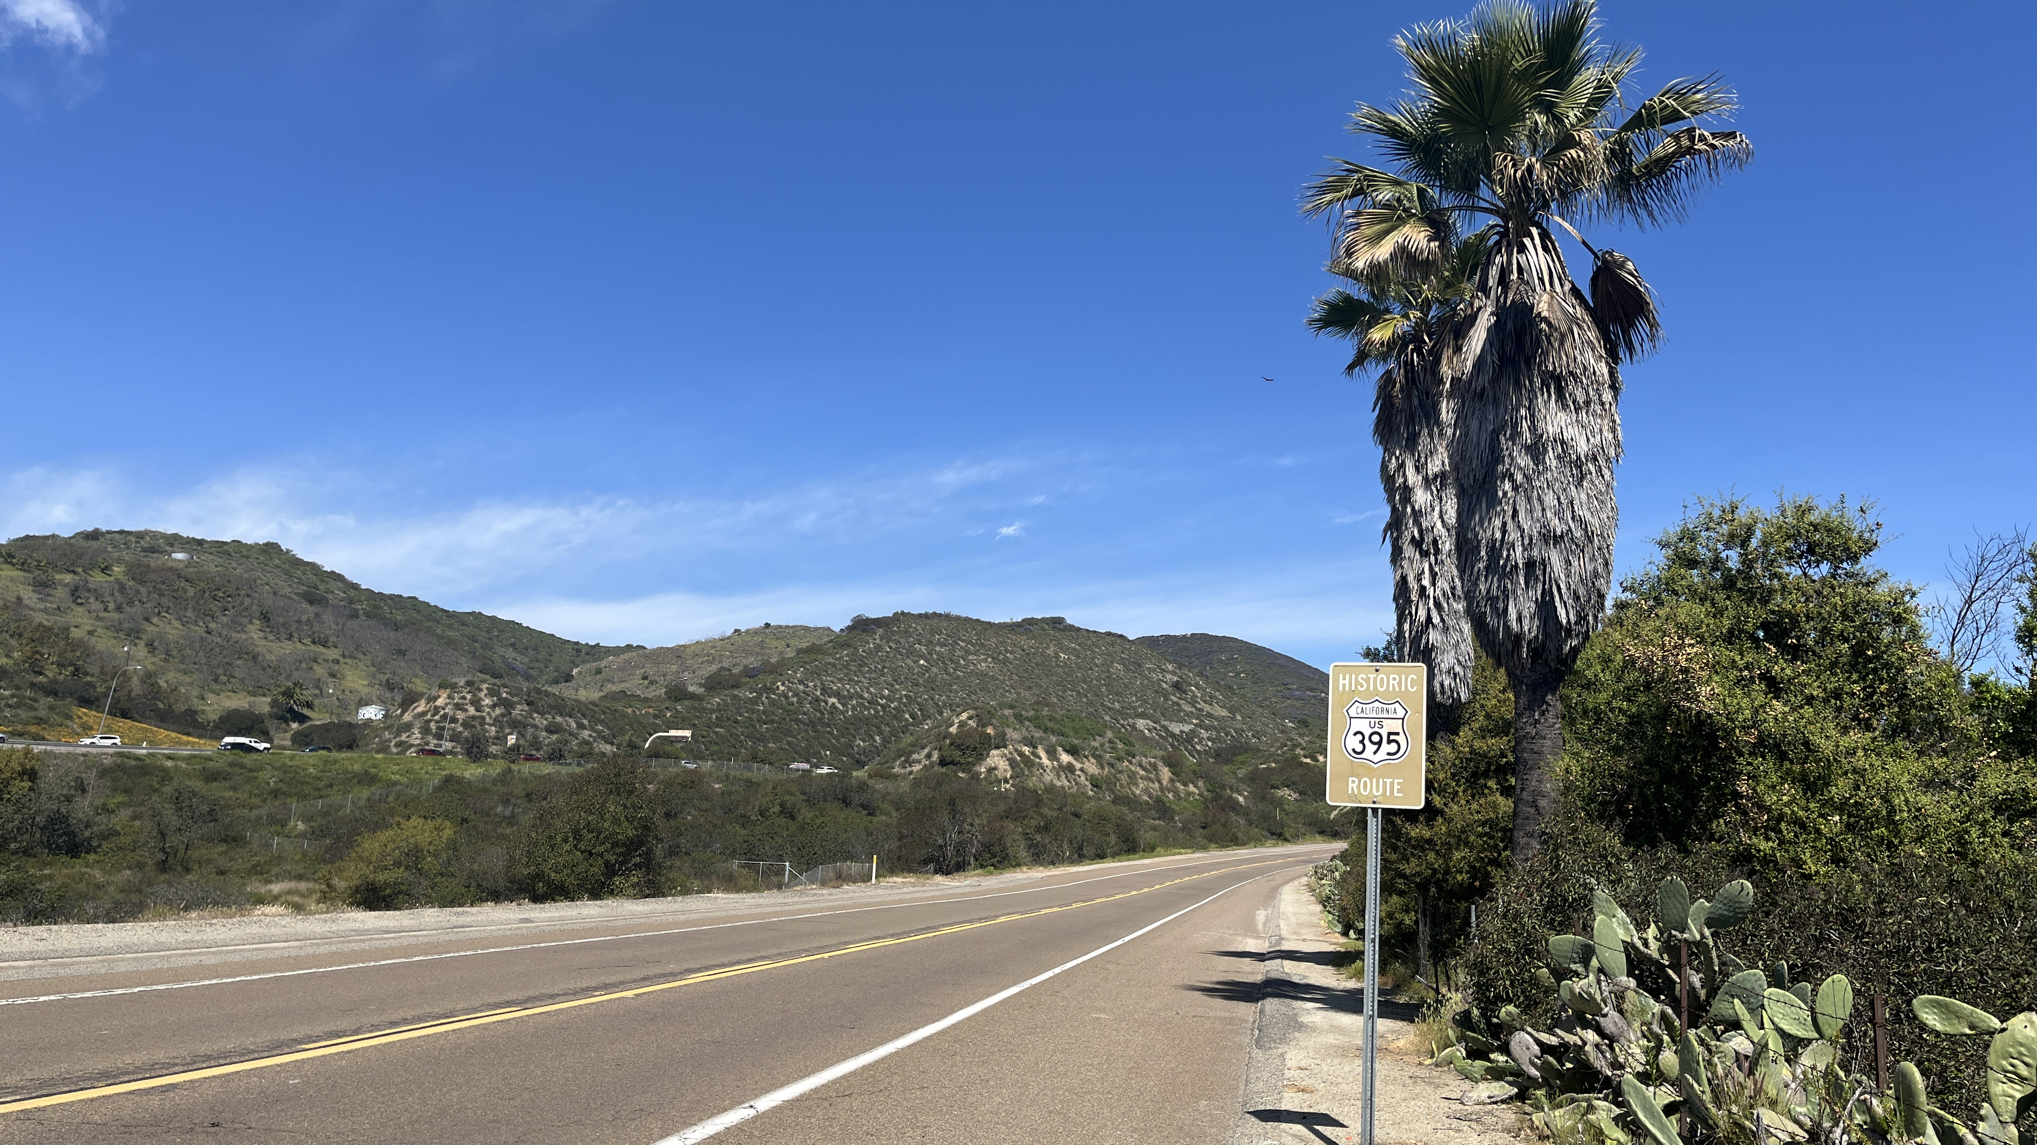
Agenda
Approval of Minutes
General Manager Comments
Committee Member Comments
Communications & Customer Service Meeting | April 2025

Slide 3
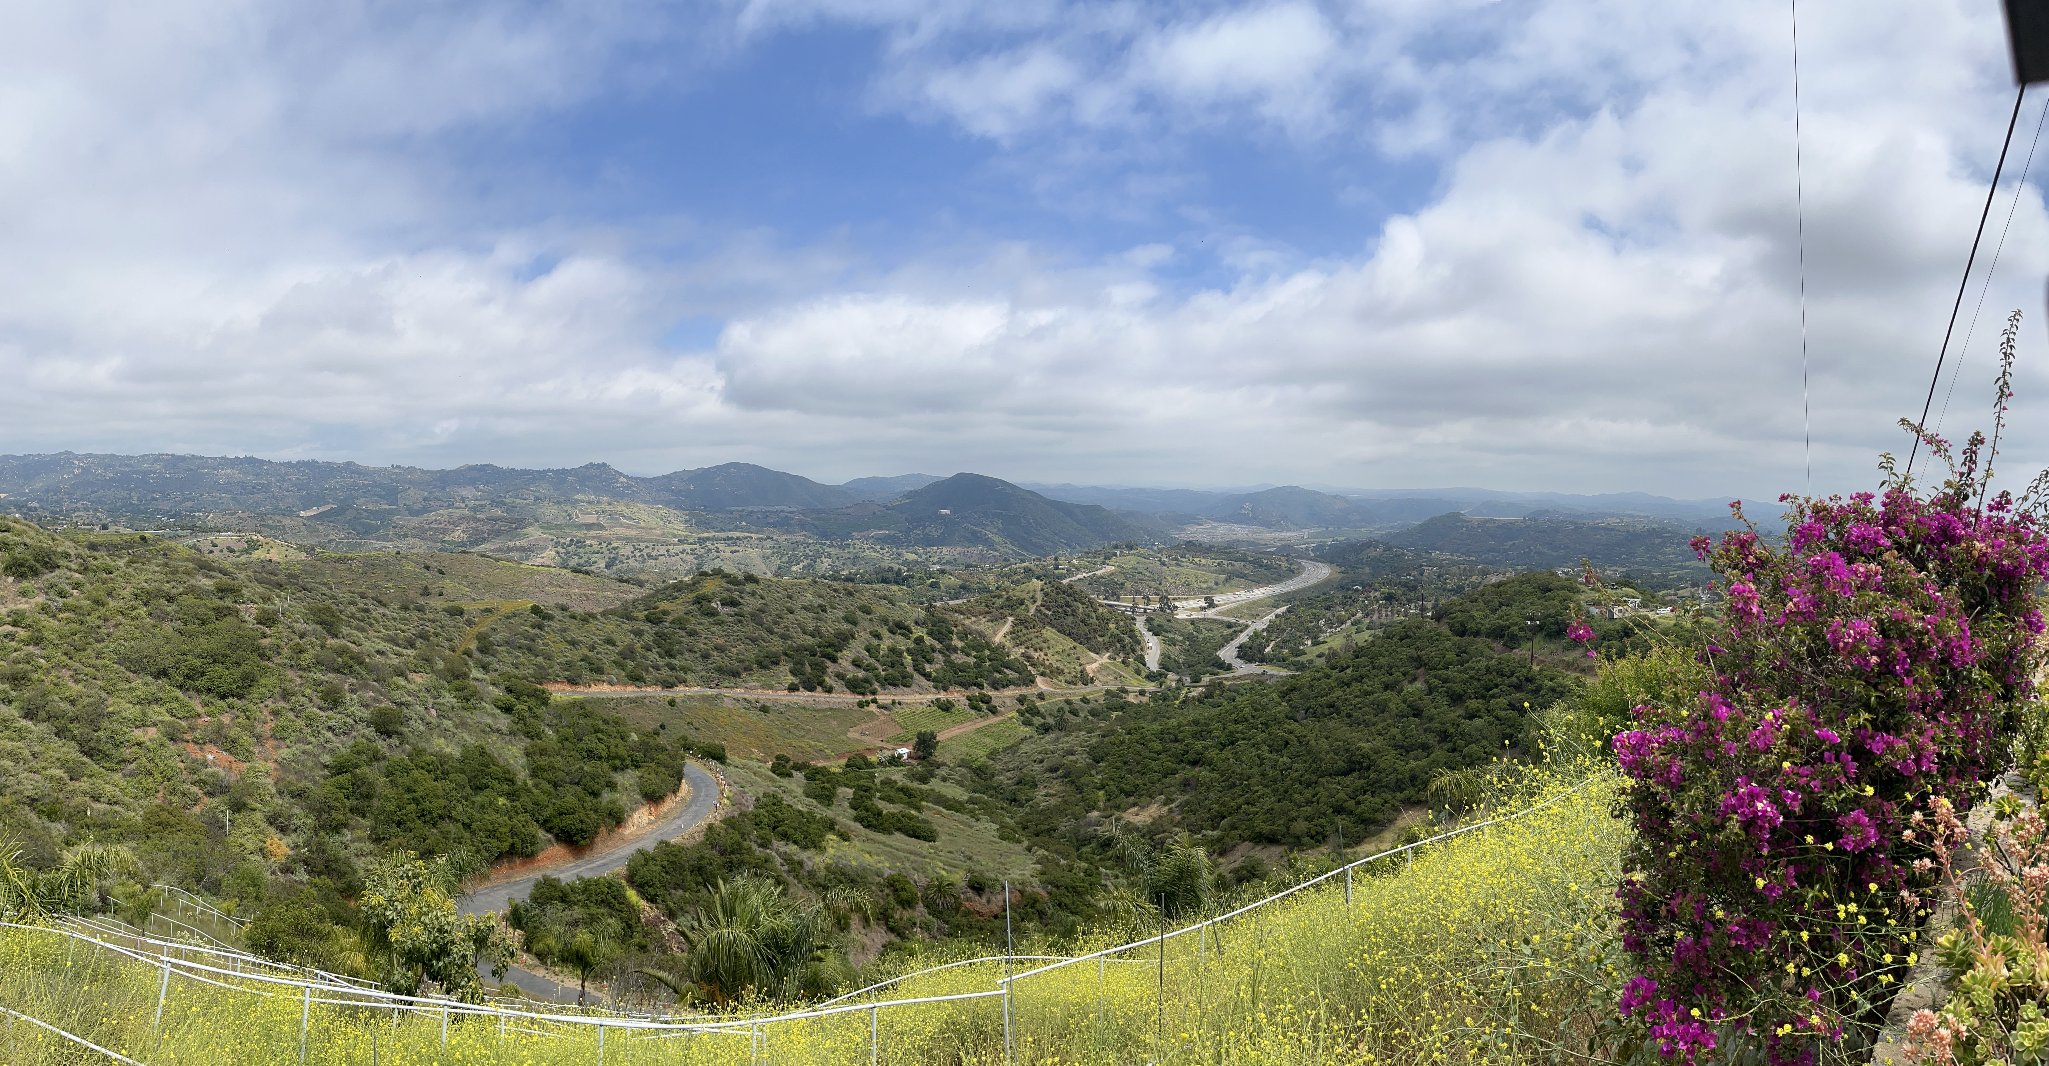

Strategic Communications Plan
Implementation Update
Communications & Customer Service Meeting | April 2025

Slide 4




Strategic Comms Plan Implementation
Phase Checklist
Phase 4: FY26 Q3
Phase 3: FY26 Q2
Annual Review & Update
Review and update Strategic Comms Plan addendum
Conduct staff review to realign comms priorities & adjust needs
Phase 2: FY26 Q1
Measurement & Toolbox Rollout
Set up internal comms metrics dashboard
Finalize comms toolbox (digital assets, print collateral)
Present year-end comms summary to Committee
Phase 1: FY25 Q4
Target Audience Engagement & Content Development
Build and design 6-month content calendar
Update and create brand collateral
Launch e-Newsletter
Foundation & Internal Alignment
Distribute final plan to staff
Committee & Board
Present at All-Hands meeting
Finalize & share internal brand guide
Create & distribute How-To video series
Add Digital Media Policy to Administrative Code
Begin event outreach
Launch feedback survey
Communications & Customer Service Meeting | April 2025
Notes:
Goal 4: Share emergency prep info at Wildfire Symposium event, newsletter, rack card, billing message, eblast and website

Slide 5





Progress Toward Strategic Goals
Goals Progress Report
Goal 1 Provide Reliable, High- Quality Water & Wastewater Services
2025 Water Quality Report and Budget Report in production FY25 Q4
Budget overview presented to committee 4/15 and workshop on 5/6
Proposed budget maintains fiscal responsibility and inflation aligned rate increase
Goal 2 Strengthen Customer Relationships & Public Trust
Avocado Festival: customer engagement, Q&A
Customer feedback survey prepared for FY25 Q4
Provide rebate info and project updated in billing message, newsletter and website
Goal 3 Ensure Transparency & Dialogue on Key Issues
Customer feedback encouraged through public meetings and workshops
City of Oceanside fee increases communicated clearly and openly
Joint letter from EMWD on Infrastructure Availability Surcharge & Detachment
Provide timely updated on construction projects and traffic impacts to community
Consistent messaging on website, newsletter and Customer Service team
Goal 4 Promote Preparedness, Efficiency & Innovation
Build emergency readiness communications via eblast, collateral, newsletter,
Wildfire Symposium
Partner with local agencies to promote landscape workshops from Met
Project of the Year award submissions for APWA & CSDA
Expand school outreach: career events, Volunteer Program & Speakers Bureau
Notes:
Goal 4: Share emergency prep info at Wildfire Symposium event, newsletter, rack card, billing message, eblast and website
In person and virtual workshops in our area from Coastal to SW Riverside County

Slide 6
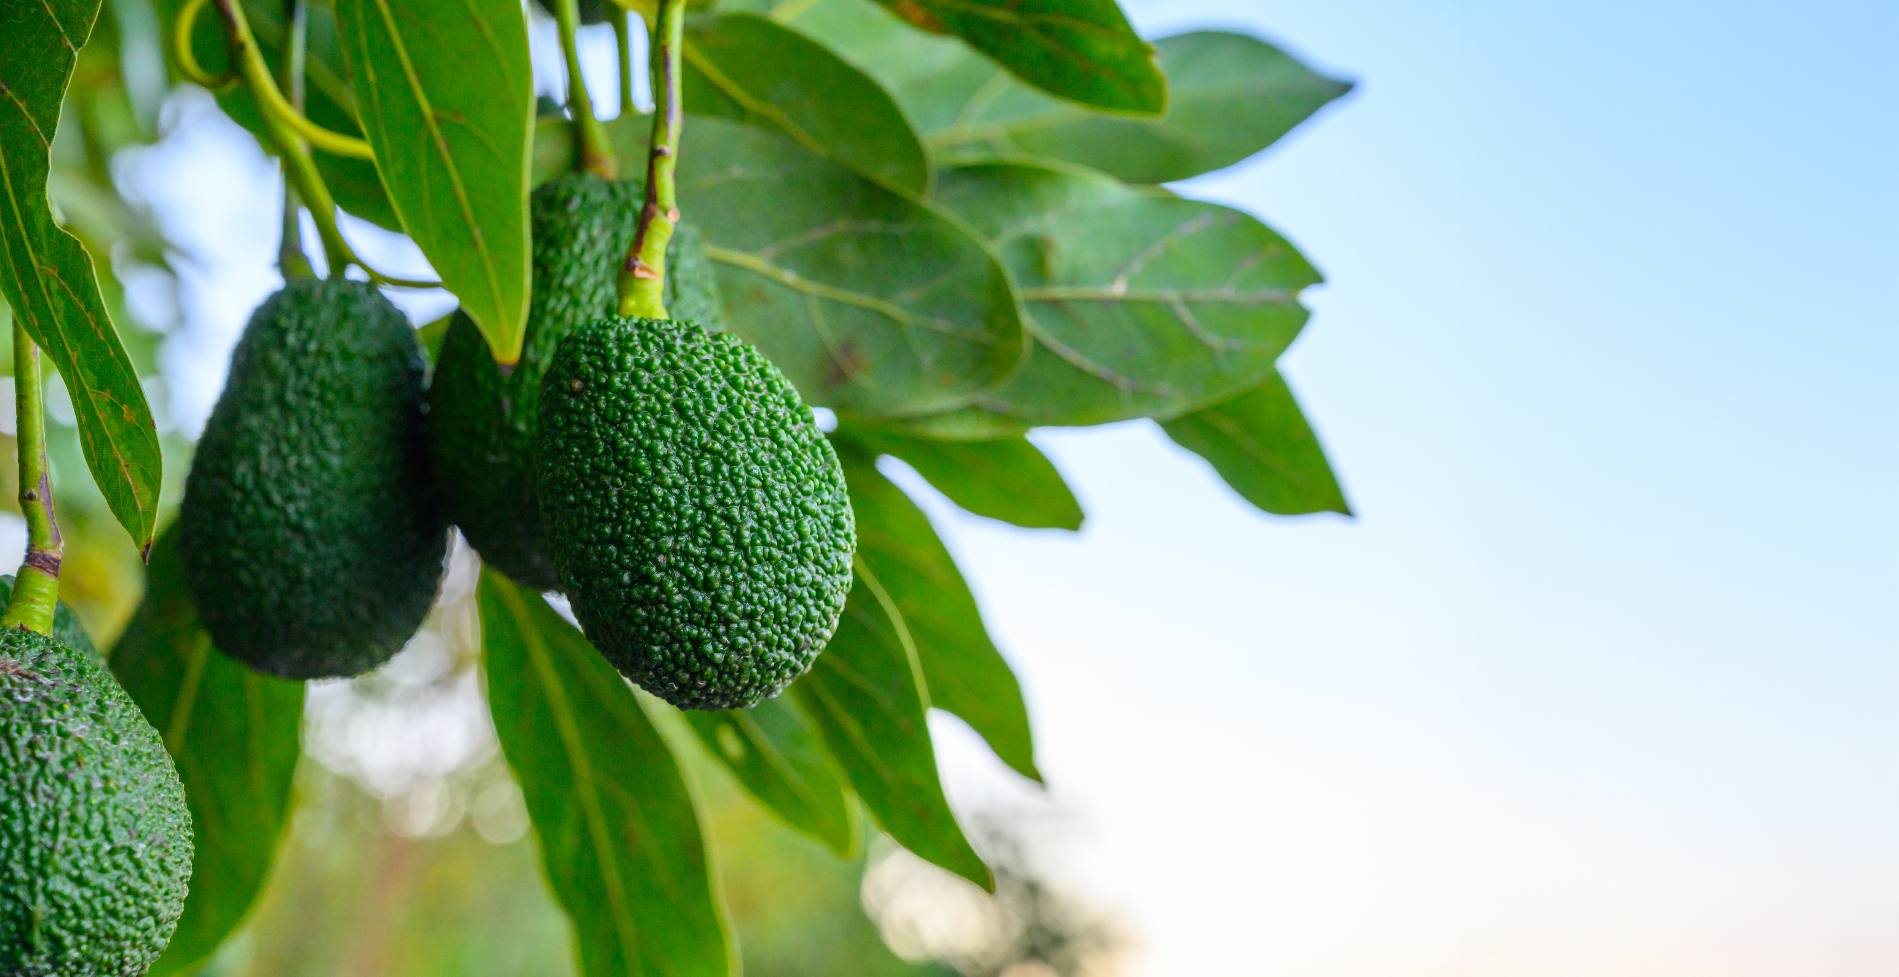
CropSWAP
Program Update
Communications & Customer Service Meeting | April 2025

Slide 7

One Year Program Update
Program Launched April 29, 2024
High volume of interest from customers since launching interest list in July 2023
Largest concentration of applicants came from Division 1
Awarded $200k in project funds in first two months and dipped into the communal grant pool
Awarded over $1M in first eight months of the program
Rainbow Water led with most
grant applications
Monitor & Report
Monitor
Communications & Customer Service Meeting | April 2025
Notes:
We started this journey in Feb 2023 to gather input form District stakeholders on how we can develop a Strategic Comms Plan. We listened to feedback from the committee at last months meeting and applied those changes. Some have already been implemented and the plan was designed from the draft to the document in your agenda packet. The final proof is now available for available for comments or notes prior to board submittal.

Slide 8
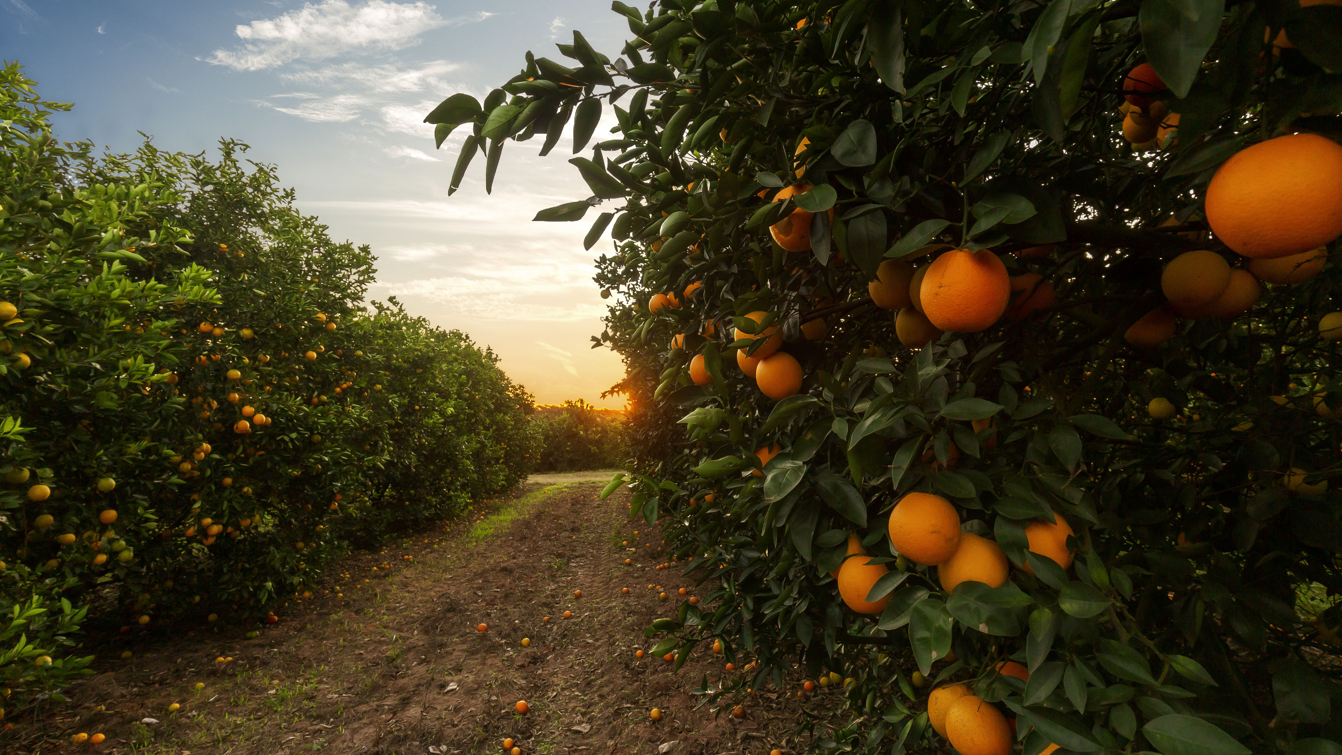




CropSWAP Program
_
89
Applications 2024-2025
$1,041,450
_
42
Projects Approved
16
Pre-Inspection/Wait-list
Total 24-25
Reserved Grant
Funding for
Approved Projects
_
23
Projects Completed & Paid Total to Date: $352,750
Notes:
Applications received since December: 3 total
Projects completed and paid: 5 total of those projects: $70 K paid to Avocado Rootstock Mulching Avocado Rootstock Avocado Tree Rejuvenation Scheduling Automation
Promotion of the program is on hold pending new grant funding opportunities

Slide 9
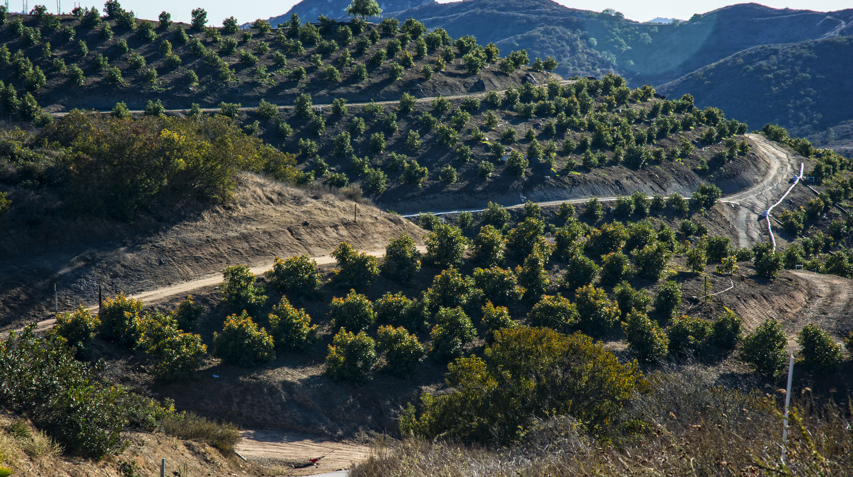
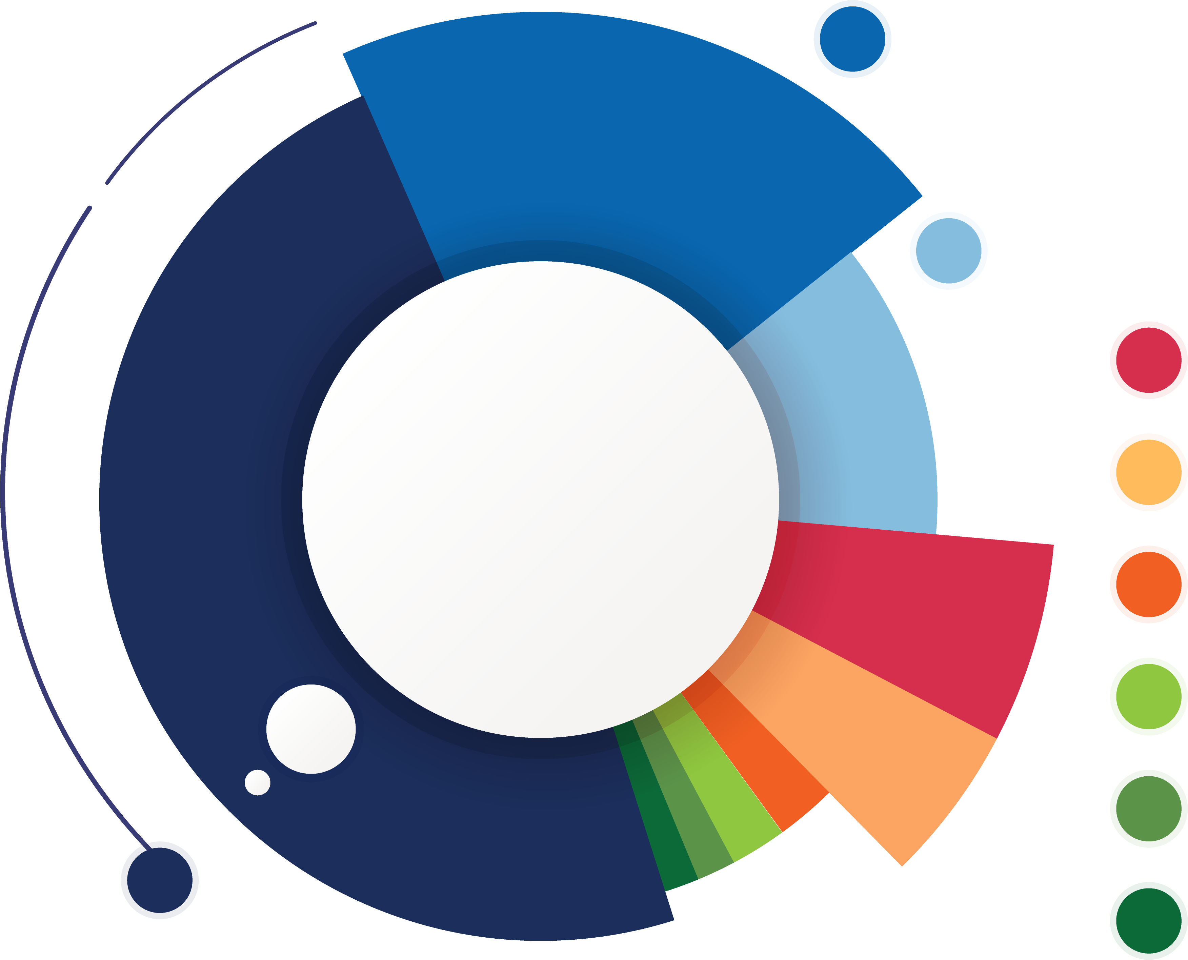
Total Applications by Project Type
17
Crop Conversion
11
Avocado Rejuvenation
8
Soil Moisture Sensors
7
Scheduling Automation
6
Mulching
5
Uniformity Improvements
2
Nutrient Management
2
Cover Crops
31
Avocado Rootstock

Slide 10
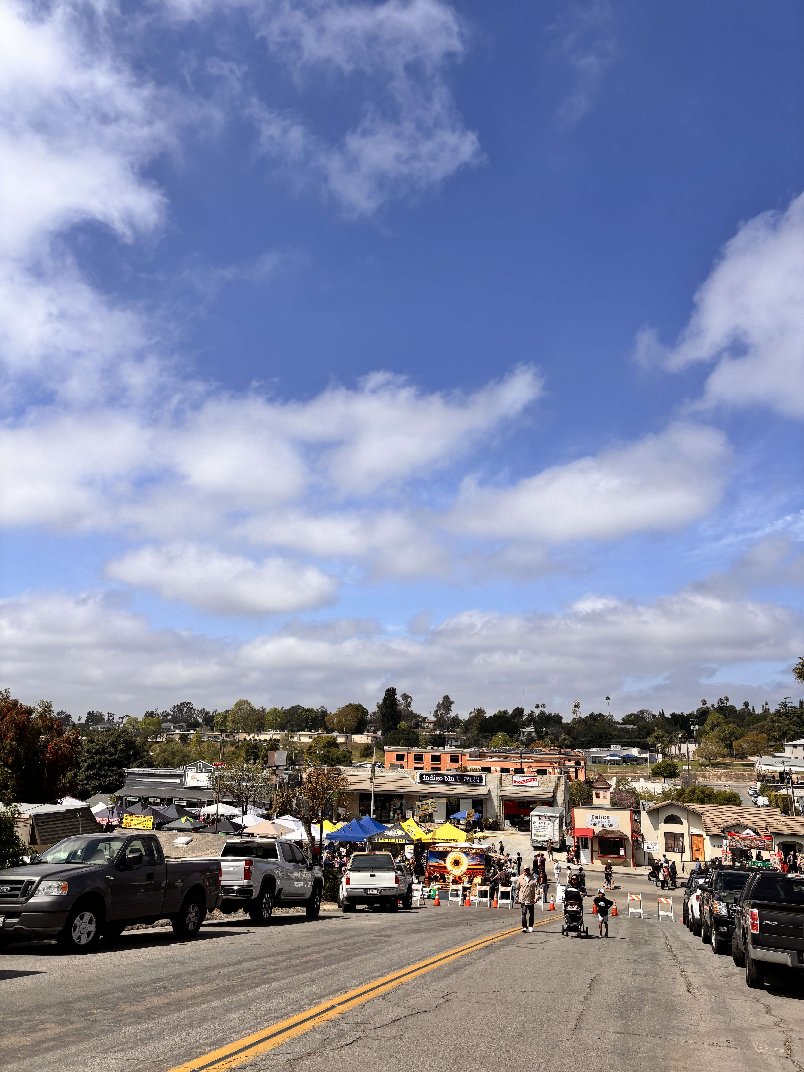
Community Events
Spring Update
Communications & Customer Service Meeting | April 2025

Slide 11

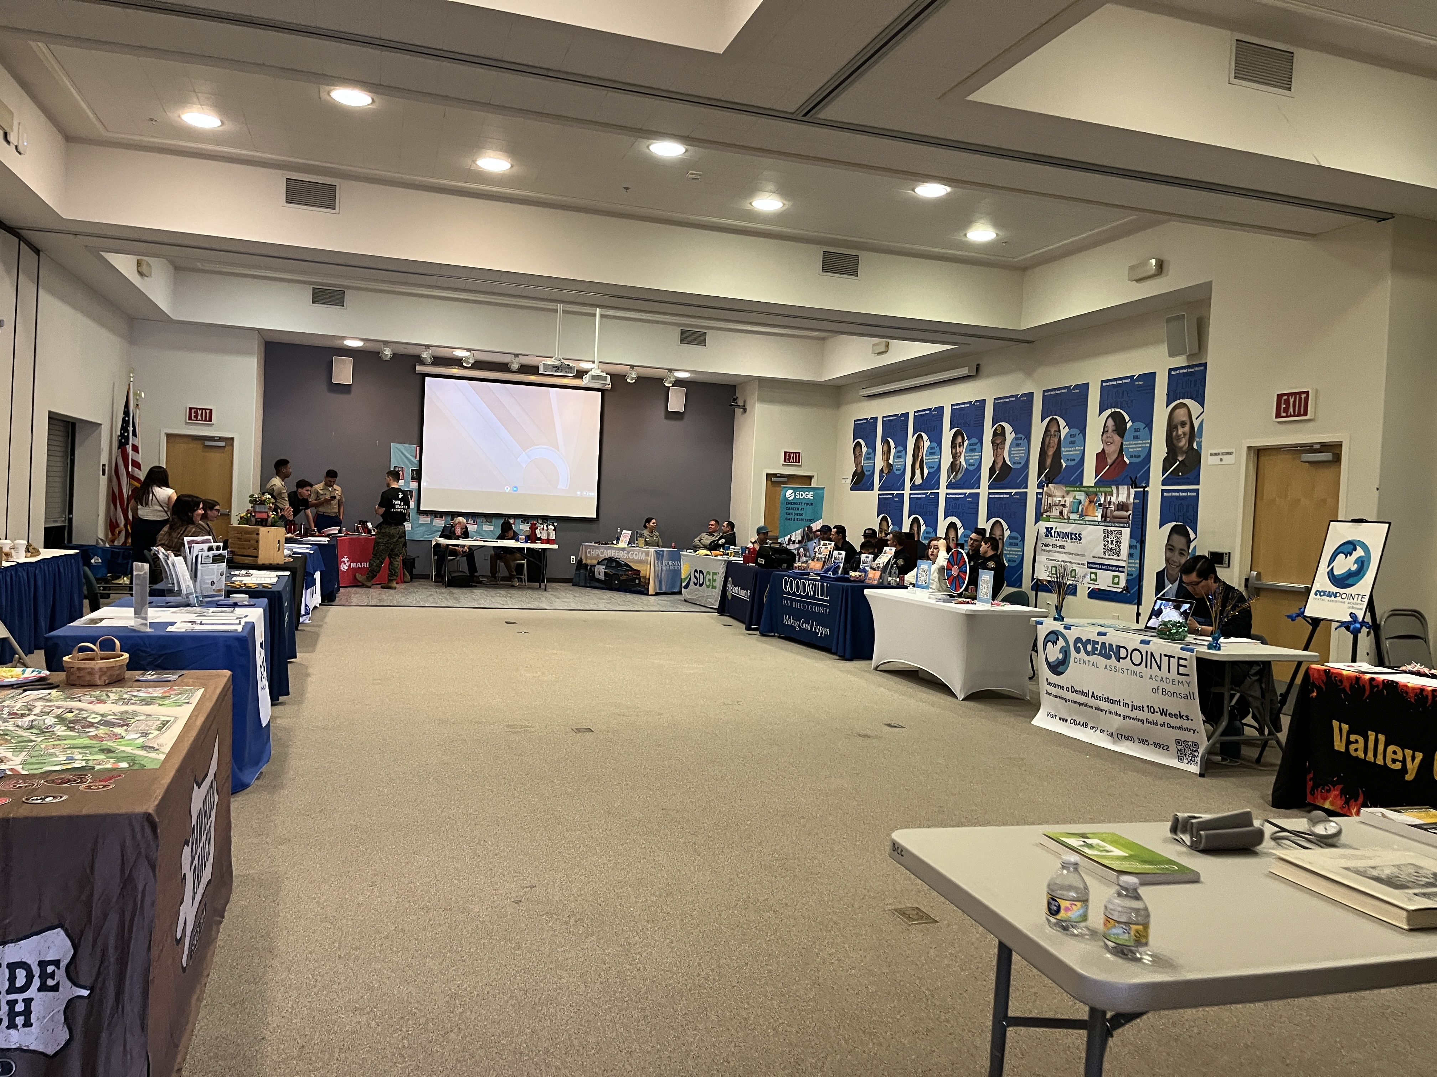

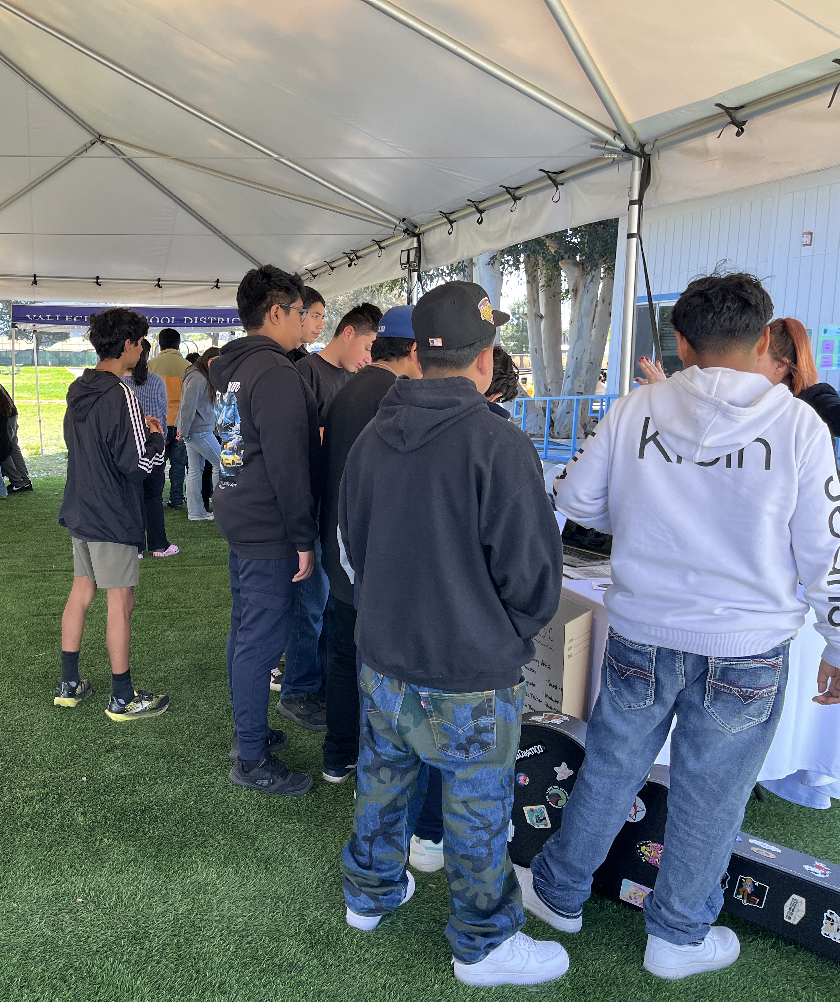
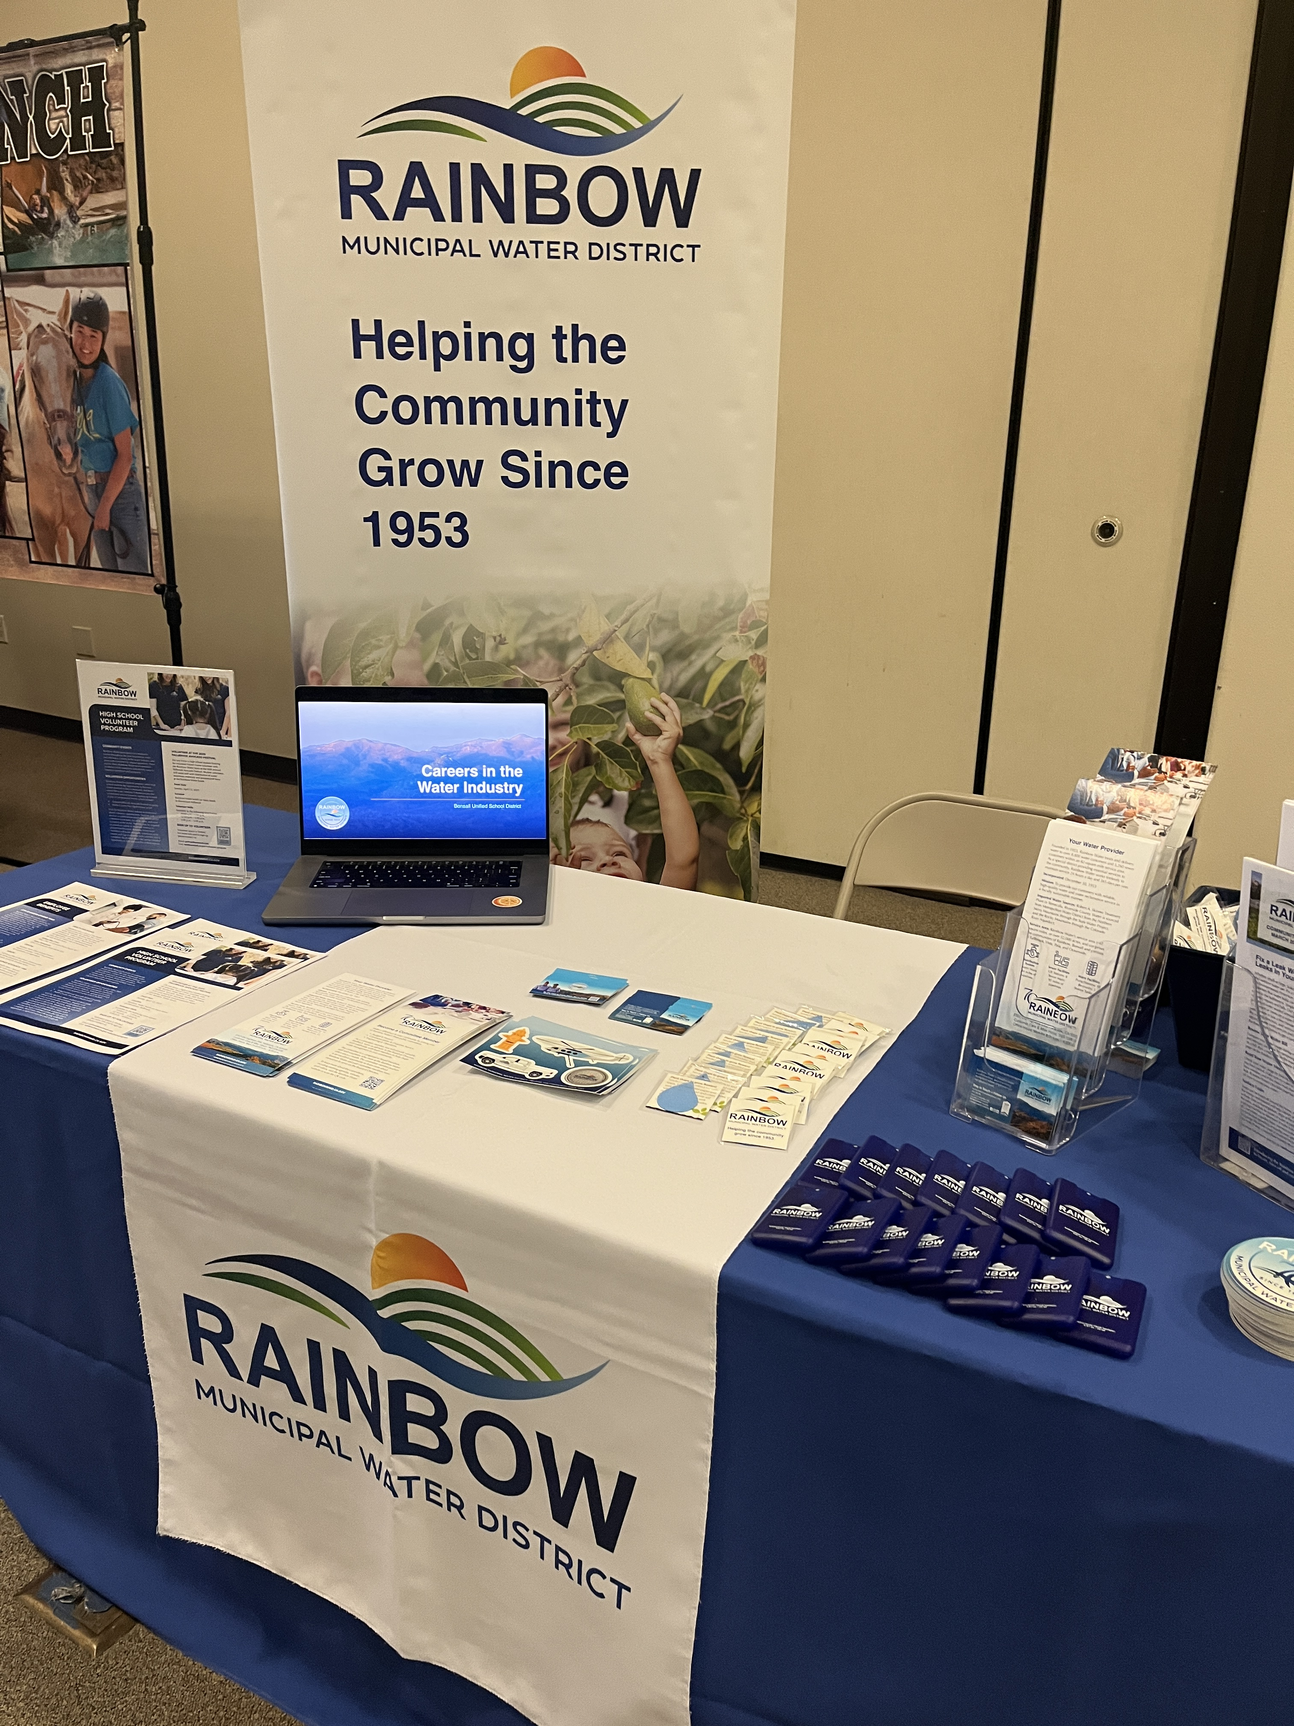
2025 Spring Career Fairs
March 27 & 29
Vallecitos School Career Fair
Bonsall Community Spring Job Fair hosted by BUSD
Staff met with students and members of the community to share information on careers in the water industry.
Networked with community organizations and BUSD staff.
Event invitation was led by previous outreach efforts and relationships
with staff.
Notes:
Event booth space is free. Allow us to showcase Rainbow Water as a community resource, opp to promote high school volunteer program, solicit volunteers for Avocado Festival booth.

Slide 12

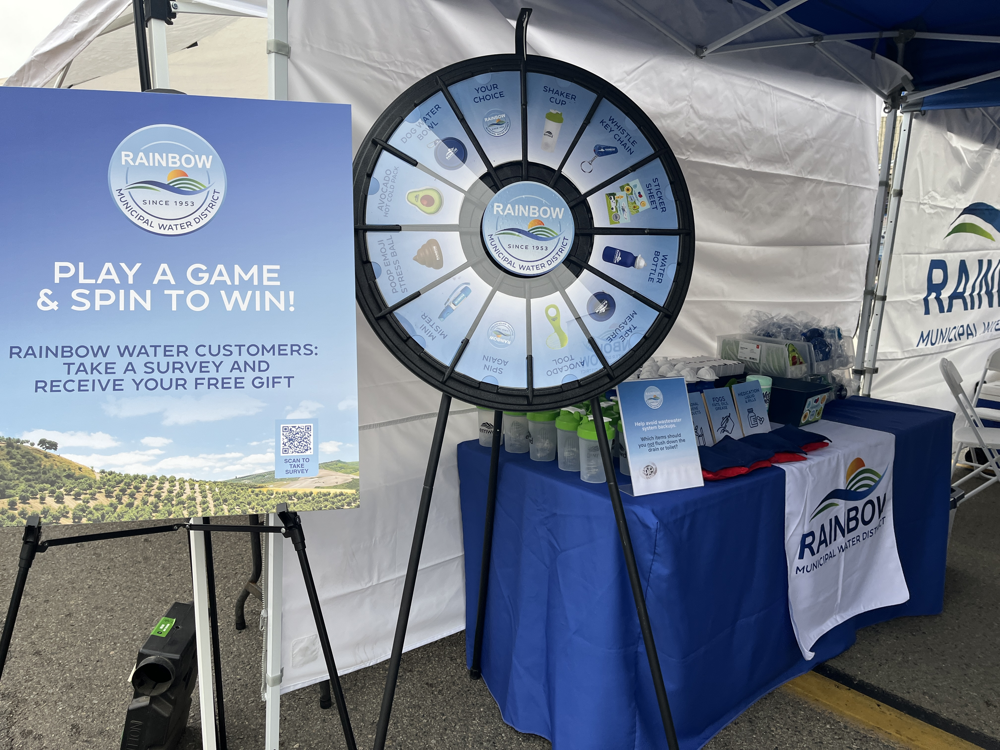


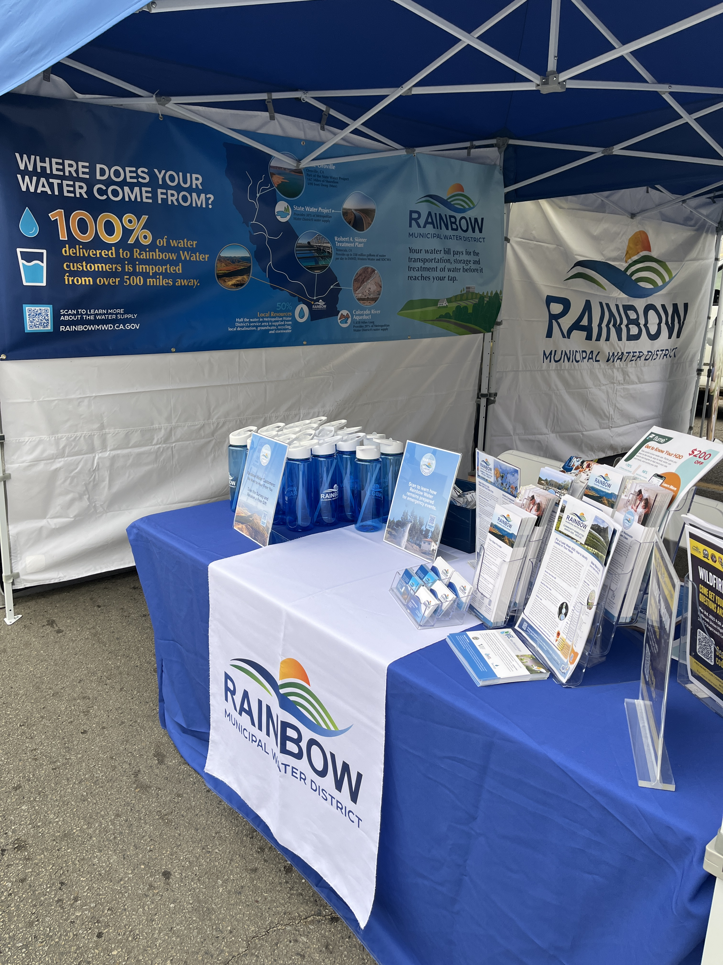
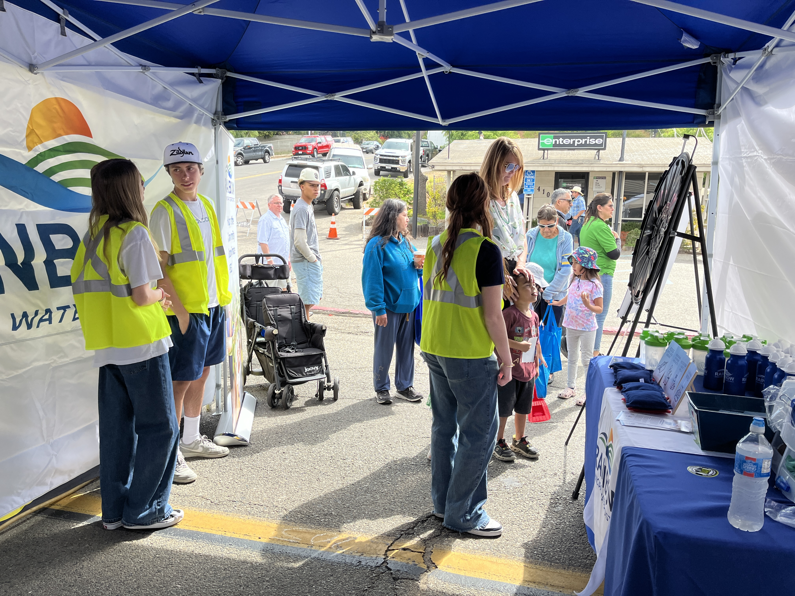


2025 Avocado Festival
April 13
Staff worked alongside high school student volunteers to engage with the public and answer customer questions.
_
Customer Surveys
Avg score 4.4
22
Engaged in conversation with customers & community members
Promoted programs and
Wildfire Symposium
Launched the Volunteer Program for high school students to earn community service hours
Notes:
57% response increase for surveys conducted by scanning QR code on signs
Engaged in meaningful conversations with customers mostly in the mid morning to mid afternoon
Most rate of surveys from 11am- 1pm
Passed out flyers to promote the Wildfire Symposium where guests scan code to RSVP to North County Fire
Volunteer program successfully launched with students assisting staff

Slide 13




2025 Avocado Festival by the Numbers
_
55
Event Prep & Planning Hours
_
30
Staff Event Hours
$3,900
Total Event Supplies
Promotional Items and Event Supplies
Printing Services
Booth Rental to Fallbrook Chamber
Annual Chamber Membership Fee
_
Booth Visitors
_
15
900+
Volunteer
Hours
_
1,090
Promo Items
8 Staff Members
5 High School Volunteers
Notes:
Total of 8 staff members, five high school volunteers helped make the event a success.
Volunteers assisted with new corn hole game of what not to flush, then spin to win a prize.
Event prep involves planning, developing collateral, inventory, design of promotional items, space planning, purchasing and organizing products.

Slide 14




2025 Spring Events
May
Wildfire Symposium
Saturday, May 3
9:00 am - 12:00 pm
Fallbrook Union High School
Joint community event with NCFPD, Cal Fire, SD County Fire, SD Sheriffs Dept, Fallbrook Regional Health District, FPUD
Staff planning and prep for the event
Event table to meet with customers, pass out info and promotional items
May
School Field Trips
Weds, May 7
7th Graders from Sullivan MS
Weds, May 21
10th Graders from BHS
Field trip is a
collaborative
effort with
City of Oceanside. Students will tour the
San Luis Rey Wastewater Treatment Plant and learn about STEM careers in the water industry.
June
San Diego Blood Bank – Mobile Unit Blood Drive
Thurs, June 17
Rainbow Water parking lot
Second blood drive event
All donors will receive a free SD Padres t-shirt
Cross promotion with community orgs: Bonsall Chamber, Fallbrook Regional Health District
Communications & Customer Service Meeting | April 2025
Notes:
Field trip confirmed, flyers and permission slips to email out next week when students return from Spring Break.
Sign up for the blood drive on the Rainbow Water website.

Slide 15
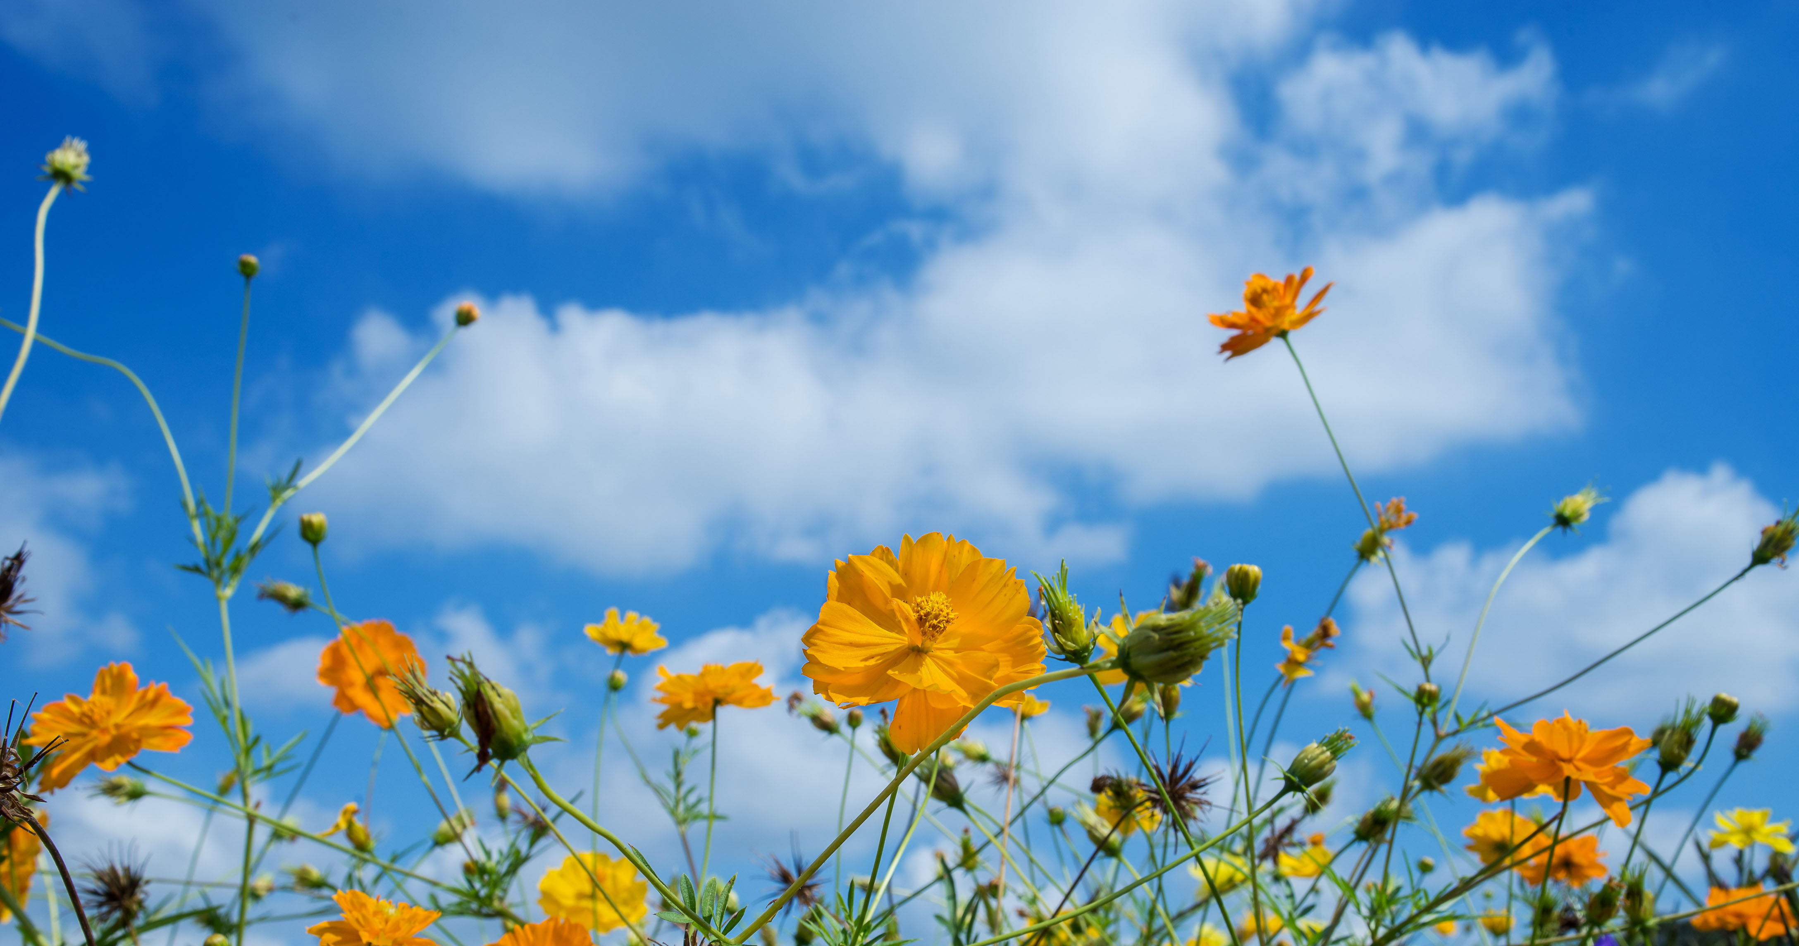
Newsletter
Content Planning
April – June 2025
Communications & Customer Service Meeting | April 2025

Slide 16
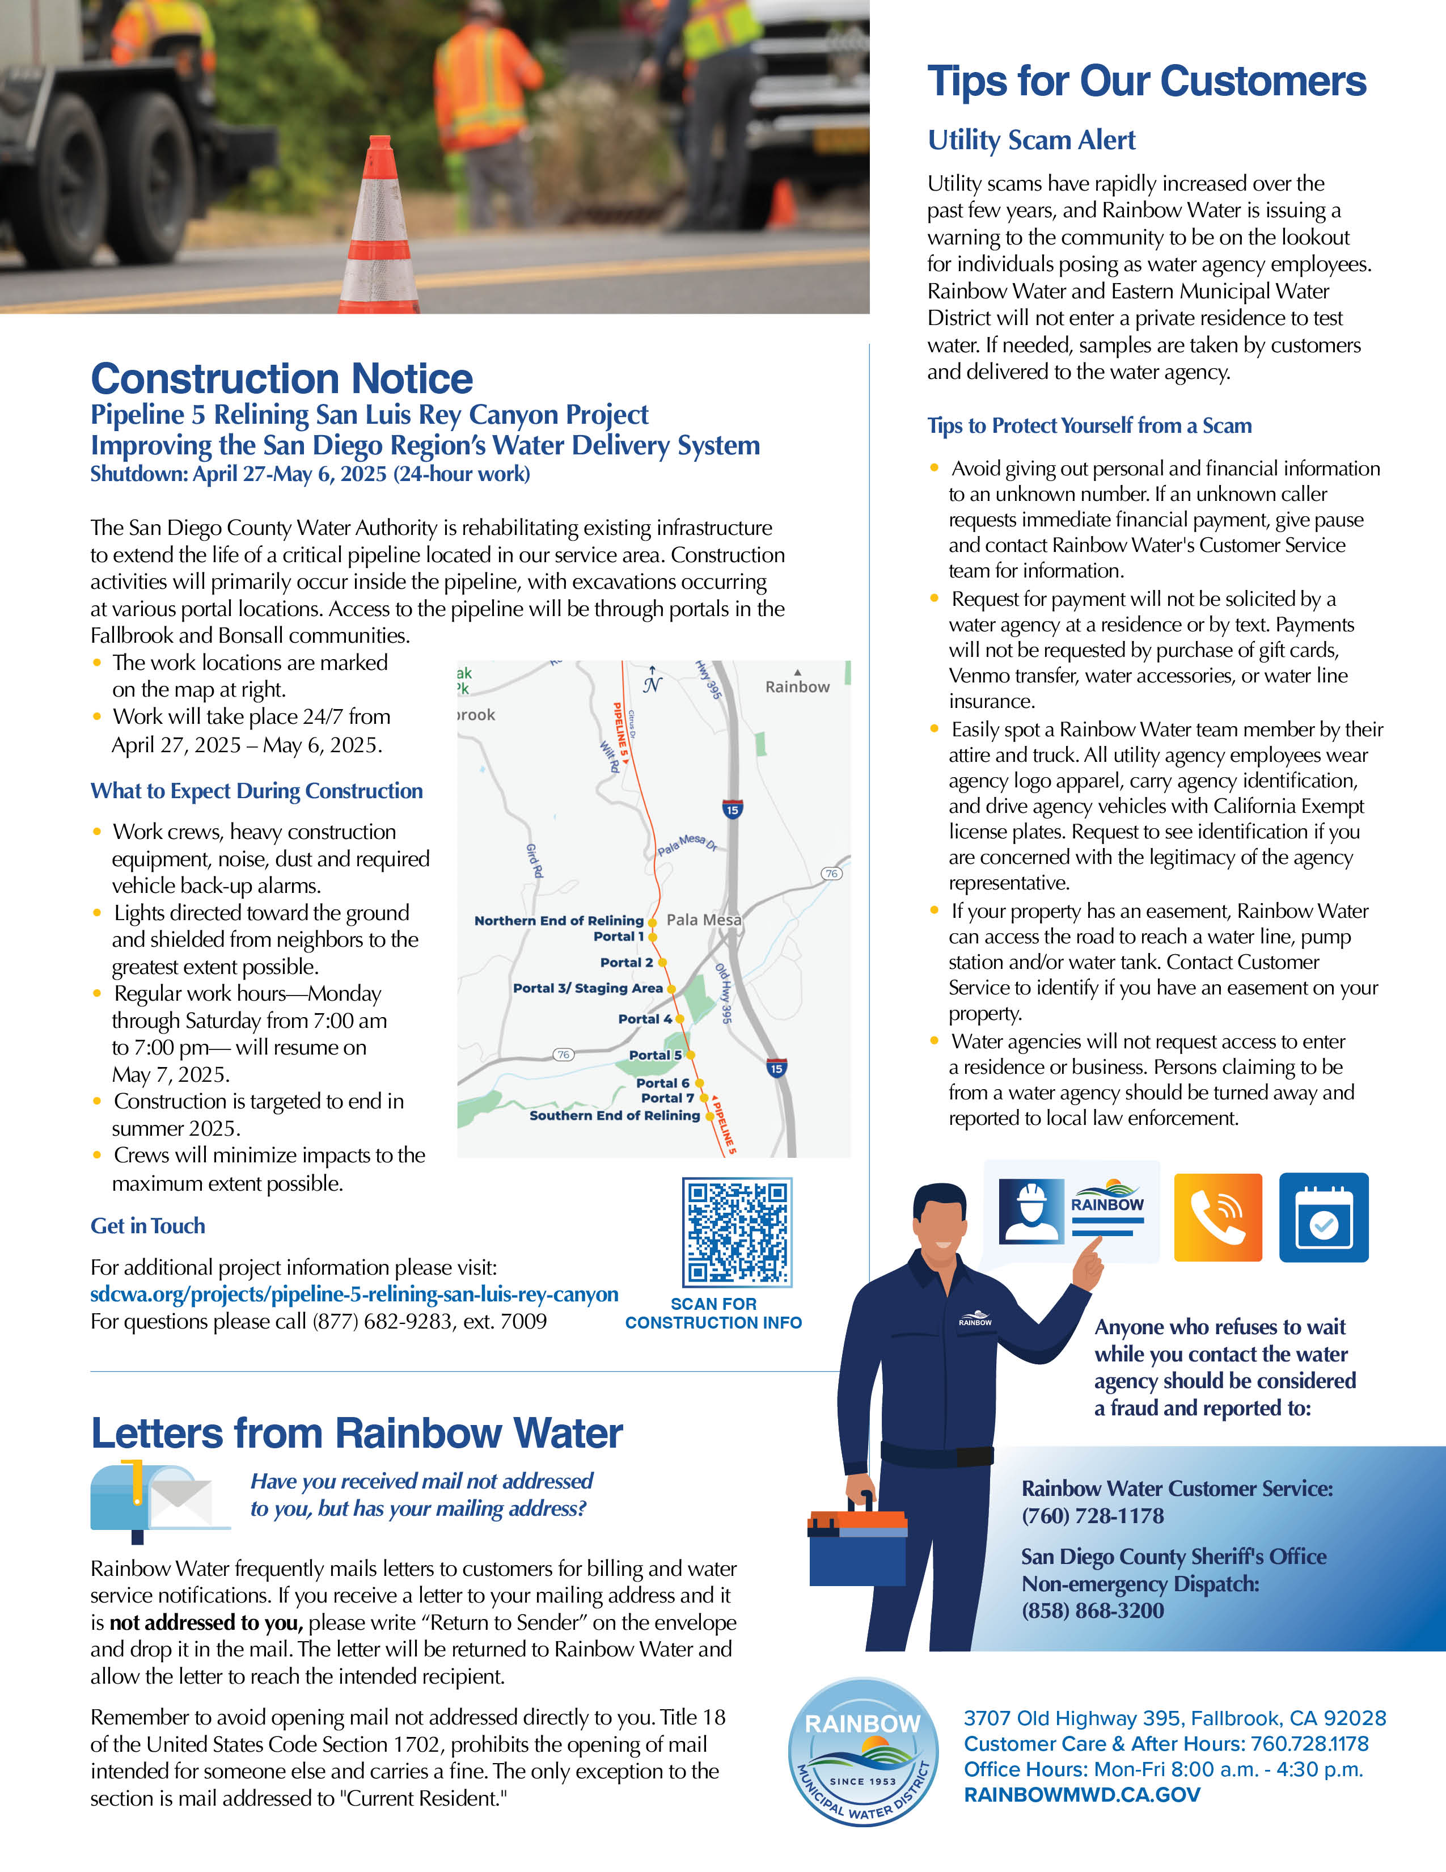

Newsletter Review
April 2025
Make Earth Day Every Day
  Small changes with a big impact: prevent water waste, shop local, recycle, Chipping Day, and SoCal Water$mart rebates
  Landscape Workshops from Met
Wildfire Symposium
  Sat, May 3 at Fallbrook Union HS
Construction Notice
  Pipeline 5 Relining: 24-hour work notice
Letters from Rainbow Water
  Reminder to avoid opening mail not addressed to occupant
Utility Scam Alert
  Who to call and how to spot a Rainbow Water employee
Notes:
Mutual aid agreement to share resources

Slide 17
Newsletter Planning
May
Celebrate Water Awareness Month
  Appreciation for the water an essential natural resources that fuels us & sustains ecosystem
  Measure your water use with a flow monitoring device from Flume
  Transform you yard this spring with native plants and take an online gardening workshop
Infrastructure Week: May 12-16
  Highlight Division 1 Pump Stations and reliability provided to the community
  Project video link
Avocado Festival Recap
  Thank you for visiting the booth, thanks to our student volunteers
Save the Date: Blood Drive in June
  San Diego Blood Bank to visit Rainbow Water
Bill Payment Options
  Pay your bill online, enroll in auto bill pay, in person at the office, and at US Bank
June
Water Quality Update
  What’s in my water? 2024 CCR Report
  Fluoride and plastics info from Met
  Where does my water come from? Virtual tour of SWP and Colorado River Aqueduct
Upgrade Your Home this Summer
  Apply online for high efficiency washer and toilet rebates
  Use water wisely, update irrigation for warm months to avoid overwatering—tips to check irrigation system
  Install a flow monitor devices to measure water flow in time for summer
Emergency Prep Tips
  Recap info from Wildfire Symposium
  Pet and Animal Disaster Evac Info
We Want Your Feedback
  Take the Customer Service Survey Online or
  at the office. Visit the office to receive your
  complimentary water bottle & dog water bowl.
Notes:
April: Profile farmers markets, opening of May: Infographic about water quality
Green gardens workshop: Goodbye Grass, hello garden with rebate info; outdoor leak detection, garden design workshop; keeping rain in the garden; CA Friendly Garden workshop; World of Succulentst; Gardening in the Shade
JULY: Keep Your Wastewater System Clean
Don’t rush to flush: items that contribute to system backups in residential and infrastructure
Proper disposal of FOGs, food waste and Rx
Video link on what happens after you flush

Slide 18
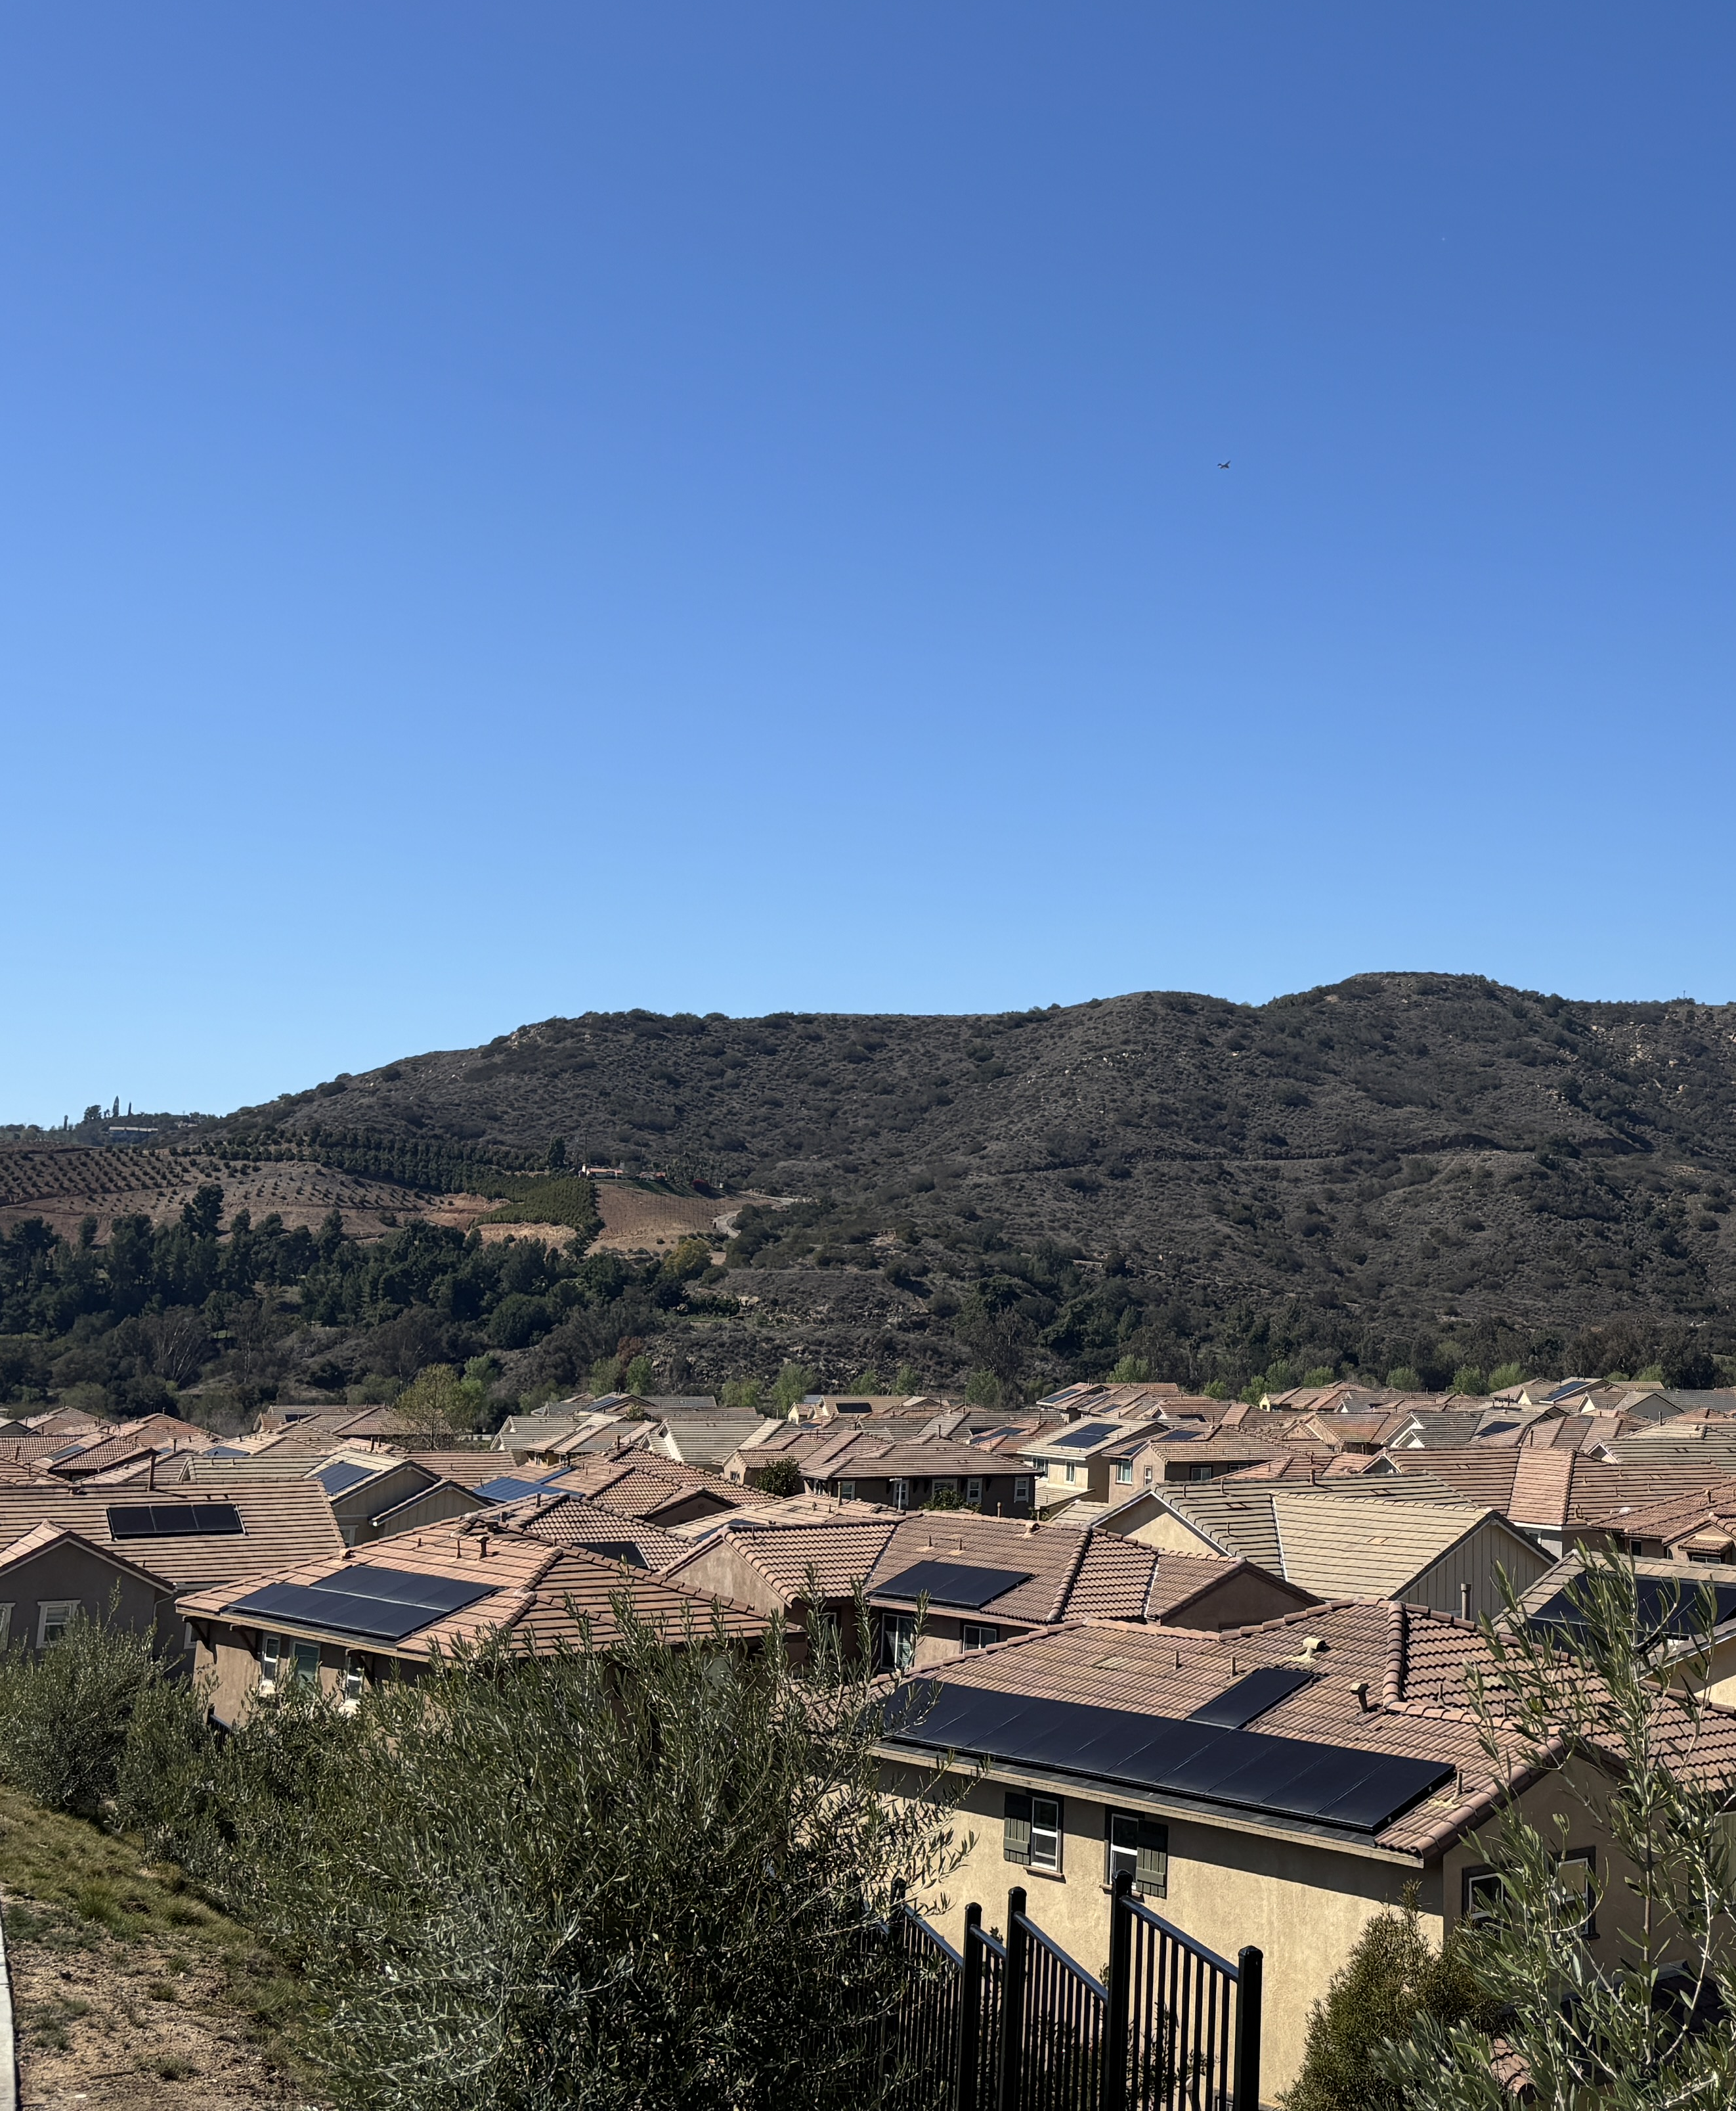
Legislative
Communications
FY 2026 Community Project Funding Update
Communications & Customer Service Meeting | April 2025

Slide 19
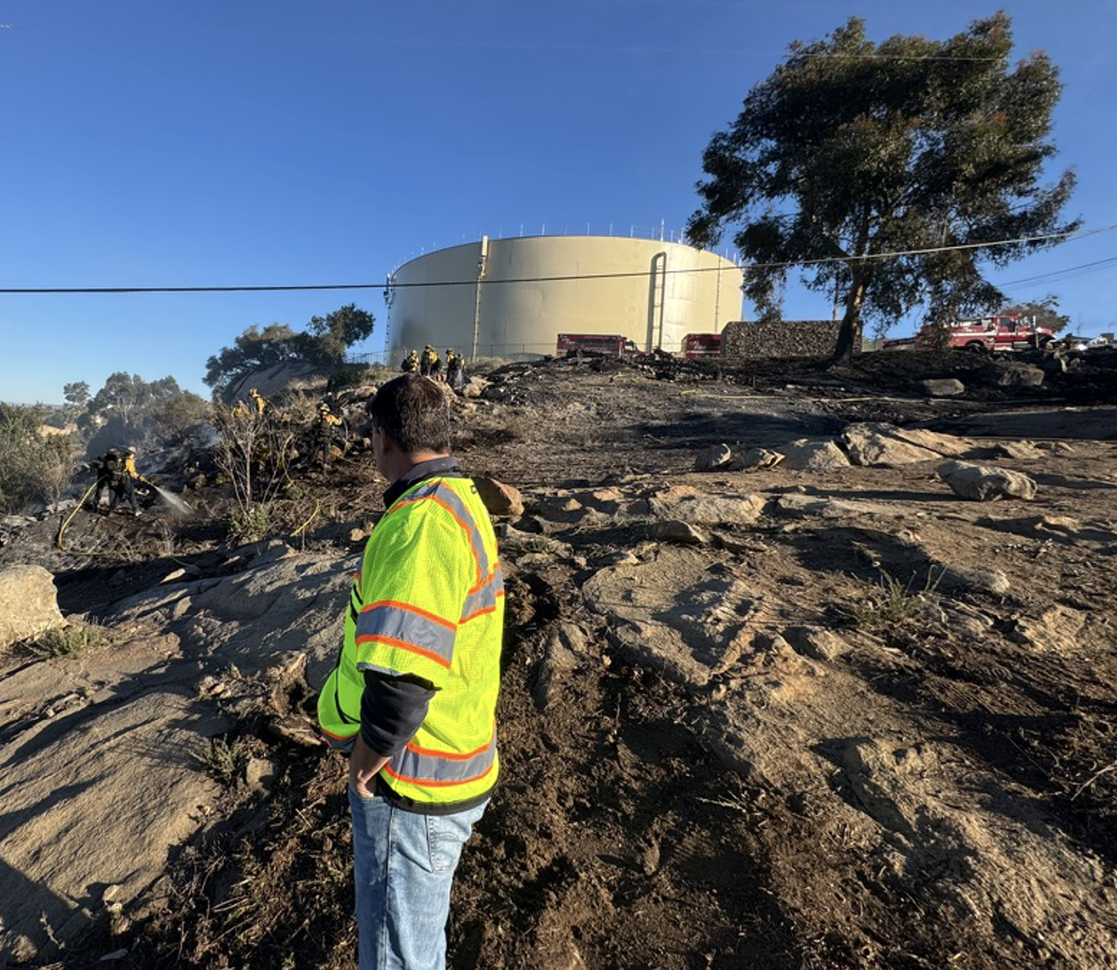




Wildland-Urban Interface: Water Reliability Projects
Addition of one “Heli-Hydrant” at Gomez Canyon
Addition of a standby Generator for emergency power at key pump station
Pipeline upgrades for fire flow requirements and additional hydrants
Communications & Customer Service Meeting | April 2025

Slide 20
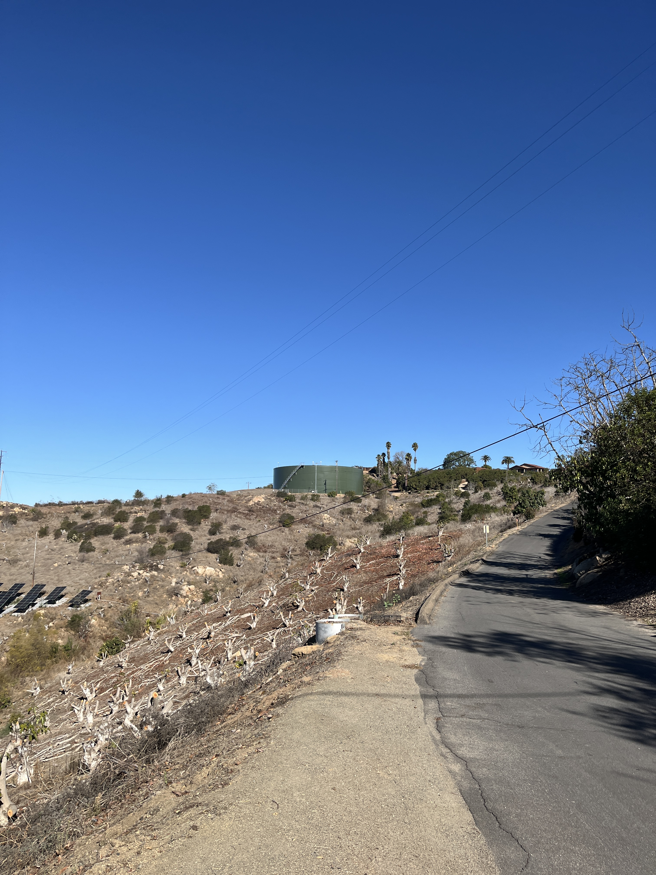
Public
Communications
& Related Media Stories
Communications & Customer Service Meeting | April 2025

Slide 21

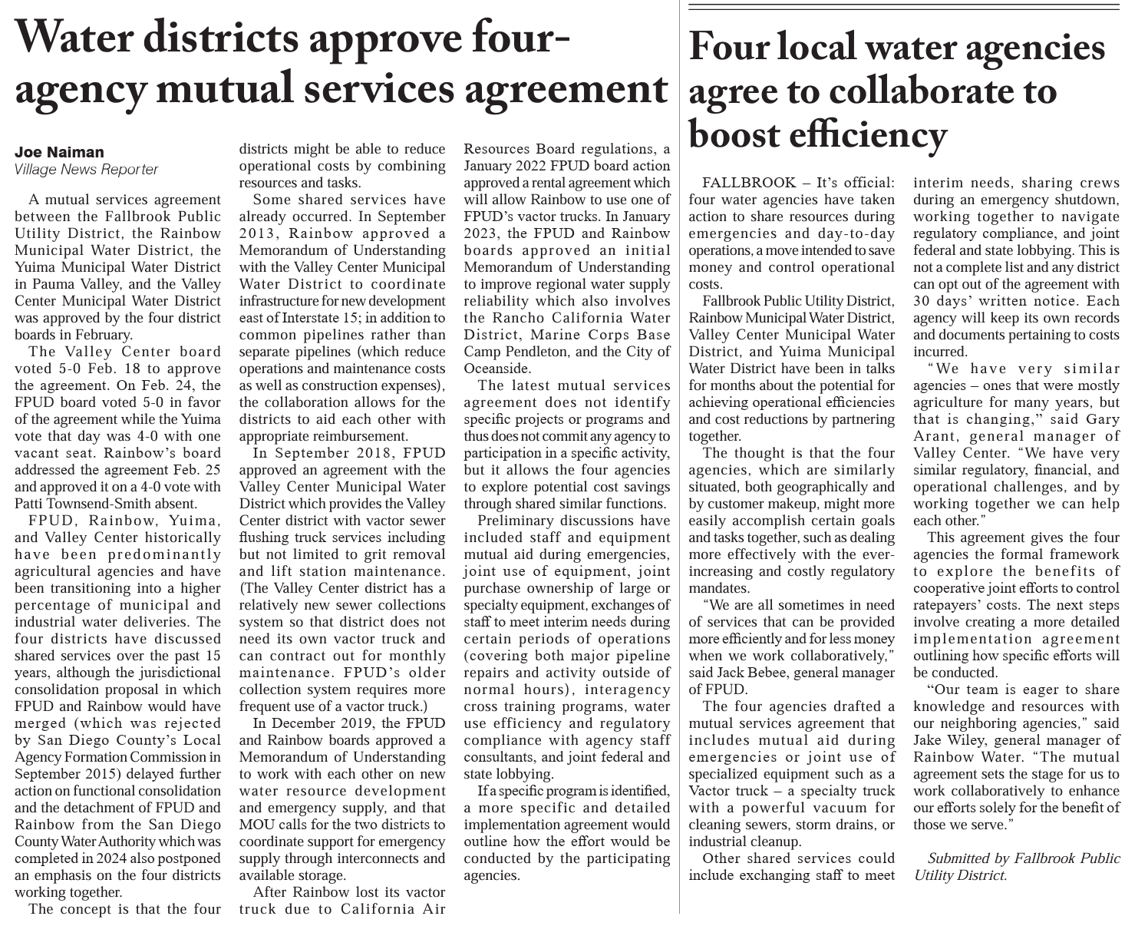
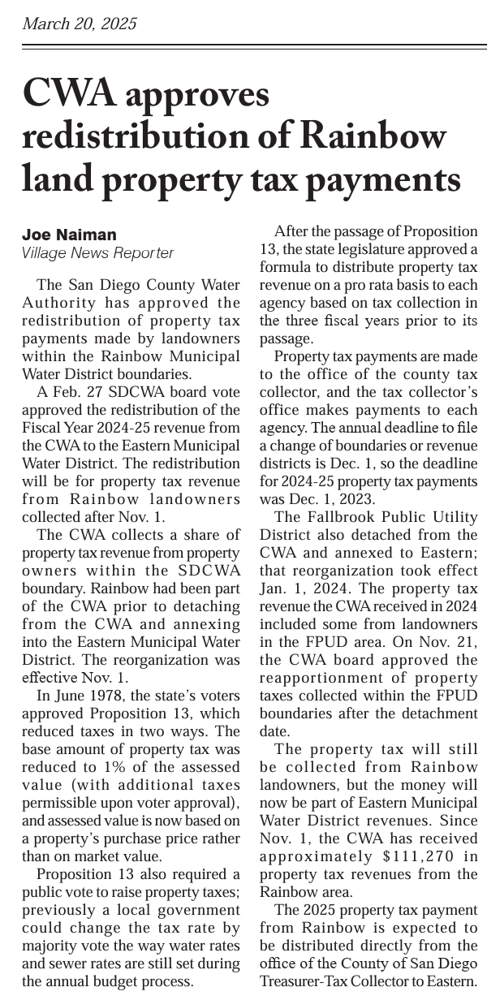
Village News
March 24
CWA Approves distribution of Rainbow land property tax payments
March 7
Water districts approve four-agency mutual services agreement
Four local water agencies agree to collaborate to boost efficiency

Slide 22
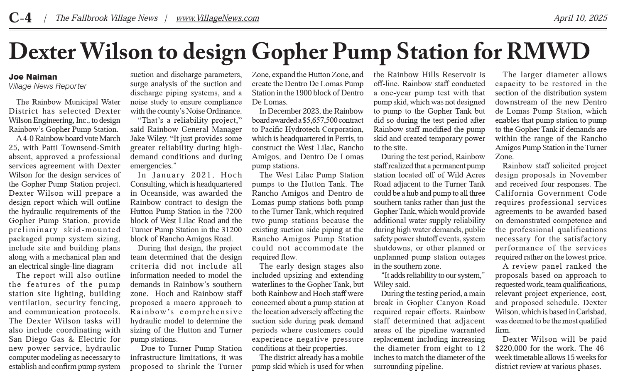
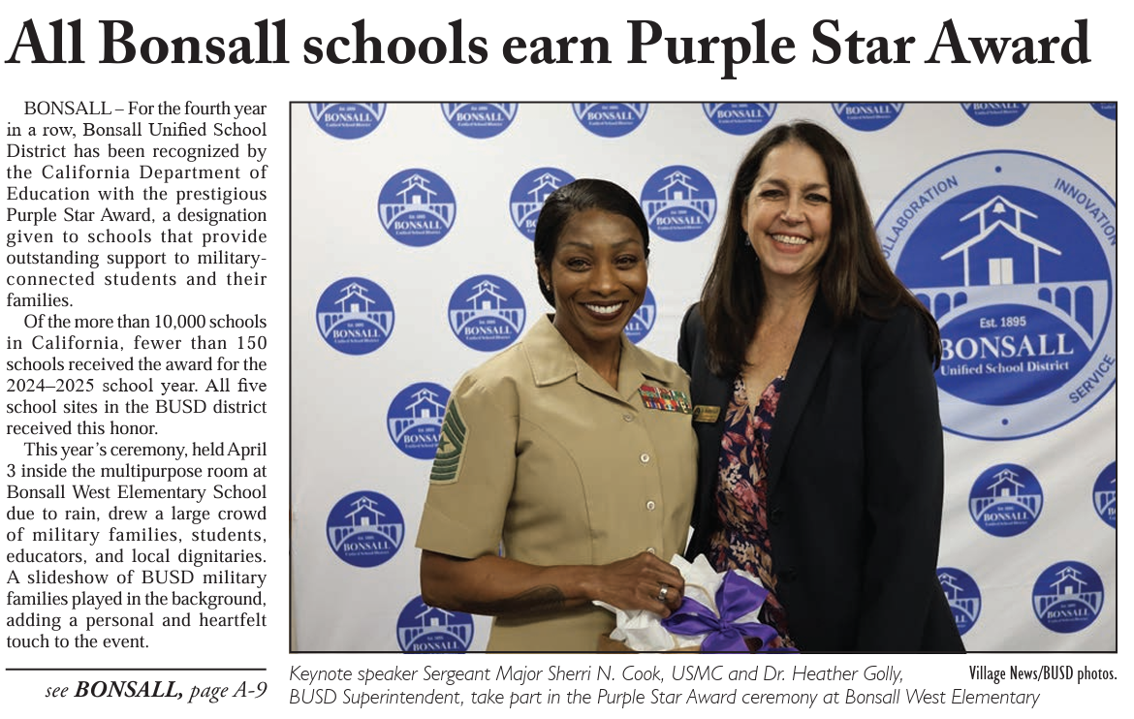
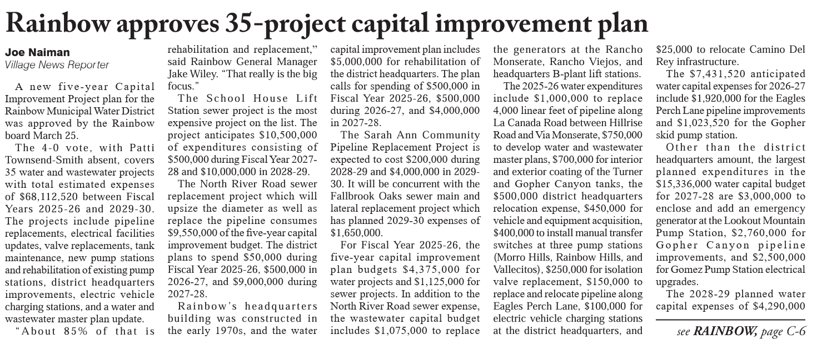
Village News
April 12
All Bonsall schools earn Purple
Star Award
April 11
Rainbow Water approves
35-project capital improvement plan
April 10
Dexter Wilson to design Gopher Pump Station for RMWD

Slide 23
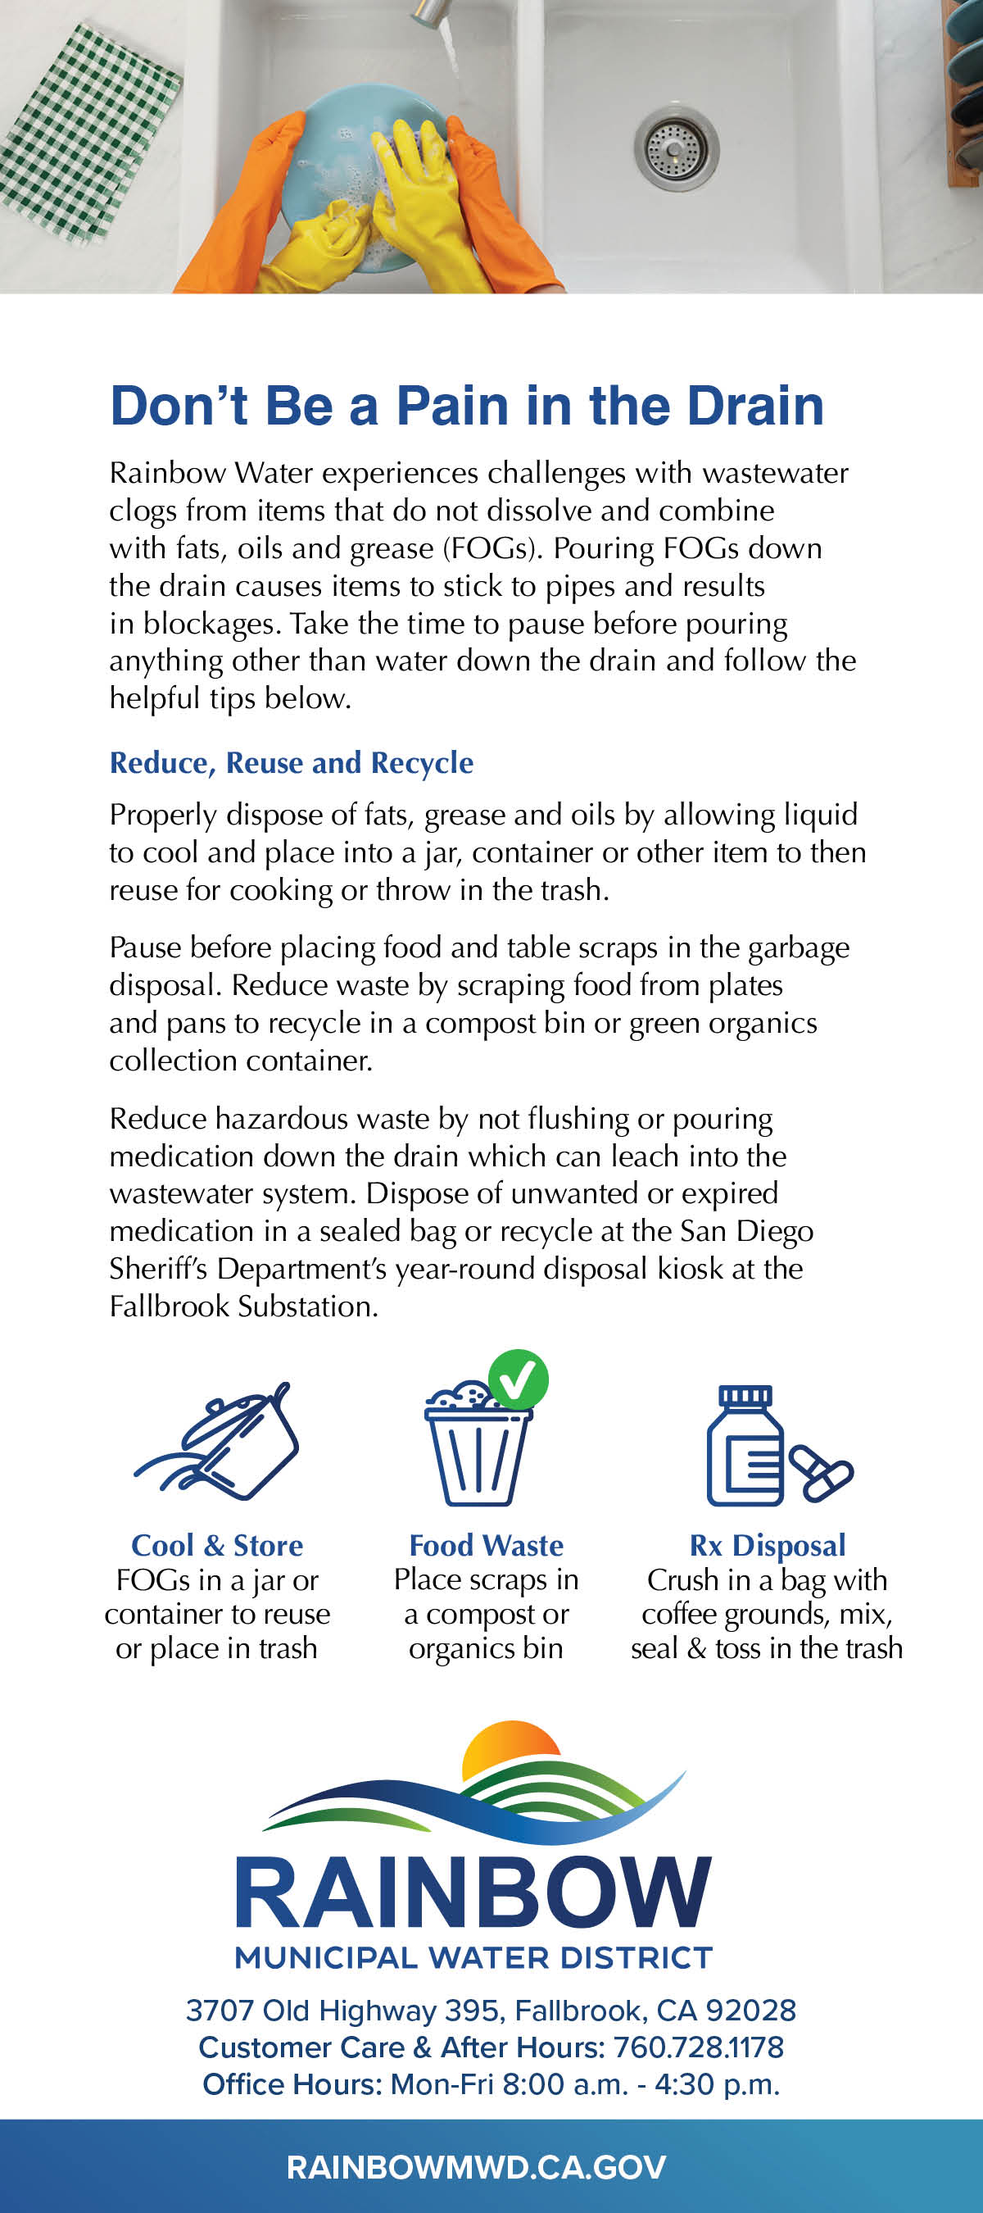


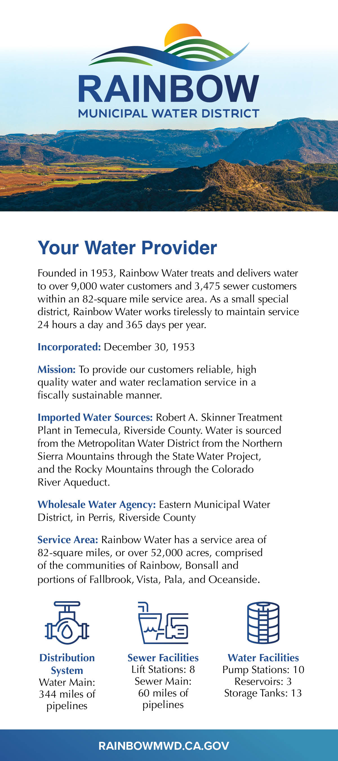
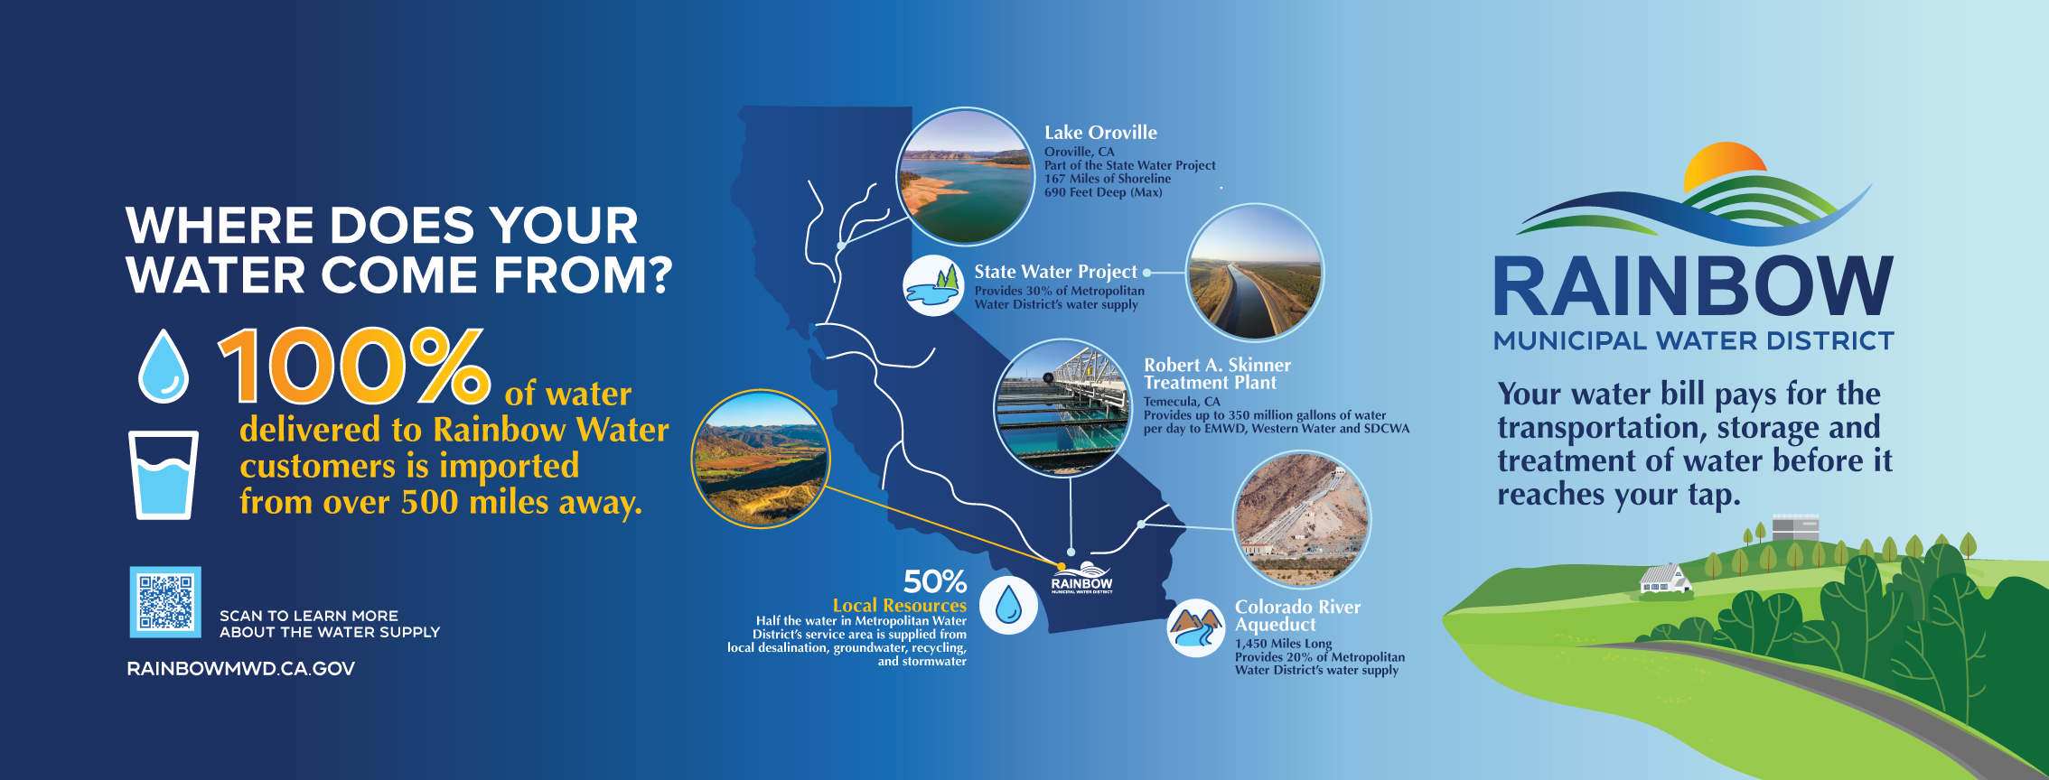
New Print Collateral
Developed new rack cards & oversized banner for the Avocado Festival and
Wildfire Symposium
Communications & Customer Service Meeting | April 2025

Slide 24
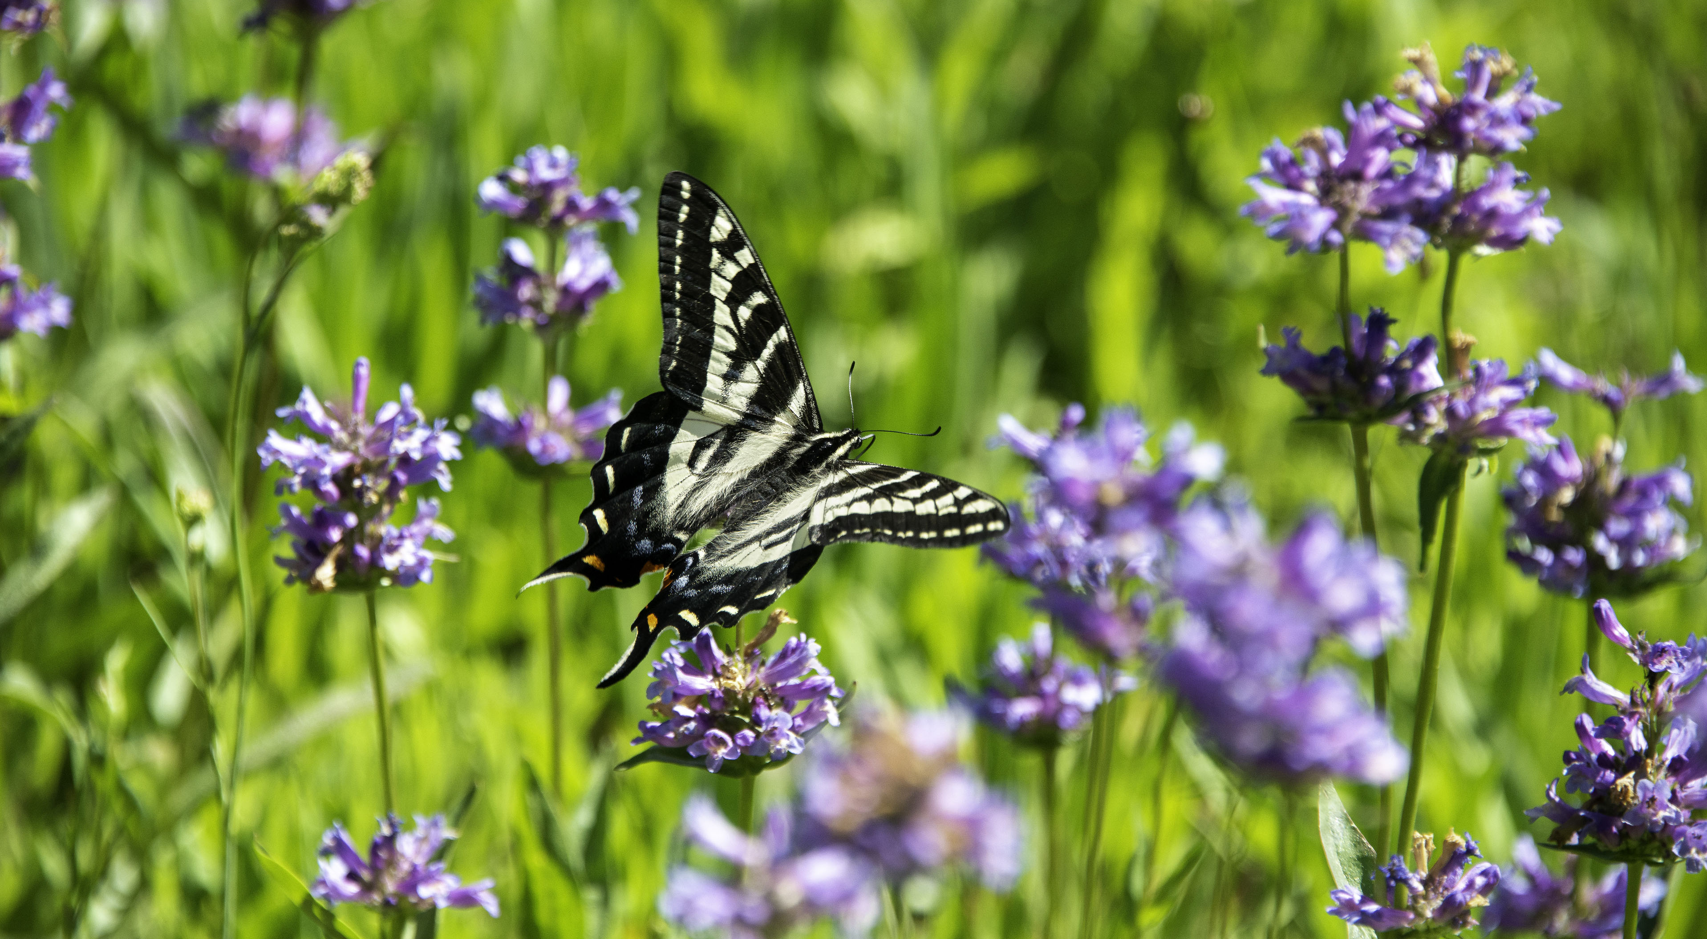
Agenda Items for the Next Meeting

