Slide 1
Communications & Customer Service
COMMITTEE MEETING
November 19, 2024

Slide 2
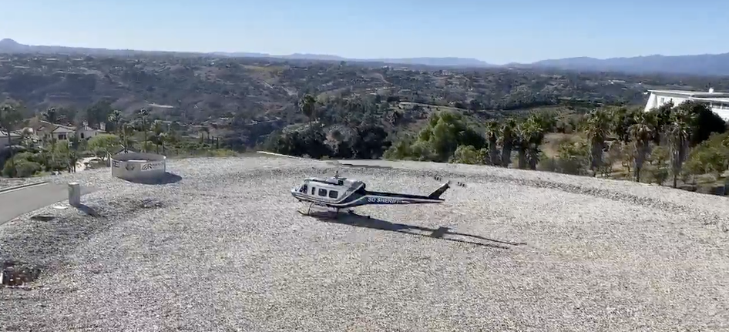
Agenda
Approval of Minutes
General Manager Comments
Committee Member Comments

Slide 3
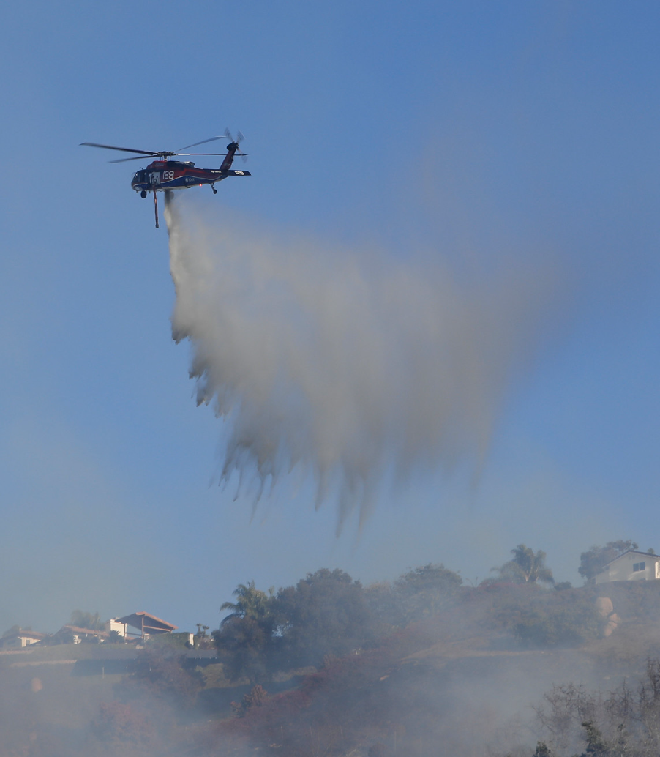
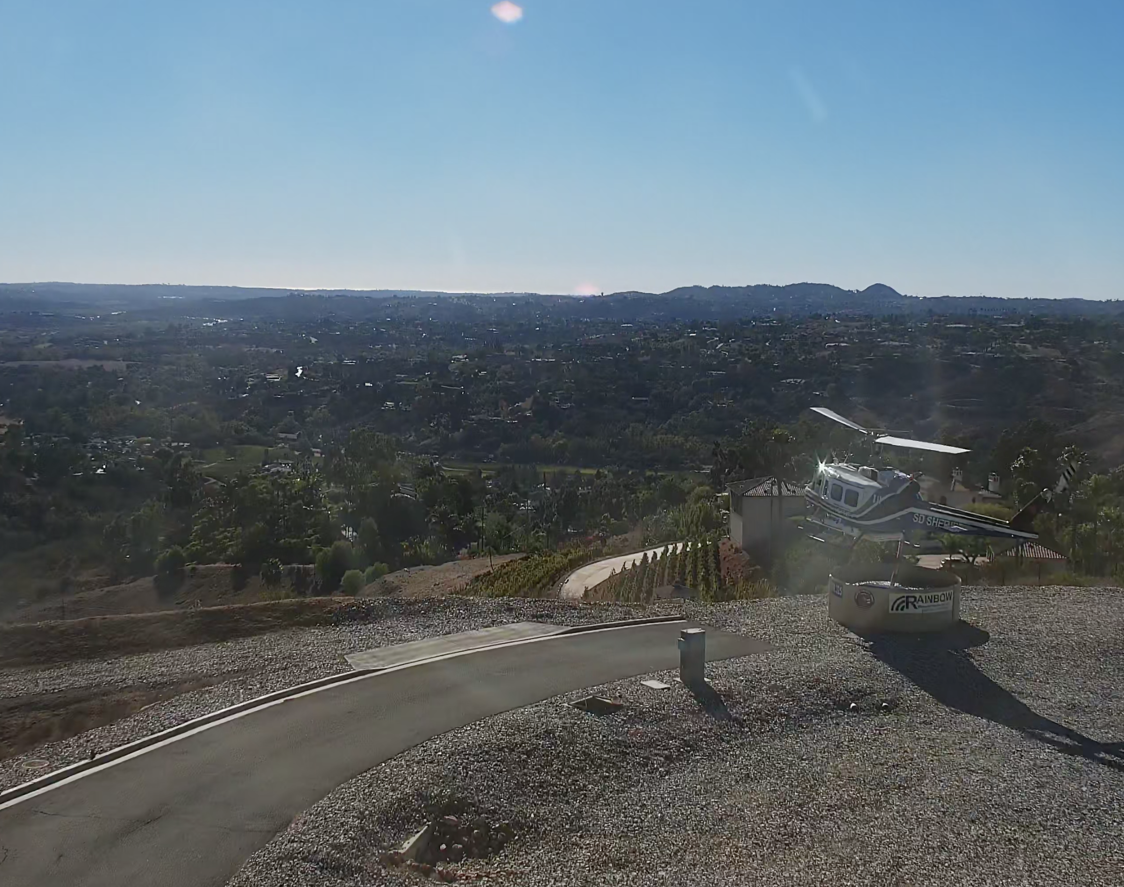
Garden Fire
Friday, November 8
  Garden Fire, Fallbrook
  48 Acres, no structures
  First use of Heli-hydrant
  at Pala Mesa Tank
  Allowed quick access of up to 5,000 gallons of water within two minutes
  Issued joint press release from RMWD, NC Fire and CAL FIRE/San Diego County Fire
Notes:
Central to the success of the firefighting efforts was the air response, including the first-ever use of the RAWS tank, also known as a "Heli-Hydrant." This system, the first of its kind in San Diego County, was commissioned by Rainbow Water in 2021 as a joint project with North County Fire Protection District and CAL FIRE. The RAWS tank provided a critical water supply for close to 30 aerial water drops, significantly increasing the effectiveness of the air response and protecting homes in the fire’s path. RAWS enables helicopter pilots to access up to 5,000 gallons of water within two minutes via an automatically filled open-top tank supplied by Rainbow Water’s infrastructure.

Slide 4
CropSWAP
Program
Regional Program Update

Slide 5
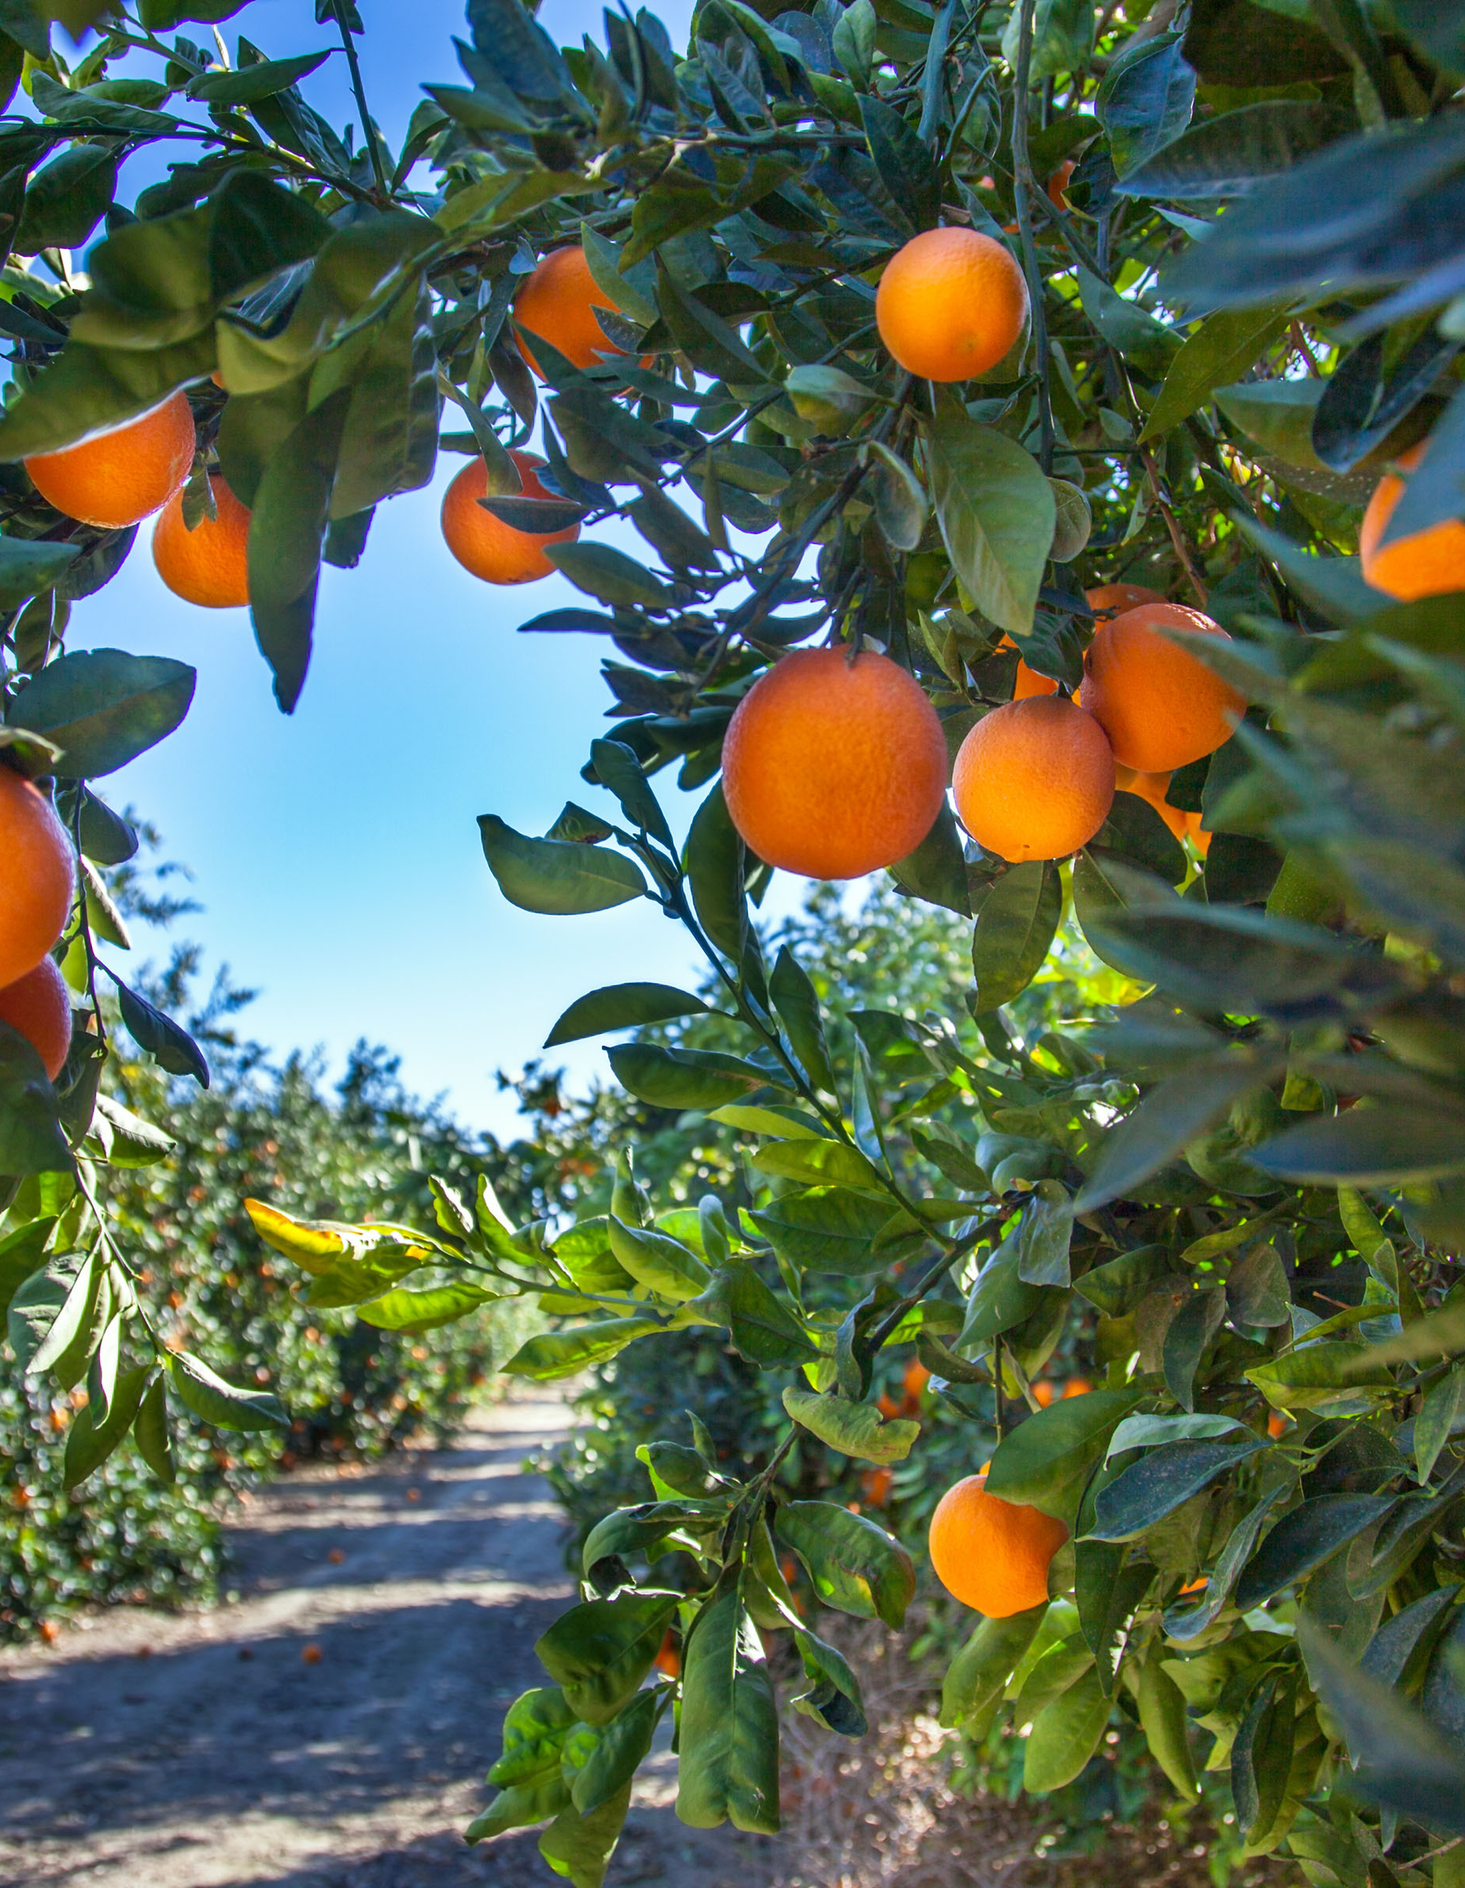

CropSWAP Program
  Rainbow Water leads with participation in Regional CropSWAP program
  Current projects are pending review
  as the first come, first served period
  has ended
_
5
Submissions October
Notes:
Applications received 1 is avocado rootstock and five are crop conversion

Slide 6

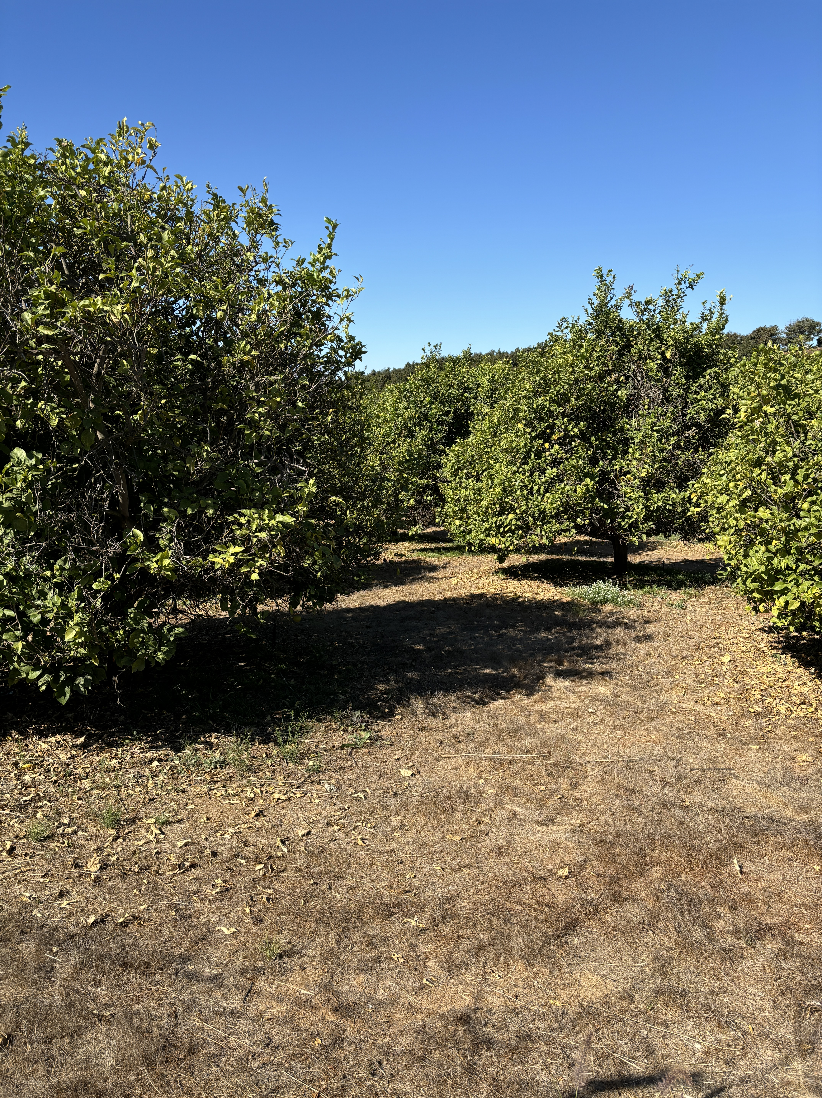



Program Metrics
_
76
Submissions to Date
_
$878,950
58
Projects Approved
In Reserved Grant
Funding for
Approved Projects
_
10
Pre-Inspection
Notes:
Pre- inspection 2 are crop conversion, 1 avocado tree rejuvenation, 1 avocado rootstock
Used 565,700 in the communal fund

Slide 7
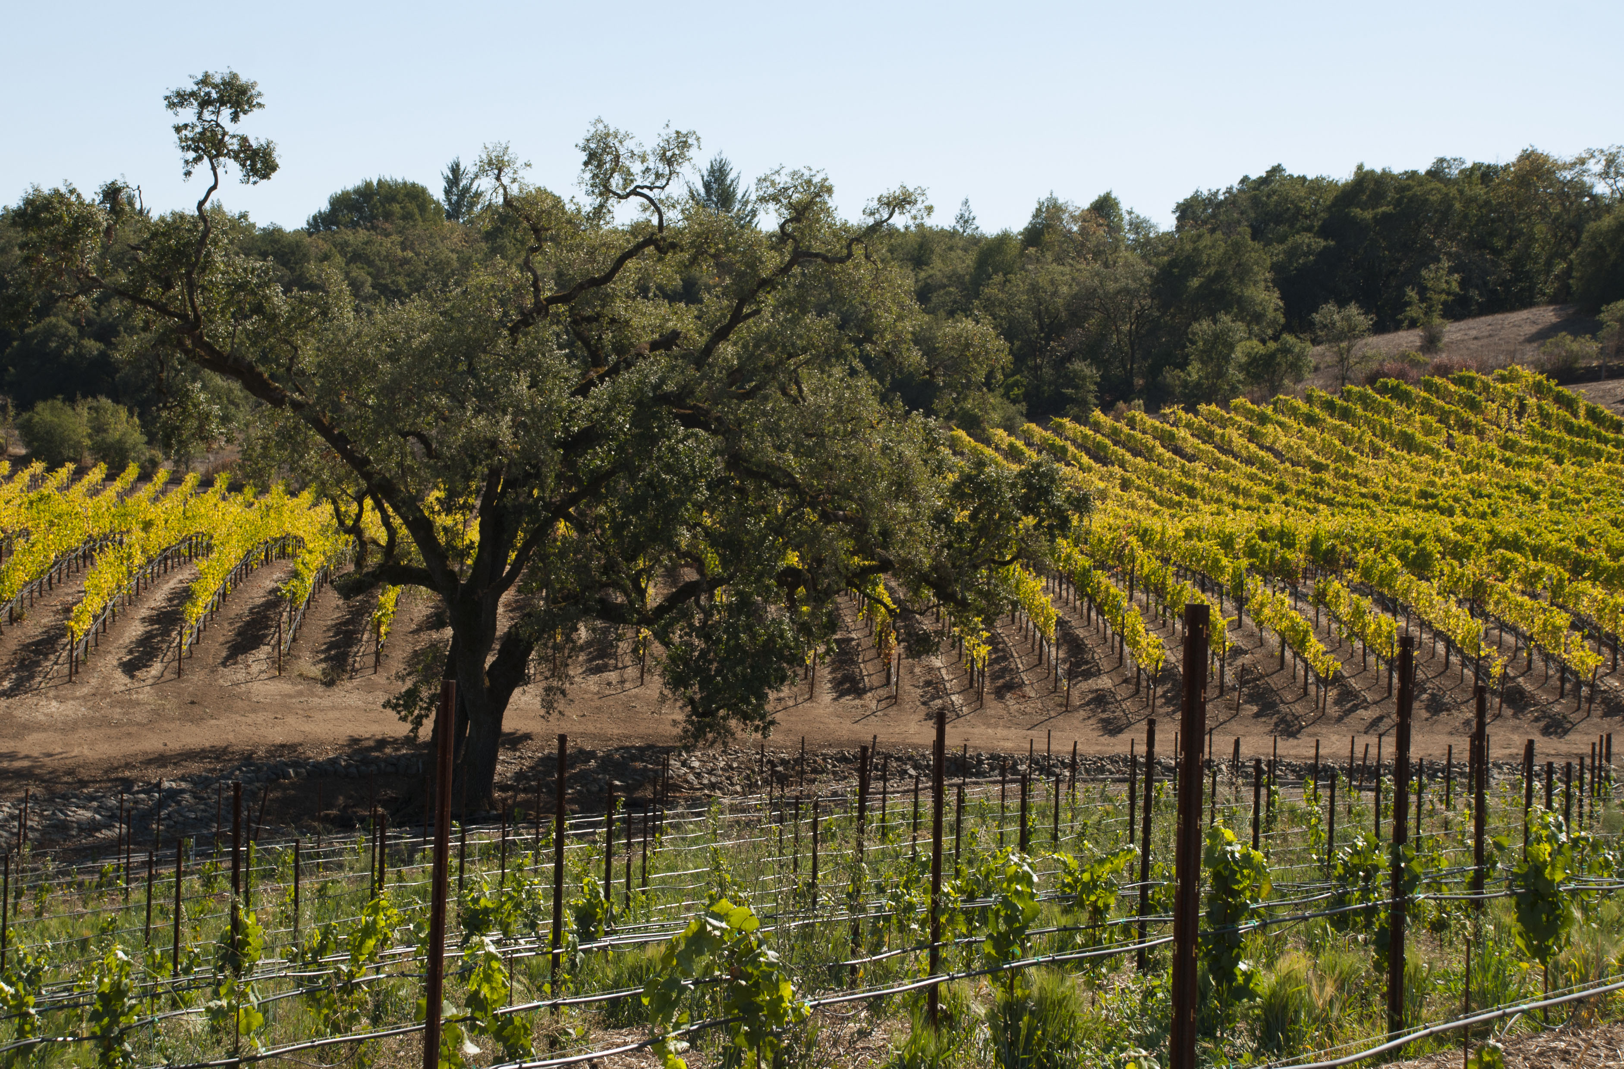
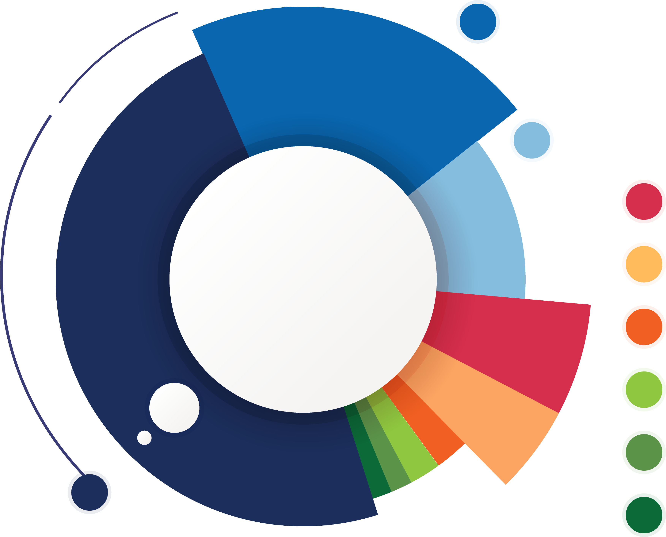
Total Applications by Project Type
17
Crop Conversion
9
Avocado Rejuvenation
6
Soil Moisture Sensors
6
Mulching
5
Scheduling Automation
3
Uniformity Improvements
2
Nutrient Management
1
Cover Crops
26
Avocado Rootstock
Notes:
Largest gains were increase of 4 crop conversion types, increase of 3 avocado rootstock, 1 avocado tree rejuvination and one soil moisture sensors

Slide 8
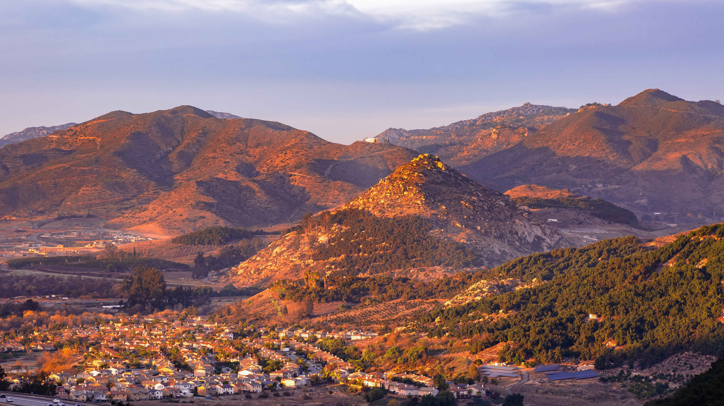
Discussion
Financial Options:
One Time Savings from Early Detachment from SDCWA

Slide 9
Financial Option:
Returning Early Detachment Budget Savings to Customers
Meter Size | As One-Time Rebate | Monthly Amount Over 6 Months
5/8 “ | $45.25 | $7.54
3/4” | $45.25 | $7.54
1” | $75.42 | $12.57
1.5” | $150.84 | $25.14
2” | $241.35 | $40.23
3” | $527.95 | $87.99
4” | $930.30 | $158.38
6” | 1,960.94 | $326.82
Notes:
Feedback on the refund amount for one time and six months
Reinvest in CIP or Replenish funds
Best for customer optics

Slide 10
Customer Service
Quarterly Call Metrics

Slide 11
August – October Average Hold Time

Slide 12
2023 vs 2024 Average Hold Time
Minutes

Slide 13
August – October Average Talk Time

Slide 14
2023 vs 2024 Average Talk Time

Slide 15
August – October Monthly Calls

Slide 16
2023 vs 2024 Monthly Calls

Slide 17
Community
Events Update

Slide 18


Blood Drive
Weds, December 18
  San Diego Blood Bank will bring their mobile unit to Rainbow Water
  9:00 a.m. – 2 p.m.
  Rainbow Water
  parking lot
  Sign up sheet on
  the website
  Promote in
  newsletter,
  press release
Notes:
Event planning underway for the holiday blood drive at Rainbow Water. To take place on Weds Dec 18 in the parking lot. We need a minimum of 20 donors for the event, please spread the word and sign up on our website to reserve your appointment time.

Slide 19

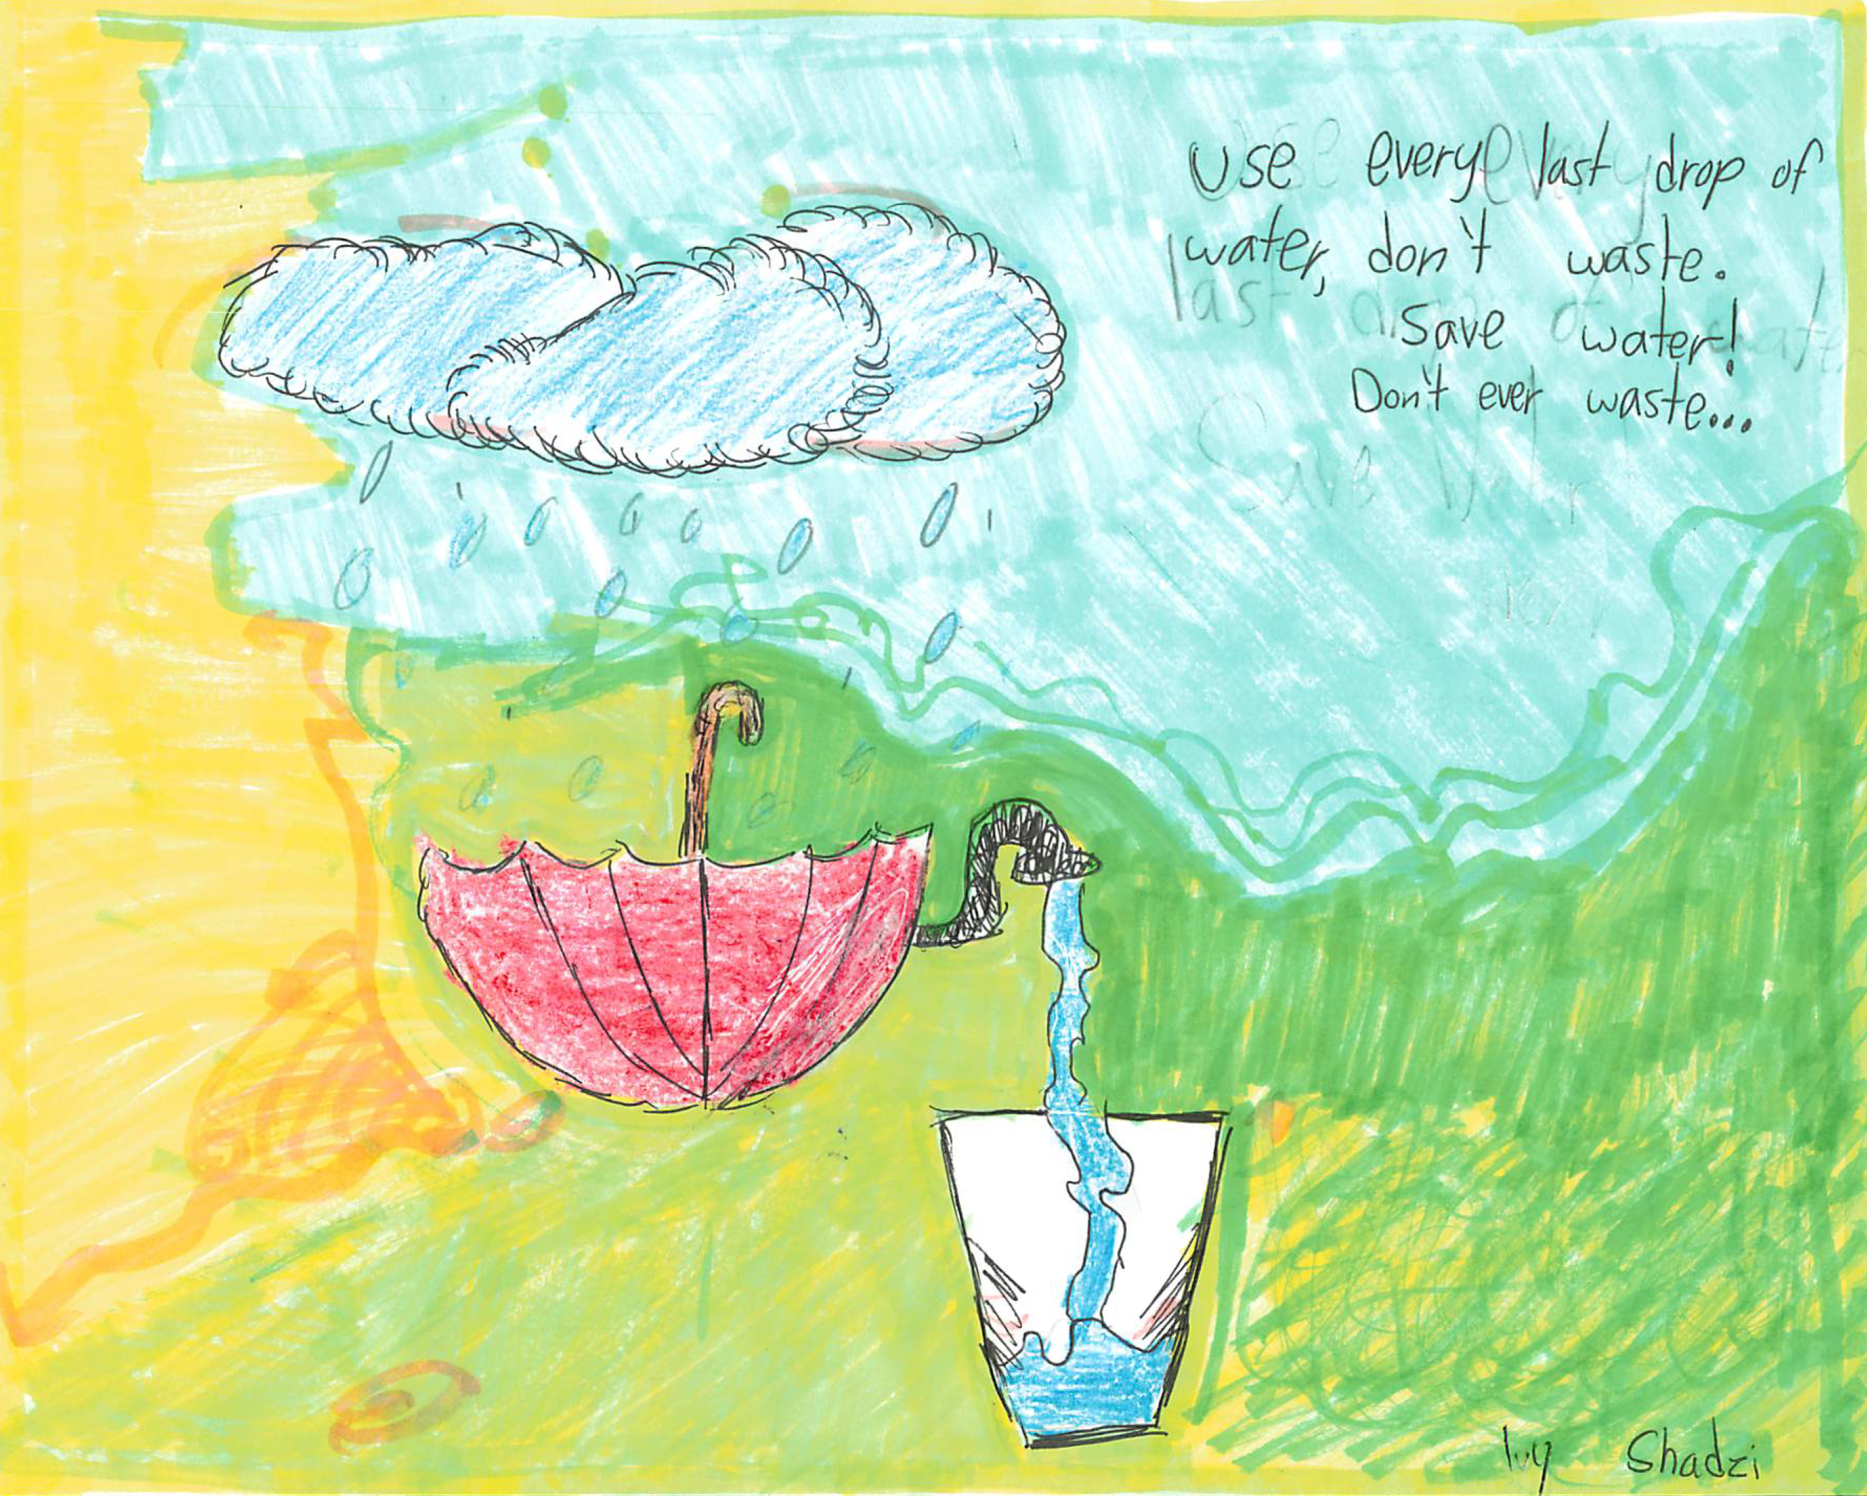


North County Water Agency Calendar
Calendar Contest Update
  2025 Calendar will be available at the office in December
  Copies distributed to student winners/BES 4th grade teachers, and BUSD Superintendent
  2025 Contest scheduled for launch Jan 2025
Notes:
The calendar proofing took place last week and the final file was sent to print. Delivery of calendar’s is slated for beginning of December.
The 2025 poster contest will launch in January and submissions will be due in April.

Slide 20
Newsletter
Content Planning

Slide 21
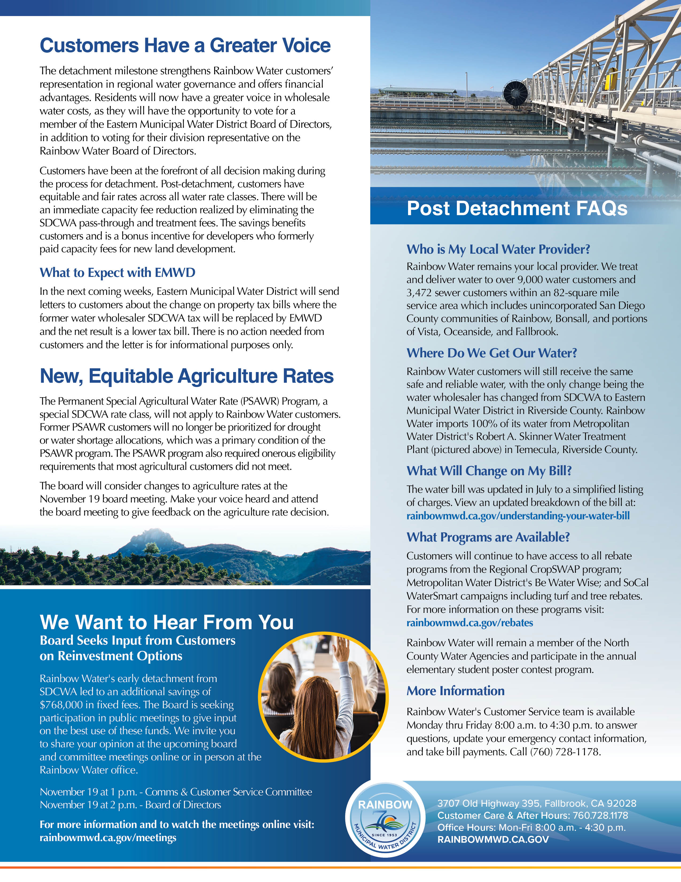
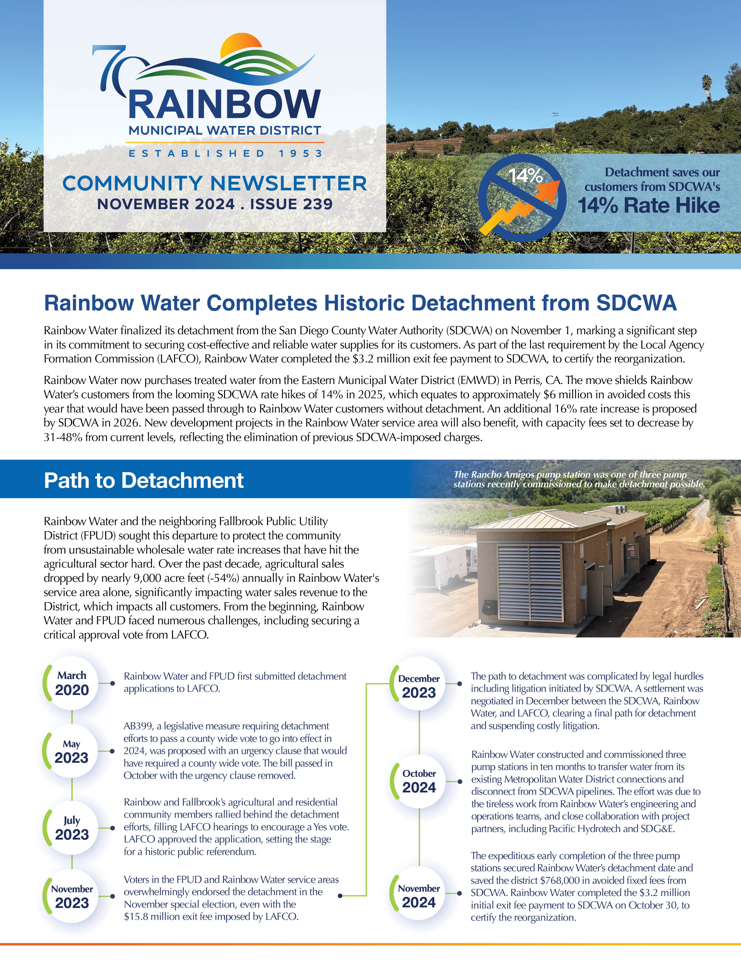
Newsletter Review
November
Historic Detachment from SDCWA
  Completion and Path to Detachment
Customers Have a Greater Voice
  Voting opportunities for EMWD Board
  What to Expect with EMWD
  Equitable Agriculture Rates
  Attend Board & Committee Meetings
Post Detachment FAQs
Blood Drive at Rainbow Water
  San Diego Blood Bank Mobile Unit visits Rainbow Water on Weds Dec 18

Slide 22
Newsletter Planning
December
  Rates Update
    New Agriculture Rates
    Fair & Equitable Rates for
    all Customers
  The Value of Water
    Importing Water from 500 miles away, cost savings with new rate from wholesaler vs SDCWA rate hike
      Infographic: Water compared to other essential expenses
  Bonsall HS Classroom Visits
    Photo feature of Chemistry Students
  Holiday Reminders
    Fats, Oils, & Greases
    Office hours, online bill pay
January
  Bill Overview
    Graphic on new bill layout
    Video on how to pay your bill online
    Sign up to receive bill via email and auto pay
  Calendar Contest
    Calendar’s & contest forms available
    at the Office
    Classroom visits open to all 4th Graders
  Rebates from Met
    High efficiency toilet install, clothes washer new requirements, and
    rain barrels
  Customer Survey
    One minute survey to let us know how we are doing

Slide 23
Public
Communications
& Related Media Stories

Slide 24

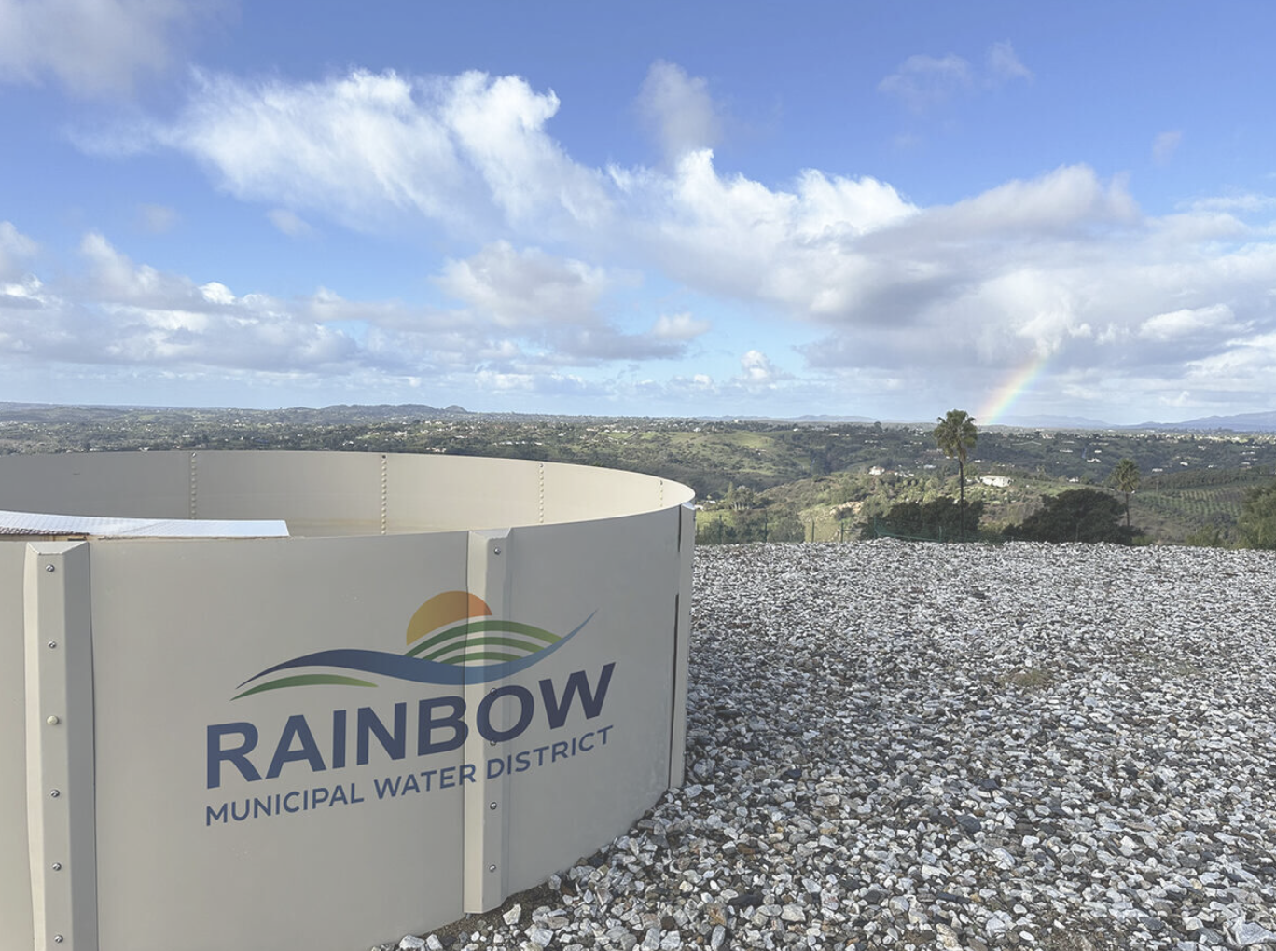
Village News
Rainbow Municipal Water District Completes Historic Detachment from San Diego County Water Authority
FALLBROOK, CA- Rainbow Municipal Water District (Rainbow Water) has finalized its detachment from the San Diego County Water Authority (SDCWA), marking a significant step in its commitment to securing cost-effective and reliable water supplies for its customers. On Wednesday, October 30, Rainbow Water made a $3.2 million exit fee payment to SDCWA, the last requirement by the Local Agency Formation Commission (LAFCO) to certify Rainbow Water's reorganization.
Effective November 1, Rainbow Water will purchase treated water from the Eastern Municipal Water District (EMWD), shielding Rainbow Water's customers from the looming SDCWA rate hikes of 14% in 2025 and an additional 16% proposed in 2026. New development projects in the Rainbow Water service area will also benefit, with capacity fees set to decrease by 31-48% from current levels, reflecting the elimination of previous SDCWA-imposed charges.
Rainbow Water and the neighboring.
November 7
Rainbow Municipal Water District Completes Historic Detachment from San Diego County Water Authority
Fallbrook Public Utility District (FPUD) sought this departure to protect the community from unsustainable wholesale water rate increases that have hit the agricultural sector hard. Over the past decade, agricultural sales dropped by nearly 9,000 acre-feet annually in Rainbow Water's service area alone, significantly impacting water sales revenue to the District, which impacts all customers.

Slide 25

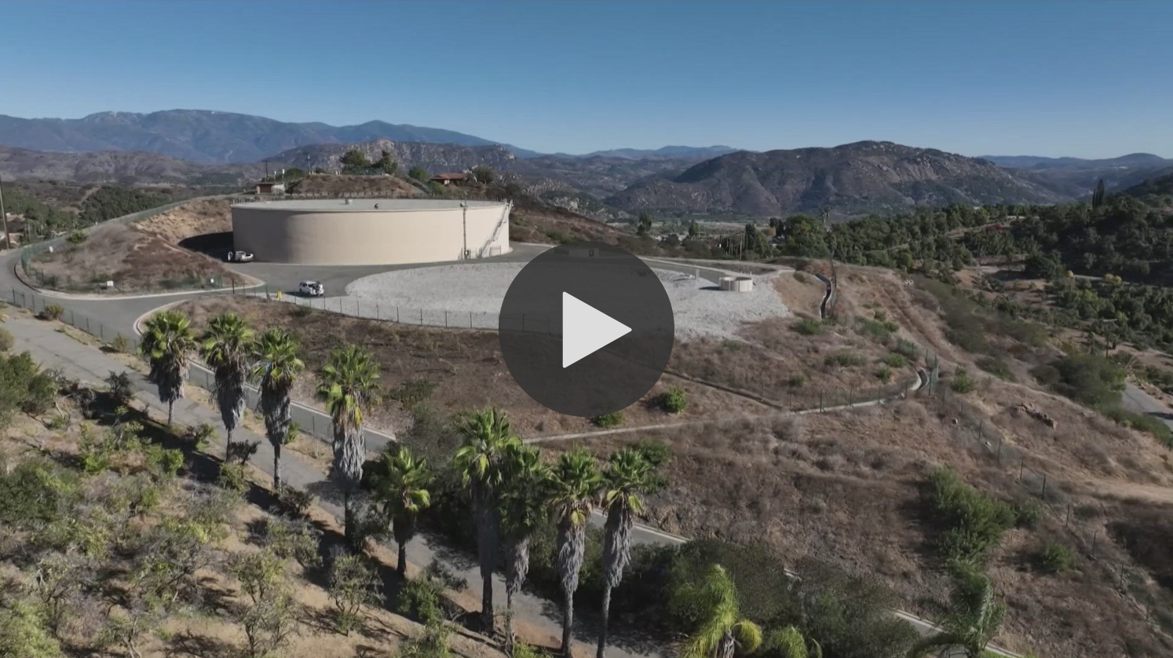
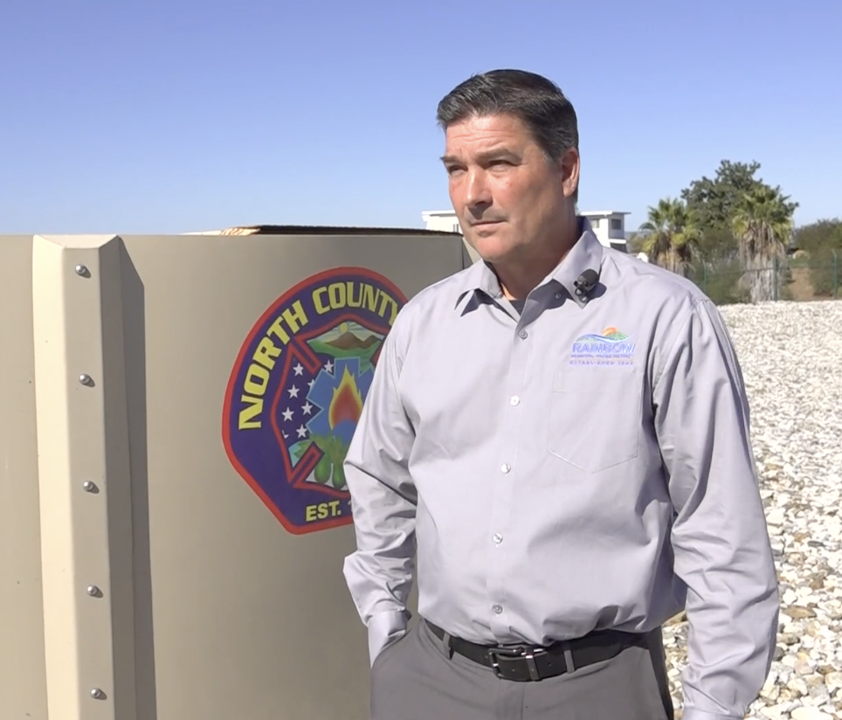
CBS 8
November 13
New Water Tank Helps Prevent Disaster in Fallbrook Wildfire
Interview with Fire Captains
and General Manager
Notes:
A new Rapid Aerial Water Supply tank in San Diego County helped contain the Fallbrook wildfire, preventing major damage and speeding up helicopter response times.

Slide 26

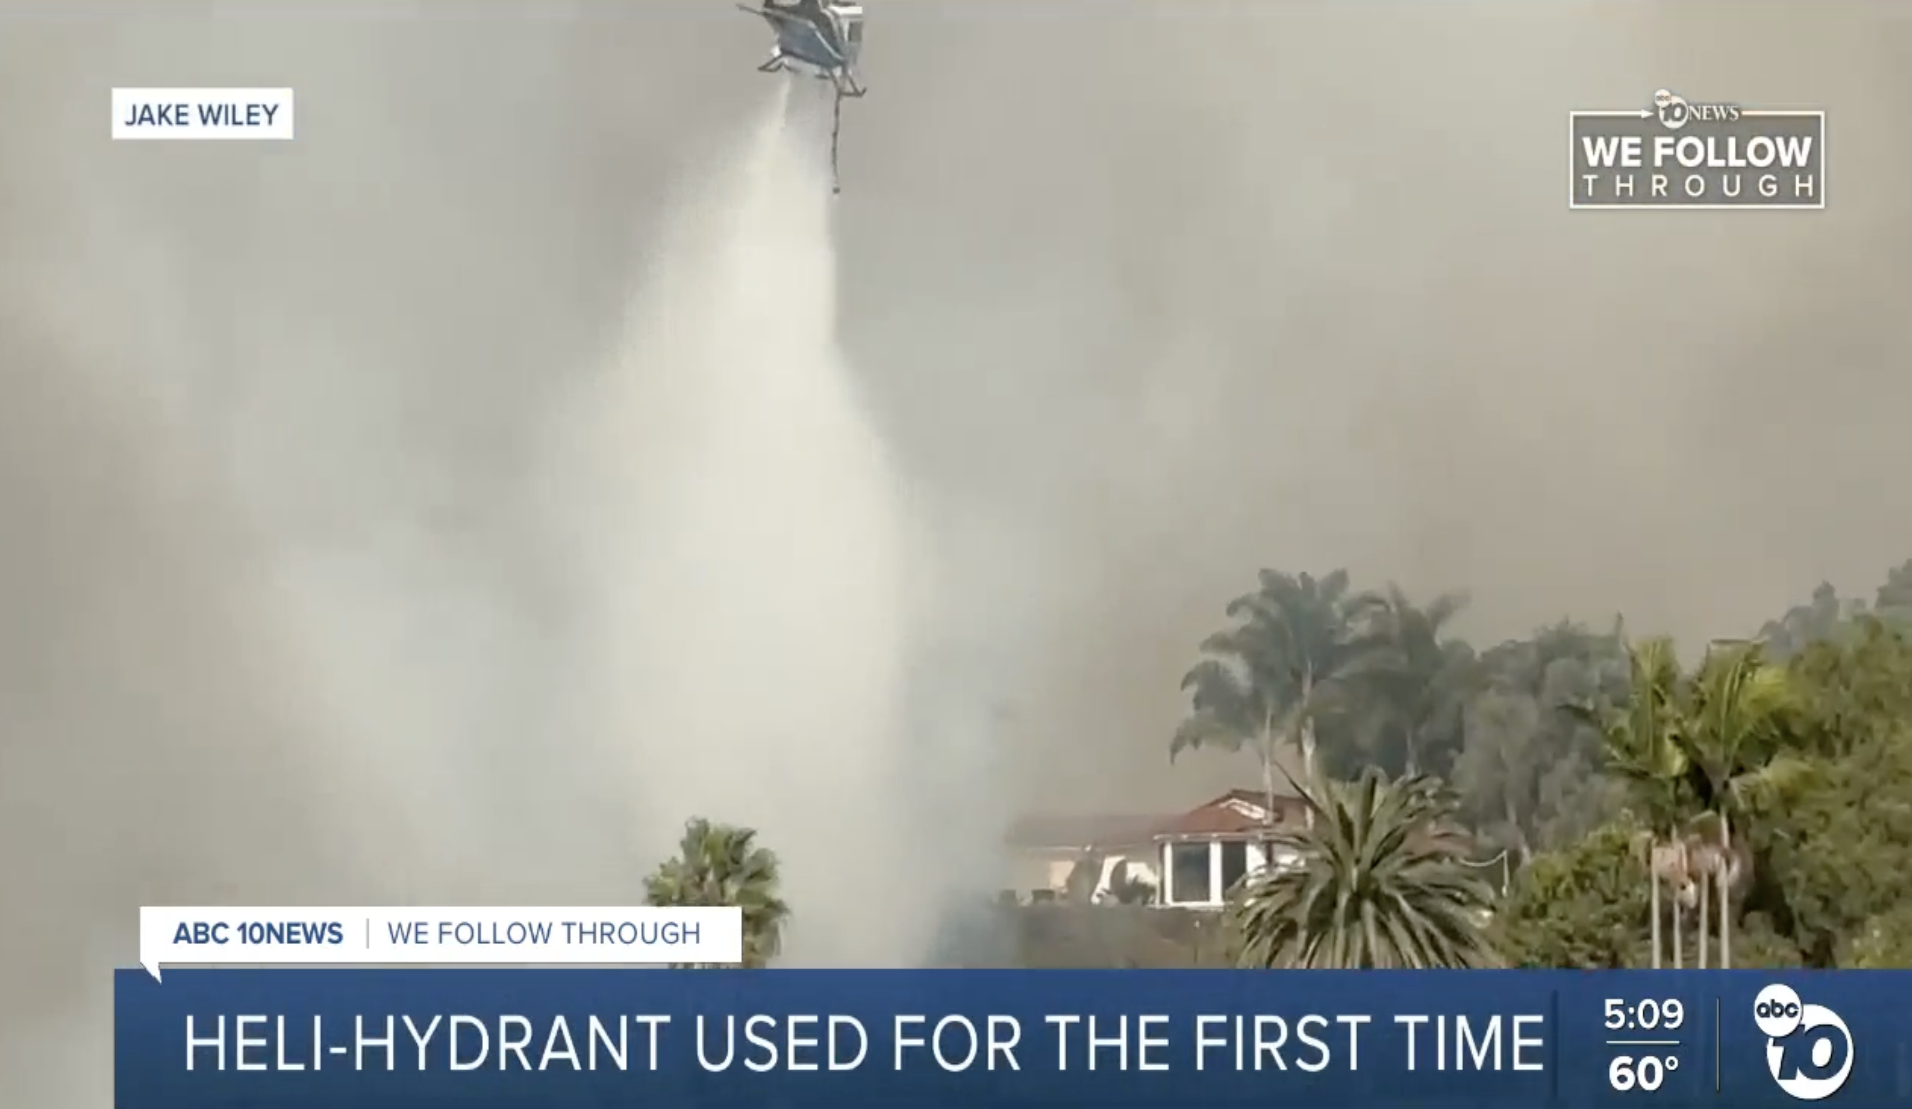
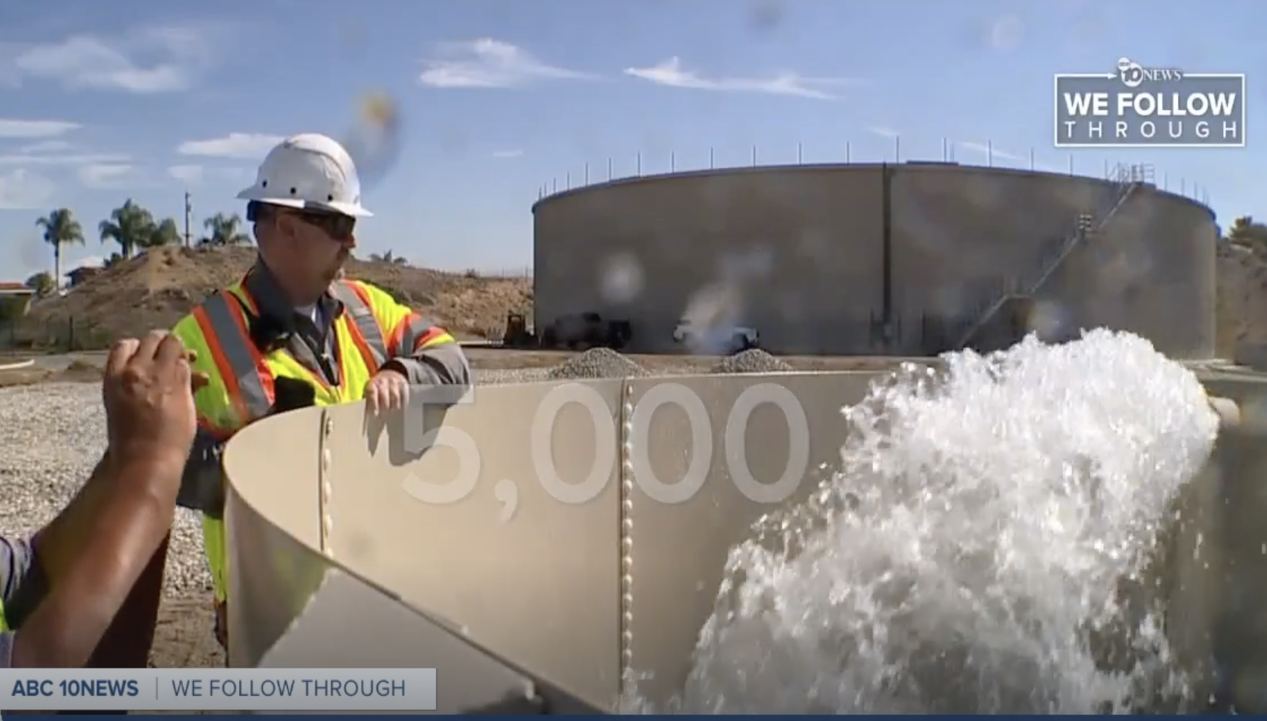
ABC 10
November 15
Fire Crews use Heli-Hydrant for its First Time to Flight Garden Fire
Notes:
35 drops were made possible from the heli-hydrant
The heli-hydrant is a reliable water source within close proximity of the fire that was key in providing swift response to the 48 acre firre.

Slide 27
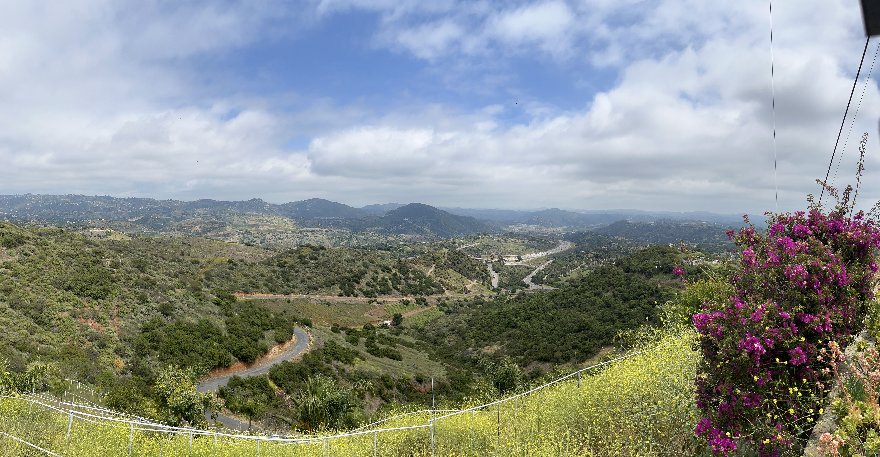
Agenda Items for the Next Meeting

