Slide 1
Gopher Canyon Emergency Pipe Project Update
Esa Lagunas: 1/28/2025

Slide 2
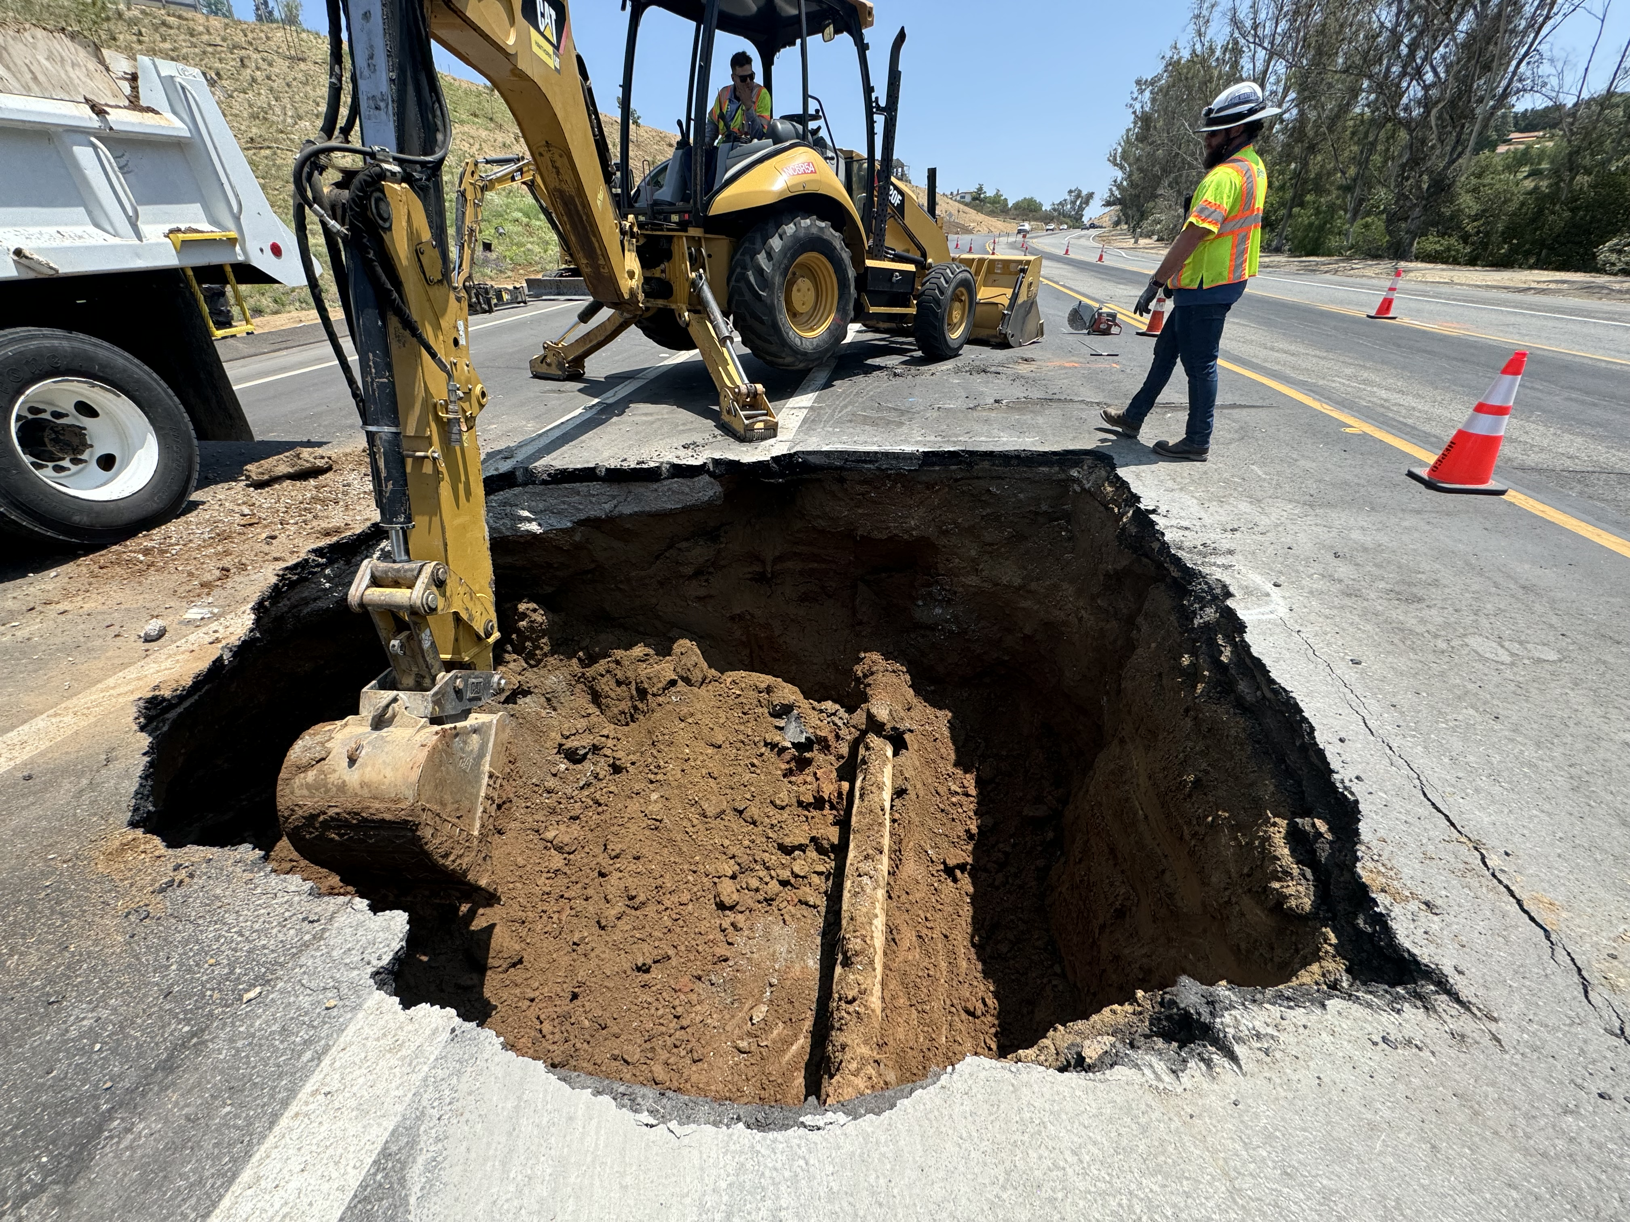
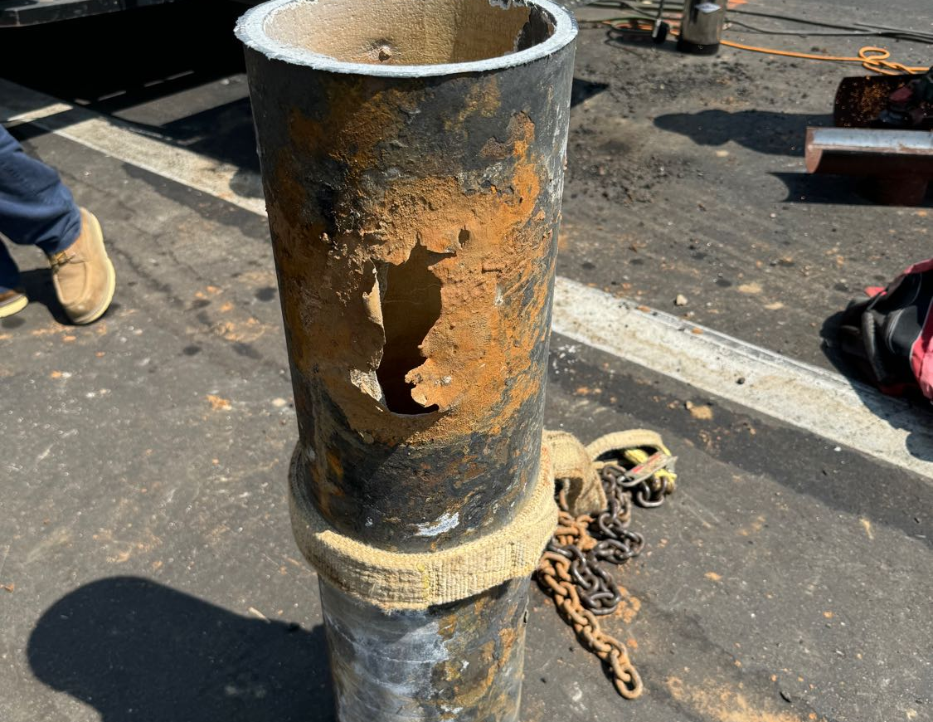
Background
7/26 Main break
8/6 Presented to E&O

Slide 3
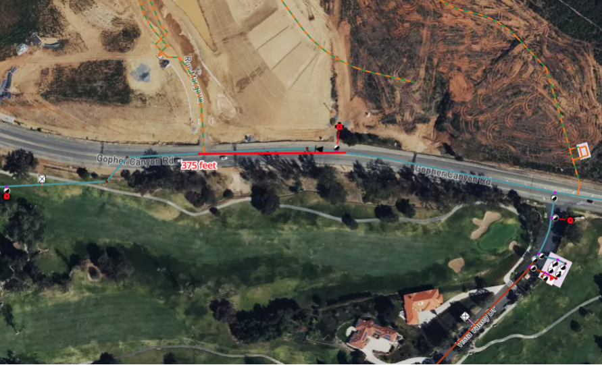

Slide 4
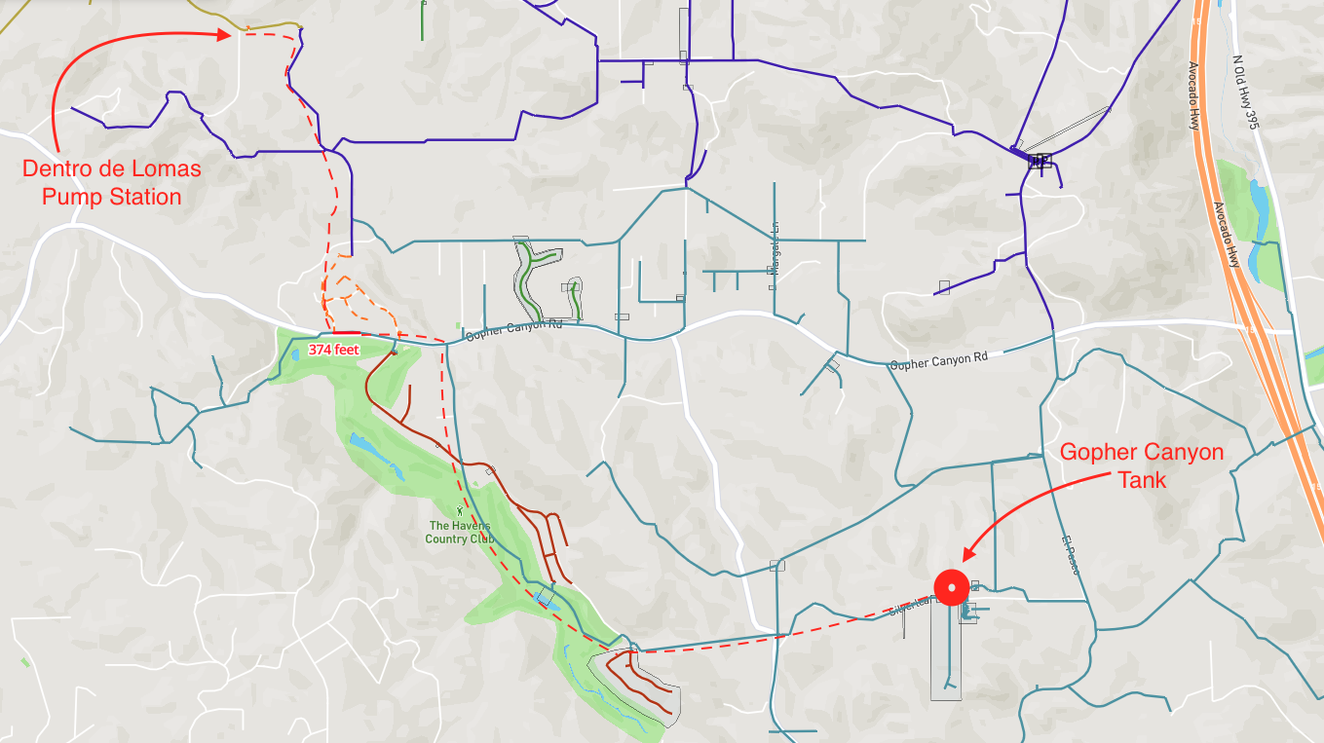

Slide 5
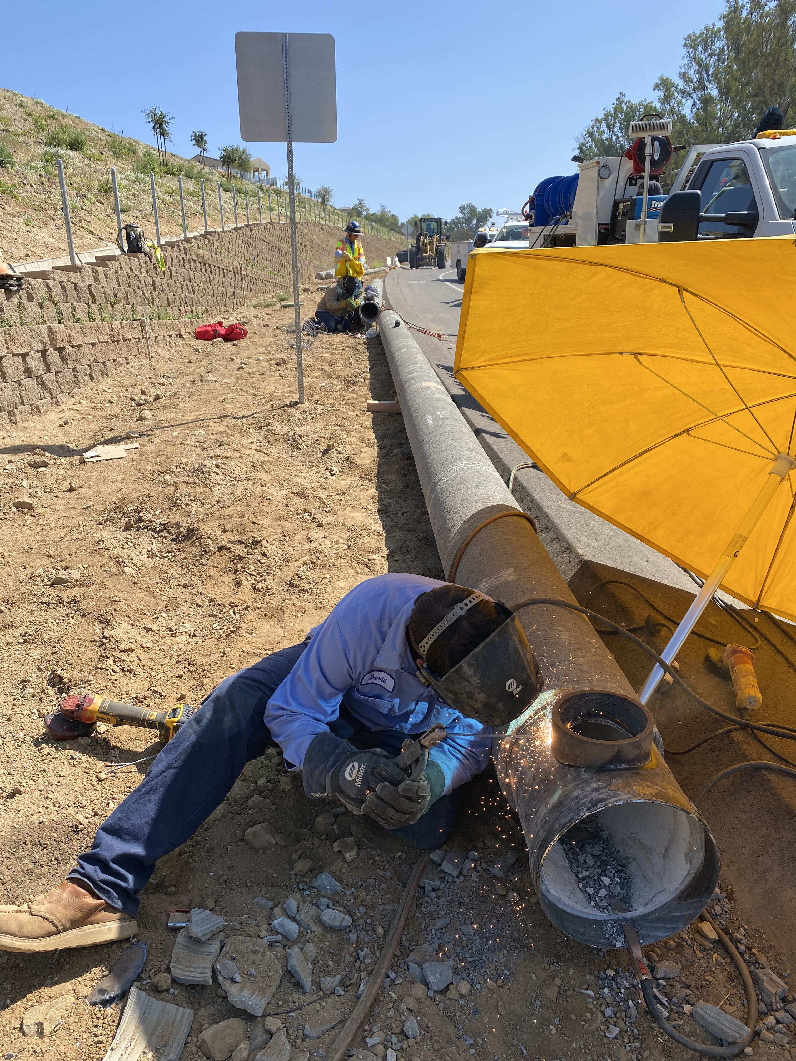
Background
8/27 Board approved $600K
  Emergency Paving
  Emergency Pipe Project
  Ordered pipe and fittings
9/26 Pipe Arrived

Slide 6
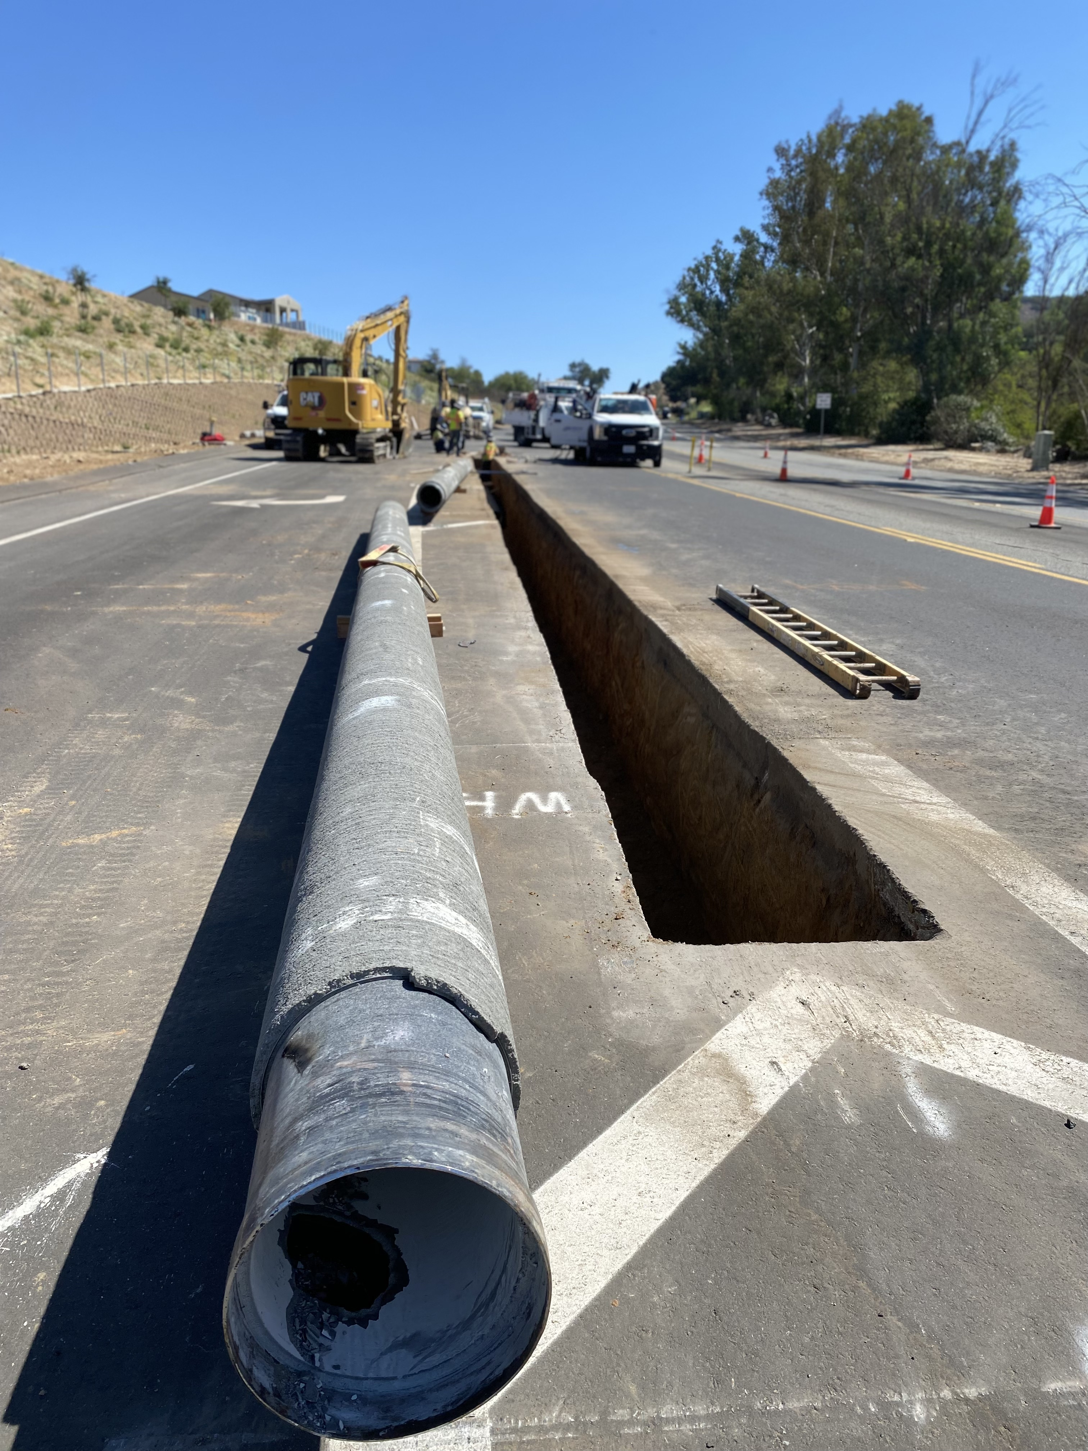
9/30 Started Installing Pipe
12-inch CML&C pipe
Upsizing from 8-inch
4 days to install 350-feet

Slide 7
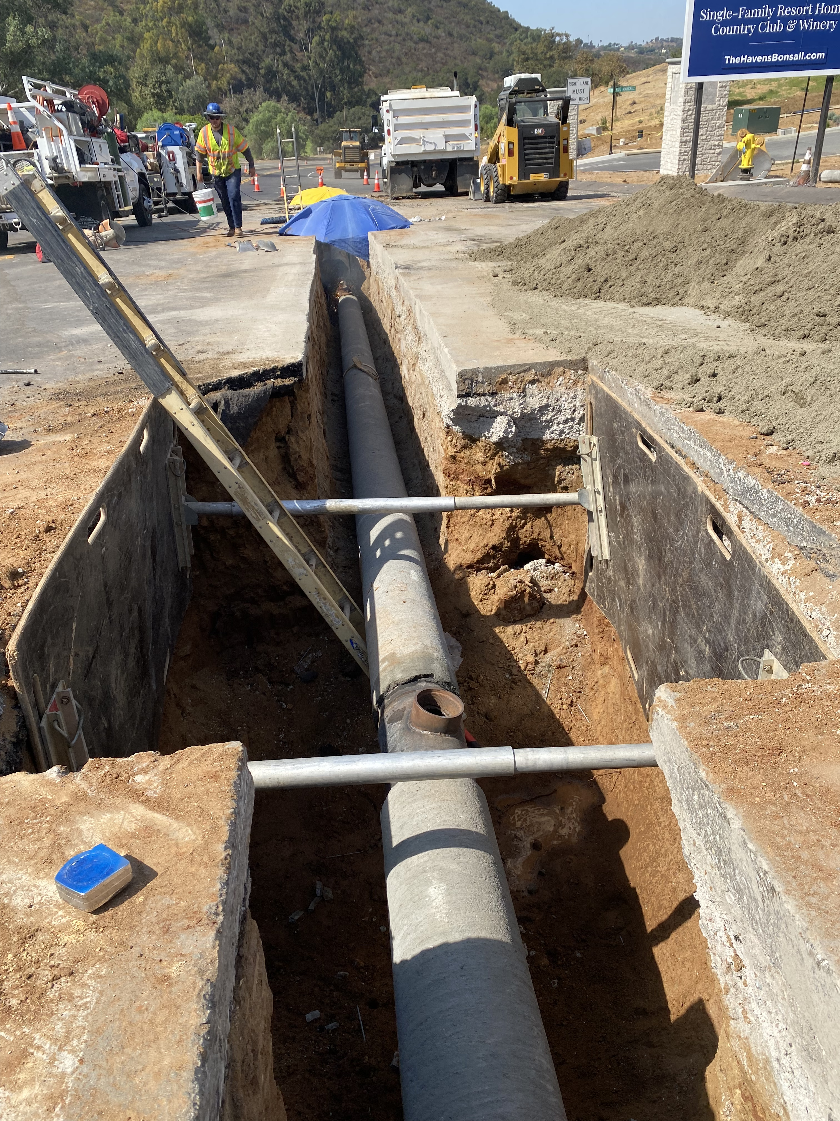
Update
10/3 Finished installing pipe
10/7 Pipe Testing (3 Days)
  Pressure testing
  High-Chlorine
  Flushing
  Bac-T samples

Slide 8
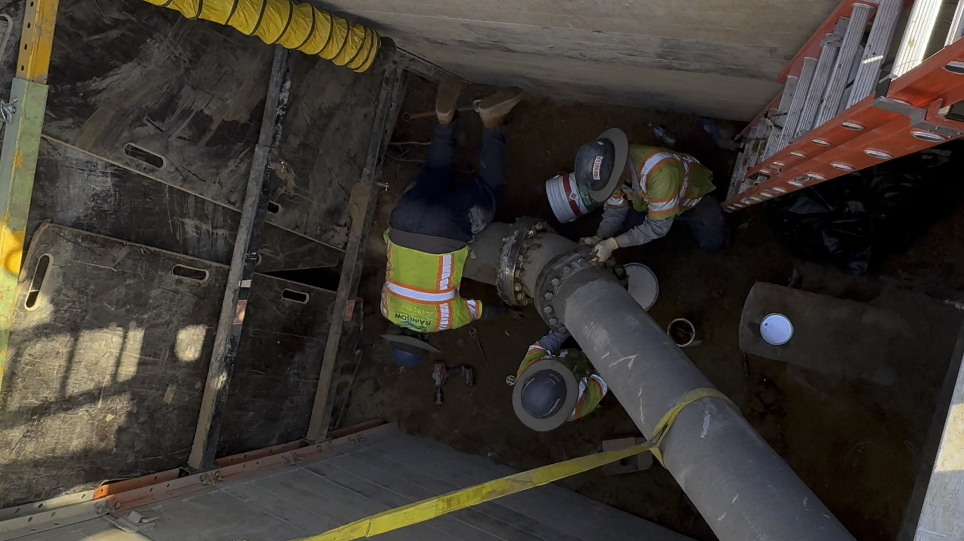
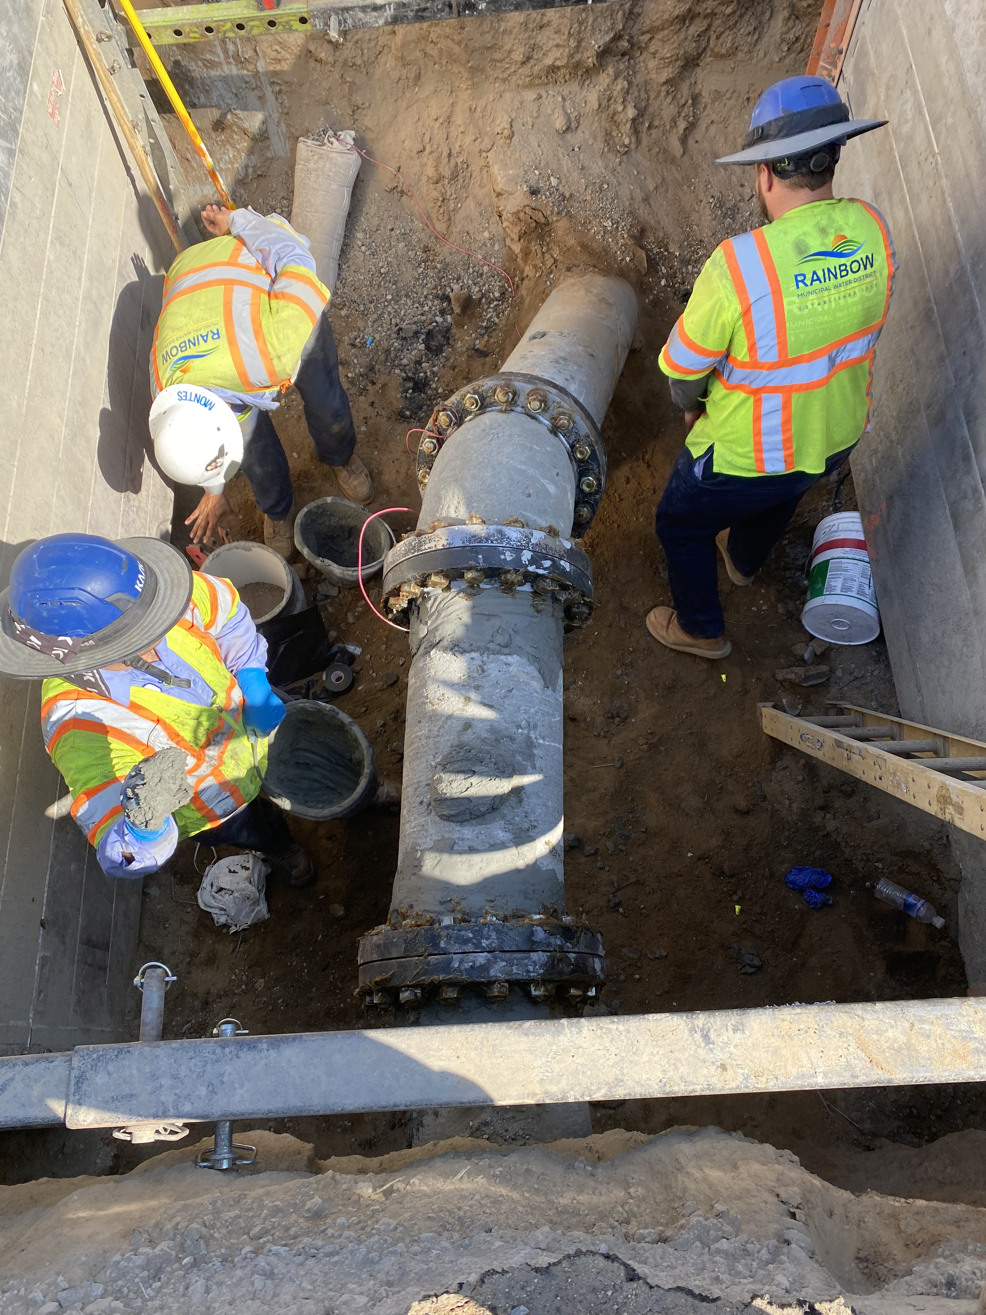
10/14 Tie-in Eastside (2 working days)

Slide 9
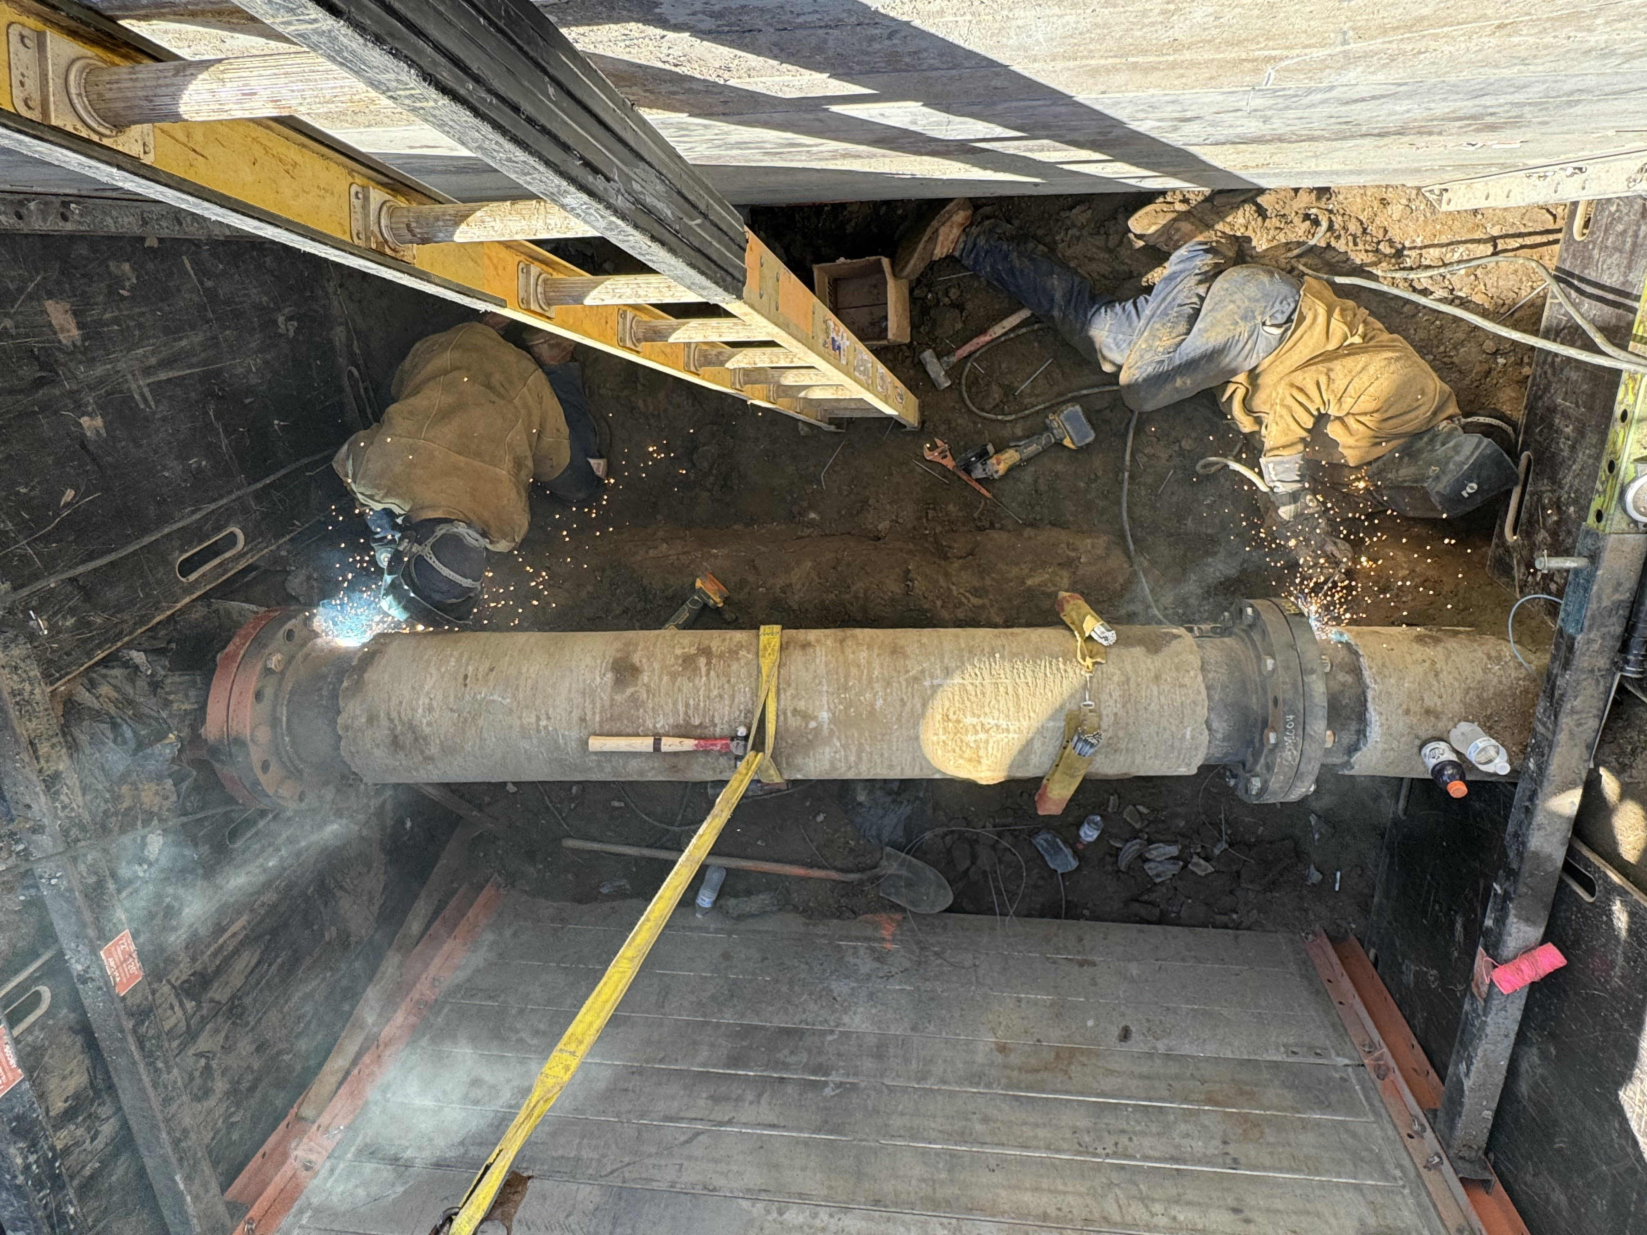
10/21 Tie-in Westside (2 working days)

Slide 10
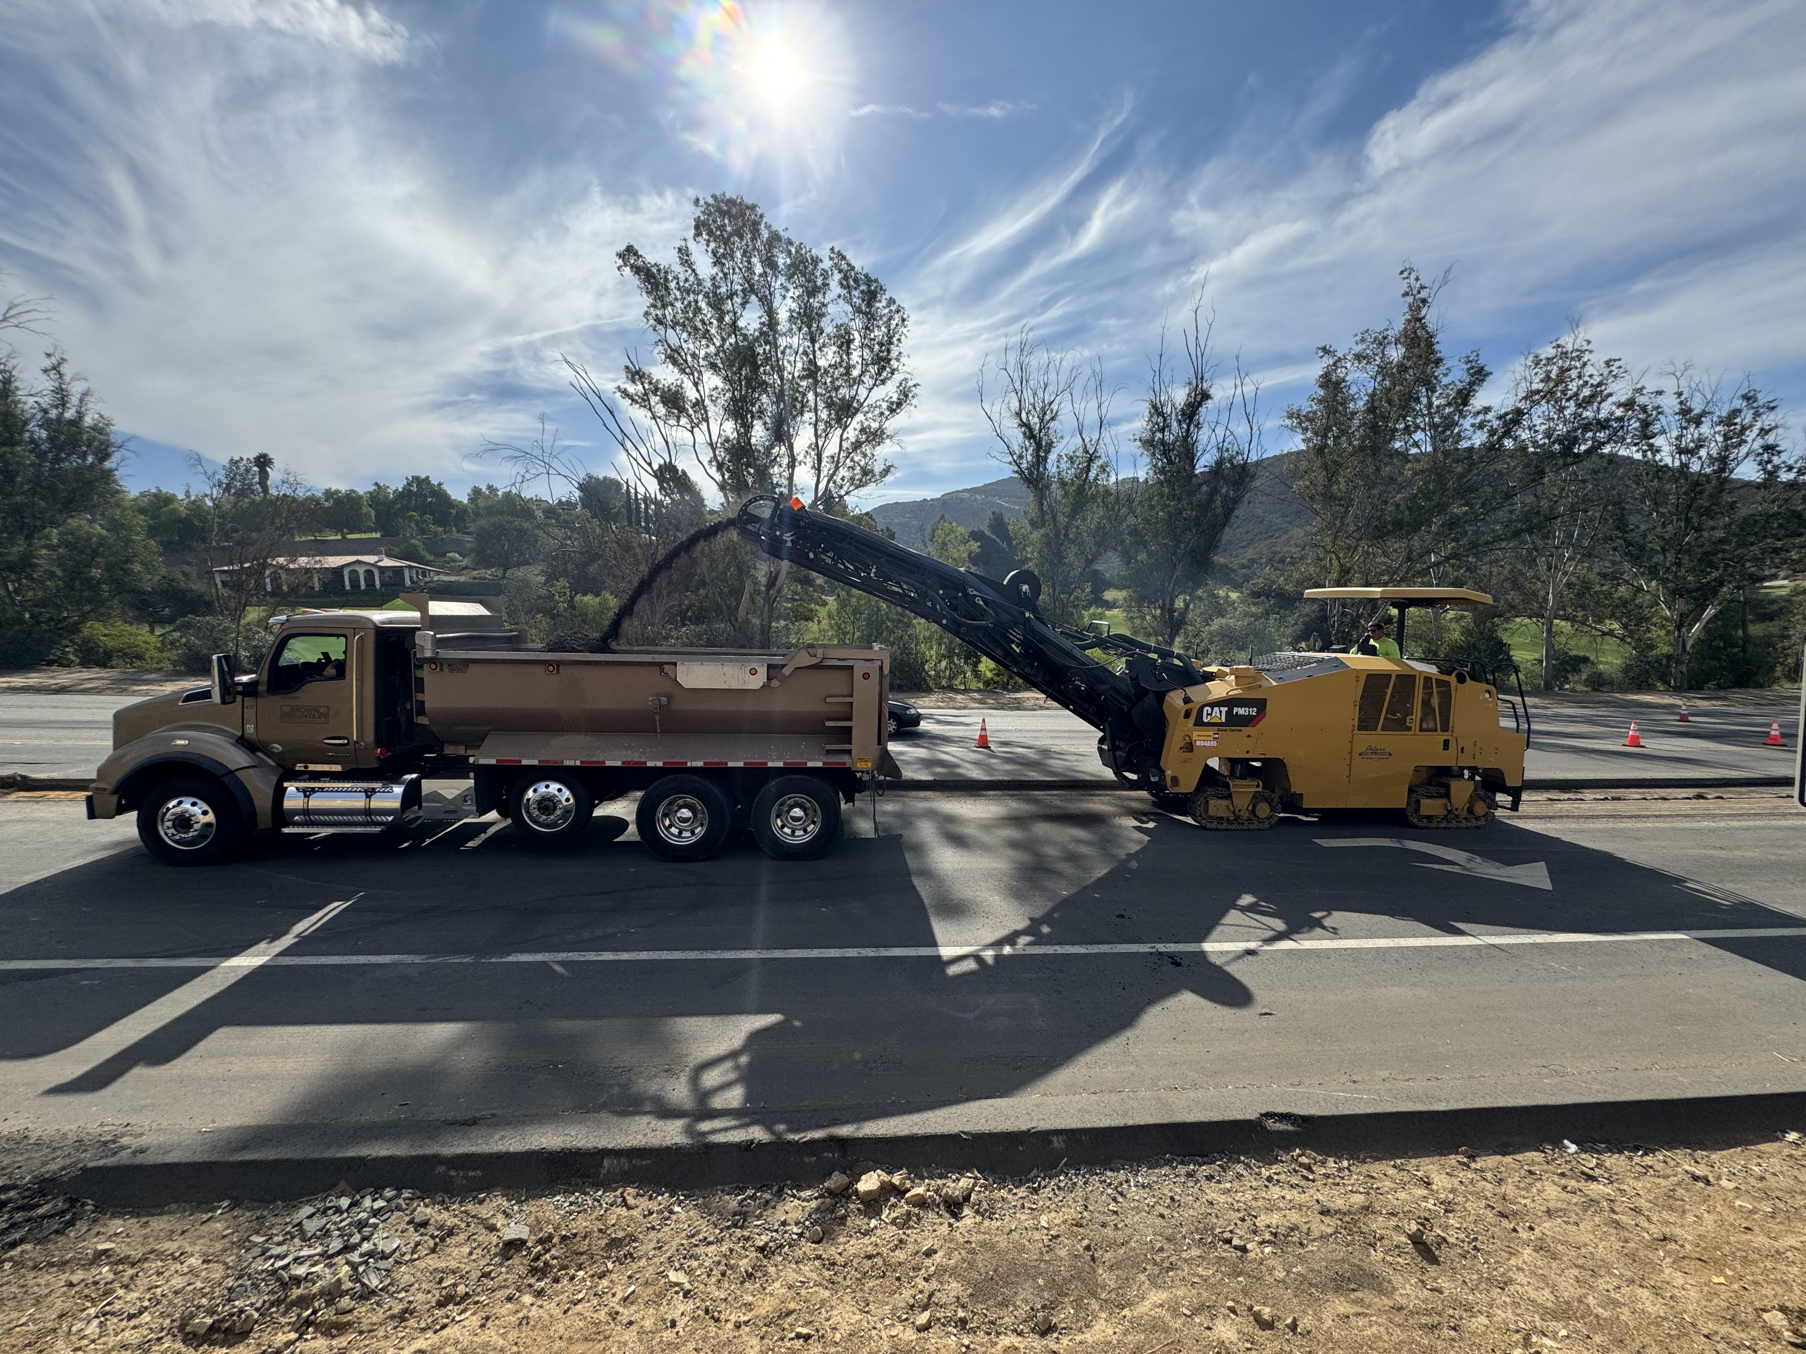
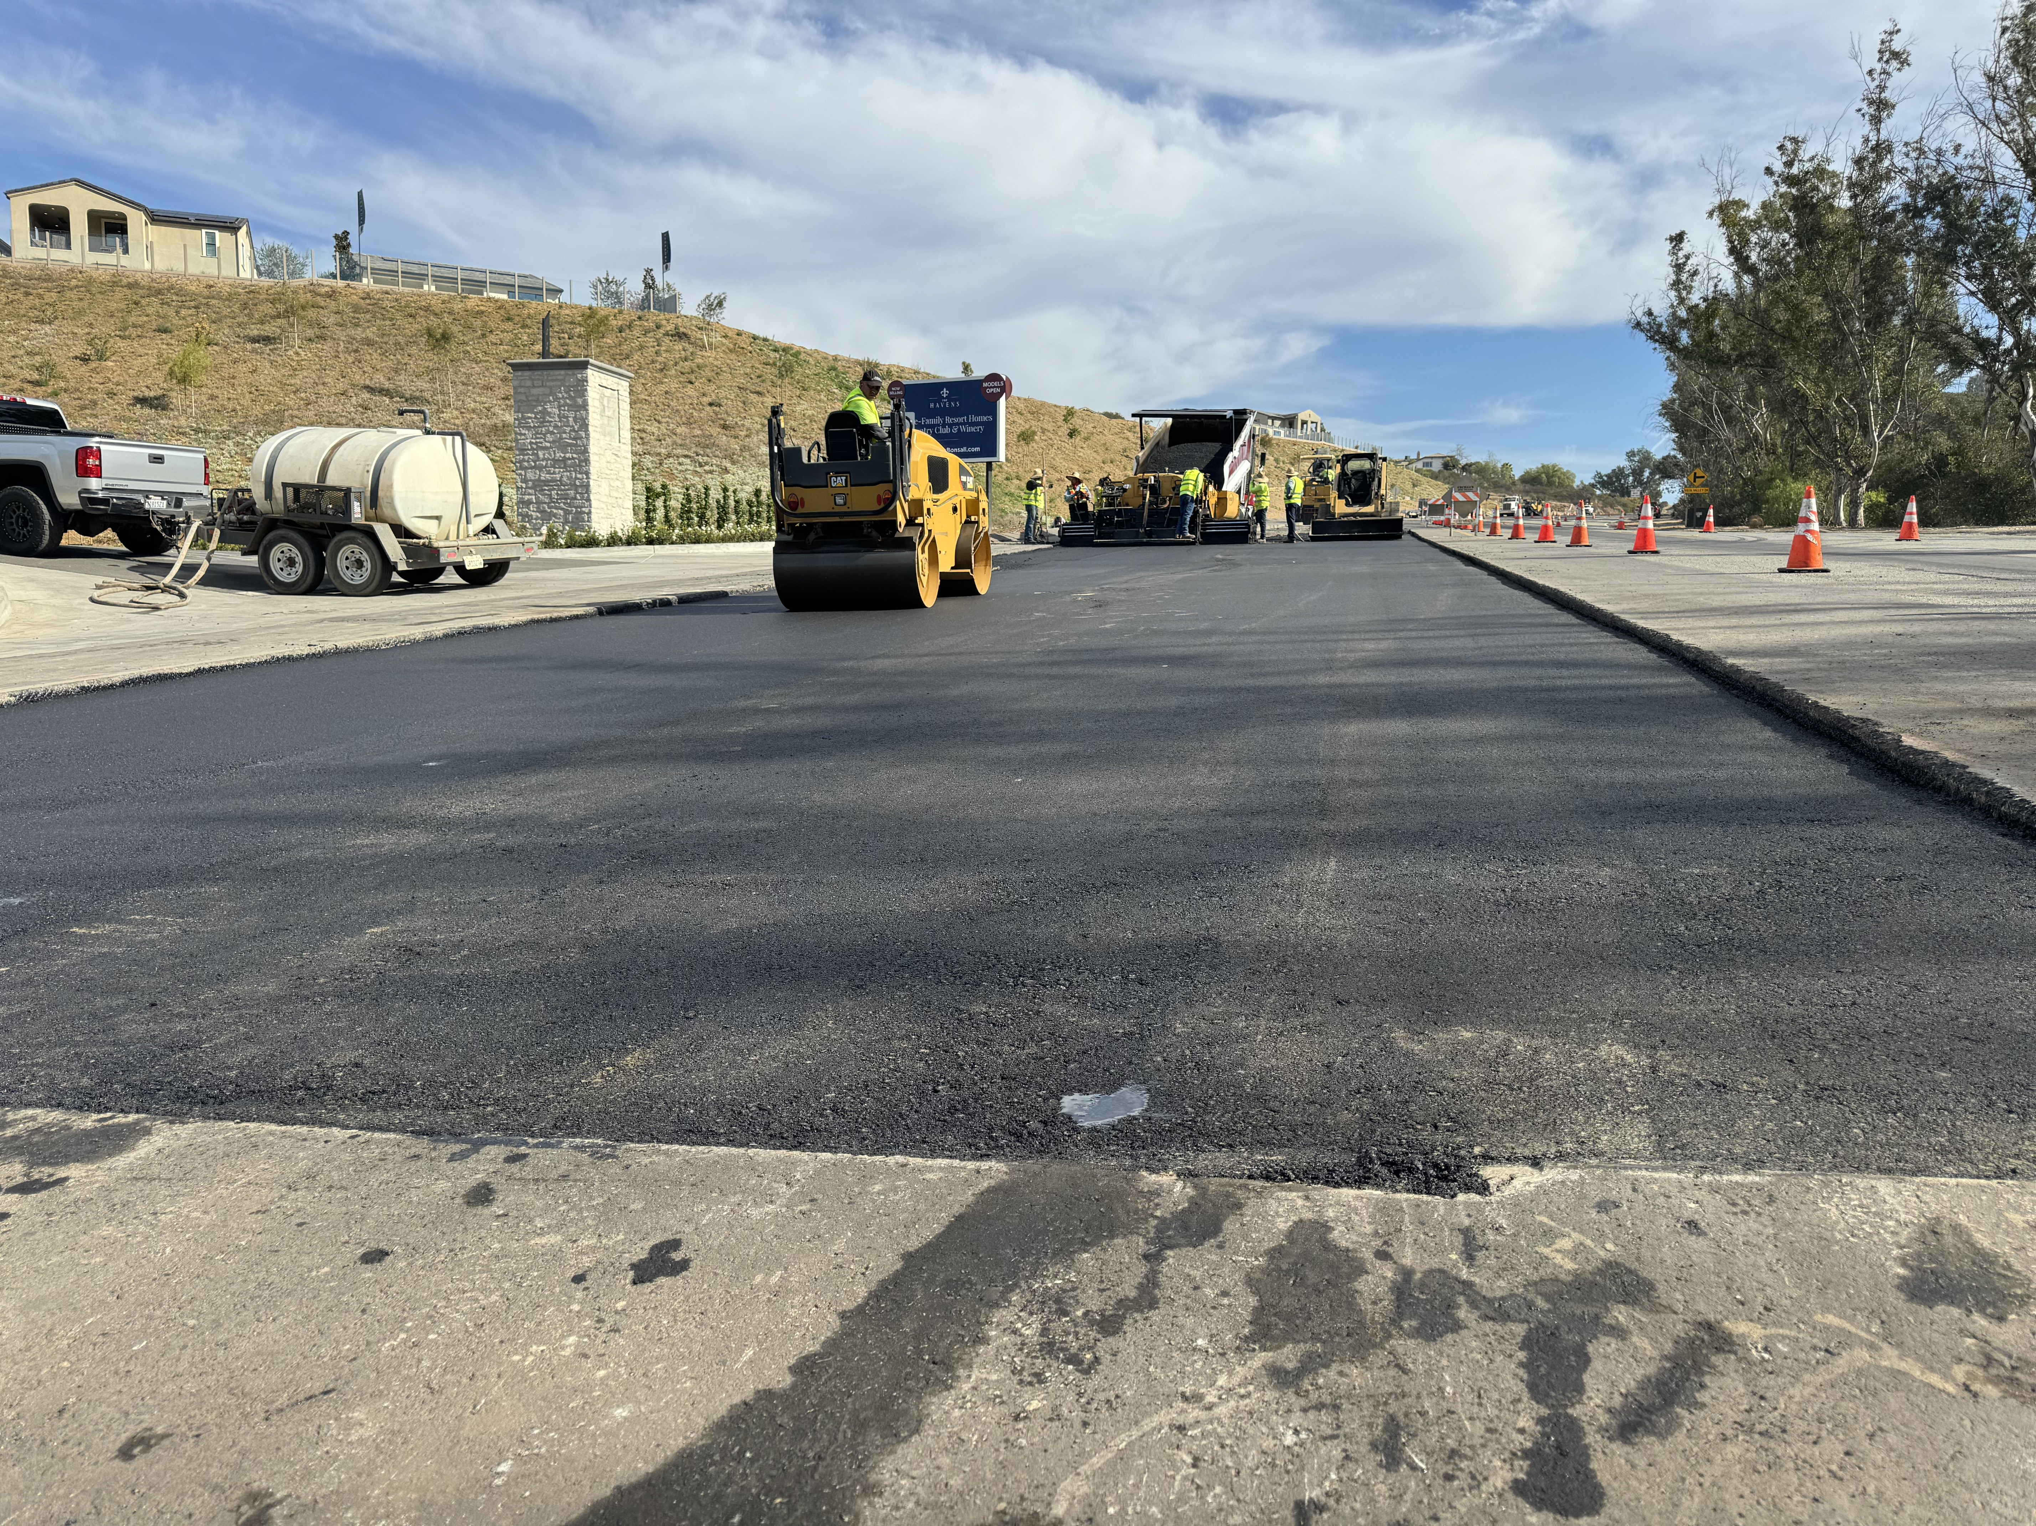
Paving Completed 12/3

Slide 11
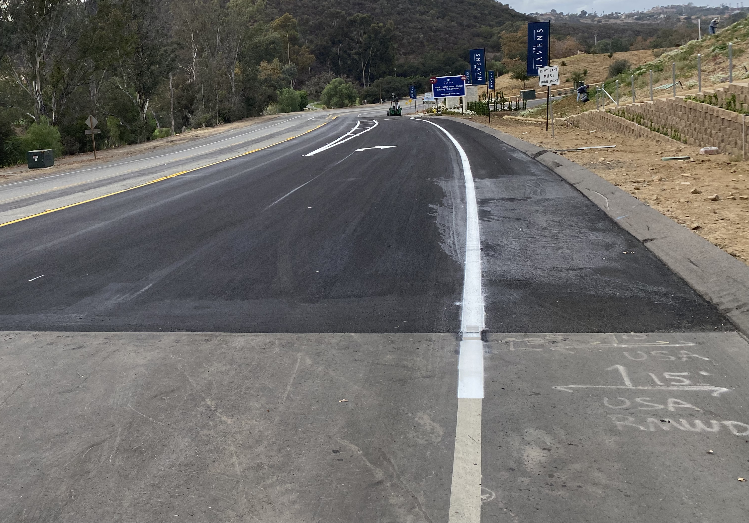
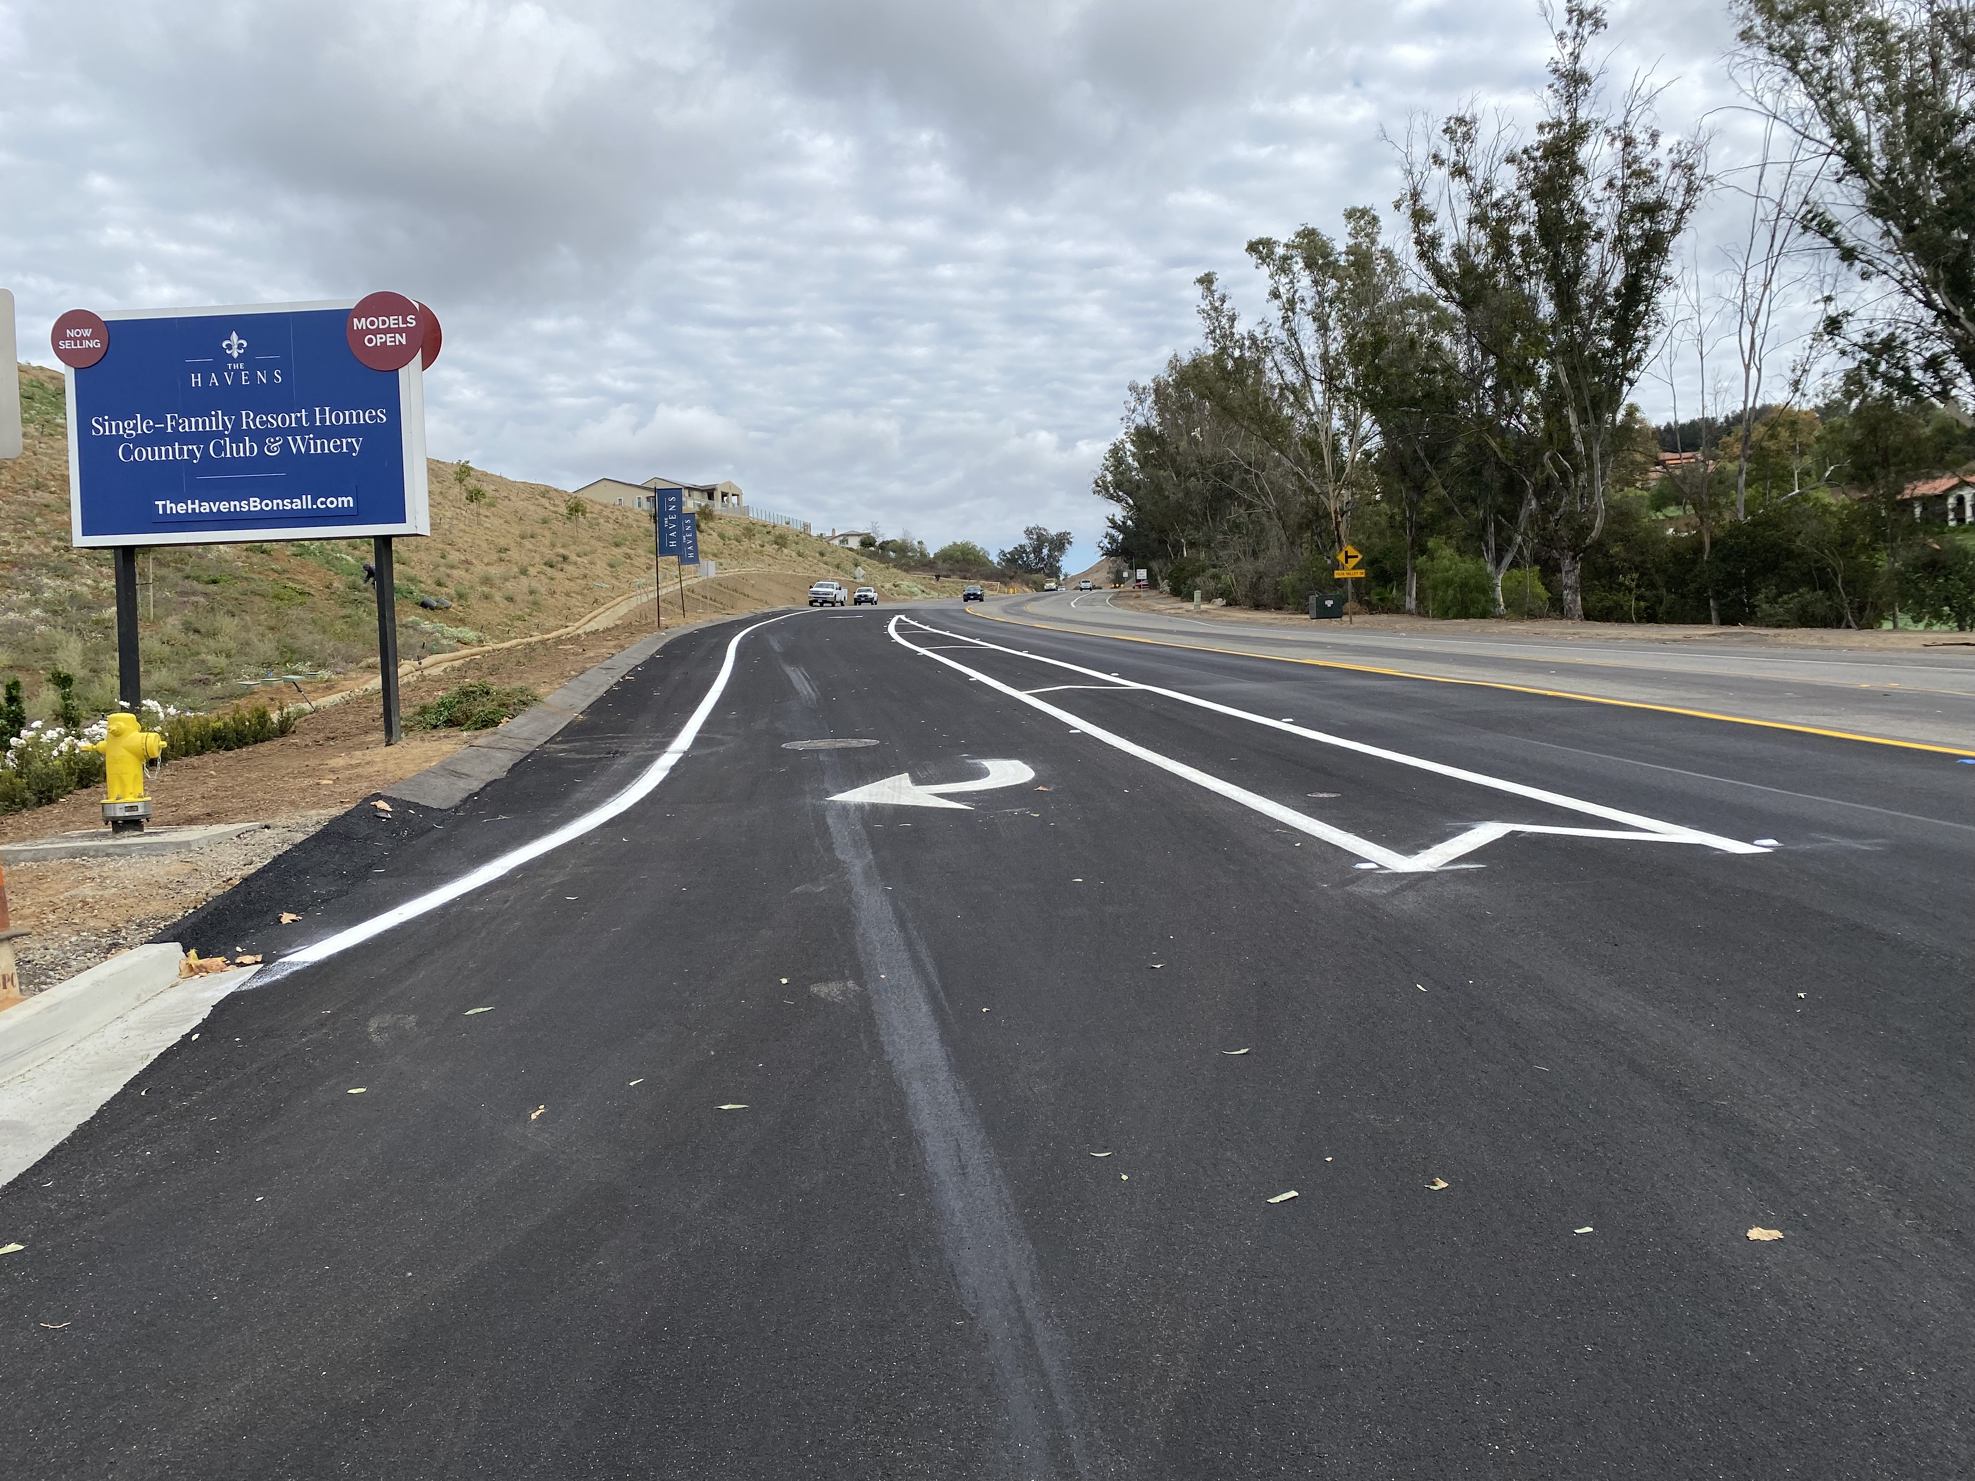
Slurry and Striping 12/10 – 12/12

Slide 12
Started Installing Pipe September 30, 2024
Tie in East 10/14
Tie in West 10/21
Main Break July 26, 2024
Presented to E&O August 6, 2024
Board Approved August 27, 2024
10/3 Finished Installing pipe
Paving December 2024

Slide 13
Cost Summary
$97,500 Paving
$74,565 RMWD Labor
$63,738 Pipe & Parts
$19,207 Equip. Rental
$10,301 Traffic Control
$9,276 Backfill Material
______________________
$274,587 Total Project Cost

Slide 14
Questions?

