Slide 1
Potential Use of One-Time Savings from Early Detachment
Board of Directors
November 19, 2024

Slide 2

Savings of $768,800 from Early Detachment
CIP Project Acceleration – La Canada Pipeline Replacement
Reserves Stabilization/Re-Invest/Strategic use for unbudgeted expenses
Bill credit in FY24/25

Slide 3
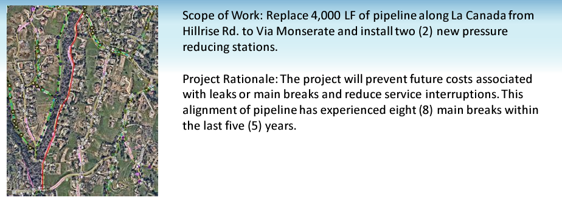
Rehabilitation/Replacement Project
La Canada Pipeline Replacement
$150k for PRS System Install in 24/25
$700k for pipeline replacement in 25/26
E&O Committee Recommendation

Slide 4
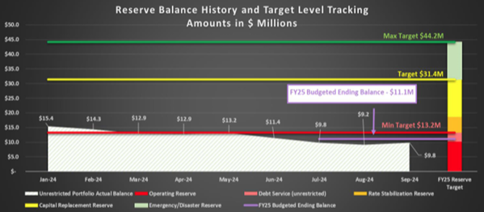
Reserves Funding
Reserves Policy establishes unexpected savings goes to reserves when under minimum targets
$7.8M current vs. $13.2M min target
Strategically invested to provide ratepayer benefits (non-rate revenue)
B&F Committee Recommendation

Slide 5
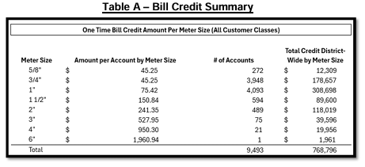
Bill Credit – Water Customers
Return $768,800 in Bill Credits beginning in Jan 2025
One-time credit – See amounts below
Over the remainder of FY24/25 equates to a 5%-8% reduction per month in customer fixed costs

Slide 6
Questions?

